Slide 1
Normalization in DBMS: 1NF, 2NF, 3NF, BCNF, 4NF and 5NF
Viren Sharma

Slide 2
Normalization
Normalization is a process of organizing the data in database to avoid data redundancy, insertion anomaly, update anomaly & deletion anomaly. Let’s discuss about anomalies first then we will discuss normal forms with examples.

Slide 3
Anomalies(problems) in DBMS
There are three types of anomalies that occur when the database is not normalized. These are –
Insertion
Update
Deletion anomaly. Let’s take an example to understand this.

Slide 4
Example:
Suppose a manufacturing company stores the employee details in a table named employee that has four attributes: - emp_id for storing employee’s id, - emp_name for storing employee’s name, - emp_address for storing employee’s address - emp_dept for storing the department details in which the employee works. At some point of time the table looks like this:
emp_id | emp_name | emp_address | emp_dept
101 | Rick | Delhi | D001
101 | Rick | Delhi | D002
123 | Maggie | Agra | D890
166 | Glenn | Chennai | D900
166 | Glenn | Chennai | D004
The above table is not normalized. We will see the problems that we face when a table is not normalized.

Slide 5
Update anomaly:
In the above table
- we have two rows for employee Rick as he belongs to two departments of the company.
If we want to update the address of Rick then we have to update the same in two rows or the data will become inconsistent.
If somehow, the correct address gets updated in one department but not in other then as per the database, Rick would be having two different addresses, which is not correct and would lead to inconsistent data.
Insert anomaly:
Suppose a new employee joins the company, who is under training and currently not assigned to any department then we would not be able to insert the data into the table if emp_dept field doesn’t allow nulls.

Slide 6
Delete anomaly:
Suppose, if at a point of time the company closes the department D890 then deleting the rows that are having emp_dept as D890 would also delete the information of employee Maggie since she is assigned only to this department.
To overcome these anomalies we need to normalize the data.
In the next section we will discuss about normalization…….

Slide 7
Normalization
“Normalization is a technique in database design for organizing data into tables to minimize redundancy and dependency, ensuring data integrity and efficiency.”
It involves breaking down large tables into smaller, related tables according to sets of rules called normal forms to reduce data duplication, prevent errors, and make the database more flexible and scalable.
Reduce Data Redundancy
Improve Data Integrity
Prevent Data Anomalies:

Slide 8
Types of Normalization:
Here are the most commonly used normal forms:
First normal form(1NF)
Second normal form(2NF)
Third normal form(3NF)
Boyce & Codd normal form (BCNF)
Fourth Normal form (4NF)
Fifth Normal Form (5NF)

Slide 9
First normal form (1NF)
As per the rule of first normal form, an attribute (column) of a table cannot hold multiple values. It should hold only atomic values.
Example: Suppose a company wants to store the names and contact details of its employees. It creates a table that looks like this:
emp_id | emp_name | emp_address | emp_mobile
101 | Herschel | New Delhi | 8912312390
102 | Jon | Kanpur | 8812121212
 |  |  | 9900012222
103 | Ron | Chennai | 7778881212
104 | Lester | Bangalore | 9990000123
 |  |  | 8123450987
Two employees (Jon & Lester) are having two mobile numbers so the company stored them in the same field as you can see in the table above.
This table is not in 1NF as the rule says “each attribute of a table must have atomic (single) values”, the emp_mobile values for employees Jon & Lester violates that rule.

Slide 10
The | 1NF | form:
emp_id |  |  | emp_name | emp_address |  | emp_mobile
101 |  |  | Herschel | New Delhi |  | 8912312390
102 |  |  | Jon | Kanpur |  | 8812121212
102 |  |  | Jon | Kanpur |  | 9900012222
103 |  |  | Ron | Chennai |  | 7778881212
104 |  |  | Lester | Bangalore |  | 9990000123
104 |  |  | Lester | Bangalore |  | 8123450987

Slide 11
Second normal form (2NF)
A table is said to be in 2NF if both the following conditions hold:
Table is in 1NF (First normal form)
No non-prime attribute is dependent on the proper subset of any candidate key of table.
Note::
An attribute that is not part of any candidate key is known as non-prime attribute.

Slide 12
Example:
Suppose a school wants to store the data of teachers and the subjects they teach. They create a table that looks like this: Since a teacher can teach more than one subjects, the table can have multiple rows for a same teacher.
teacher_id | subject | teacher_age
111 | Maths | 38
111 | Physics | 38
222 | Biology | 38
333 | Physics | 40
333 | Chemistry | 40
The table is in 1 NF because each attribute has atomic values. However, it is not in 2NF because non prime attribute teacher_age is dependent on teacher_id alone which is a proper subset of candidate key. This violates the rule for 2NF as the rule says “no non-prime attribute is dependent on the proper subset of any candidate key of the table”.
Candidate Keys: { teacher_id, subject } Non prime attribute: teacher_age

Slide 13
The 2NF Form
We can break it in two tables like this:
teacher_details table:
teacher_id teacher_age
teacher_subject table:
teacher_id subject
Now the tables
 |  |  |  | comply with Second
111 | 38 | 111 | Maths | normal form (2NF).
222 | 38 | 111 | Physics
333 | 40 | 222 | Biology
 |  | 333 | Physics
 |  | 333 | Chemistry

Slide 14
Third Normal form (3NF)
A table design is said to be in 3NF if both the following conditions hold:
Table must be in 2NF
Transitive functional dependency of non-prime attribute on any super key should be removed.
An attribute that is not part of any candidate key is known as non-prime attribute.
In other words 3NF can be explained like this: A table is in 3NF if it is in 2NF and for
each functional dependency X->Y at least one of the following conditions hold:
X is a super key of table
Y is a prime attribute of table
An attribute that is a part of one of the candidate keys is known as prime attribute.

Slide 15
Example:
Suppose a company wants to store the complete address of each employee, they create a table named employee_details that looks like this:
emp_id | emp_name | emp_zip | emp_state | emp_city | emp_district
1001 | John | 282005 | UP | Agra | Dayal Bagh
1002 | Ajeet | 222008 | TN | Chennai | M-City
1006 | Lora | 282007 | TN | Chennai | Urrapakkam
1101 | Lilly | 292008 | UK | Pauri | Bhagwan
1201 | Steve | 222999 | MP | Gwalior | Ratan
Super keys: {emp_id}, {emp_id, emp_name}, {emp_id, emp_name, emp_zip}…so on
Candidate Keys: {emp_id}
Non-prime attributes: all attributes except emp_id are non-prime as they are not part of any candidate keys.
Here, emp_state, emp_city & emp_district dependent on emp_zip. And, emp_zip is dependent on emp_id that makes non-prime attributes (emp_state, emp_city & emp_district) transitively dependent on super key (emp_id). This violates the rule of 3NF.

Slide 16
The 3NF Form
employee table:
employee_zip table:
emp_id 1001
1002
1006
1101
1201
emp_name John
Ajeet Lora Lilly Steve
emp_zip 282005
222008
282007
292008
222999
emp_zip emp_state 282005 UP
222008 TN
282007 TN
292008 UK
222999 MP
emp_city Agra Chennai Chennai Pauri Gwalior
emp_district Dayal Bagh M-City Urrapakkam Bhagwan Ratan

Slide 17
Boyce Codd normal form (BCNF)
It is an advance version of 3NF that’s why it is also referred as 3.5NF. BCNF is stricter than 3NF. A table complies with BCNF if it is in 3NF and for every functional dependency X->Y, X should be the super key of the table.

Slide 18
Example:
Suppose there is a company wherein employees work in more than one department. They store the data like this:
emp_id | emp_nationality | emp_dept | dept_type | dept_no_of_emp
1001 | Austrian | Production and planning | D001 | 200
1001 | Austrian | stores | D001 | 250
1002 | American | design and technical support | D134 | 100
1002 | American | Purchasing department | D134 | 600
Functional dependencies in the table above:
emp_id -> emp_nationality
emp_dept -> {dept_type, dept_no_of_emp}
Candidate key: {emp_id, emp_dept}
The table is not in BCNF as neither emp_id nor emp_dept alone are keys.

Slide 19
The BCNF Form
emp_nationality table:
emp_id emp_nationality
emp_dept table:
emp_dept | dept_type | dept_no_of_emp
Production and planning | D001 | 200
stores | D001 | 250
design and technical support | D134 | 100
Purchasing department | D134 | 600
1001
1002
Austrian American
emp_dept_mapping table:
Functional dependencies:
emp_id -> emp_nationality
emp_dept -> {dept_type, dept_no_of_emp}
emp_id
1001
1001
1002
1002
emp_dept
Production and planning stores
design and technical support Purchasing department
Candidate keys:
For first table: emp_id
For second table: emp_dept
For third table: {emp_id, emp_dept}
This is now in BCNF as in both the functional dependencies left side part is a key.

Slide 20
Fourth normal form (4NF)
Fourth normal form (4NF) is a level of database normalization where there
are no non-trivial multivalued dependencies other than a candidate key.
It builds on the first three normal forms (1NF, 2NF and 3NF) and the Boyce-Codd Normal Form (BCNF). It states that, in addition to a database meeting the requirements of BCNF, it must not contain more than one multivalued dependency

Slide 21
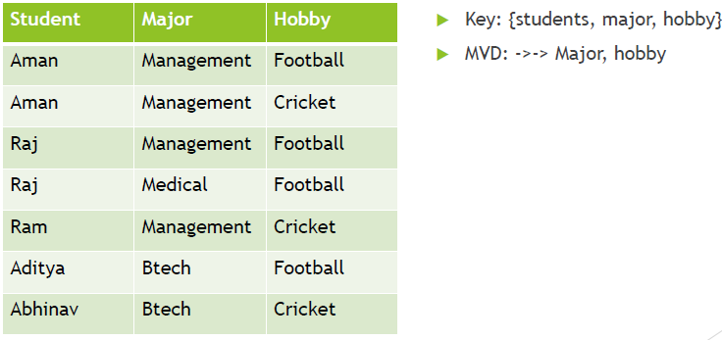
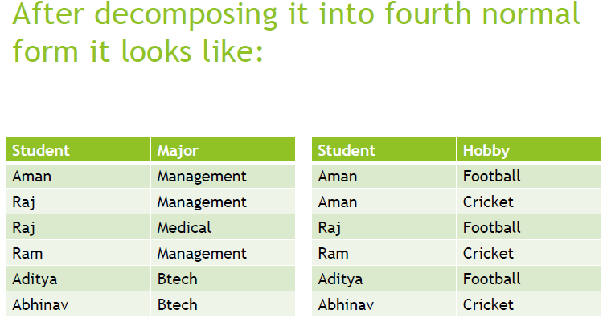
Example:

Slide 22
Fifth normal form (5NF)
A database is said to be in 5NF, if and only if,
- It's in 4NF.
- If we can decompose table further to eliminate redundancy and anomaly, and when we re-join the decomposed tables by means of candidate keys, we should not be losing the original data or any new record set should not arise.
In simple words, joining two or more decomposed table should not lose records nor create new records.

Slide 23
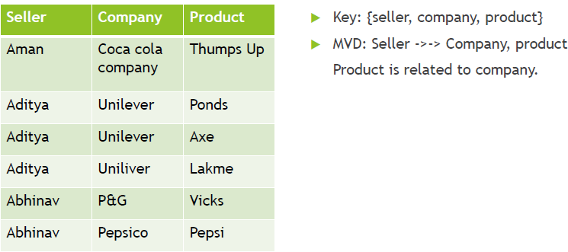
Example:

Slide 24
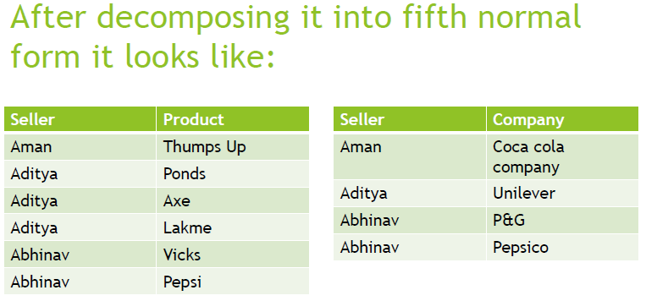
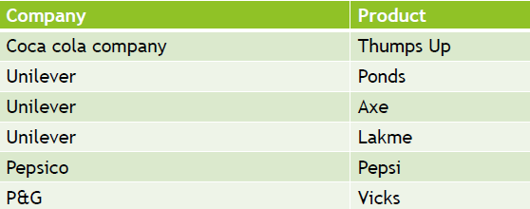

Slide 25
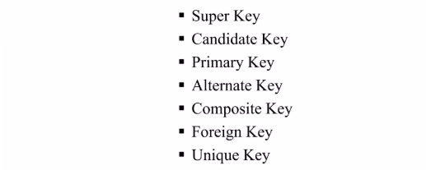
Types of Keys

Slide 26
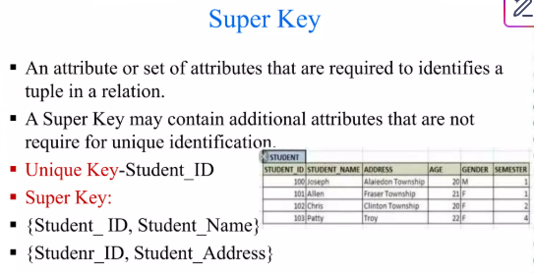

Slide 27
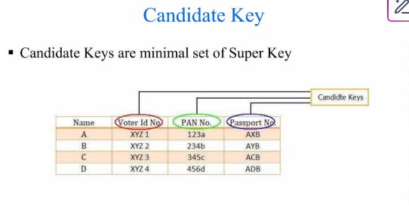


Slide 28
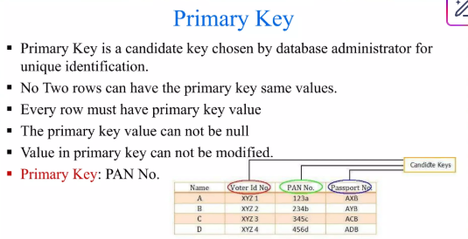

Slide 29
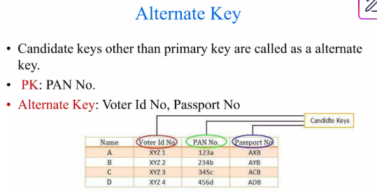
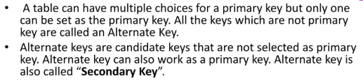

Slide 30
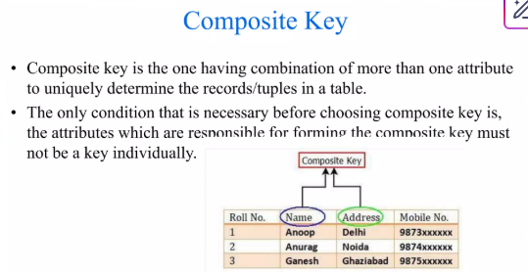


Slide 31
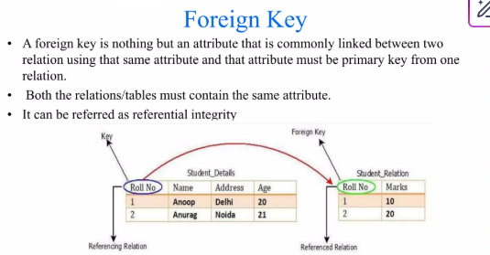

Slide 32
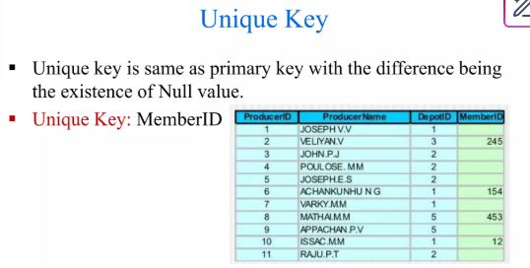
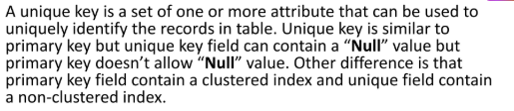

Slide 33
