Slide 1
FinOps Essentials: Comprehensive Guide
Cost Monitoring | Pricing Models | Budgeting | Resource Optimization

Slide 2
What is FinOps?
FinOps (Financial Operations) is a cloud financial management framework enabling collaboration among finance, engineering, and business teams.
Objective: Achieve maximum business value by controlling and optimizing cloud costs.
Encourages accountability and cost transparency across the organization.

Slide 3
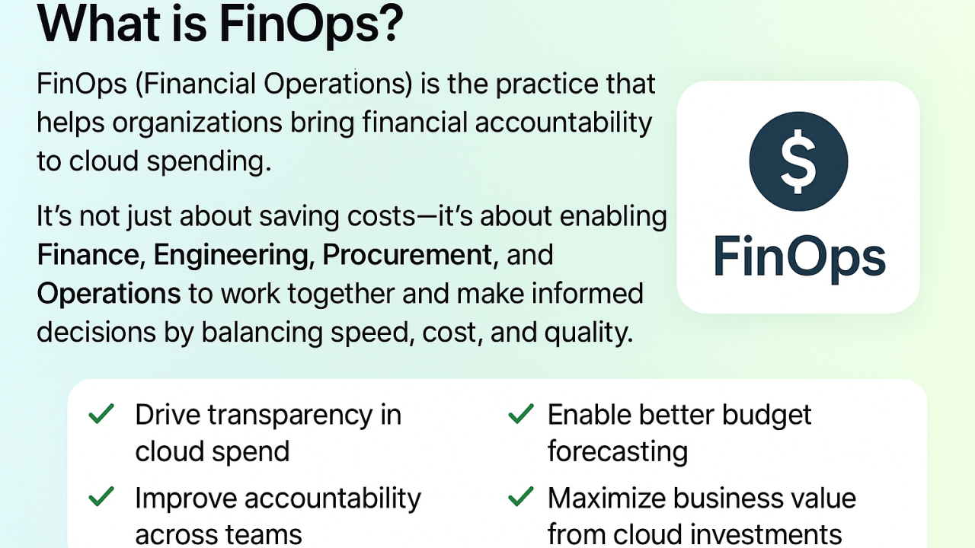

Slide 4
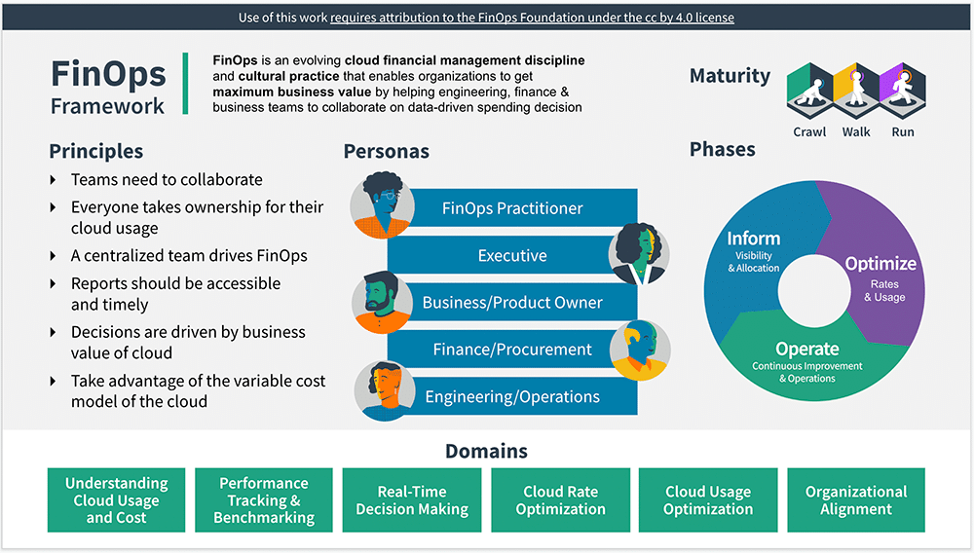

Slide 5
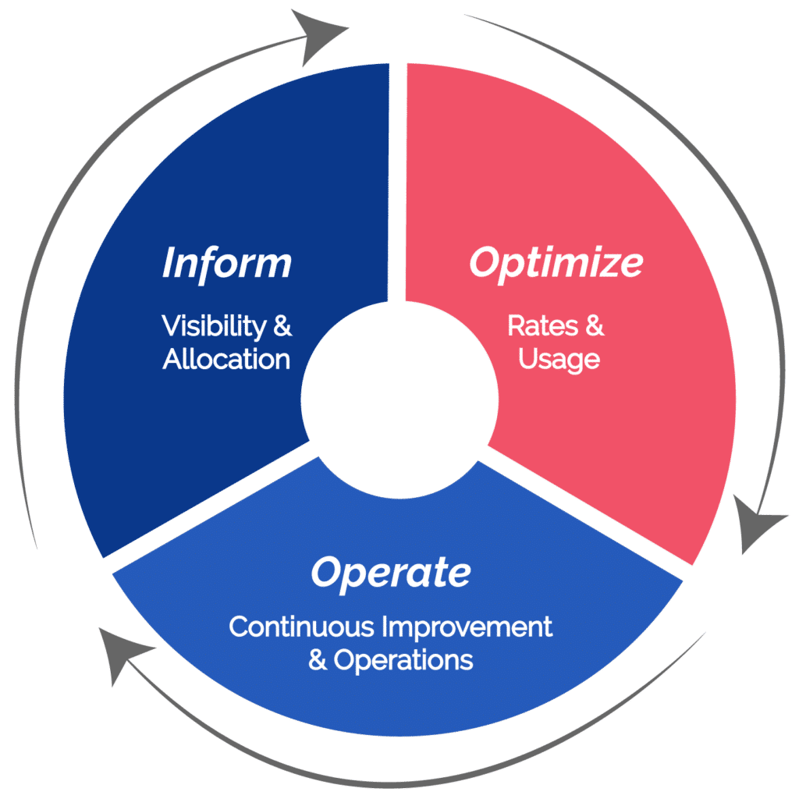
FinOps Lifecycle Stages
1. **Inform** – Gain visibility into cloud spend and allocate costs accurately.
2. **Optimize** – Identify opportunities for savings and improve efficiency.
3. **Operate** – Continuously monitor and govern cost optimization practices.

Slide 6
Understanding Cost Monitoring
Cost monitoring involves tracking and analyzing cloud spend across accounts, services, and projects.
Helps in detecting anomalies, managing budgets, and enforcing accountability.

Slide 7
Key Cost Monitoring Tools
• AWS Cost Explorer and AWS Budgets
• Azure Cost Management + Billing
• Google Cloud Billing Reports and BigQuery Cost Tables
• Third-party tools: CloudHealth, Apptio Cloudability, Kubecost (for Kubernetes)

Slide 8
Cost Monitoring Example
Example: A retail company using AWS noticed rising EC2 costs.
After monitoring, they found multiple idle instances running overnight.
Action Taken: Implemented scheduling scripts to stop non-critical workloads outside business hours.
Result: Saved ~25% in monthly compute costs.

Slide 9
Cloud Pricing Models Overview
Cloud providers offer flexible pricing options to suit different usage patterns.
Selecting the right model can significantly reduce costs.

Slide 10
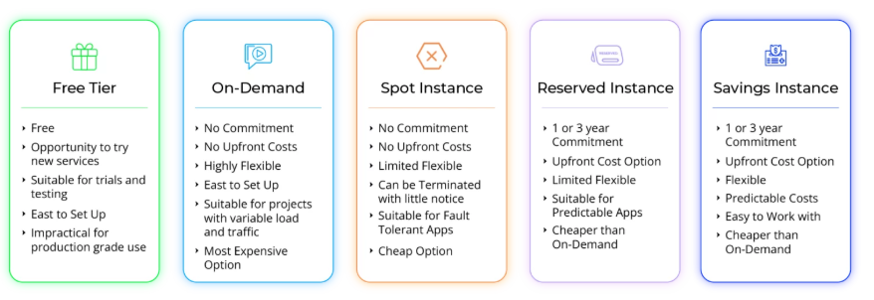
Major Pricing Models Explained
Pay-as-you-go: Pay for actual resource usage without long-term commitment.
Reserved Instances: Discounted prices (up to 75%) for 1 or 3-year commitments.
Spot Instances: Unused capacity sold at steep discounts (great for non-critical workloads).
Savings Plans: Flexibility with consistent usage commitments for lower costs.

Slide 11
Pricing Model Example
Example: A startup runs batch processing jobs on AWS.
They switched from On-Demand EC2 to Spot Instances for non-critical workloads.
Outcome: Reduced compute costs by 60% while maintaining performance.

Slide 12
Importance of Budgeting
Budgeting ensures that cloud expenses align with business goals and financial expectations.
It also promotes accountability by allocating budgets to departments or projects.

Slide 13
Forecasting Cloud Spend
Forecasting uses historical spending data and usage patterns to predict future costs.
• Helps in capacity planning and financial planning cycles.
• Cloud providers offer forecasting tools such as AWS Cost Anomaly Detection and Azure Cost Forecasts.

Slide 14
Budgeting Example
Example: A financial firm allocates $50,000/month for cloud operations.
They set automated alerts when spending reaches 80% of the budget.
Result: Prevented unexpected overruns and improved spend predictability.

Slide 15
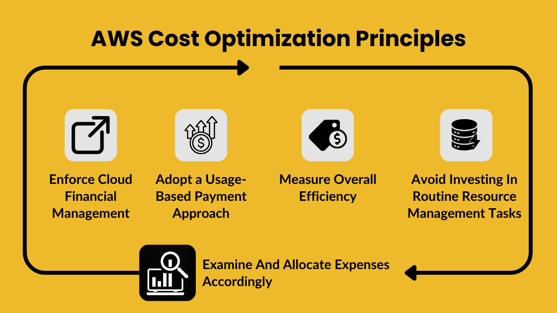
Resource Optimization Strategies
Optimization ensures efficient use of cloud resources to minimize waste.
Common techniques include right-sizing, autoscaling, and identifying idle assets.

Slide 16
Compute Optimization
• Use instance families that match workload requirements.
• Employ autoscaling to dynamically adjust capacity.
• Implement instance scheduling for non-production environments.

Slide 17
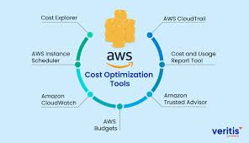

Slide 18
Storage Optimization
• Move infrequently accessed data to cheaper storage tiers (e.g., S3 Glacier).
• Enable lifecycle policies for automatic data archiving.
• Delete old snapshots and unattached volumes.

Slide 19
Optimization Example
Example: A SaaS company used cost reports to find underutilized RDS databases.
Action: Consolidated workloads into fewer instances and switched to Graviton processors.
Result: Achieved 35% savings on database costs.

Slide 20
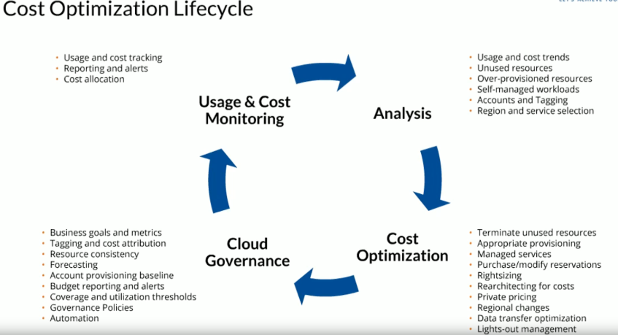

Slide 21
Automation in FinOps
Automation helps maintain efficiency at scale by minimizing manual intervention.
Examples:
• Scheduled shutdown of idle instances.
• Automated budget alerts and anomaly detection.
• Scripts for identifying unused resources.

Slide 22
Cultural and Organizational Best Practices
• Create a FinOps Center of Excellence (CoE).
• Foster collaboration between finance and DevOps teams.
• Conduct regular cost optimization reviews.
• Educate teams on cost awareness and accountability.

Slide 23
Conclusion
FinOps transforms cloud cost management into a continuous, data-driven discipline.
By implementing effective monitoring, budgeting, and optimization strategies, organizations can achieve sustainable cloud efficiency.
FinOps is not a one-time project—it’s a cultural and operational shift towards financial accountability.

