Slide 1


REST API basics
Author : Virendra Sharma

Slide 2
Traditional web applications
Client
GET : Method URL : /the-resource ...
Server
(1)
200 OK
<html>Code...</html>
Displays the page, then user clicks on link.
(2)
GET :Method URL: /another-resource ...
(3)
200 OK
<html>Code...</html>
(4)
Displays the other page, ...

Slide 3
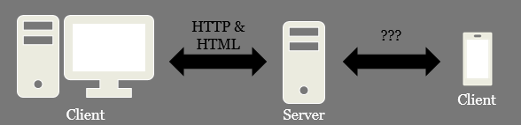

Traditional web applications
The interface is built on HTML & HTTP.
Drawbacks:
The client must understand both HTTP and HTML.
HTTP & HTML can be used.
The GUI on smartphones does not use HTML.

Slide 4
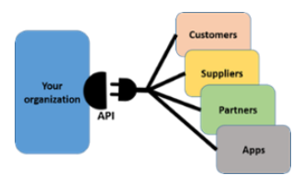

Application programming interface
API stands for the Application Programming Interface, They are basically a collection of functions and procedures which allows us to communicate two application or library. For example, It like a connector as seen in the picture. All data connects to our organization through API

Slide 5
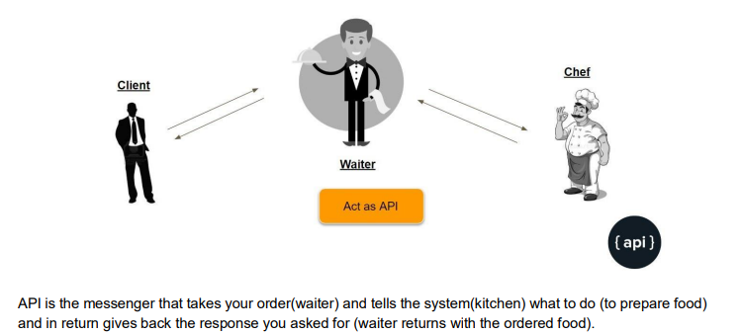
In one line, API is its an interface between different software programs or service.

Slide 6

What is REST API ?
REST is a software architectural style that defines the set of rules to be used for creating web services.
REST acronym.
- REpresentational means formats (such as XML, JSON, YAML, HTML, etc.)
- State means data
- Transfer means carrying data between consumer and provider using the HTTP protocol
It allows requesting systems to access and manipulate web resources by using a uniform and predefined set of rules.

Slide 7
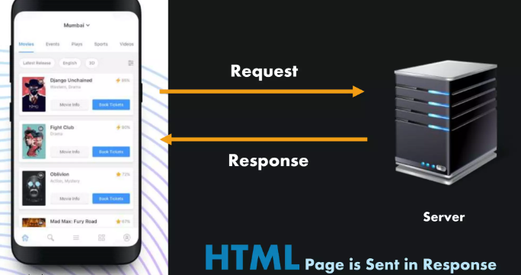
Why you need REST API?
Consider a scenario where you are using the Book My Show app. Now, obviously, this application needs a lot of Input data, as the data present in the application is never static that means data is always changing in these applications.
Either it is movies getting released on dates, or various cities showing different languages movies at various times of the day. It’s never static

Slide 8
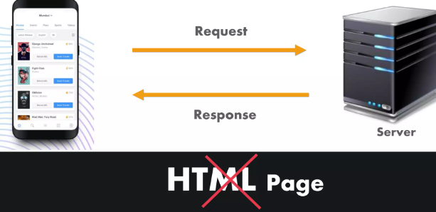
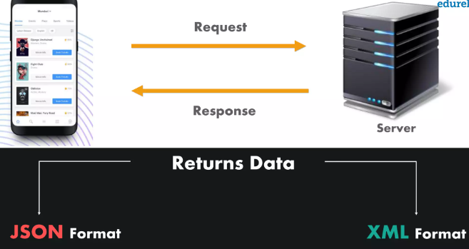
Over here, the response sent to the client is in the form of an HTML Web Page. But, do you think this is the response that you would expect when you send a request?
Well, NO. Since, you would prefer the data returned by the server, in response to the request of the client is either in the format of JSON or XML rather than the HTML page.

Slide 9
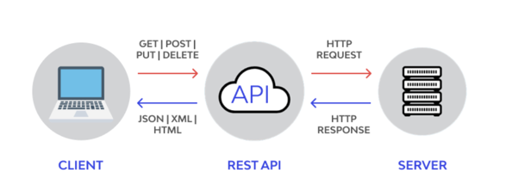
- Well, this data is received from the Server or most commonly known as a Web- server. - The client requests the server for the required information, via an API, and then, the server sends a response to the client in the format of JSON or XML.

Slide 10
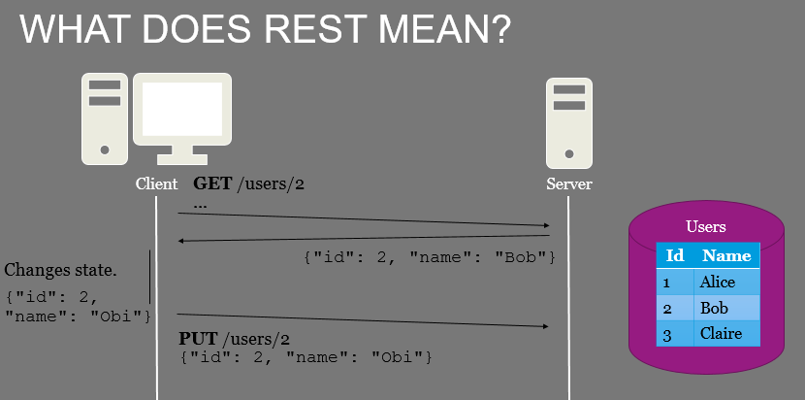
(1)
(2)
(3)

Slide 11
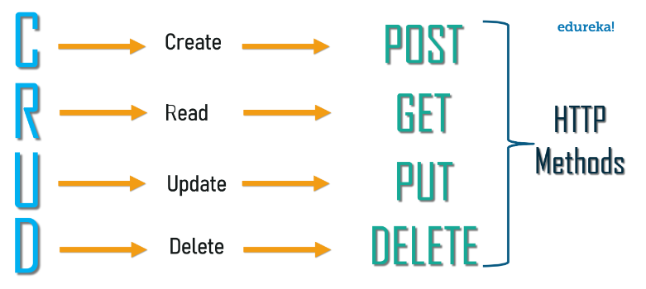

CRUD stands for Create, Read, Update, and Delete, which make up these four fundamental operations.

Slide 12
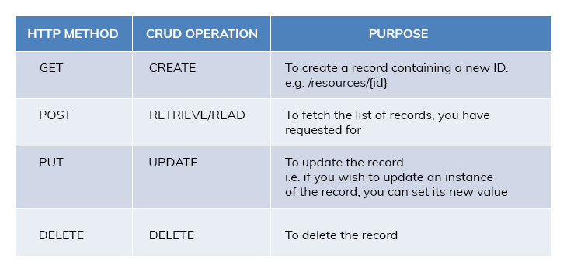



Slide 13
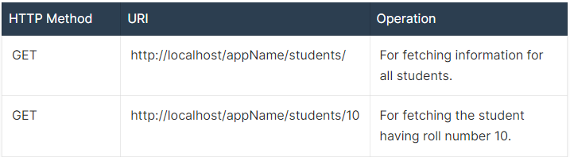
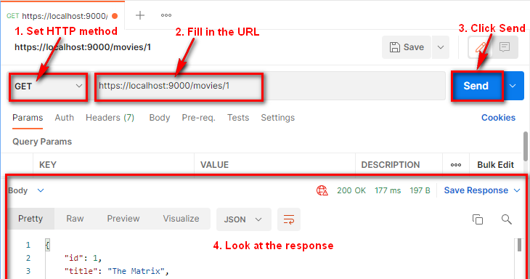
HTTP GET Method
GET is used to request data from a specified resource.
GET requests can be cached.
GET requests remain in the browser history.

Slide 14
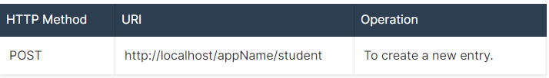
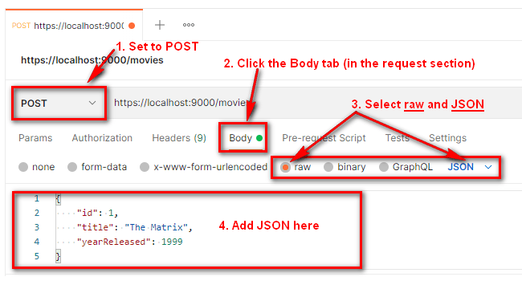
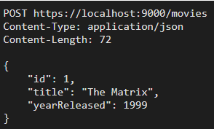
HTTP POST Method
POST is used to create data to a server
POST requests are never cached.
POST requests do not remain in the browser history.
When you send a request body, Postman automatically adds the proper content headers for you.
POST is not idempotent means if you execute POST request multiple times, you'll create a new resource multiple times despite them having the same data being passed in.

Slide 15
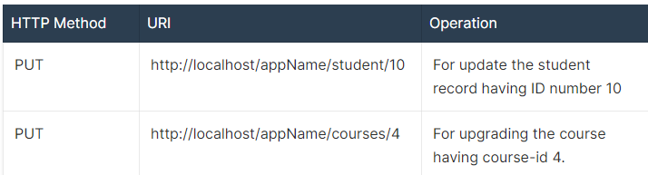
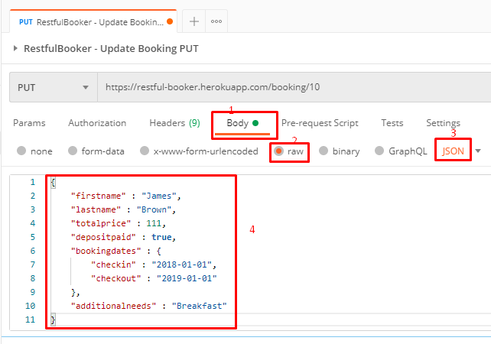
HTTP PUT Method
PUT is used to to modify a resource. To create/update a resource
PUT updates the entire resource with data that is passed in the body payload. If there is no resource that matches the request, it will create a new resource.
PUT requests are idempotent, meaning that executing the same. PUT request will always produce the same result

Slide 16
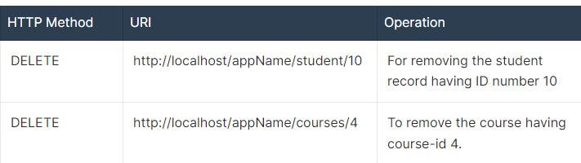
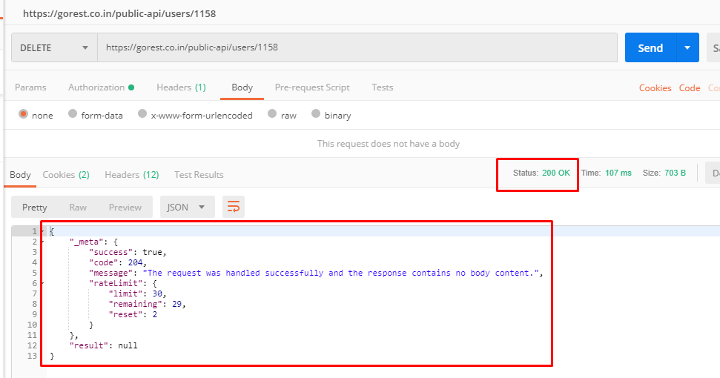
HTTP DELETE Method
DELETE is used to to delete a resource

