Slide 1
Statistically Sound Discrete Event Simulations
Varsha Apte CS 681
Reference: Simulation Modeling & Analysis by Law & Kelton

Slide 2
Outline
Conducting proper simulations of random systems
Analyzing output of simulations of random systems

Slide 3
Conducting Simulations of Random Systems
Using random Number Generators, streams, seeds, repetitions, generating random variates of distributions

Slide 4
Random Experiments
Often, quantitative questions have to be asked about “stochastic” or random systems
  E.g. Probability that a coin toss results in a head
  Average score on a particular test by 5th graders
  Etc…

Slide 5

…Random Experiments
To answer these questions, we have to do experiments which have random outcomes
Consider the problem of finding :
p_{h} = Prob[Coin toss results in a head]
for the new 10-rupee coins

Slide 6
Example 1: Coin Toss Experiment
One way
Get a coin – toss it m times
Note m_{h} = number of times result was head
Estimate probability as m_{h}/m
Problem
There might be minor differences in different coins (some randomness). Only one coin may not give a good estimate

Slide 7
…Coin Toss Experiment
Better way:
Get n coins (10-15)
Do m (100-200) tosses with each coin
Note m_{h}^{i} for each coin i
The experiment with each coin i will result in a fraction of heads seen p_{h}^{i} = m_{h}^{i}/m
Estimate required probability p_{h} as:
(p_{h}¹ ⁺ p_{h}² ⁺ p_{h}³ +….+ p_{h}^{n} )/ n

Slide 8
…Coin Toss Experiment
This method takes care of random differences between coins
Should give a better estimate than using just one coin
Intuitively, we know that increasing n and m will improve the estimate
But still – how do we know how close we are to the “real” probability of head?

Slide 9
Example 2: M/M/1 queue
Questions we want to ask. For a given arrival rate λ and average service time (τ)
  What is the average utilization?
  What is the average delay (waiting time) of a customer? …etc
M/M/1 queue is a “random” system – how do we determine these quantities? (In this case, we know the theoretical answer – but what if we didn’t?)
  Observe an actual M/M/1 queue (like we actually did coin tosses) with the given parameters – not always possible
  Estimate the quantities using a discrete event simulation program

Slide 10
M/M/1 Simulation
Simulation should be functionally correct
Simulation should be statistically correct.
Since original system has randomness, simulation model should also incorporate randomness.
Specifically, in this case, inter-arrival times, and service times should be EXP

Slide 11
…Randomness in Simulations
How do we generate EXP times ?
Use pseudo-random number generators available as library calls in most languages
“rand” or similar function returns a random number (called a random variate) from a Uniform (0,1) distribution
  If R ~ Uniform(0,1), P[R < r ] = r.

Slide 12
…Generating Random Variates
But we want EXP random variates
Note code in the queuesim.c is as follows
Here “mean” is mean of the EXP distribution
And lcgrand(stream) returns a Uniform (0,1) pseudo-random number
float expon(float mean) /* Exponential variate generation function. */
{
/* Return an exponential random variate with mean "mean". */
return -mean * log ( lcgrand(stream) );
}

Slide 13
…Generating EXP random variates
If R ~ Uniform (0,1) and
X = - m ln(R) //this the formula in the code
What is the distribution of X ?
Pr [X < x] = P[-m ln R < x]
= P[ ln R > -x/m ] = P [ R > e^{-x/m} ]
= 1 – P[ R < e^{-x/m} ]
= 1 – e^{-x/m} → EXP (1/m)
  Exponentially distributed with mean m

Slide 14
Using pseudo-random numbers
Given Uniform(0,1) random numbers, we can generate EXP random numbers
Random number generator (RNG) functions have multiple “streams” of random numbers that they can generate
  Stream can be given as argument to the RNG function call
  In each stream “seed” specifies the point of starting the stream
    Seed of a stream is set using a related function
    ( lcgrandst (seed, stream) in the queuesim.c code)

Slide 15
…Using pseudo-random numbers
If we do not change stream or seed, we will get the same results for a simulation for a given arrival rate and service time (see code & run it)
  This is not very useful
We must do simulations in a way that even for the same arrival rate and service time, we should get different results in different runs
→ Set different streams and seeds in different runs

Slide 16
…Using pseudo-random numbers
Using different streams in different runs is important (random numbers from the same stream may be correlated)
If we carry out multiple runs with different seeds/streams, we get varied estimates for the same metric (e.g. average delay), even for the same arrival rate and service time
  This is what we want (it is similar to using 10 different coins and doing 100 tosses with each coin)
See the code & run it

Slide 17
Summary of part I
Run each simulation to collect one sample point of your metric (e.g. one M/M/1 simulation run gives one sample point of average delay)
Do repetitions (runs) of your simulation
In each repetition, ensure that random number generator with different stream and seed is being used
This will ensure output is random and different for each run

Slide 18

Analyzing Simulation Output Data
Please note in the rest of these slides X(n) and are one and the same thing. (Slides are using X(n) because it is tedious to get “X-bar” in powerpoint!)

Slide 19
M/M/1 queue example
Average delay estimates
For λ =1, τ = 0.8, number delays recorded in each run is 2000. These were averaged for each run. Five such runs (with different seeds/streams) resulted in these values:
  3.240
  3.354
  3.807
  3.885
  3.557
Average of these is 3.57

Slide 20
Estimating Average Delay
But how do we know whether this is “correct” (close to the real average delay?)

Slide 21
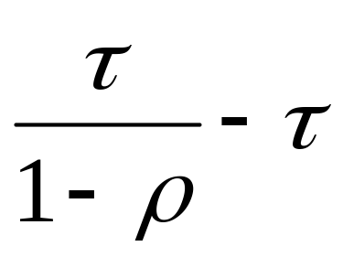
…Estimating Average Delay
In the M/M/1 case, we know that the correct answer (calculated theoretically) is:
Where τ is service time and ρ is utilization.
For τ =0.8 and λ =1, ρ = 0.8, this value is 3.2
The simulation gave us 3.57, which seems close enough

Slide 22
…estimating average delay
But how do we know close/far from the “real” value that we are estimating, when we do not know the real value?
Use confidence intervals

Slide 23
Confidence intervals
Theory of sample mean and variance, central limit theorem, how it applies to simulation output

Slide 24
Note: in the following slides the symbol μ is used to denote population mean. This is the convention in statistics. Do not confuse this with service rate μ of queueing theory.

Slide 25
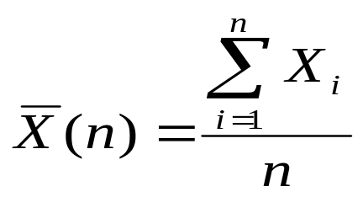
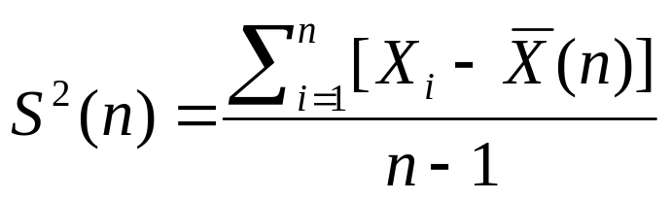
Sample mean & variance
Let X₁, X,…X_{n} be i.i.d. random variables with mean μ and variance σ² (they are like sample points from a population with mean μ and variance σ²)
Then sample mean given by,
is an unbiased estimator of μ. i.e. E[ X(n) ] = μ
And sample variance S²(n) given by:
is an unbiased estimator of σ² , i.e. E[S²(n)] = σ²

Slide 26
Variance & mean of Sample Mean
Note that the sample mean X(n) itself is a random variable.
  If we get a different set of n sample points from the same population, the sample mean is different for each set → X(n) itself is random variable
We already know that expectation of the sample mean is μ (E[X(n)] = μ)
What is the variance of the sample mean?
  Var[X(n)] = σ²/n
  You can see that Variance of the sample mean decreases as the size of the sample increases!

Slide 27
Important Note
Note that the following two quantities are totally different
Sample Variance S²(n)
  This is the variance of the sample, an estimator of population variance σ². If the sample size (n) is large , this should be close to the population variance σ²
Variance of the Sample Mean
  (Var[X(n)] = σ²/n)
  This is the variance of the random variable that is the sample mean. This variance DECREASES (to 0!!) if the sample is large

Slide 28
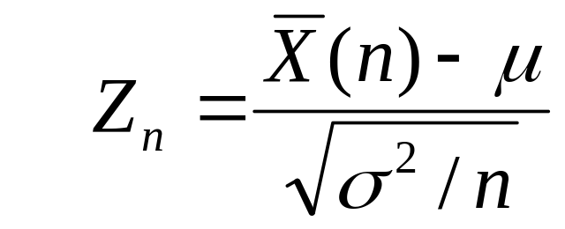
Central Limit Theorem
If n is large then (the random variable that is the sample mean) has normal distribution
  With Mean: μ
  And variance σ²/n
Equivalently,
is Normal(0,1) – has standard normal distribution

Slide 29
…Central Limit Theorem
In other words, if we take many different samples of size n – and calculate sample mean X(n) for each sample and plot the histogram, the shape will look “normal” if n is large. Also, as n increases the variance will decrease, so the chance of X(n) to be closer to μ will be higher.
μ
Small n
μ
Large n

Slide 30
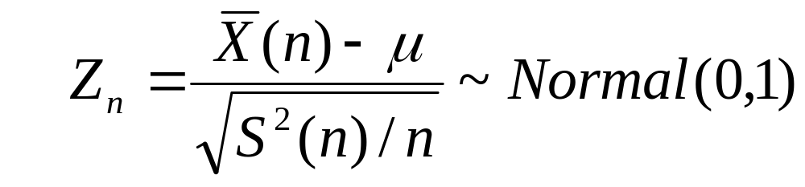
…Central Limit Theorem
Now, in Central Limit Theorem, the result still applies if we replace σ² by sample variance, because S²(n) → σ² as n grows to infinity
So we can re-state the theorem as:
For a large n

Slide 31
Applying Central Limit Theorem to Discrete Event Simulations
Confidence intervals!

Slide 32
Applying Central Limit Theorem
When we do multiple simulation runs (also called repetitions), each run i generates a statistic X_{i}. This is one sample point.
  For the same system, with the same parameters, we can assume that X₁, X₂,…,X_{n} are identically distributed.
  We can assume that they are independent since we ensure we used a different stream/seed for each run
  So we can assume X_{i}’s are i.i.d. So they can be the n sample points of the Central Limit Theorem.

Slide 33
…applying Central Limit Theorem
Sample mean is defined as usual (X(n))
Sample variance (S²(n) )is defined as usual
Central Limit theorem may help us answer the question of how close is X(n) to the actual mean μ?

Slide 34
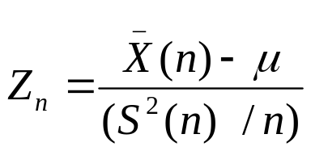
…using Normal Distribution
Now, by central limit theorem has normal distribution.
So, for any given value β, where 0< β <1, there is a point z such that
P[-z <= Z_{n} <= z] = β.
This is because normal distribution is symmetric around the mean (mean in this case is 0).
Given a β , can we figure out what the value of this z is going to be?
(See explanation next slide)

Slide 35
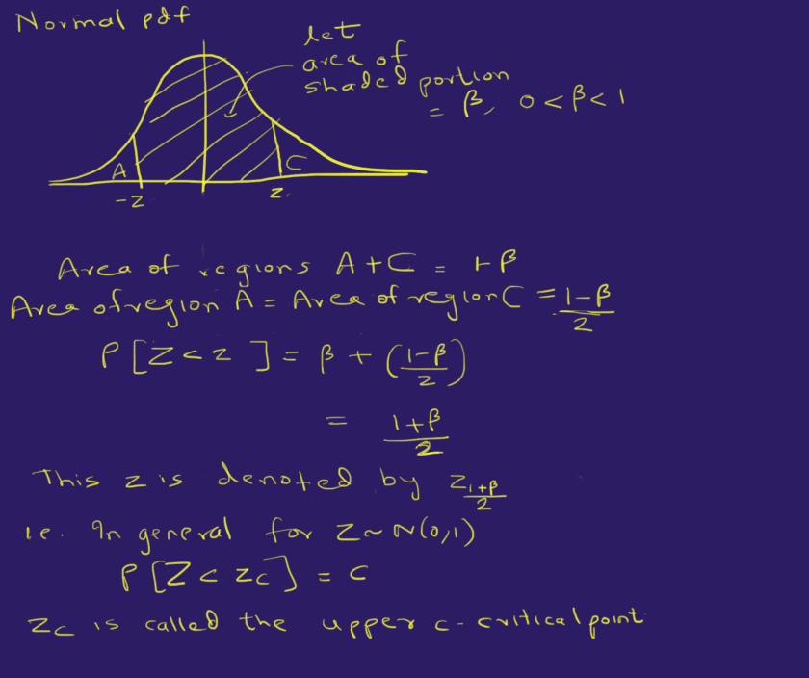

Slide 36
…using Normal Distribution
Now for standard normal distribution, CDF values have been tabulated. So given some p, we can find a z_{p} such that
  P[Z_{n} < z_{p}] = p, where Z_{n} ~ Normal(0,1)
This z_{p} is called the upper p critical point of the standard normal distribution.
E.g. from Table C.3 in KST book, z_{0.95} is 1.55 i.e. P[Z_{n} < 1.55] = 0.95

Slide 37
…using Normal Distribution
Coming back to given a value β, 0< β < 1, the z that will give us
P[-z < Z_{n} < z] = β
Will be equal to z_{(1+ β)/2.}(as explained earlier).

Slide 38
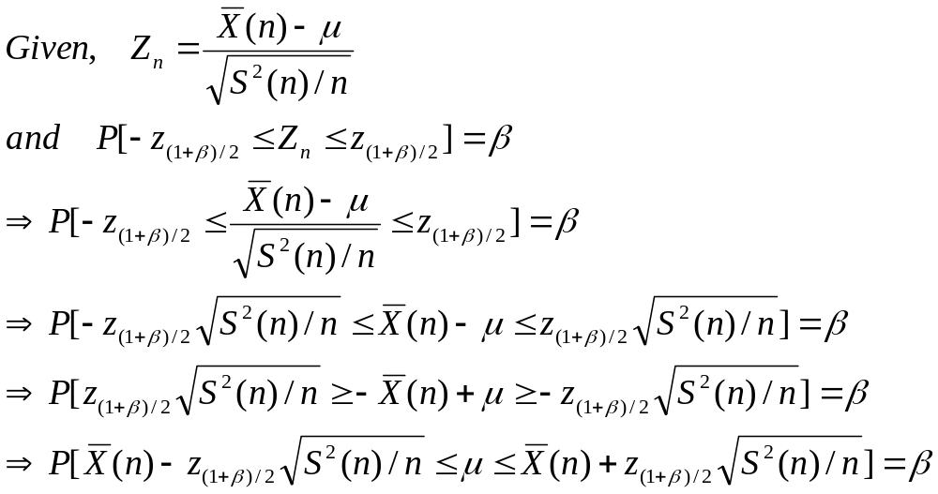
…Confidence Intervals
So given any β, we can find z_{(1+ β)/2} (from standard normal distribution tables), such that P[- z_{(1+ β)/2} < Z_{n} < z_{(1+ β)/2}] = β. Now:

Slide 39
…Confidence Interval
The equation says that the mean μ lies in this interval with probability β :
This is also called the 100β % confidence interval for the mean μ.
  This means that there is a 100β % chance that the real μ lies in this interval.

Slide 40
Confidence Interval
This answers the question of how good is our estimate of the mean?
  Note now: we do NOT give a single point estimate, we now give an interval (the confidence interval) as our “interval estimate”
We say that we are 100 β% confident that the actual mean lies in this interval

Slide 41
Confidence Interval
Width of the interval is large if S²(n), i.e., sample variance, is large
To reduce the width of the interval, we have to increase n, then variance of the sample mean (σ²/n ), estimated by S²(n)/n, will decrease.
The formula shows that to halve the width of the interval, you have to do four times as many repetitions.

Slide 42
Confidence Interval
Now we will show a step by step method to generate confidence intervals, with the example of the M/M/1 simulation. You should extrapolate this to your project/assignment.
Metric being estimated is average delay.
Suppose you will keep average service time τ constant and vary λ from 0.1/τ to 0.9/τ in steps of 0.1/τ

Slide 43
Confidence Interval Method
Initialize
  n (number of runs) ~ around 20
  m (number of samples in each run) ~ long enough for queue to achieve steady state (1000s)
  Initialize λ = 0.1/τ
  Initialize confidence level β (say 0.95)
  Initialize z_{(1+ β)/2} , the (1+ β)/2 upper critical point of the standard normal distribution
While λ <= 0.9/τ
  Carry out the n runs with different seeds/streams. From each run i = 1, 2…n, you will get an average delay X_{i}

Slide 44
…Confidence Interval
  For the sample of average delays X₁, X₂,….X_{n}
    Calculate sample mean X(n)
    Calculate sample variance S²(n)
  Calculate confidence interval as:
  This is the confidence interval of the average delay for this value of λ. Save these values.
  Increment λ, and go to step 2.1
Output the values (λ, confidence interval) for all λ, and plot them.

Slide 45
Confidence Intervals
Your final plot will look like this:
Average Delay
λ
Note: the width of the interval will generally increase with increasing load. Try to do enough number of repetitions so that confidence interval is not too wide (10-20% around midpoint)

Slide 46
Numerical Example
See spreadsheet.

Slide 47
Appendix (code)
Download queuesim.c, lcgrand.c and lcgrand.h. Also input file queuesim.in
Inputs
  Demo? (1 If you want detailed trace, 0 if not)
  Mean interarrival time, mean service time, Number of delays per run
  Number of runs (repetitions)
  <seed,stream> for each run
Compile as
  gcc –o queuesim queuesim.c lcgrand.c –lm
Output of all runs in file queuesim.out – average utilization, delay etc. for each run.

