Slide 1
JavaXcelerate: Java Performance Optimization Workshop
BY M.H. SHOIAB
9840135749

Slide 2
Day 1
Overview of Performance Optimization
Introduction to Agile Programming
o Importance of performance optimization
o Key performance metrics:Latency,throughput,responsetime,CPU,memory
usage
Understanding the JavaVirtual Machine(JVM)
o JVM architecture and execution model
o How the JVM manages memory: Heap,Stack,GarbageCollection(GC)
o JVM options and tuning flags for performance
Performance Bottlenecks
o Common performance bottlenecks in Java applications
o Identifying bottlenecks: CPU-bound vs. IO-bound applications

Slide 3
AGILE
PROGRAMMING A DEEP DIVE

Slide 4
Importance of performance optimization
Performance optimization is crucial in Java applications to ensure smooth and efficient functionality.
Optimizing an application can improve the user experience, reduce resource consumption, and increase the scalability and reliability of the software.
Java, being widely used for high scale applications, benefits greatly from proper tuning and optimization.
Performance tuning in Java involves optimizing code and system configurations to improve the efficiency, speed, and resource usage of applications.
It is critical for ensuring high performance, scalability, and reliability in both Core Java applications (standalone programs) and Enterprise Java applications (web-based, distributed systems).
The approach varies depending on the application's complexity, architecture, and use case.

Slide 5
Overview of Performance Optimization
Key Performance Metrics
Understanding the key performance metrics is essential for evaluating how well your application is performing:
1. Latency: The time taken to process a single request. Lower latency is generally better, as it means requests are handled faster.
2. Throughput: The number of tasks or requests processed per unit of time. Higher throughput is typically a sign of a well optimized system.
3. Response Time: The total time taken from when a request is made until the response is received by the user. Response time is closely related to latency but includes additional factors.
4. CPU Usage: The percentage of CPU resources used by the application. High CPU usage can indicate a CPUbound application, while low CPU usage may indicate an IObound application.
5. Memory Usage: The amount of memory used by the application. Excessive memory usage can lead to memory leaks and increased garbage collection activity.
Initialization time
Managing Cache
Managing Garbage Collection
Boot up sequence.

Slide 6
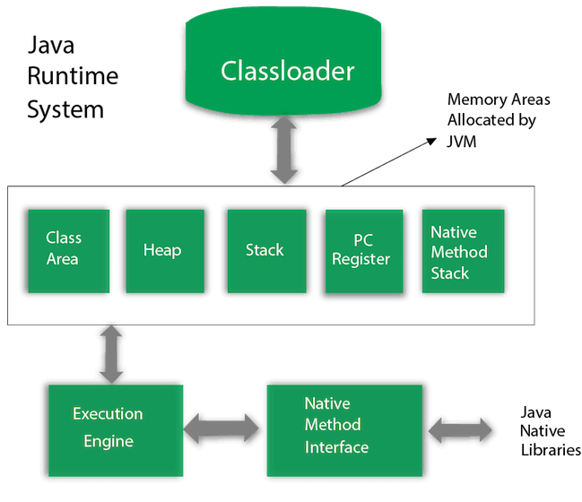
Understanding the Java Virtual Machine (JVM)
The Java Virtual Machine (JVM) is the runtime engine that executes Java bytecode, providing platform independence ("Write Once, Run Anywhere"). Below is a breakdown of its architecture, memory management, and performance tuning.

Slide 7
Class Loader
Loads .class files into memory.
Three types:
Bootstrap ClassLoader (loads core Java classes, e.g., java.lang.*).
Extension ClassLoader (loads jre/lib/ext classes).
Application ClassLoader (loads user-defined classes).
Runtime Data Areas (Memory Management)
Heap (Object storage, shared across threads).
Method Area (Stores class metadata, static variables, constants).
JVM Stacks (Per-thread stack for method calls, local variables).
PC Register (Tracks thread execution point).
Native Method Stack (For native code, e.g., JNI calls).
Execution Engine
Interpreter: Executes bytecode line-by-line (slow).
JIT Compiler (Just-In-Time): Converts frequently used bytecode to native machine code (optimizes performance).
Garbage Collector (GC): Automatically reclaims unused memory.

Slide 8
Core Java applications are typically standalone programs or tools. The performance bottlenecks in such applications are often related to memory management, algorithms, and threading.
Key Areas for Tuning in Core Java
1. Garbage Collection (GC):
- Optimize JVM GC settings using flags like -XX:+UseG1GC or -Xms/-Xmx.
- Analyze GC logs to minimize pauses.
2. Data Structures and Algorithms:
- Use the right data structures (ArrayList, HashMap, etc.) for the task.
- Optimize loops and recursion.
3. String Management:
- Use StringBuilder for concatenations instead of String.
- Leverage Java 9+ Compact Strings.
4. Multithreading:
- Use thread pools (ExecutorService) instead of manually creating threads.
- Reduce thread contention using synchronized blocks or java.util.concurrent locks.
5. File I/O:
- Use buffered streams for efficient file operations.
- Leverage NIO or NIO.2 for non-blocking I/O.

Slide 9
Performance Tuning in Enterprise Java - Enterprise Java applications are complex, distributed systems often built with frameworks like Spring, Hibernate, or JEE technologies. Tuning involves optimizing both the application code and the infrastructure it runs on.
Key Areas for Tuning in Enterprise Java
1. Database Optimization (JPA/Hibernate):
- Use lazy loading to fetch only necessary data.
- Optimize queries with indexes and projections.
- Use batching for inserts/updates.
2. Caching:
- Implement caching strategies using tools like Ehcache, Redis, or Spring Cache.
- Cache frequently accessed data to reduce database calls.
3. Web Application Performance:
- Use connection pooling for efficient database access.
- Compress HTTP responses using GZIP.
- Optimize static resource delivery with CDNs.
4. Garbage Collection and JVM Tuning:
- Monitor and tune JVM parameters (e.g., -XX:+UseParallelGC, -Xmx for heap size).
- Enable detailed logging with -Xlog:gc.
5. Asynchronous Processing:
- Use message brokers like RabbitMQ or Kafka for asynchronous tasks.
- Leverage non-blocking APIs (e.g., CompletableFuture, WebFlux).
6. Microservices and Scalability:
- Ensure lightweight service communication using gRPC or REST.
- Optimize containerized environments using tools like Kubernetes and Docker.

Slide 10
Improving the performance of a Spring Boot application by:
- Caching expensive database queries.
- Reducing the payload size in REST APIs with DTOs.
- Monitoring with APM tools like New Relic or Dynatrace.
General Tools for Performance Tuning
1. Profilers:
- JProfiler, MAT, VisualVM.
2. Garbage Collection Analyzers:
- GCViewer, GCEasy.
3. Heap Dump Analyzers:
- Eclipse MAT (Memory Analyzer Tool).
4. Load Testing Tools:
- Apache JMeter.
Key Performance Metrics
1. Throughput: Number of requests/operations per second.
2. Latency: Time taken to process a single request.
3. Memory Usage: Heap/stack utilization.
4. CPU Usage: CPU efficiency during processing.
Core Java Tuning: Focuses on efficient use of algorithms, threading, and memory.
Enterprise Java Tuning: Involves database optimization, caching, GC tuning, and scaling distributed systems.
Tools and Monitoring: Use profilers, heap analyzers, and APM tools to diagnose bottlenecks.
Performance tuning is an iterative process that requires profiling, diagnosing bottlenecks, and applying targeted optimizations.

Slide 11
Exercise: Measure Performance Metrics in a Sample Application
package performancepack;
public class Ex4 {
public static void main(String[] args) {
// Measure precise time in nanoseconds
long startTimeNano = System.nanoTime();
System.out.println("Start time in nanoseconds (from nanoTime): " + startTimeNano);
try {Thread.sleep(1);}catch(Exception e) {}
long endTimeNano=System.nanoTime();
System.out.println("End time in nanoseconds (from nanoTime): " + endTimeNano);
System.out.println("Time Difference is..:"+(endTimeNano-startTimeNano));
// Memory usage
long freeMemory = Runtime.getRuntime().freeMemory();
long totalMemory = Runtime.getRuntime().totalMemory();
long usedMemory = totalMemory - freeMemory;
System.out.println("Start Free Memory (bytes): " + freeMemory);
System.out.println("Total Memory (bytes): " + totalMemory);
System.out.println("Memory Usage Before (bytes): " + usedMemory);
}
}

Slide 12
In Java's JVM options, XX stands for non-standard or advanced options that are specific to the HotSpot JVM implementation. These options are typically used for fine-tuning JVM performance, debugging, or experimenting with internal JVM behaviors. They are not guaranteed to be available across all JVM implementations or versions.
Types of JVM Options
1. Standard Options:
- Begin with a single - (e.g., -classpath, -Dproperty=value).
- These are guaranteed to work across all JVM implementations.
2. Non-Standard Options:
- Begin with -X (e.g., -Xms, -Xmx for heap sizes, -Xss for stack size).
- Commonly supported but not part of the Java SE specification.
3. Advanced Options:
- Begin with -XX: (e.g., -XX:+UseG1GC).
- Offer advanced controls over JVM internals and are JVM-specific.

Slide 13
S.No | Option | Description
1 | -Xms | Sets Heap Memory - By Default it is 1/64th of the physical memory, can be increased upto 1/4th of the physical memory. Ex: - Xms512m
2 | -Xmx | To set the maximum size – Ex: -Xmx512m
3 | -Xss | in a 64 bit machine - Stack Memory is allotted 1 MB (1024KB)//in a 32 bit 320 KB Ex: -Xss10m
4 | XX | -XX options are JVM-specific (mainly for Oracle's HotSpot or OpenJDK).
5 | -XX:+UseG1GC | Enables the G1 Garbage Collector.
6 | -XX:MaxHeapSize =<size> | Sets the maximum heap size (similar to -Xmx).
7 | -XX:InitialHeapSize = <size> | Sets the initial heap size (similar to -Xms).
8 | -XX:PermSize= <size> | Sets the initial size of the Permanent Generation (pre-Java 8).

Slide 14
S.No | Option | Description
9 | -XX:MetaspaceSize =<size> | Sets the initial size of Metaspace (Java 8 and later).
10 | -XX:NewRatio= <value> | Sets the ratio of the old generation to the young generation in the heap.
11 | -XX:+HeapDumpOnOutOfMemoryError | Dumps the heap to a file when an OutOfMemoryError occurs.
12 | -XX:MaxMetaspaceSize=<size> | Sets the maximum size of Metaspace.
13 | XX:+UseSerialGC | Suitable for singlethreaded environments.
14 | XX:+UseParallelGC | Uses multiple threads for GC in both Young and Old Generations
15 | XX:+UseG1GC | Suitable for large heaps with low pause requirements.
16 | XX:+UseZGC | Designed for ultralow pause times.

Slide 15
S.No | Option | Description
17 | XX:+PrintGCDetails | Print detailed GC information
18 | XX:+PrintGCTimeStamps | Print timestamps for each GC event
19 | XX:+PrintGCDateStamps | Print date and time of each GC event
20 | XX:+PrintHeapAtGC | Print heap status before and after GC
21 | -Xlog:gc*:file=gc.log:time,uptime,level,tags | gc*: Enables logging for garbage collection events. file=gc.log: Writes the logs to a file named gc.log. time: Includes timestamps in the logs. uptime: Logs the uptime since JVM startup. level,tags: Adds logging levels and tags for clarity.
22 | java -XX:+PrintFlagsFinal -version | This prints all -XX options with their default values, categorized as default, command-line, JVM-internal, or system properties.

Slide 16
Introduction to Garbage Collection in Java
What is Garbage Collection?
Importance of GC
Garbage Collection Architecture
Young Generation:
Old Generation (Tenured Space): How GC Works
YOUNG
GENEGERATION
OLD GENERATION (TENURED SPACE)
EDEN SPACE
SURVIVOR SPACE
S0
S1
METASPACE

Slide 17
Garbage Collection Algorithms – We can choose
Different GC algorithms (or collectors) are available in Java, and each has its strengths and tradeoffs:
1. Serial Garbage Collector
JVM Option: XX:+UseSerialGC
2. Parallel Garbage Collector (Throughput Collector)
JVM Option: XX:+UseParallelGC
3. G1 Garbage Collector (Garbage First)
JVM Option: XX:+UseG1GC
4. Z Garbage Collector (ZGC)
JVM Option: XX:+UseZGC

Slide 18
The default garbage collector (GC) depends on the Java version and the operating system you're running. Here's the general trend:
JDK 8: The default GC is the Parallel Garbage Collector (Throughput Collector) for most platforms.
-XX:+UseParallelGC
JDK 9 to JDK 17: The G1 Garbage Collector (Garbage First) is the default.
-XX:+UseG1GC
JDK 18+: The G1 Garbage Collector remains the default, but on specific systems (e.g., with very large heaps), the JVM may automatically select ZGC.
To confirm which GC is being used by your JVM, you can add this option to your application:
//JVM Flags - -XX:+PrintGCDetails -XX:+PrintCommandLineFlags

Slide 19
Performance Tuning for GC
Tuning garbage collection can help in optimizing memory usage, reducing GC pause times, and improving overall performance.
Key Tuning Parameters
Heap Size: Increase or decrease heap size based on the application’s memory requirement.
2. GC Algorithm Selection: Choose the right GC algorithm based on application needs (e.g., G1GC for lowlatency).
3. Adjusting Young Generation Size: Affects frequency of Minor GCs.
4. G1GC Tuning (for applications with low latency requirements)
Example Tuning Setup for Low Latency Application
java Xms4g Xmx4g XX:+UseG1GC XX:MaxGCPauseMillis=200 XX:InitiatingHeapOccupancyPercent=45 MyApp

Slide 20
Key Differences
Verbose GC
What It Shows:GC Type: Either GC (minor/young GC) or Full GC.
Before and After Heap Usage: (e.g., 12345K->4567K).
Total Heap Size: (e.g., 123456K).
Time Taken: (e.g., 0.1234560 secs).
Feature | -verbose:gc | -Xlog
Availability | Available in all Java versions. | Introduced in Java 9 and later.
Customization | None. | Highly customizable (tags, levels, output).
Details Logged | Basic GC info (type, heap usage, time). | Detailed GC info, including timestamps, phases, and more.
Other JVM Components | Logs only GC events. | Logs many components (GC, threads, memory, etc.).
Log Format | Simple and human-readable. | Structured, customizable, and programmatically friendly.
Performance Impact | Minimal but not optimized. | Designed for efficient logging.

Slide 21
Analyzing Collection Level Memory Leaks
Common Causes
Unintended References: Collections holding references to objects that should have been released
Static Collections: Collections declared as static/global that keep growing
Listener/Callback Accumulation: Collections storing event listeners that aren't properly removed
Caching Without Eviction: Caches that grow indefinitely without size limits or expiration
Map Key Issues: Using mutable objects as keys in maps that change their hash codes
Analysis Techniques
1. Heap Dump Analysis
2. Memory Profiling
3. Code Inspection Patterns
Prevention Strategies
Use Weak References
Implement Size Limits
Clear Collections
Use Specialized Collections
Monitor Collection Sizes

Slide 22
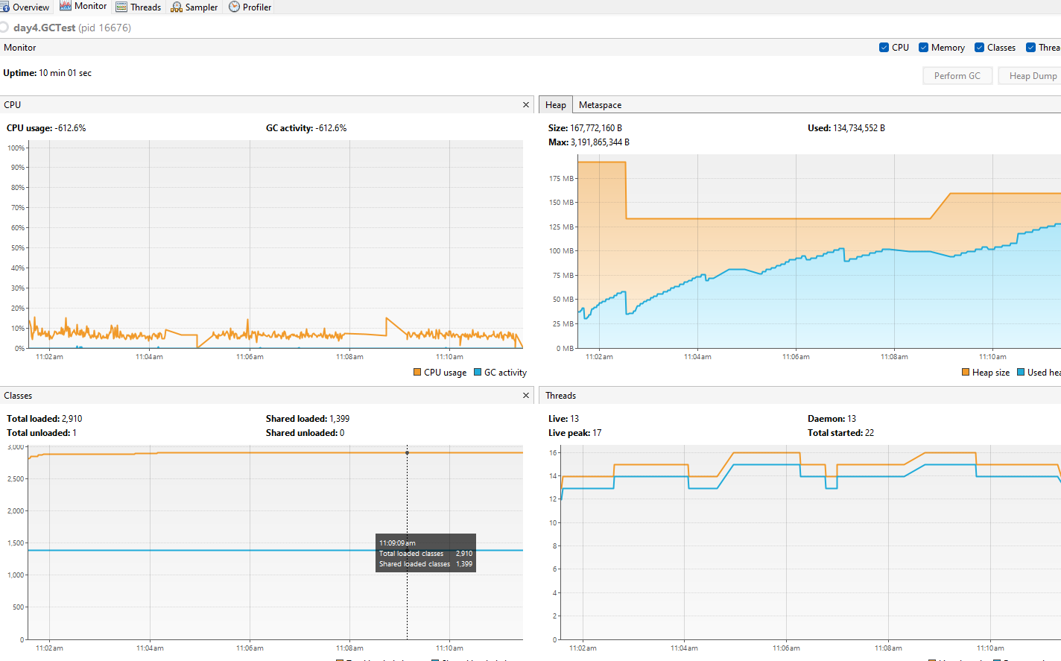
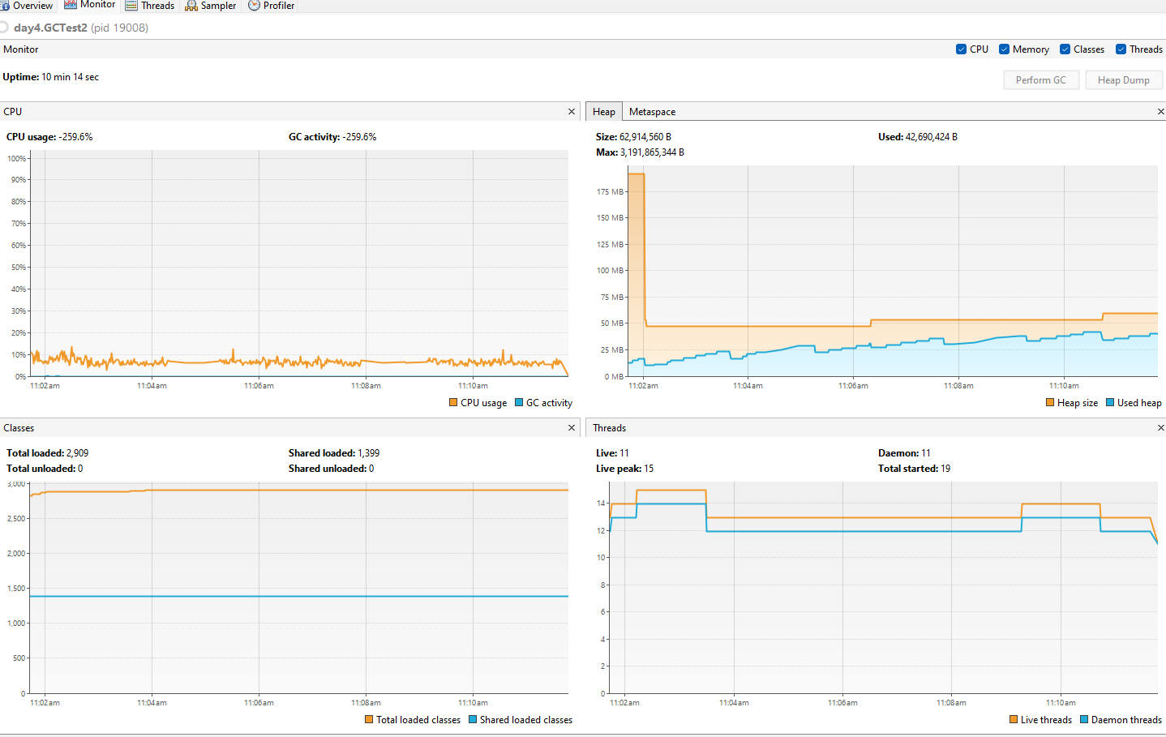
package day4;
import java.util.ArrayList;
import java.util.List;
import java.util.concurrent.PriorityBlockingQueue;
public class GCTest {
public static void main(String[] args) {
List<String> list=new ArrayList<>();
long startTime=System.currentTimeMillis();
//run for 10 minute
while(System.currentTimeMillis()-startTime<600000) {
for(int i=0;i<10000;i++) {
list.add("Message..."+i);
}
for(int i=0;i<5000;i++) {
list.remove(i);
}
}
}
}
package day4;
import java.util.ArrayList;
import java.util.List;
import java.util.concurrent.PriorityBlockingQueue;
public class GCTest2 {
public static void main(String[] args) {
PriorityBlockingQueue<String> queue=new PriorityBlockingQueue();
long startTime=System.currentTimeMillis();
//run for a minute
while(System.currentTimeMillis()-startTime<600000)
{
for(int i=0;i<10000;i++) { queue.add("Message..."+i);
}
for(int i=0;i<5000;i++) {
queue.remove(i);
}
}
}
}
Heap Memory Used
Heap Memory Used

Slide 23
Introduction to Telemetry
What is Telemetry?
Telemetry is the automated process of collecting, transmitting, and analyzing data from applications or systems to monitor their health, performance, and behavior. It provides critical insights into how applications function, helps identify bottlenecks, and ensures reliability in production environments.
---
Importance of Telemetry in Modern Applications
1. Observability: Provides visibility into the internal state of an application to detect and troubleshoot issues.
2. Performance Monitoring: Tracks metrics like response time, error rates, and resource usage to ensure optimal performance.
3. Proactive Issue Detection: Enables quick identification and resolution of performance degradations or system failures.
4. Scalability: Assists in determining scaling requirements by analyzing resource utilization trends.
5. Compliance and Auditing: Captures logs and traces to meet regulatory requirements.
Types of Telemetry Data
1. Logs:
- Captures event information about what is happening in the application.
- Example: Errors, warnings, and debug information.
2. Metrics:
- Numeric representations of the application's performance over time.
- Example: CPU usage, memory usage, request latency, throughput.
3. Traces:
- Tracks a request's journey across distributed systems, showing the time spent at each stage.
- Example: End-to-end request latency in a microservices architecture.

Slide 24
Implementing Telemetry in Java
Tools and Libraries
1. OpenTelemetry:
- A vendor-neutral observability framework for logs, metrics, and traces.
- Supports distributed tracing and integrates with popular backends like Prometheus, Jaeger, and Elasticsearch.
2. Micrometer:
- A metrics library that integrates seamlessly with frameworks like Spring Boot.
- Provides instrumentation for JVM metrics, HTTP requests, and more.
- Works with monitoring systems like Prometheus, Datadog, and New Relic.
3. Dropwizard Metrics:
- A Java library for metrics collection and reporting.
- Useful for tracking counters, timers, and gauges.
---
Setting Up Basic Telemetry
1. Metrics Collection:
- Use Micrometer or Dropwizard Metrics to collect metrics like request latency, JVM memory usage, and thread counts.
- Export these metrics to a monitoring backend such as Prometheus.
2. Logging:
- Use SLF4J, Logback, or Log4j2 for structured logging.
- Ensure logs are centralized using tools like Elasticsearch, Fluentd, or Logstash.
3. Tracing:
- Integrate OpenTelemetry for distributed tracing across microservices.
- Export trace data to visualization tools like Jaeger or Zipkin.

Slide 25
Instrumenting Your Code for Telemetry
1. Capturing Key Performance Indicators (KPIs):
- Counters: Track occurrences of events (e.g., requests processed, errors).
- Timers: Measure how long an operation takes.
- Gauges: Monitor instantaneous values (e.g., current memory usage).
Example KPIs:
- Request processing time (latency).
- Error rates (number of failed requests).
- Resource utilization (CPU, memory).
2. Integrating Metrics:
- Use Micrometer's annotations or APIs to measure method execution time.
- Example: @Timed annotation in Spring Boot for automatic latency tracking.
3. Adding Tracing:
- Instrument your code with OpenTelemetry to trace requests across services.
- Use manual spans for custom events or automatic instrumentation for HTTP clients and servers.
4. Logging Best Practices:
- Use structured logging formats like JSON for easier parsing.
- Include correlation IDs in logs to link requests with traces.

Slide 26
For the below example, Please add the dependancies in pom.xml
<dependency>
<groupId>io.dropwizard.metrics</groupId>
<artifactId>metrics-core</artifactId>
<version>4.2.18</version> <!-- Replace with the latest version if needed -->
</dependency>
<dependency>
<groupId>io.micrometer</groupId>
<artifactId>micrometer-core</artifactId>
<version>1.11.3</version> <!-- Replace with the latest version if needed -->
</dependency>
<dependency>
<groupId>io.micrometer</groupId>
<artifactId>micrometer-registry-prometheus</artifactId>
<version>1.11.3</version> <!-- Replace with the latest version if needed -->
</dependency>
<dependency>
<groupId>org.openjdk.jmh</groupId>
<artifactId>jmh-generator-annprocess</artifactId>
<version>1.37</version>
<scope>test</scope>
</dependency>

Slide 27
CyclicBarrier and Phaser
Both CyclicBarrier and Phaser are synchronization constructs used to coordinate the execution
of multiple threads.
CyclicBarrier: It is a simple synchronization barrier where a fixed number of threads must arrive
at the barrier before any of them can proceed. Once all threads arrive, the barrier is "reset" and
can be reused.
Phaser: It is a more flexible and dynamic synchronization construct, which allows threads to wait
on one or more phases. It provides more control over phases and participants and can be used
in more complex scenarios, including cases where the number of threads might vary over time.
Key Differences:
CyclicBarrier is fixed in terms of the number of threads that need to synchronize.
Phaser allows for more complex synchronization patterns, including dynamic participation
(threads can register and deregister).

Slide 28
ConcurrentSkipListMap was introduced in Java 6 as part of the java.util.concurrent package.
It is a thread-safe, scalable, and navigable map implementation based on a skip list data structure. The map is sorted according to the natural ordering of its keys or by a specified comparator. Its non-blocking nature and guaranteed log(n) time complexity for most operations make it suitable for highly concurrent environments.
Feature | TreeMap | ConcurrentSkipListMap
Thread Safety | Not thread-safe; requires external synchronization | Thread-safe; supports concurrent access
Synchronization Scope | Must synchronize externally | Uses fine-grained locks for efficient concurrency
Performance | Slower in multi-threaded environments due to explicit locking | Faster in multi-threaded environments due to lock-free design
Ordering | Maintains natural order of keys | Maintains natural order of keys
Scalability | Limited scalability in multi-threaded | scenarios Highly scalable for concurrent access
Use Case | Single-threaded scenarios or explicit synchronization | Multi-threaded scenarios with sorted data

Slide 29
JDBC Performance Improvement
HikariCP is an open-source project originally developed by Brett Wooldridge. It is not tied to any specific company but is widely used in the Java community due to its high performance and low latency.
The project is hosted on GitHub under the repository: brettwooldridge/HikariCP, and it is licensed under the Apache License 2.0. Brett Wooldridge designed HikariCP to be a "lightweight and lightning-fast JDBC connection pool."
Feature | Direct (DriverManager) | Connection Pool (DataSource)
Performance | Slow due to the cost of creating/closing connections | Fast as connections are reuse
Scalability | Poor scalability in high-concurrency environments | Highly scalable with efficient resource usage
Ease of Use | Simple but not suitable for production | Slightly complex setup but production-ready
Connection Management | Manually managed, prone to resource leaks | Automatically managed, reduces resource leaks
Use Case | Simple, small-scale apps | High-performance, multi-threaded applications

