Slide 1
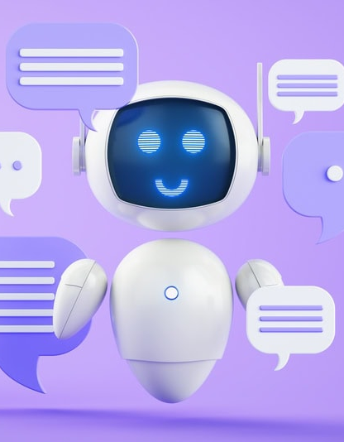
Welcome
Simple Chatbot and DSA Project

Slide 2
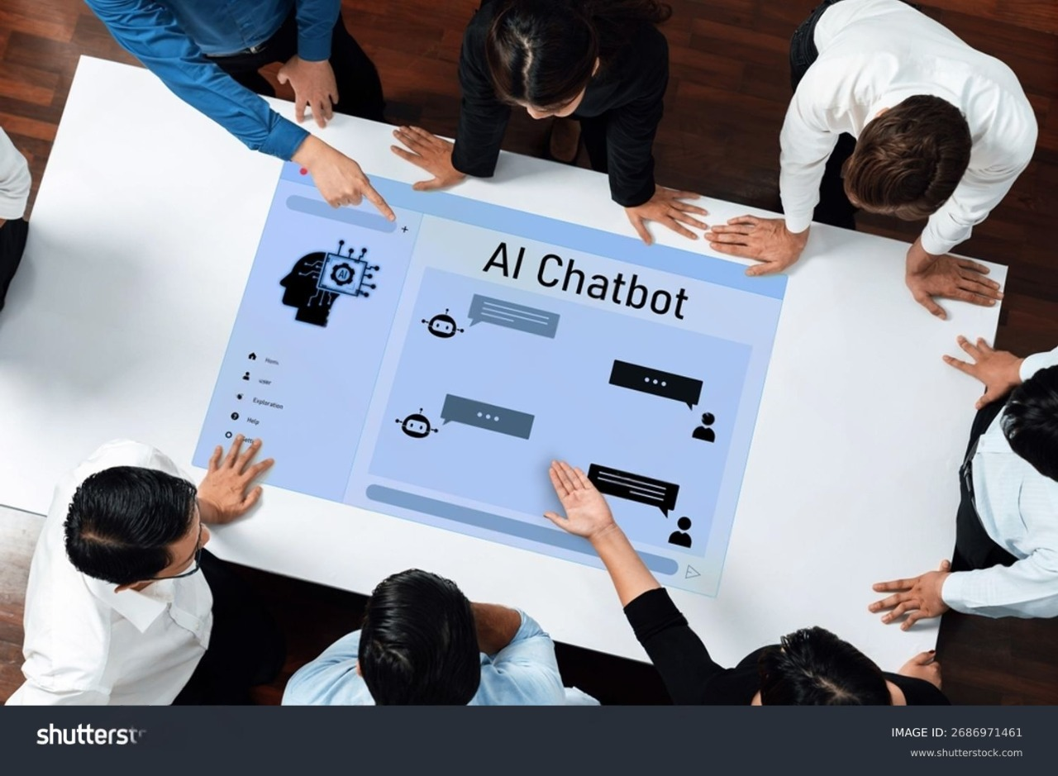

Simple Chatbot
DSA Project
Members Involved
s.no | Name | ID | Contributions
1 | Virendra Pal (Leader) | BCAI2024126 | 100%
2 | Vivek Verma | BCCC2024017 | 100%
3 | Anamta Niyazi | BCAI2024019 | 100%
4 | Arshdeep Kaur | BCAI2024034 | 100%
5 | Suryansh Shrivastav | BACI2024017 | 100%
6 | Piyush Gupta | BCAI2024116 | 100%

Slide 3
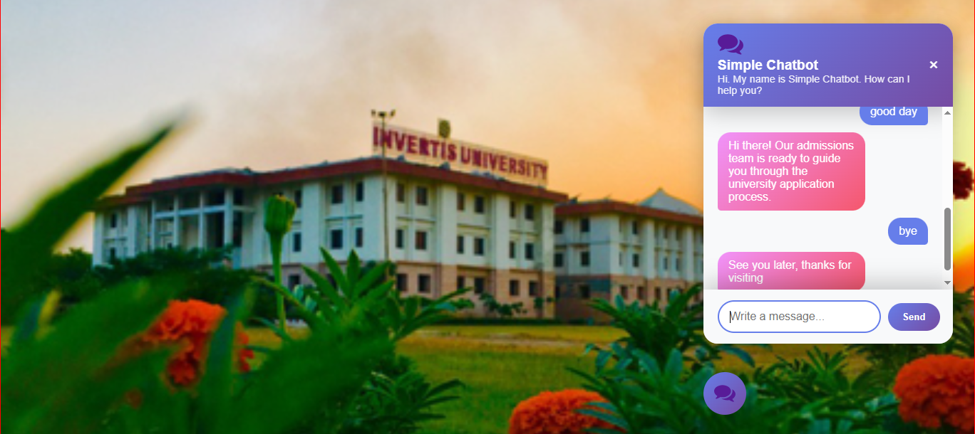
Concepts:-
Objectives and Scope
Technology Stack (Python, HTML, CSS, JavaScript, JSON, Markdown, Other formats: Images(SVG,JPG)
Key Features and Functionalities
Architecture Diagram (backend and frontend interaction)
Code Snippets and Logic Flow
Challenges and Solutions
Future Enhancements and Conclusion

Slide 4
Chatbot Project Task Distribution for Members
Backend development: Writing chatbot logic in Python, implementing data structures and algorithms for efficient query handling.
Frontend web design: Creating the user interface using HTML, CSS, and JavaScript, JSON, Markdown, Other formats: Images(SVG,JPG) for chatbot user interaction.
Web integration: Connecting the Python backend with the web frontend, ensuring smooth communication between layers.
Data analysis and visualization: Designing performance graphs, monitoring project metrics, and preparing visual reports.
Project coordination and documentation: Managing schedules, tracking progress, and preparing presentations and reports.
Testing and debugging: Conducting systematic testing, identifying bugs, and optimizing chatbot performance for stability.

Slide 5
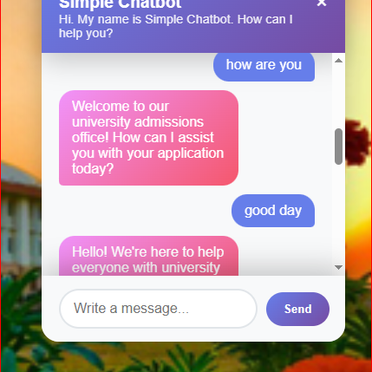
Input & Output
Responses

Slide 6
Key Opportunities with Chatbots
Enhanced Customer Support: Chatbots provide 24/7 customer service by answering FAQs, handling inquiries instantly, and allowing human agents to focus on complex issues. This improves response times and customer satisfaction.​
Cost and Efficiency Gains: Automating routine interactions with chatbots reduces labor costs and operational overhead while scaling to handle multiple users simultaneously without adding staff.​
Personalization and Engagement: Advanced chatbots can use historical data to offer personalized recommendations and proactive engagement, boosting conversion rates and loyalty.​
Industry-Specific Use Cases: Chatbots are transforming customer experience in healthcare, finance, education, HR, travel, ecommerce, and more by automating processes like appointment booking, lead generation, employee onboarding, and surveys.​
Data Collection & Insights: Interactions with chatbots generate valuable data to analyze customer preferences and feedback, enabling businesses to refine products, marketing, and service quality.​
New Revenue Models: Businesses can create chatbot-as-a-service products, licensing chatbot technology or offering AI-powered customer interaction solutions.​
Integration with Emerging Technologies: AI chatbots can be combined with IoT, AR/VR, blockchain, and 5G networks for innovative use cases like smart home control, immersive customer support, and secure interactions.​
Skill Development & Career Opportunities: The growing demand for chatbot development offers career paths in AI, NLP, software engineering, and customer experience design.

Slide 7
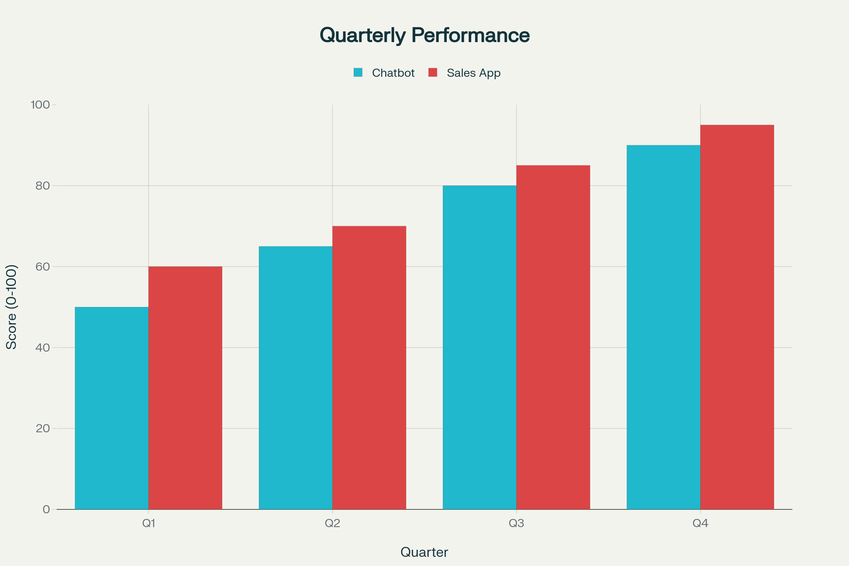

Slide 8
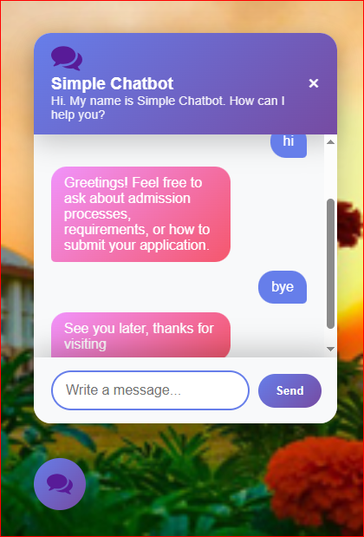
Summary
Overall, chatbots represent promising opportunities for businesses to revolutionize customer engagement, improve efficiencies, and unlock new revenue streams while also driving technological innovation and workforce transformation

Slide 9
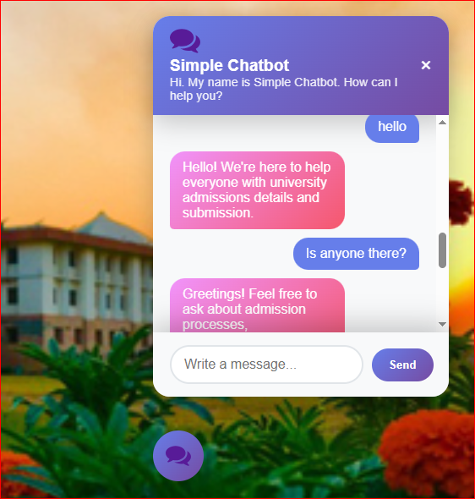
Thank you
Lead By Virendra Pal

