Slide 1
Spring MVC - E0
CEG – Open Source

Slide 2
Agenda
SpringMVC Features
Request Processing Work flow
Key Components in Spring MVC
Annotations in SpringMVC
DispatcherServlet
WebApplicationContext
HandlerMapping
Controller
Processing Form Submissions
ModelAndView
Resolving View
View Resolver
Validation Framework

Slide 3
Spring MVC Features
Based on MVC design pattern
Clear separation of roles. Each role -- controller, validator, command object, form object, model object, DispatcherServlet, handler mapping, view resolver, and so on.
Adaptability, non-intrusiveness, and flexibility - Define any controller method signature you need, possibly using one of the parameter annotations (such as @RequestParam, @RequestHeader,@PathVariable, and more) for a given scenario.
Reusable business code, no need for duplication. Use existing business objects as command or form objects instead of mirroring them to extend a particular framework base class.
Customizable locale and theme resolution, support for JSPs with or without Spring tag library, support for JSTL, support for Velocity

Slide 4
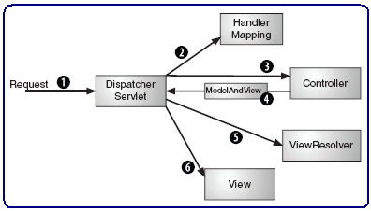
Request Processing Work flow
A request is dispatched by DispacherServlet to a controller (which is chosen through a handler mapping). Once the controller is finished, the request is then sent to a view (which is chosen through a ViewResolver) to render output.

Slide 5
Request Processing Work flow (continue)
DispatcherServlet receives a request
DispatcherServlet consults HandlerMapping to find a controller
DispatcherServlet dispatches the request to Controller for processing.
Controller performs business logic, sets the model, package the model and view name into a ModelAndView object and returns it to DispatcherServlet.
DispatcherServlet consults its view resolver to find a view.
DispatcherServlet forwards the request to the view which displays the result to the user.
Notes:
File handling commands help us to copy/move/delete a file
Help us to locate the file, list the files in the directory

Slide 6
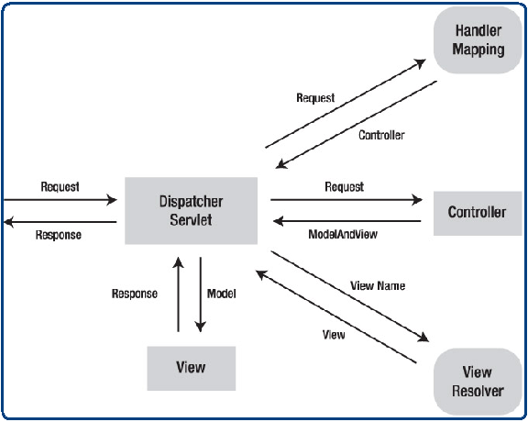
Key Components in Spring MVC
1. DispatcherServlet
2. HandlerMapping
3. Controller
4. ModelAndView
5. ViewResolver
6. Validator
7. Spring Tag Library
8. Spring MVC Annotations
Notes:
File handling commands help us to copy/move/delete a file
Help us to locate the file, list the files in the directory

Slide 7
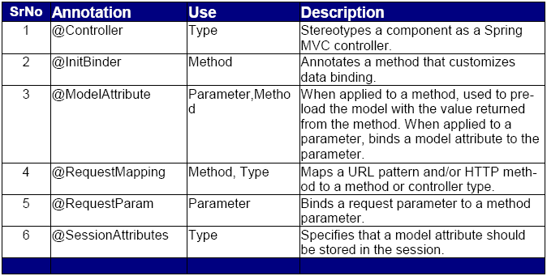
Annotations in SpringMVC
Spring MVC supports following annotations:
Notes:
File handling commands help us to copy/move/delete a file
Help us to locate the file, list the files in the directory

Slide 8
Setup for Spring MVC Annotations
Before you can use annotations on Spring MVC controllers, you’ll need to add a few lines of XML to tell Spring that your controllers will be annotation-driven. So that you won’t have to register each of your controllers individually as <bean>s, you’ll need a <context:component-scan>:
<context:component-scan base-package="com.tcs.opensource"/>
We’ll also need to tell Spring to honour the other Spring MVC annotations. For that we’ll need <context:annotation-config> :
<context:annotation-config/>
Add these two lines highlighted in the Spring's bean configuration(Application Context ) file where you have entered the bean definitions.

Slide 9
DispatcherServlet
The heart of Spring MVC.
Inherits from HttpServlet class.
Acts as a front controller and delegates responsibility to other components.
Must be configured in your web application’s web.xml file under <servlet> tag
You need to map requests that you want DispatcherServlet to handle, by using a URL mapping in the same web.xml file.
Upon initialization of a DispatcherServlet, the framework looks for a file named [servlet-name]-servlet.xml in the WEB-INF directory of your web application and creates the beans defined there.

Slide 10
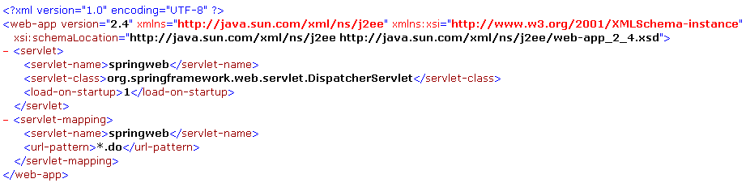
DispatcherServlet (continue)
DispatcherServlet in web.xml:
Notes:
File handling commands help us to copy/move/delete a file
Help us to locate the file, list the files in the directory

Slide 11
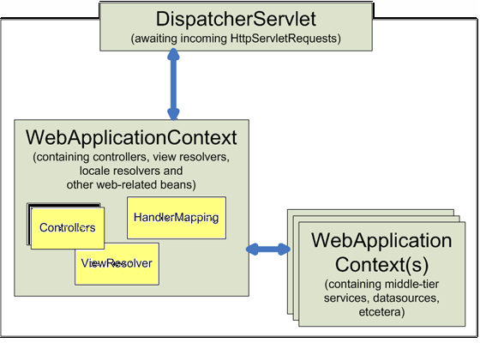
DispatcherServlet in WebApplicationContext

Slide 12
WebApplicationContext
WebApplicationContext is an extension of the plain ApplicationContext that has some extra features necessary for web applications.
Each DispatcherServlet has its own WebApplicationContext which inherits all the beans already defined in the root WebApplicationContext
It is bound in the ServletContext
It is capable of resolving themes and it knows which servlet it is associated with
The root application context cannot access the web application context.
The web application context can access the root application context.

Slide 13
HandlerMapping
Interface used by DispatcherServlet for mapping incoming requests to individual controllers.
Helps DispatcherServlet to figure out which controller the request should be sent to.
Apply from the base url-pattern specified in the web.xml.
You can configure HandlerMapping in the spring application context file.
By default, if no handler mapping can be found in the context, the DispatcherServlet creates a BeanNameUrlHandlerMapping for you.
DispatcherServlet also enables the DefaultAnnotationHandlerMapping, which looks for @RequestMapping annotations on @Controllers.

Slide 14
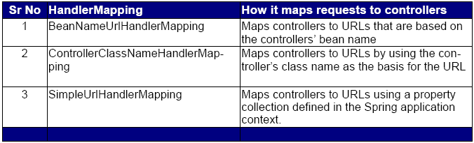
HandlerMapping examples
Few HandlerMapping shown in the table
Handler mappings help DispatcherServlet find the right controller to handle a request

Slide 15
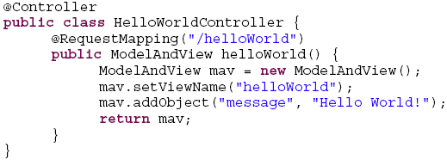
Controller
DispatcherServlet is the heart of Spring MVC then controllers are the brains
Controller receives requests from DispatcherServlet and performs some business functionality on behalf of the user and transform it into a model that is represented to the user by the view.
Spring 2.5 introduced an annotation-based programming model for MVC controllers that uses annotations such as @RequestMapping, @RequestParam, @ModelAttribute, and so on. Controllers implemented in this style do not have to extend specific base classes or implement specific interfaces.

Slide 16
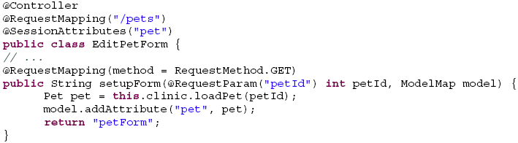
@Controller,@RequestMapping and @RequestParam
@Controller and @RequestMapping annotations allow flexible method names and signatures. @Controller annotation indicates that a particular class serves the role of a controller. @Controller annotation acts as a stereotype for the annotated class, indicating its role.
@RequestMapping annotation is used to map URLs onto an entire class or a particular handler method.
@RequestParam annotation is used to bind request parameters to a method parameter in your controller. @RequestParam throws an exception when the parameter is missing in the request.
e.g

Slide 17



Processing form Submissions
On receiving GET request, controller displays a form to collect user input.
Controller then binds the request parameter to the command object
Upon submitting the form with an HTTP POST, the controller processes the input and returns a success page.

Slide 18
ModelAndView
ModelAndView class uses a ModelMap class that is a custom Map implementation that automatically generates a key for an object when an object is added to it.
ModelAndView object contains both the model data as well as a hint to what view should render the results.
ModelAndView doesn’t carry a reference to the actual JSP. Instead it only carries a logical name that will be used to look up the actual view that will produce the resulting HTML.
Once the ModelAndView is delivered to the DispatcherServlet, the DispatcherServlet asks a view resolver to help find the actual JSP

Slide 19
Resolving views
All MVC frameworks for web applications provide a way to address views.
Spring provides view resolvers, which enable you to render models in a browser without tying you to a specific view technology.
Out of the box, Spring enables you to use JSPs, Velocity templates and XSLT views.
The two interfaces that are important to the way Spring handles views are ViewResolver and View.
The ViewResolver provides a mapping between view names and actual views.
The View interface addresses the preparation of the request and hands the request over to one of the view technologies.

Slide 20
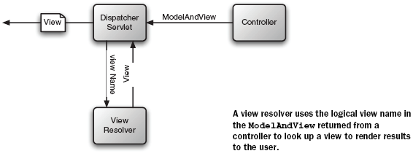
ViewResolver

Slide 21
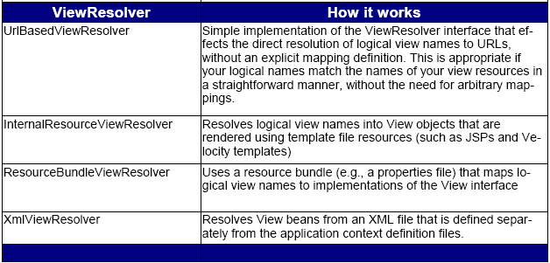
ViewResolver (continue)
Spring comes with several implementations of ViewResolver, as listed in table.

Slide 22
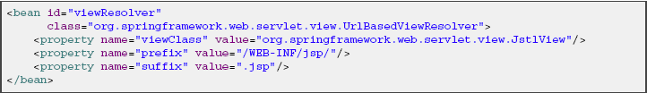
ViewResolver (continue)
As an example, with JSP as a view technology, you can use the UrlBasedViewResolver.
This view resolver translates a view name to a URL and hands the request over to the RequestDispatcher to render the view.
When returning test as a logical view name, this view resolver forwards the request to the RequestDispatcher that will send the request to /WEB-INF/jsp/test.jsp.

Slide 23
Validation Framework (continue)
Spring offers its own validation infrastructure as an add-on to core Spring.
Validators are implementations of the org.springframework.validation.Validator interface. They are stateless singleton classes that are configured in the Spring ApplicationContext and injected into your Controllers and test objects and their property values.
Validator interface is basic and eminently usable in every layer of an application.
The Validator and the DataBinder make up the validation package
Two types of Validator implementations exist
1. Programmatic Validators where validation constraints are coded
2. Declarative Validators that create validation constraints based on configuration
The Validator interface has two methods that should be implemented.
public interface org.springframework.validation.Validator {
public boolean supports(Class clazz);
public void validate(Object target, Errors errors);
}

Slide 24
Validation Framework (continue)
The validate() method implements the actual constraints on the target object.
The supports() method defines which classes the Validator supports.
Validation errors are reported to the Errors object passed to the validator.

Slide 25
Thank You

