Slide 1
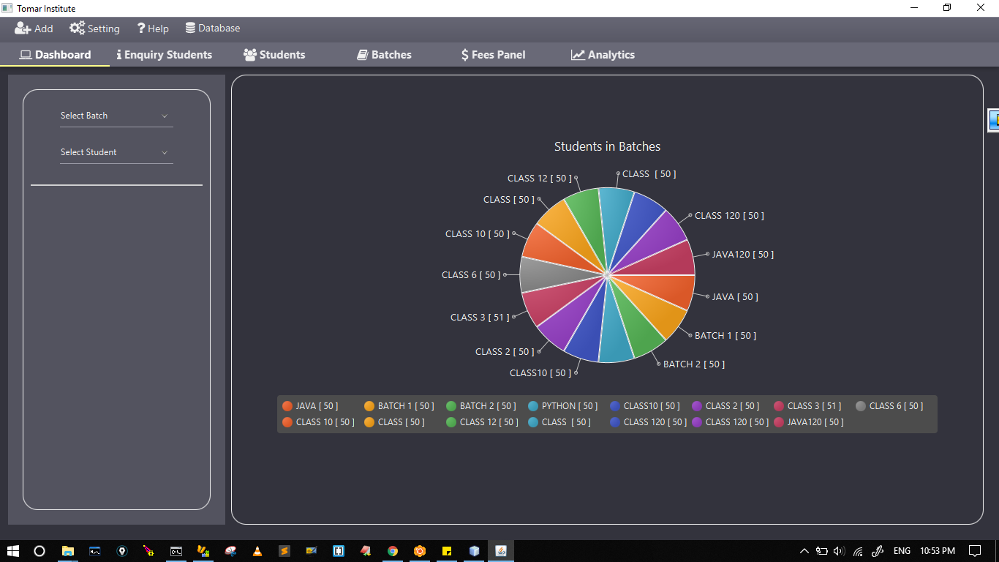
Student Fees Manager
Feel Free To Code

Slide 2




Language
Tools
Scene builder
Feel Free To Code

Slide 3

DataBase
Feel Free To Code

