Slide 1
Doctor Search Website
Virendra kumar
Indian Institute of Technology Ropar

Slide 2
AGENDA
Introduction
Tools and Techniques
Design of Project
Working of Project
Live Demo
References

Slide 3
Introduction
The doctor search website is a platform to search for the right doctor according to the needs.
To search for the doctor, the user just has to enter the category and area of the doctor.
Users can also find information about the experience of doctors and general information about the service that our platform is providing.

Slide 4
Tools and Techniques
Design – To design the prototype of the Project, we have used the Figma tool.
Frontend – to create the frontend part of the project, we used HTML, CSS, and JavaScript. We have also used the Locofy.ai tool to generate the front-end code of our project.
Backend – to create the web service, we have used the PHP language and jQuery to connect with the front end.
Database - to store the data of doctors, we have used the MYSQL database.
Hosting Platform – to make our project public, we have used the 000webhost platform.

Slide 5

Design
Navbar
Search functionality
Search Result
Steps to get solution
Platform service Quality

Slide 6
Working of Project
Enter Doctor type and Doctor area
Data fetching request to the backend
Data fetching from Database
The user enters the details and presses the search button.
A request will be sent to the backend through jQuery for doctors’ data.
Now backend web service will fetch doctor data from the database.
Now data will be sent to the backend web service.
From the backend web service, data will be fetched by jQuery and will show on the front end.

Slide 7
Live Demo
Link of website – https://veertask1.000webhostapp.com/
Link of Figma file - Figma file
Project link- https://github.com/virendrarpr/task1

Slide 8
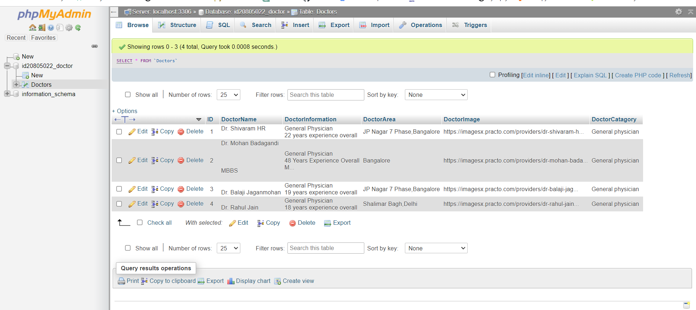
Database image

Slide 9
References
Hack Veda Full stack web development playlist
Locofy
Locofy tutorial
Figma tutorial

Slide 10
Thank You

