Slide 1
Assignment 1
Atari Breakout
Virendra Wali
Manuja Sanjay Bandal
Bivas Maiti

Slide 2
Problem Statement
Develop a primitive version of the classic game ATARI, with one brick, a moving ball and a slider to control movement of the ball. The game should also have a clock to track the time played.

Slide 3
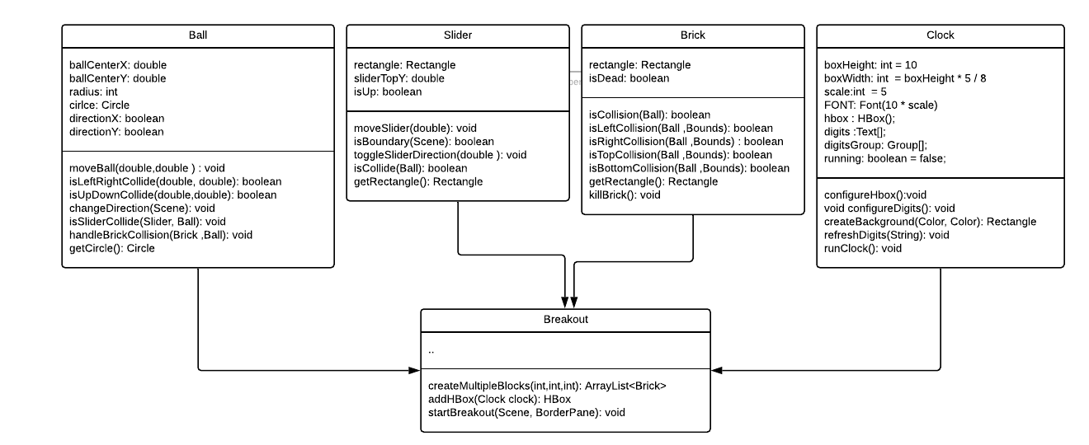
Design- Class Diagram

Slide 4
Ball
moveBall: This method handles the movement of the ball.
getCircle():This method gets the JavaFX Circle object from the ball object.
isLeftRightCollide: This method checks if the ball is touching the left or right boundaries of the screen.
isUpDownCollide: This method checks if the ball is touching the top or bottom boundaries of the screen.
changeDirection: This method changes direction of the ball when it hits the boundaries.
isSliderCollide: This method checks if the ball is colliding with the slider.
handleBrickCollision: This method handles collision of the ball with the brick.

Slide 5
Slider
moveSlider: This method handles the movement of the slider.
isBoundary: This method checks if the slider is at the panel boundary.
toggleSliderDirection: This method toggles the direction of the slider.
isCollide: This method checks if the slider is colliding with the ball.
getRectangle: This method gets the JavaFX Rectangle object from the Slider object.

Slide 6
Brick
isCollision: This method checks if the brick is colliding with the ball.
isLeftCollision: This method checks if the ball is colliding on the left side of the brick.
isRightCollision: This method checks if the ball is colliding on the right side of the brick.
isTopCollision: This method checks if the ball is colliding on top of the brick.
isBottomCollision: This method checks if the ball is colliding at the bottom of the brick.
getRectangle: This method gets the JavaFX Rectangle object from the Brick object.
killBrick: This method sets the isDead flag in the brick, once the brick is exploded by the ball.

Slide 7
Clock
configureHbox: This method creates boxes to show the digits of the timer.
configureDigits: This method creates and configures the digits and the background of the boxes.
createBackground: This method creates the layout.
refreshDigits: This method refreshes the timer after 60 seconds.
runClock: This method calculates the time and updates the count for the time.

Slide 8
Breakout
createMultipleBlocks: This method creates multiple blocks in the breakout game
addHBox: This method adds a horiziontal panel for the clock.
startBreakout: This method starts the breakout game, creating all objects, adding into the panel, handling keypress events.

Slide 9
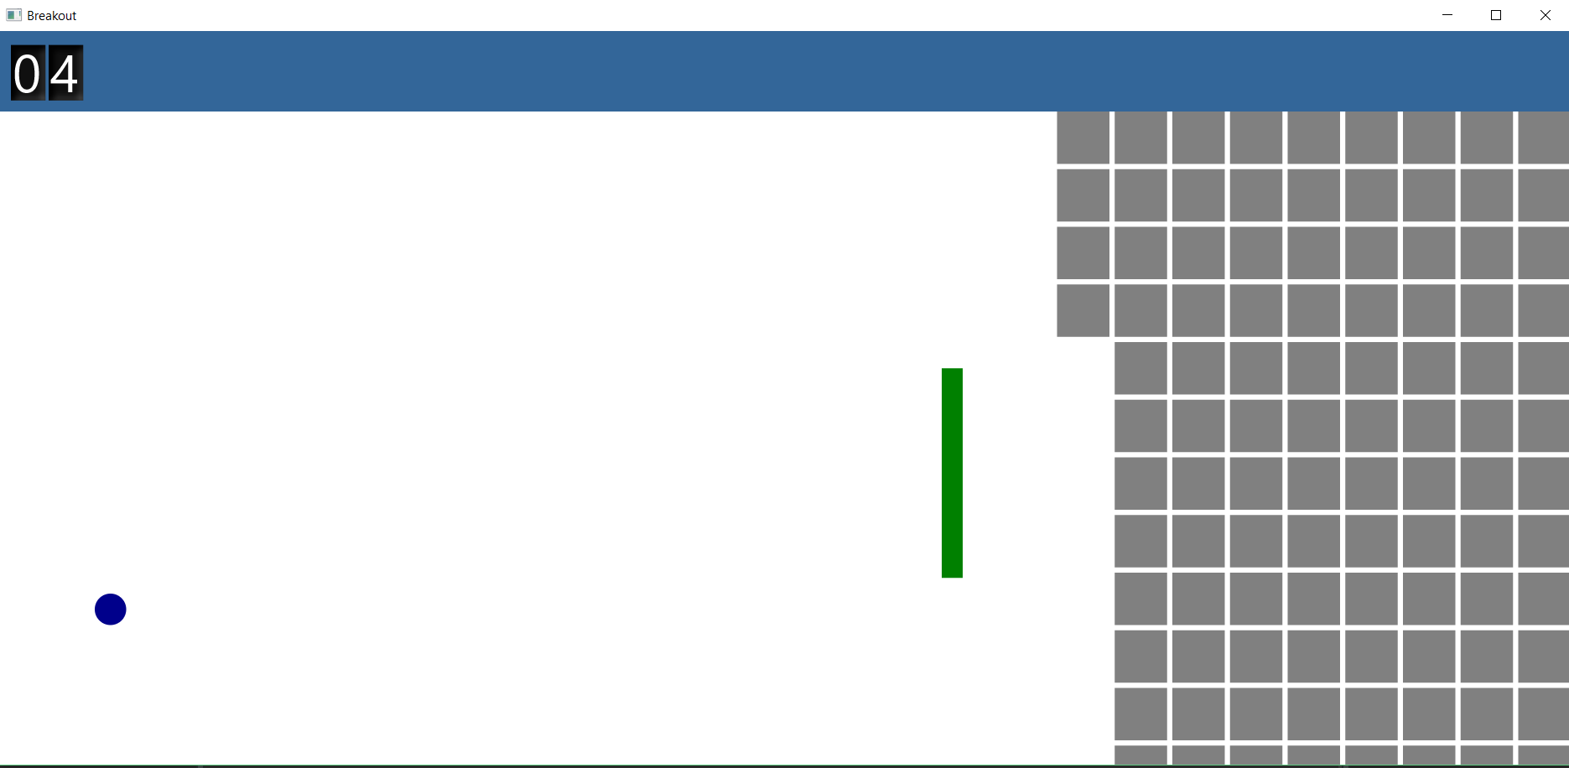
Game Screenshot:1

Slide 10
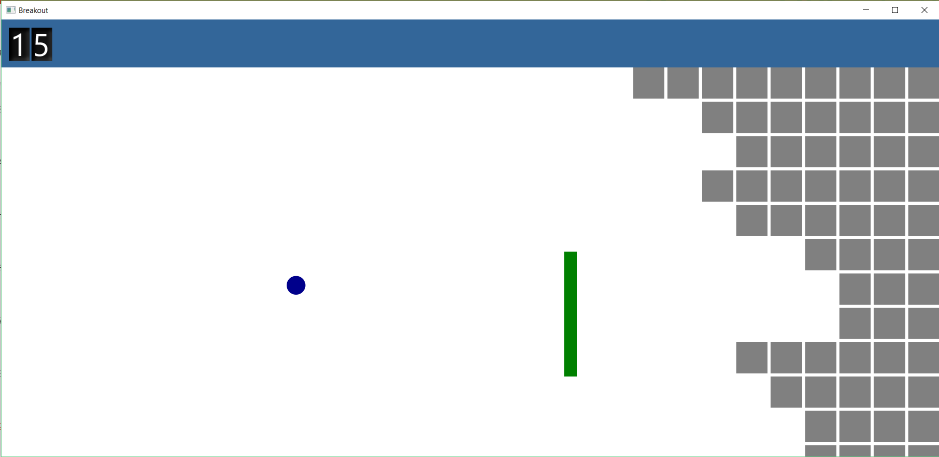
Game Screenshot:2

