Slide 1
Kubernetes Session By : Viresh Rawool

Slide 2
Agenda
Containers:
Kubernetes:
Kubernetes cluster:
Pods:
Replica Sets:
Deployments:
Reference:

Slide 3
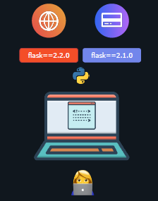
Introduction to Container
New Development Task.
You are developing an application on your laptop. It has certain dependencies such as the flask framework for serving a website. You are also working on another part of the application – say a payment service that also uses the flask framework but relies on a different version of the library.
It's going to be hard to manage different versions of dependencies on the same OS.
Moreover, let's say you bring in a friend to help you develop the application. That person need to setup the exact same environment in the exact same way with
the exact same versions of dependencies and libraries. And if the other person uses a completely different operating system, then a whole different nightmare awaits.

Slide 4
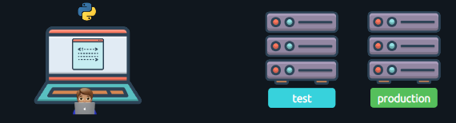
Problems while Deploying on TEST and PROD.
What happens when the application is deployed to a test environment or to a production environment. You'll have to make sure you setup the environment in the exact same way with the exact same dependencies. If you change something in the development environment, you'll have to make sure it gets updated in the test and prod environments. Otherwise, things end up working in one environment and not working in the other.
And no matter how much you try it's impossible to make sure these environments remain the same. At some point in time, someone is going to make a change to a dependency or add another dependency and forget to update them in the other environments and things are going to break.

Slide 5
Solution : Images
What if you could build an image that consists of the app itself and all of its dependencies at both the app level and system level and package it…
And use the same exact image in all of the different environments That way anytime you make a change in the future, the image is rebuilt and the same image is used in all of the different environments. No more differences
between different environments. So that's what containers can help us with.

Slide 6
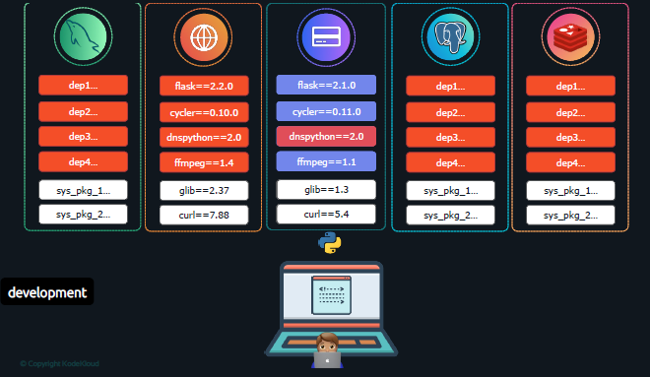
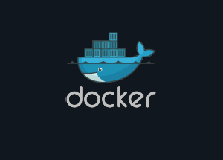
Containers
Containers help us create isolated environments on our systems to run applications completely isolated from each other. You could run a different web application with different versions of dependencies or a PostgreSQL server or a MySQL server or Redis server. All on the same system with their own libraries and dependencies.
And one of the most popular tools to containerize applications and run containers is Docker.

Slide 7
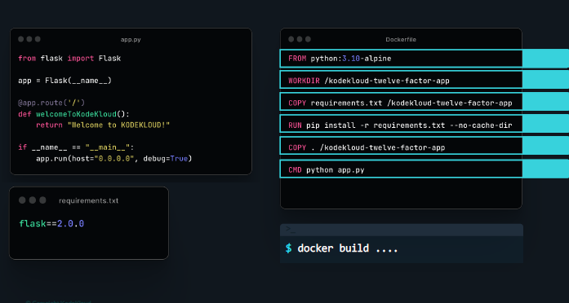
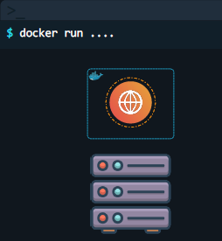
Refresh on docker:
Now by running the docker build command
we build an image.
And by running the docker run command we run one instance of our application.

Slide 8
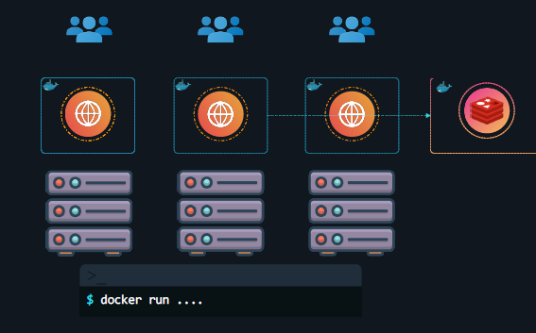
What is Container Orchestration?
So we have learned about containers, let us now see what’s Container Orchestration
By running the docker run command we were able to run one instance of our application. This instance can serve one set of users.
But what if users increase?
If one instance crashes for some reason?
If there isn't enough resources on the server?
If there too many resources on the server?
Container orchestration is the automated process of managing and scheduling the deployment, scaling, and networking of containers. It involves using tools and platforms to efficiently handle the lifecycle of containers in a distributed environment, ensuring high availability, reliability, and performance.

Slide 9
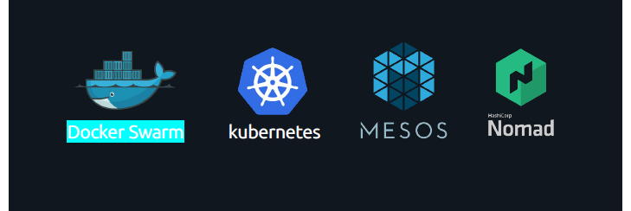
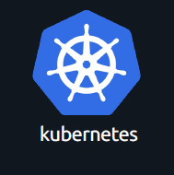
There are different container orchestration solutions out there today – such as
Docker Swarm, Kubernetes, Mesos and now Nomad to name a few.
Kubernetes is the most popular of it all and we will focus on Kubernetes.

Slide 10
Kubernetes
With docker we were able to run a single instance of an application using the docker run command. Which is great! Running an application has never been so easy before.
With Kubernetes, using the Kubernetes CLI known as kubectl, you can run a 1000 instance of the same application with a single command. Kubernetes can scale it up to 2000 with another command.

Slide 11
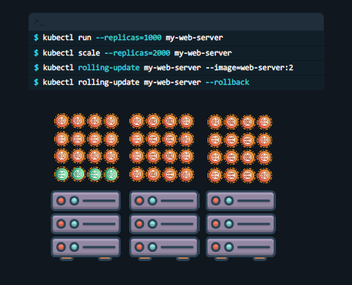
Kubernetes can even be configured to do these automatically so that instances and the infrastructure itself can scale up and down based on user load.
Kubernetes can upgrade these 2000 instances of application in a rolling fashion one at a time, with a single command. If something goes wrong, it can help you roll back these images with a single command.
Kubernetes can help you test new features of your application by only upgrading a percentage of these instances through A/B testing methods.

Slide 12
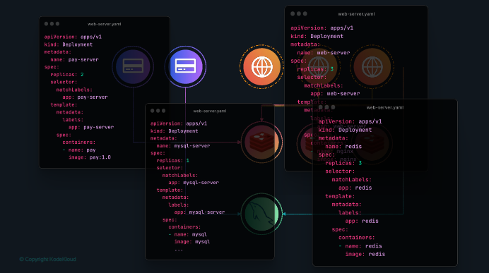
With Kubernetes you are able to define the expected state of your application.
For example, you can define that your application consists of 4 different services.
The webserver must have 3 instances running, the payment service to have 2. There should be a Redis service with 3 instances running and a database service to which these services connect to.
And you can define these in code and Kubernetes will ensure that the state you have defined for your application is always maintained.

Slide 13
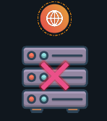
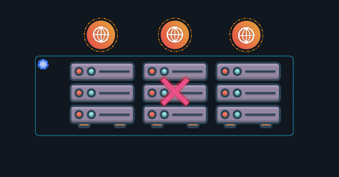
Nodes
Let's us understand the basic components in a Kubernetes Cluster first. Let us start with Nodes. A node is a machine – physical or virtual – on which Kubernetes is installed. A node is a worker machine, and this is where containers will be launched by Kubernetes.
But what if the node on which our application is running fails? Well, obviously our application goes down. So, you need to have more than one nodes.
A cluster is a set of nodes grouped together. This way even if one node fails you
have your application still accessible from the other nodes.
Moreover, having multiple nodes helps in sharing load as well.

Slide 14
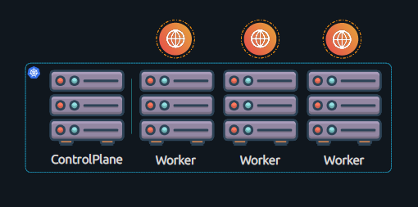
Control Plane
Now we have a cluster, but who is responsible for managing the cluster?
Were is the information about the members of the cluster stored?
How are the nodes monitored? When a node fails how do you move the workload of the failed node to another worker node?
That’s were the ControlPlane comes in. Also previously known as the master node.
The controlplane is another node with Kubernetes components installed in it. The controlplane watches over the nodes in the cluster and is responsible for the actual orchestraCon of containers on the worker nodes.

Slide 15
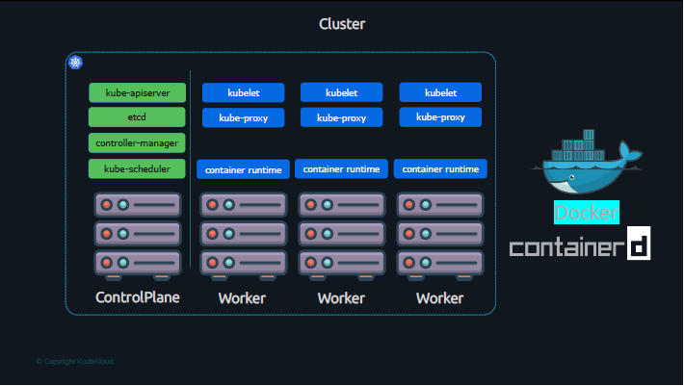
When you install Kubernetes on a System, you are actually installing the following components.
An API Server. An ETCD service. Controllers and Schedulers.

Slide 16
The API server acts as the front-end for Kubernetes. The users, management devices, Command line interfaces all talk to the API server to interact with the Kubernetes cluster.
Next is the ETCD key store. ETCD is a distributed reliable key-value store used by Kubernetes to store all data used to manage the cluster. This is where information about the nodes in the cluster, the application running on the cluster are stored.
The controllers are the brain behind orchestration. They are responsible for noticing and responding when nodes, containers or endpoints goes down. The controllers makes decisions to bring up new containers in such cases.
The scheduler is responsible for distributing work or containers across multiple nodes. It looks for newly created containers and assigns them to Nodes.
On the worker nodes you have the kubelet which is the agent that runs on each node in the cluster. The agent is responsible for making sure that the containers are running on the nodes as expected.
You also have the kube-proxy that is responsible for maintaining rules on the nodes.
On the worker nodes you also have container runtime that is responsible for running containers. And one example of that is Docker. Now, it used to be Docker for a long time in the past – because Kubernetes was originally built to orchestrate Docker containers specifically. However, over a period of time it evolved to support other container runtimes. So it no longer supports Docker directly but supports the runtime component of Docker which today is managed by ContainerD.

Slide 17
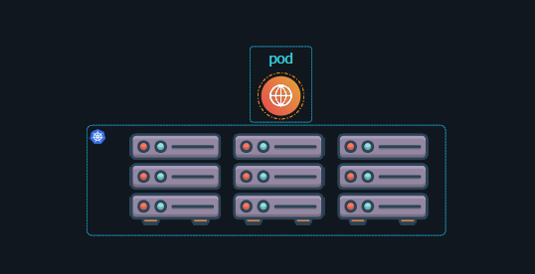
Pods
with Kubernetes our aim is to deploy our application in the form of containers on a set of machines that are configured as worker nodes in a cluster.
However, Kubernetes does not deploy containers directly on the worker nodes. The containers are encapsulated into a Kubernetes object known as PODs.
A POD is a single instance of an application. A POD is the smallest object, that you can create in Kubernetes.
So what happens when you want to scale up?
Do you add more containers to the same pod? No! You create more pods. Typically, an application instance running as a container has a 1-to-1 relationship with a Pod. To create more instances of application you create more Pods. However, the 1-to-1 relationship is not a strict rule.

Slide 18
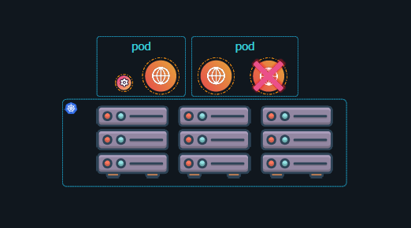
It is a common practice to have a helper container or a sidecar container along with the main application.
Such as an agent that collects logs or monitors the application and reports to a third party. And that's absolutely fine.

Slide 19
Demo

Slide 20
Reference
https://www.youtube.com/watch?v=XuSQU5Grv1g&t=1495s
https://learn.kodekloud.com/user/courses/youtube-labs-kubernetes-crash-course?context=youtube-ads-kubcrashcourse&utm_source=youtube&utm_medium=labs&utm_campaign=kubernetes_crash_course

