Slide 1

Heroku: Training -by SpringPeople

Slide 2
Table of Content
Heroku Introduction : Architecture and design
Heroku Understanding Application Deployment
Heroku Build Application
Heroku run Application
Heroku BuildPack
Heroku Slug
Heroku Dyno
Heroku Release
Heroku Ci-CD
Heroku Redis
Heroku Security
Heroku Salesforce Integration
Heroku Kafka Integration
Heroku Troubleshooting and support
Heroku monitoring and metric
Heroku Logging
Heroku Set up
Heroku app.json
Heroku App Performance
Heroku Java

Slide 3
Table of Content
Heroku Introduction : Architecture and design
Heroku Understanding Application Deployment
Heroku Build Application
Heroku run Application
Heroku BuildPack
Heroku Slug
Heroku Dyno
Heroku Release
Heroku Ci-CD
Heroku Redis
Heroku Security
Heroku Salesforce Integration
Heroku Kafka Integration
Heroku Troubleshooting and support
Heroku monitoring and metric
Heroku Logging
Heroku Set up
Heroku app.json
Heroku App Performance
Heroku Java

Slide 4
Heroku: Introduction
Heroku Architecture and Design

Slide 5
Heroku: Introduction
Heroku is a cloud platform as a service (PaaS) supporting several programming languages like Java, Node.js, Scala, Clojure, Python, PHP, and Go.
For this reason, Heroku is said to be a polyglot platform as it has features for a developer to build, run and scale applications in a similar manner across most languages.

Slide 6
Heroku: Introduction
Heroku lets you deploy, run and manage applications written in Ruby, Node.js, Java, Python, Clojure, Scala, Go and PHP - utilizing the dependencies and Procfile.
What is the application ?
An application is a collection of source code written in one of these languages, perhaps a framework, and some dependency description that instructs a build system as to which additional dependencies are needed in order to build and run the application.

Slide 7
Heroku: Introduction
There is no need to make many changes to an application in order to run it on Heroku.
One requirement is informing the platform as to which parts of your application are runnable (Executables/Jars etc).
Heroku can figure out the executables for the established standards like :
Ruby on Rails, it’s typically rails server
in Django it’s python <app>/manage.py runserver
in Node.js it’s the main field in package.json
For others there is a provision of ProcFile- where explicitly declare what can be executed

Slide 8
Heroku: Introduction
In Procfile : Each line declares a process type - a named command that can be executed against your built application.
Example:
So, here we have described a web process.
web: java -jar lib/foobar.jar $PORT
queue: java -jar lib/queue-processor.jar

Slide 9
Heroku: Introduction
Now from the Heroku perspective the deployable Application is the combination of :
Source Code
Dependency description
Procfile

Slide 10

Heroku: Deploy

Slide 11
Heroku: Deploying applications
Git is a powerful, distributed version control system that many developers use to manage and version source code.
The Heroku platform uses Git as the primary means for deploying applications (there are other ways to transport your source code to Heroku, including via an API).
When you create an application on Heroku, it associates a new Git remote, typically named heroku, with the local Git repository for your application.
As a result, deploying code is just the familiar git push, but to the heroku remote instead:
$ git push heroku master

Slide 12
Heroku: Deploying applications
Deploying applications involves sending the application to Heroku using either Git, GitHub, or via an API.
There are many other ways of deploying applications too. For example, you can enable:
GitHub integration so that each new pull request is associated with its own new application, which enables all sorts of continuous integration scenarios.
Or you can use the Heroku API to build and release apps.

Slide 13
Heroku: Build application
When the Heroku platform receives the application source, it initiates a build of the source application.
The build mechanism is typically language specific, but follows the same pattern, typically retrieving the specified dependencies, and creating any necessary assets (whether as simple as processing style sheets or as complex as compiling code).

Slide 14
Heroku: Build application
For example, A Java application may fetch binary library dependencies using Maven, compile the source code together with those libraries, and produce a JAR file to execute.
The source code for your application, together with the fetched dependencies and output of the build phase such as generated assets or compiled code, as well as the language and framework, are assembled into a slug.

Slide 15
Heroku: BuildPack
Buildpacks are responsible for transforming deployed code into a slug, which can then be executed on a dyno.
Buildpacks are composed of a set of scripts, and depending on the programming language, the scripts will retrieve dependencies, output generated assets or compiled code, and more.
This output is assembled into a slug by the slug compiler.

Slide 16
Heroku: BuildPack
Officially supported buildpacks
Heroku maintains a collection of officially supported buildpacks that are available by default to all Heroku apps during slug compilation.
These buildpacks are open-source and available on GitHub
By default, these buildpacks will be searched in certain order until a match is detected and used to compile your app. If the build succeeds, the detected buildpack will be permanently set for future pushes to your application.
Setting a buildpacks on an application
You can change the buildpack used by an application by setting the buildpack value. When the application is next pushed, the new buildpack will be used
$ heroku create herokutraining --buildpack heroku/java

Slide 17
Heroku: BuildPack
Removing Buildpacks:
$ heroku buildpacks:remove heroku/java
BuildPack Info can be set into App.json
{
"buildpacks": [
{
"url": "heroku/ruby"
}
]
}

Slide 18
Heroku: BuildPack
Detection failure
If the configured buildpack cannot handle your application (as determined by its detection script), you will receive an error.
For example, Heroku’s Ruby buildpack expects a Gemfile to be present in the root folder of an application to correctly identify its type, but if the buildpack of an application is set to heroku/ruby and no Gemfile is present, the application will fail to build.
Default BuildPack
You can return to using your app’s default Heroku buildpack with the following command:
$ heroku buildpacks:clear

Slide 19
Heroku: BuildPack

Slide 20
Heroku: BuildPack

Slide 21

Heroku: What is Slug
A slug is a bundle of your
source,
fetched dependencies,
the language runtime, and
compiled/generated output of the build system - ready for execution.
These slugs are a fundamental aspect of what happens during application execution.
They contain your compiled, assembled application - ready to run - together with the instructions (the Procfile) of what you may want to execute.

Slide 22
Heroku: Slug
Slugs are compressed and pre-packaged copies of your application optimized for distribution to the dyno manager.
When we git push to Heroku, code is received by the slug compiler which transforms your repository into a slug.
Scaling an application then downloads and expands the slug to a dyno for execution.

Slide 23
Heroku: Slug
Compilation
The slug compiler is invoked by a git pre-receive hook, which follows these steps:
Create a fresh checkout of HEAD from the master branch.
Remove anything specified in a top-level .slugignore file.
Download, build, and install local dependencies as specified in your build file( pom.xml, etc.) with the dependency management tool (Maven).
Package the final slug archive.

Slide 24
Heroku: Slug
Time limit
Slug compilation is currently limited to 15 minutes.
If deploys start timing out during compilation there are various strategies to speed things up, but these will vary based upon the build tool used.
Very large applications which time out should usually have independent components spun off into separate libraries.
Keep in mind that disk IO performance on dynos can vary widely, so in some cases compilations that finish in 10 minutes on a local SSD could take over 15 during deployment.

Slide 25
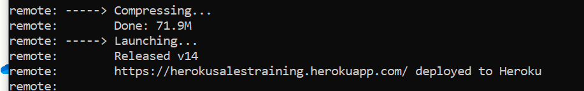
Heroku: Slug
Slug size
Slug size is displayed at the end of a successful compile after the Compressing message. The maximum allowed slug size (after compression) is 500 MB

Slide 26
Heroku: Slug
Slug size varies greatly depending on what language and framework you are using, how many dependencies you have added and other factors specific to your app.
Smaller slugs can be transferred to the dyno manager more quickly, allowing for more immediate scaling. Try to keep your slugs as small and nimble as possible.
Here are some techniques for reducing slug size:
Move large assets like PDFs or audio files to asset storage.
Remove unneeded dependencies and exclude unnecessary files via .slugignore.
Purge the build cache using the heroku-repo CLI plugin.

Slide 27
Heroku: Running Application
Heroku executes applications by running a command you specified in the Procfile, on a dyno that’s been preloaded with your prepared slug (in fact, with your release, which extends your slug and a few items not yet defined: config vars and add-ons).
Think of a running dyno as a lightweight, secure, virtualized Unix container that contains your application slug in its file system.
Dynos are isolated, virtualized Unix containers, that provide the environment required to run an application.

Slide 28
Heroku: Running Application

Slide 29
Heroku: Dyno
All Heroku applications run in a collection of lightweight Linux containers called dynos.
Every dyno belongs to one of the three following configurations:
Web: Web dynos are dynos of the “web” process type that is defined in your Procfile.
Only web dynos receive HTTP traffic from the routers.
Worker: Worker dynos can be of any process type declared in your Procfile, other than “web”.
Worker dynos are typically used for background jobs, queueing systems, and timed jobs.
You can have multiple kinds of worker dynos in your application. Example, one for urgent jobs and another for long-running jobs.
One-off: One-off dynos are temporary dynos that can run detached, or with their input/output attached to your local terminal.
They can be used to handle administrative tasks, such as database migrations and console sessions.
They can also be used to run occasional background work, as with Heroku Scheduler.

Slide 30
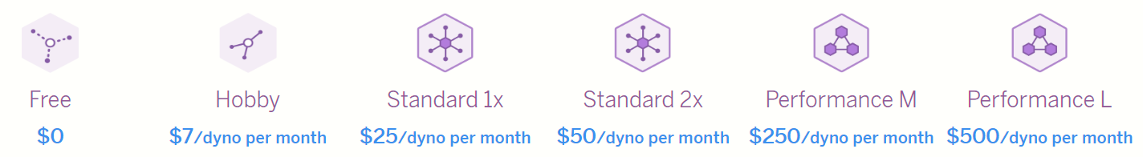
Heroku: Dyno
The Dyno Manager
The dyno manager keeps dynos running automatically;
So operating your app is generally hands-off and maintenance free.
The Common Runtime has a single Dyno Manager per region that is responsible for managing all dynos across all tenants running in a region.
The Private Spaces Runtime has a dedicated Dyno Manager per space.
This Dyno Manager only manages dynos that run within the space

Slide 31
Heroku: Dyno
Scalability
To scale horizontally (scale out), add more dynos.
For example, adding more web dynos allows you to handle more concurrent HTTP requests, and therefore higher volumes of traffic.
To scale vertically (scale up), use bigger dynos. The maximum amount of RAM available to your application depends on the dyno type you use.
Both horizontal and vertical scale are features of the professional dynos, and are not available to free or hobby dynos.

Slide 32
Heroku: Dyno
Redundancy and shared nothing Architecture:
Applications with multiple running dynos will be more redundant against failure.
If some dynos are lost, the application can continue to process requests while the missing dynos are replaced.
Typically, lost dynos restart promptly, but in the case of a catastrophic failure, it can take more time.
Multiple dynos are also more likely to run on different physical infrastructure (for example, separate AWS Availability Zones), further increasing redundancy.

Slide 33
Heroku: Dyno
Isolation and security
All dynos are strongly isolated from one another for security purposes. Heroku uses OS containerization with additional custom hardening to ensure that access is properly restricted for all customers.
Free, Hobby and Standard dynos, even though completely isolated, may share an underlying compute instance.
Heroku employs several techniques to ensure fair use of the underlying resources.
However, these dyno types may experience some degree of performance variability depending on the total load on the underlying instance.
Performance and Private dynos do not share the underlying compute instance with other dynos. Therefore, these dyno types are not only more powerful but also experience low variability in performance.
In addition to having dedicated compute resources, Private dynos are furthermore isolated in their own virtual network determined by the Private Space(Enterprise) they are deployed in.

Slide 34

Heroku: Dyno
Task | Example
List the dynos for an app | heroku ps
Start worker dynos. (Look at your Procfile to see the worker process types that are defined for your app) | heroku ps:scale worker=2
Stop a particular dyno type * | heroku ps:stop worker
Stop a particular dyno * | heroku ps:stop worker.2
Restart all dynos | heroku ps:restart
Restart a particular dyno type | heroku ps:restart web
Restart a particular dyno | heroku ps:restart web.1
Scale horizontally (Add more dynos) | heroku ps:scale web=2
Scale horizontally by incrementing the current number of dynos | heroku ps:scale web+5
Scale different dyno types horizontally at the same time | heroku ps:scale web=1 worker=5
Scale vertically (Use bigger dynos) | heroku ps:resize worker=standard-2x
Scale horizontally and vertically at the same time. This example scales the number of web dynos to 3 and resizes them to performance-l | heroku ps:scale web=3:performance-l
Get help for the heroku ps command | heroku ps --help
Launch a one-off dyno that runs bash in a console | heroku run bash
Launch a one-off dyno that runs the “worker” process type that is present in your application’s Procfile | heroku run worker
View logs | heroku logs or heroku logs --tail

Slide 35
Heroku: Dyno Formation
Your application’s dyno formation is the total number of currently-executing dynos, divided between the various process types you have scaled.
The term dyno formation refers to the layout of your app’s dynos at a given time.
The default formation for simple apps will be a single web dyno, whereas more demanding applications may consist of web, worker, clock, etc… process types.

Slide 36
Heroku: Dyno

Slide 37
Heroku: Release
Releases
As part of running the application on a dyno, the Heroku platform loaded the dyno with your most recent slug.
This needs to be refined: in fact it loads it with the slug and any config variables you have assigned to the application.
The combination of slug and configuration is called a release.

Slide 38
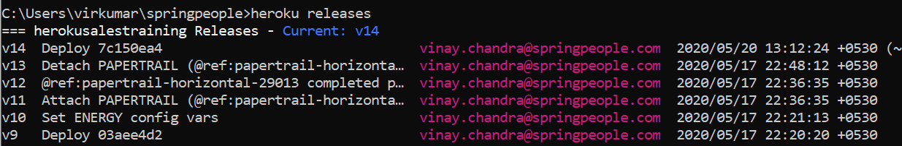
Heroku: Release
Releases are an append-only ledger of slugs and config vars.
All releases are automatically persisted in an append-only ledger, making managing your application, and different releases, easy.
Use the heroku releases command to see the audit trail of release deploys:
$ heroku releases

Slide 39
Heroku: Release
The number next to the deploy message, for example 582fc95, corresponds to the commit hash of the repository you deployed to Heroku.
Every time you deploy a new version of an application, a new slug is created, and release is generated.
As Heroku contains a store of the previous releases of your application, it’s very easy to rollback and deploy a previous release:
$ heroku releases:rollback v102

Slide 40
Heroku: Release
Making a material change to your application, whether it’s changing the source or configuration, results in a new release being created.
A release then, is the mechanism behind how Heroku lets you modify the configuration of your application (the config vars) independently of the application source (stored in the slug) - the release binds them together.
Whenever you change a set of config vars associated with your application, a new release will be generated.

Slide 41
Heroku: HTTP Routing
Depending on your dyno formation, some of your dynos will be running the command associated with the web process type, and some will be running other commands associated with other process types.
The dynos that run process types named web are different in one way from all other dynos - they will receive HTTP traffic. Heroku’s HTTP routers distribute incoming requests for your application across your running web dynos.
So scaling an app’s capacity to handle web traffic involves scaling the number of web dynos:
$ heroku ps:scale web+5
A random selection algorithm is used for HTTP request load balancing across web dynos - and this routing handles both HTTP and HTTPS traffic. It also supports multiple simultaneous connections, as well as timeout handling.

Slide 42
Heroku: Architecture and Terminologies
The concepts explained so far can be divided into two buckets: those that involve the development and deployment of an application, and those that involve the runtime operation of the Heroku platform and the application after it’s deployed.
The following two sections recapitulate the main components of the platform, separating them into these two buckets:
Deploy Time
Run Time

Slide 43
Heroku: Architecture and Terminologies(Deploy)
Components | Functionality
Applications | consist of your source code, a description of any dependencies, and a Procfile.
Procfiles | list process types - named commands that you may want executed.
Deploy | involves sending the application to Heroku using either Git
Buildpacks | lie behind the slug compilation process. Buildpacks take your application, its dependencies, and the language runtime, and produce slugs.
Slug | is a bundle of your source, fetched dependencies, the language runtime, and compiled/generated output of the build system - ready for execution.
Config Vars | contain customizable configuration data that can be changed independently of your source code. The configuration is exposed to a running application via environment variables.
Add-ons | are third party, specialized, value-added cloud services that can be easily attached to an application, extending its functionality.
Release | is a combination of a slug (your application), config vars and add-ons. Heroku maintains an append-only ledger of releases.

Slide 44
Heroku: Architecture and Terminologies(RunTime)
Components | Functionality
Dynos | are isolated, virtualized Unix containers, that provide the environment required to run an application.
Dyno Formation | is the total number of currently-executing dynos, divided between the various process types you have scaled.
Dyno Manager | is responsible for managing dynos across all applications running on Heroku.
One-off Dynos | are temporary dynos that run with their input/output attached to your local terminal. They’re loaded with your latest release.
Scaling | an application involves varying the number of dynos of each process type.
LogPlex | automatically collates log entries from all the running dynos of your app, as well as other components such as the routers, providing a single source of activity.

Slide 45
Heroku: Continuous Integration and Delivery (CI-CD)

Slide 46
Heroku: CI-CD
Heroku provides a variety of continuous delivery tools to help you deploy effortlessly and safely:
Pipelines make it easy to maintain separate staging and production environments for your app.
Review apps let you try out a GitHub pull request’s changes in an isolated and disposable environment.
Heroku CI automatically runs your app’s test suite on new GitHub pull requests, or when code is merged into your repo’s master branch.
Release phase lets you run tasks (such as database migrations) before a new release is deployed.

Slide 47
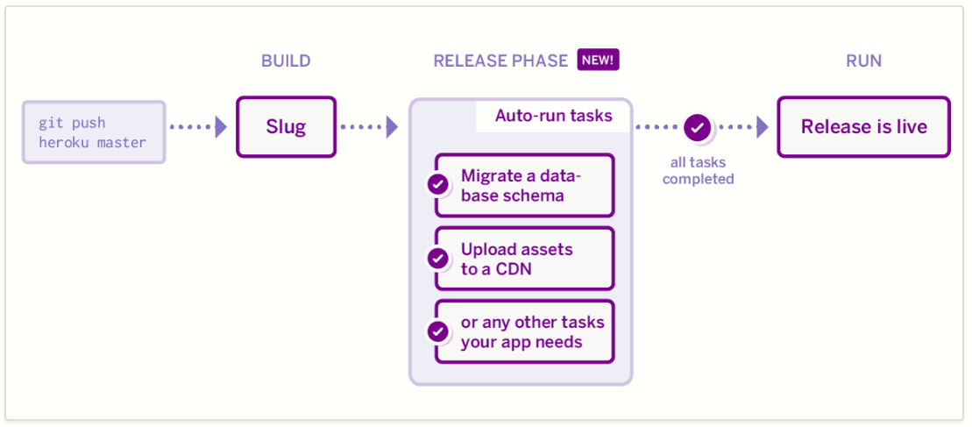
Heroku: CI-CD

Slide 48

Heroku: CI-CD
Create a staging app
Add the github
Enable autodeployment
Create a prod app
Add it to the pipeline
Enable review apps
Raise a pull request
Merge the pull request to the master.
Promote from staging to prod

Slide 49
Heroku: CI-CD: Release Phase
Release phase enables you to run certain tasks before a new release of your app is deployed. Release phase can be useful for tasks such as:
Sending CSS, JS, and other assets from your app’s slug to a CDN or S3 bucket.
Priming or invalidating cache stores.
Running database schema migrations.
If a release phase task fails, the new release is not deployed, leaving your current release unaffected.

Slide 50

Heroku: CI-CD
Specifying release phase tasks
To specify the tasks to run during release phase, define a release process type in your app’s Procfile.
In this Procfile example, release executes a Django database migration:
release: python manage.py migrate
web: gunicorn myproject.wsgi --log-file –
-

