Slide 1

Spark Interview Questions RDD vs DatFrame vs DataSet

Slide 2
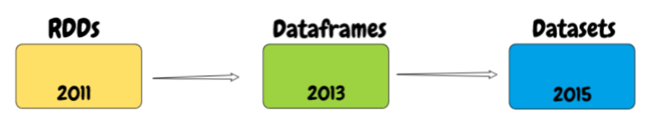
What is RDD

Slide 3
What is RDD
RDD was the primary user-facing API in Spark since its inception.
Resilient Distributed Datasets (RDD) is a fundamental data structure of Spark.
Each dataset in RDD is divided into logical partitions.
RDD is an immutable distributed collection of elements of input data.
RDD is partitioned across nodes in the cluster that can be processed in parallel.
Spark makes use of the concept of RDD to achieve faster and efficient data processing.

Slide 4
What is DataFrame
DataFrame is an immutable distributed collection of data like RDDs.
But Unlike an RDD, data is organized into named columns, like a table in a relational database.
DataFrame is designed to make large data sets processing even easier.
DataFrame allows developers to impose a structure onto a distributed collection of data, allowing higher-level abstraction.
DataFrame provides a domain specific language API to manipulate your distributed data.
DataFrames in Spark have their execution automatically optimized by a query optimizer called Catalyst.
Catalyst optimizer understands the structure of the data with DataFrames, it can make intelligent decisions to speed up computation.

Slide 5
What is DataSet
Dataset is an extension of Dataframe which provides type-safe, object oriented interface.
DataSet are introduced in Spark 1.6
DataFrame and Dataset APIs are built on top of the Spark SQL engine.
DataSet provides Static-typing and runtime type-safety.
Datasets provide efficient memory consumption.
 | SQL | DataFrame | DataSet
Syntax Errors | Run Time | Compile Time | Compile Time
Analysis Errors | Run Time | Run Time | Compile Time

Slide 6
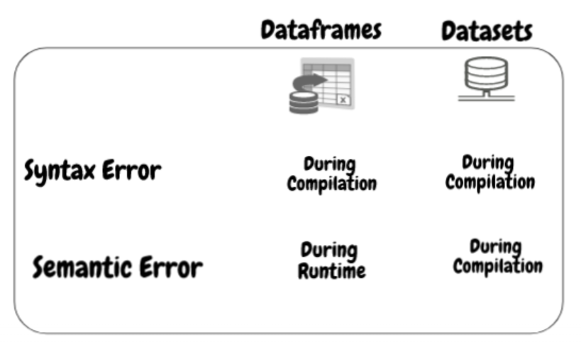
What is DataFrame

Slide 7
RDD vs DataFrame vs DataSet
 | SQL | DataFrame | DataSet
Syntax Errors | Run Time | Compile Time | Compile Time
Analysis Errors | Run Time | Run Time | Compile Time
RDD – RDD provides a familiar object-oriented programming style with compile-time type safety.
DataFrame – If you are trying to access the column which does not exist in the table in such case Dataframe APIs does not support compile-time error. It detects analysis error only at runtime.
DataSet – It provides compile-time safety for both Syntax and Analysis.

Slide 8
When to use DataFrames or Datasets
For Object oriented , high-level abstractions, and domain specific APIs, use DataFrame or Dataset.
For processing high-level expressions like filters, maps, aggregation, averages, sum, SQL queries, columnar access and use of lambda functions on semi-structured data, use DataFrame or Dataset.
For type-safety at compile time, for taking advantage of Catalyst optimization ,use Dataset.

Slide 9
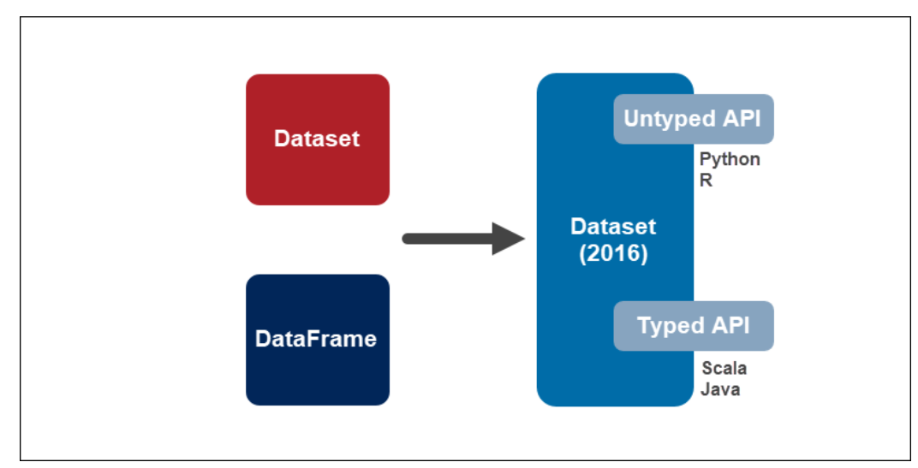
When to use DataFrames or Datasets

Slide 10
Thanks and do subscribe to my channel

