Slide 1

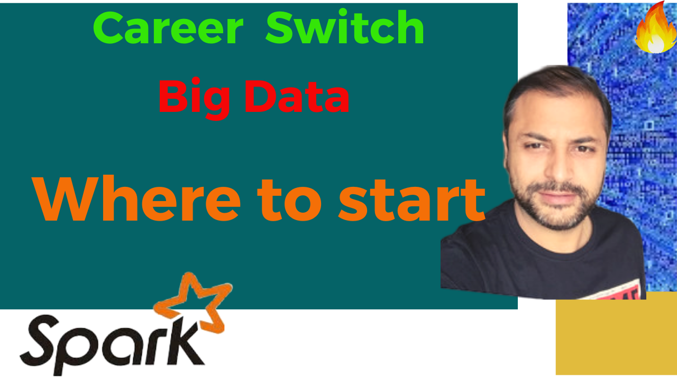

Partition Pruning
&
Predicate Pushdown
Interview Question

Slide 2
Where to start
1. Goal
2. Practical Knowledge gaining
3. Start Backwards
4. Current Background Self Analysis
5. Study/practice material
6. Identifying Use Cases

Slide 3

Goal Setting
A very Crisp and clear goal , that we are targeting is get into a good corporate for a :
Big Data Engineering Role
Tech Stack:
Hadoop , Spark , Hive and related….

Slide 4

Practical Knowledge
Practical Knowledge
not
Academic

Slide 5

Start Backwards
Typical Life Cycle :
Study Basics/Concepts
Practical Implementation
Actual Domain/Function Area
Interview Oriented Prep
Update Resume
Interview

Slide 6

Current Background Self Analysis
From OOPs programming
Database Admin/Programmer
Datawarehouse
SQL Developer

Slide 7

Study/Prep Resources
In Action books
Official documentation
Only Focus on three things:
Hadoop
Spark
Hive

Slide 8

Use Cases
Functional Understanding of data
Domain oriented

Slide 9


