Slide 1

Partition Pruning
&
Predicate Pushdown
Interview Question

Slide 2
Cost Based Optimization
Cost-Based Optimization --
is an optimization technique in Spark SQL that uses table statistics to determine the most efficient query execution plan of a structured query .
This is especially useful for queries with multiple joins.
For this to work it is critical to collect table and column statistics.

Slide 3
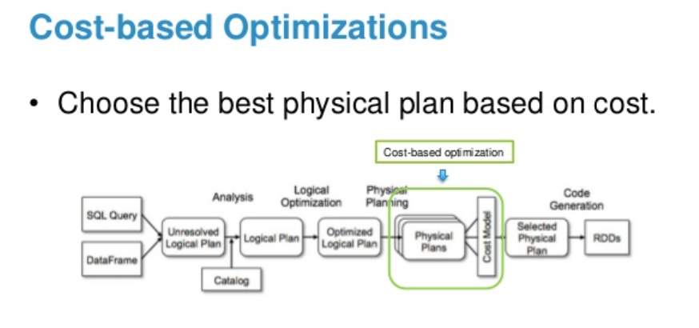
Cost Based Optimization

Slide 4
Cost Based Optimization
Cost-Based Optimization uses logical optimization rules
(e.g. CostBasedJoinReorder)
to optimize the logical plan of a structured query based on statistics.
Statistics are calculated using the commands like:
ANALYZE TABLE COMPUTE STATISTICS

Slide 5
Cost Based Optimization
Table Statistics
The table statistics can be computed for tables, partitions and columns and are as follows:
Total size (in bytes) of a table or table partitions
Row count of a table or table partitions
Column statistics,
min | max
num_nulls | distinct_count
avg_col_len | max_col_len
histogram

Slide 6
Cost Based Optimization
Let look at the example Demo

Slide 7
Cost Based Optimization
Thanks and do subscribe to my channel

