Slide 1

APACHE SPARK DEEP DIVE ---Number of Partitions in Spark---

Slide 2

Partition Numbers
How Many Partitions Does An RDD Have?
For tuning and troubleshooting, it's often necessary to know how many partitions an RDD/DF represents. There are a few ways to find this information:
View Task Execution Against Partitions Using the UI

Slide 3
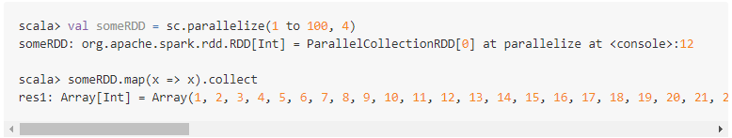
Partition Numbers
When a stage executes, you can see the number of partitions for a given stage in the Spark UI. For example, the following simple job creates an RDD of 100 elements across 4 partitions

Slide 4
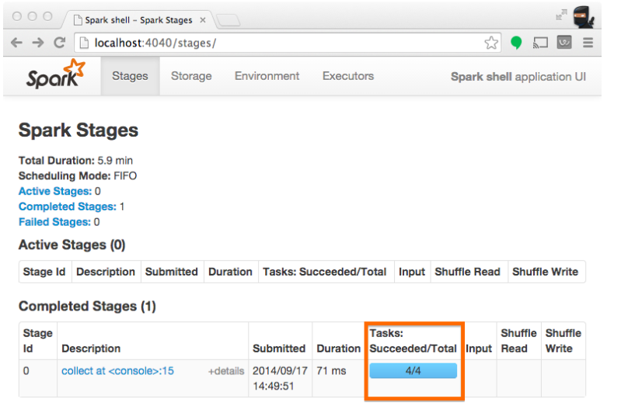
Partition Numbers

Slide 5
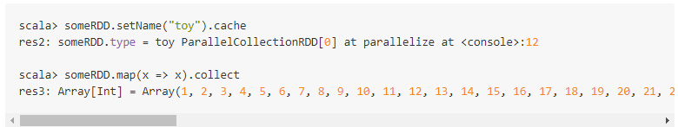
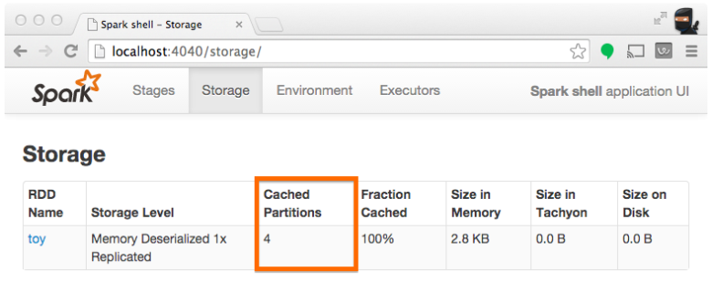
View Partition Caching Using the Spark UI

Slide 6
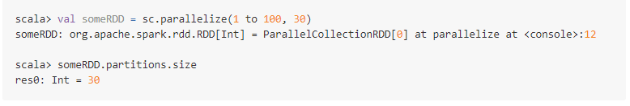
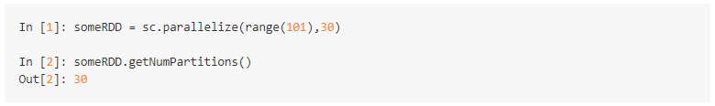
Inspect RDD Partitions Programmatically

Slide 7
Thanks and do subscribe to my channel

