Slide 1


Partition Pruning
&
Predicate Pushdown
Interview Question

Slide 2
What is Apache Arrow
Apache Arrow is a cross-language development platform for in-memory data.
Apache Arrow specifies a standardized language-independent columnar memory format.
Apache Arrow can handle flat and hierarchical data.
Apache Arrow can organize for efficient analytic operations.

Slide 3
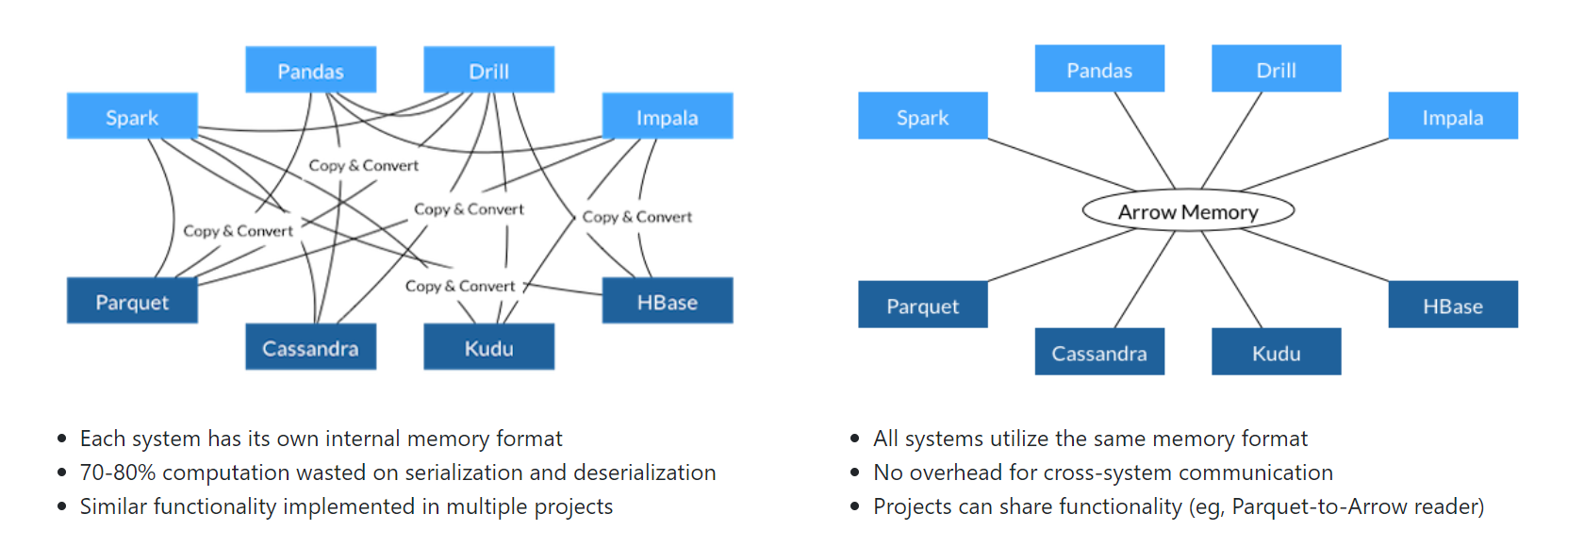
Common Memory Data Layer: Apache Arrow

Slide 4
Advantages: Apache Arrow
Columnar memory layout allows applications to avoid unnecessary IO.
Accelerate analytical processing performance on modern CPUs and GPUs.

Slide 5
Apache Arrow with Spark
Apache Arrow is an in-memory columnar data format that is used in Spark to efficiently transfer data between JVM and Python processes.
This currently is most beneficial to Python users that work with Pandas/NumPy data and levearaging Spark as the Bigdata processing engine.
Its usage is not automatic and might require some minor changes to configuration or code to take full advantage and ensure compatibility.
spark.conf.set("spark.sql.execution.arrow.enabled", "true")

Slide 6
Enabling for Conversion to/from Pandas
Arrow is available as an optimization when converting:
Spark DataFrame to a Pandas DataFrame using the call toPandas()
and
when creating a Spark DataFrame from a Pandas DataFrame with createDataFrame(pandas_df).
To use Arrow when executing these calls, users need to first set the Spark configuration spark.sql.execution.arrow.enabled to true. This is disabled by default.

Slide 7
Apache Arrow
DEMO

