Slide 1
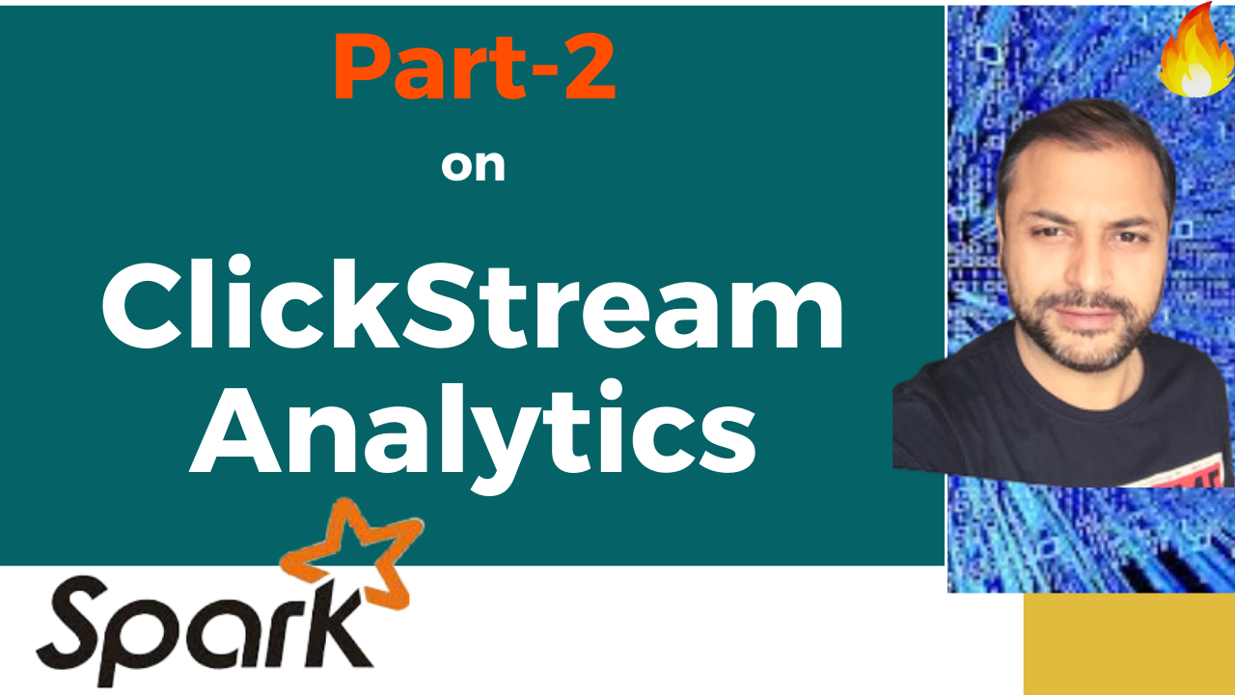

Partition Pruning
&
Predicate Pushdown
Interview Question

Slide 2
Spark Interview Question: Clickstream Analytics
Thanks and do subscribe to my channel

