Slide 1


Partition Pruning
&
Predicate Pushdown
Interview Question

Slide 2
Spark Interview Question : Fold vs Reduce
Problem
You want to walk through all of the elements in a Scala sequence, and want to apply some 2-argument function on all the neighboring elements of the scala sequence or collection.
Solution
Use the reduceLeft, foldLeft, reduceRight, and foldRight methods to walk through the elements in a sequence, applying your function to neighboring elements to yield a new result.
which is then compared to the next element in the sequence to yield a new result.
And this is done for all the elements in the collection.

Slide 3
Spark Interview Question : Fold vs Reduce
Folding/Reducing allows to run a given 2-argument function against consecutive elements of that collection.
And the result of that function is passed as the first argument in the next invocation.
Second argument is always the current item in the collection.
For example, use reduceLeft/foldLeft to walk through a sequence from left to right reduceLeft starts by comparing the first two elements in the collection with your algorithm, and returns a result.
That result is compared with the third element, and that comparison yields a new result.
That result is compared to the fourth element to yield a new result, and so on.

Slide 4
Spark Interview Question : Fold vs Reduce
The fold method works just like reduce, but it lets you set a seed value to be used for the first element.

Slide 5
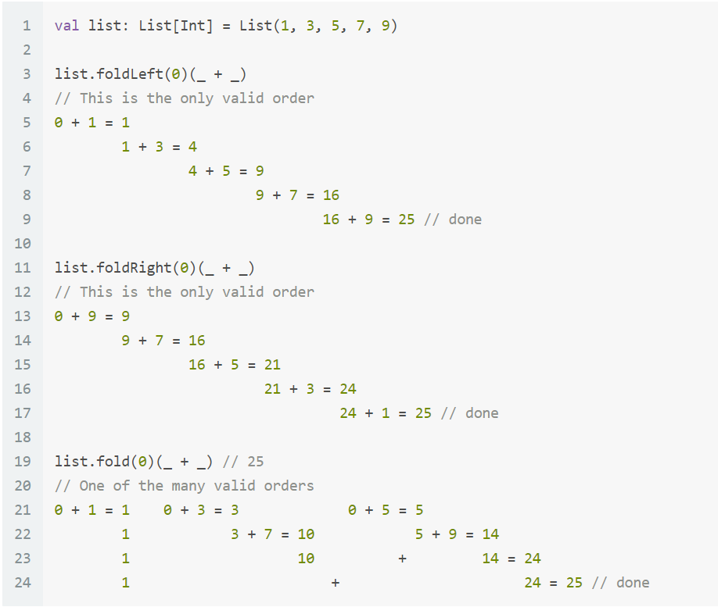
Spark Interview Question : Fold vs Reduce

Slide 6
Spark Interview Question : Fold vs Reduce

Slide 7
Spark Interview Question : Fold vs Reduce

Slide 8
Spark Interview Question : Fold vs Reduce

Slide 9
Spark Interview Question : Fold vs Reduce

Slide 10
Map vs MapPartition vs MapPartitionWithIndex
Thanks and do subscribe to my channel

