Slide 1
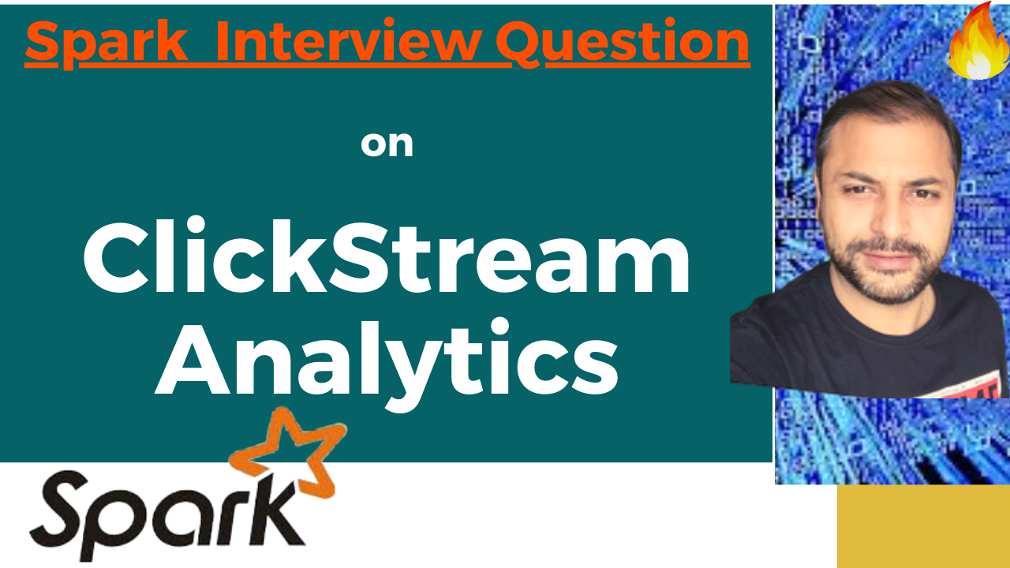

Partition Pruning
&
Predicate Pushdown
Interview Question

Slide 2
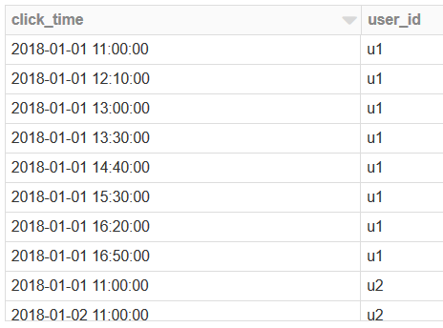
Spark Interview Question : Click Stream Analytics
Given a time series data which is a clickstream of user activity , ask is to find the relevant user session for each click event.
Session Definition:
#1 Session expires after inactivity of 30 mins, because of inactivity no clickstream record will be generated.
#2 Session remains active for a total duration of 2 hours.

Slide 3
Spark Interview Question : Click Stream Analytics
From a functional perspective :
A lot of product(Websites/apps) are based on the idea of a user “session.”
What do users do when they first log in?
In what order do users take specific actions?
How long do people use your site in an average sitting?
Does activity vary by device?
Based on the user behavior determined through the click stream analytics, lot of actions can be taken to promote or improve upon that product

Slide 4
Spark Interview Question : Click Stream Analytics
What's a User Session?
A user session is a period of uninterrupted activity on a website or app.
If a user opens Facebook, clicks around the timeline, looks at a few pictures, and then closes Facebook, that would be one session.

Slide 5

ClickStream Analytics
Thanks and do subscribe to my channel

