Slide 1

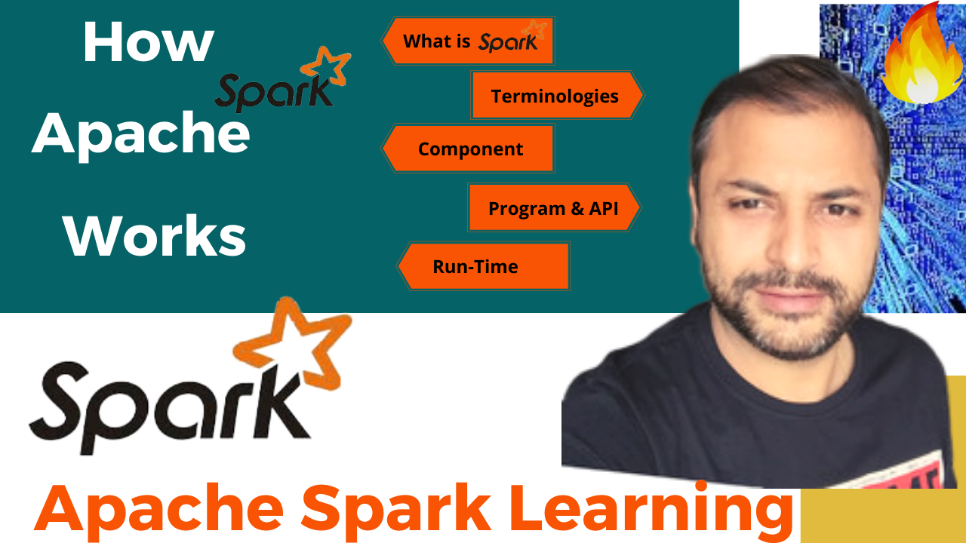

Partition Pruning
&
Predicate Pushdown
Interview Question

Slide 2
How Apache Spark Works
Here we will discuss :
Run-time architecture of Apache Spark.
Key Spark Terminologies like Apache SparkContext, SparkSession, Apache Spark application, task, job and stages in Spark.
Components of Spark run time architecture like the Spark driver, cluster manager & Spark executors.
How Apache spark works using these components.

Slide 3
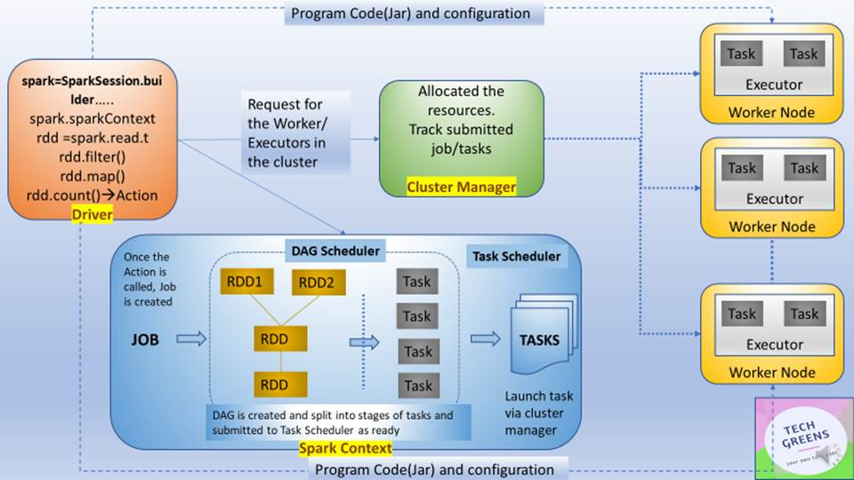
Terminologies of Spark
SparkContext
SparkSession
Spark Application
Job
Stage
Tasks

Slide 4
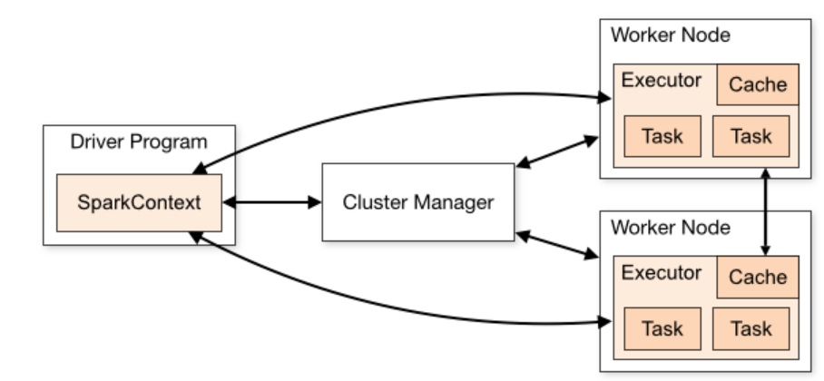
Components of Spark Run-time Architecture
Apache Spark Driver
Apache Spark Cluster Manager
Apache Spark Executors
Apache Spark Application on a cluster

Slide 5
How Apache Spark Works
Using spark-submit, the user submits an application.
In spark-submit, we invoke the main() method that the user specifies. It also launches the driver program.
The driver program asks for the resources to the cluster manager that we need to launch executors.
The cluster manager launches executors on behalf of the driver program.

Slide 6

How Spark Works
Thanks and do subscribe to my channel

