Slide 1
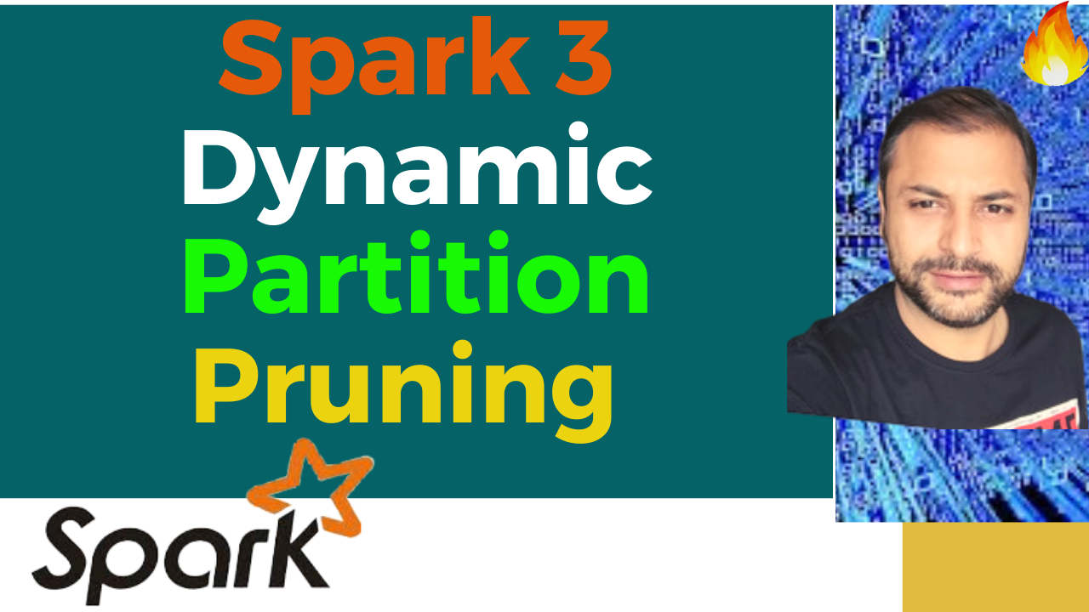

Partition Pruning
&
Predicate Pushdown
Interview Question

Slide 2
Spark 3 : Dynamic Partition Pruning

Slide 3
Spark 3 : Dynamic Partition Pruning

Slide 4
Spark 3 : Dynamic Partition Pruning

Slide 5
Spark 3 : Dynamic Partition Pruning

Slide 6
Spark 3 : Dynamic Partition Pruning

Slide 7
Apache Arrow
DEMO

