Slide 1


Partition Pruning
&
Predicate Pushdown
Interview Question

Slide 2
Spark SQL Bucketing
Bucketing is an optimization technique that uses buckets (and bucketing columns) to determine :
Data partitioning
and
Avoid data shuffle.
The motivation is to optimize performance of a join query by avoiding shuffles of tables participating in the join.
Bucketing results in fewer exchanges (and so stages).

Slide 3
Spark SQL Bucketing
Bucketing further categories / distributes the data within partitions.
Thus the total number of data files stored on disk would be:
number of partitions * number of buckets

Slide 4
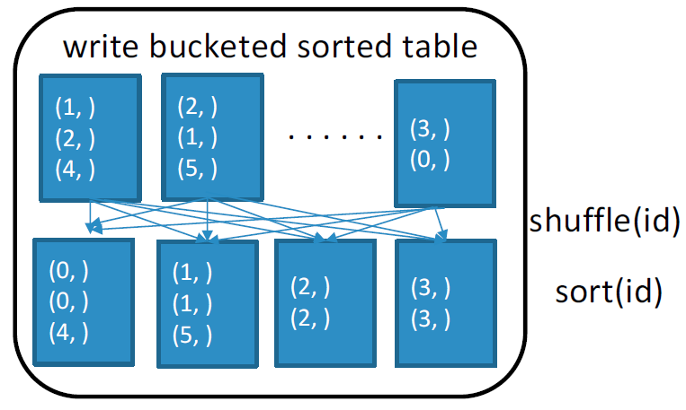
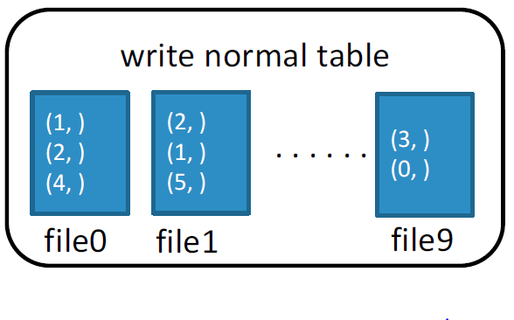
Pre-shuffle and (optionally) pre-sort when writing table. Avoid shuffle and (optionally) sort when reading table.

Slide 5
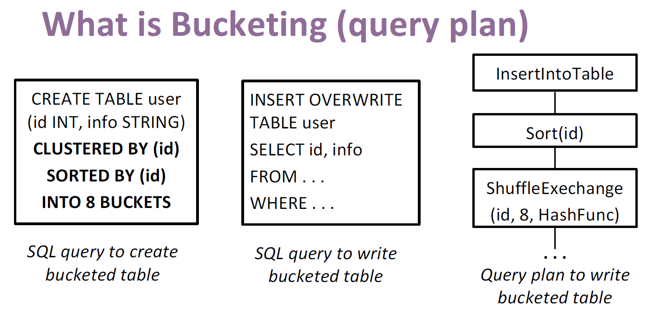

Slide 6
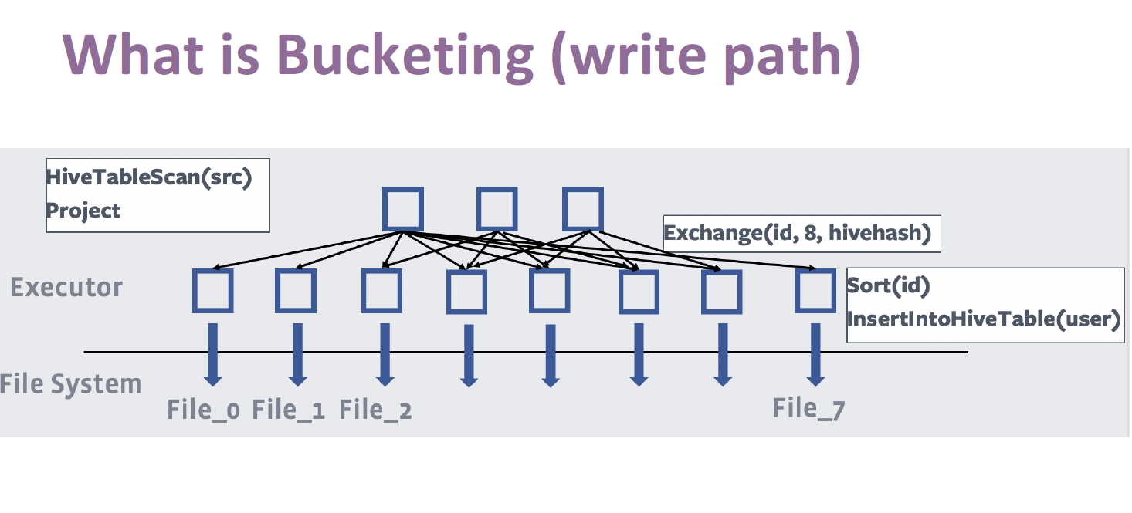

Slide 7
Apache Arrow
DEMO

