Slide 1



Apache Hive Interview Questions
Skew Join in Hive

Slide 2
Skew Join in Hive
When there is a table with skew data in the joining column, we use skew join feature.
What is skewed table: it is a table that is having values that are present in large numbers in the table compared to other data.
However, while the rest of the data is stored in a separate file Skew data is stored in a separate file.

Slide 3
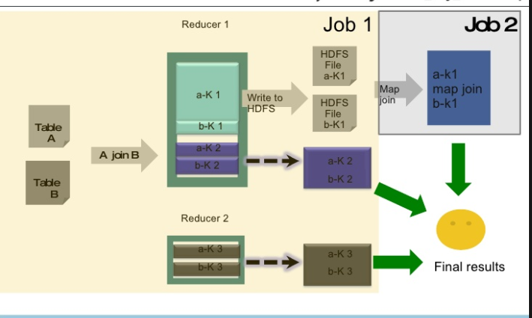
Skew Join in Hive

Slide 4
Skew Join in Hive
However, let’s assume if table A join B, and A has skew data “1” in joining column. At First store, the rows with key 1 in an in-memory hash table and read B.Further to read A run a set of mappers. Afterward, do the following:
Make sure use the hashed version of B to compute the result since it has key 1.
Then, send all other keys to a reducer which does the join. Basically, from a mapper, this reducer will get rows of B also.
Hence, as a result, we end up reading only B twice. Basically, that implies that the skewed keys in A are only read and processed by the Mapper. Also, they are not sent to the reducer. Moreover, remaining keys in A go through only a single Map/Reduce. However, the assumption is that B has few rows with keys which are skewed in A. Hence, in this way these rows can be loaded into the memory.

Slide 5
Skew Join in Hive
Disadvantages:
So, the major disadvantage of it is One table is read twice here.
Moreover, it is necessary that users should be aware of the skew key.

Slide 6
Thanks and do subscribe to my channel

