Slide 1


Hadoop Tutorial
Introduction : What is Hadoop

Slide 2
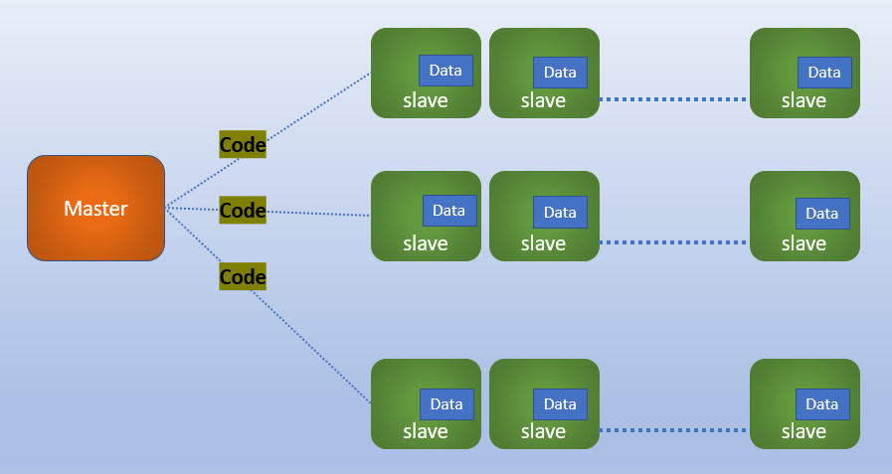
What is Hadoop
Apache Hadoop is a collection of open-source software utilities to solve problems involving massive amounts of data and computation.
Apache Hadoop facilitate Big Data processing and storage using a network of many computers in the form of cluster consisting of several nodes.
Apache Hadoop Works on the concept of distributed computing, where processing and storage of data will be done across multiple machines/nodes in the cluster.
Apache Hadoop based on the design assumption that hardware failures are common occurrences and should be automatically handled by the framework.
Apache Hadoop provides parallel processing of data as it works on multiple machines simultaneously

Slide 3
Hadoop: Component Architecture
Hadoop1
Hadoop2
MapReduce
(Cluster Resource management and Data processing)
MapReduce (Data Processing)
Others
(Data Processing)
YARN
(Cluster Resource management and Data processing)
HDFS
HDFS

Slide 4
What is Hadoop
The base Apache Hadoop framework is composed of the following modules:
Hadoop Common – contains libraries and utilities needed by other Hadoop modules.
Hadoop Distributed File System (HDFS) – a distributed file-system that stores data on commodity machines, providing very high aggregate bandwidth across the cluster.
Hadoop YARN – introduced in 2012 is a platform responsible for managing computing resources in clusters and using them for scheduling users' applications.
Hadoop MapReduce – an implementation of the MapReduce programming model for large-scale data processing.

Slide 5
Hadoop: Master-Slave
slave
slave
slave
Data
Data
Data
Code
Master
slave
slave
slave
Code
Data
Data
Data
Code
slave
slave
slave
Data
Data
Data

Slide 6
Hadoop Computation
Hadoop splits files into large blocks and distributes them across nodes in a cluster.
It then transfers packaged code into nodes to process the data in parallel.
This approach takes advantage of data locality, where nodes manipulate the data they have access to.
This allows the dataset to be processed faster and more efficiently than it would be in a more conventional monolithic vertically scalable architecture.

Slide 7
Thanks and do subscribe to my channel

