Slide 1



Hadoop Tutorial
Hadoop 2.x VS Hadoop 3.x

Slide 2
Hadoop2 Vs Hadoop3
 | Hadoop 2 | Hadoop 3
JAVA Version | Minimum supported version of java is java 7 | Minimum supported version of java is java 8
Fault Tolerance | Fault tolerance can be handled by replication (which is wastage of space). | Fault tolerance can be handled by Erasure coding
Data Balancing | For data, balancing uses HDFS balancer | For data, balancing uses Intra-data node balancer
Storage Scheme | Uses 3X replication scheme | Support for erasure encoding in HDFS.
Storage Overhead | HDFS has 200% overhead in storage space | Storage overhead is only 50%
Shaded Client Jars | The hadoop-client available in Hadoop 2.x releases pulls Hadoop’s transitive dependencies onto a Hadoop application’s classpath. This can create a problem if the versions of these transitive dependencies conflict with the versions used by the application. | So in Hadoop 3, we have new hadoop-client-api and hadoop-client-runtime artifacts that shade Hadoop’s dependencies into a single jar. hadoop-client-api is compile scope & hadoop-client-runtime is runtime scope.

Slide 3
Hadoop2 Vs Hadoop3
 | Hadoop 2 | Hadoop 3
Scalability | We can scale up to 10,000 Nodes per cluster | Better scalability. we can scale more than 10,000 nodes per cluster.
Storage Overhead Example | If there is 6 block so there will be 18 blocks occupied the space because of the replication scheme | If there is 6 block so there will be 9 blocks occupied the space 6 block and 3 for parity
YARN Timeline Service | Uses an old timeline service which has scalability issues | Improve the timeline service v2 and improves the scalability and reliability of timeline service
Opportunistic containers | NA | A new ExecutionType has been introduced, i.e. Opportunistic containers, which can be dispatched for execution at a NodeManager even if there are no resources available at the moment of scheduling. This will improve cluster utilization.

Slide 4
Hadoop2 Vs Hadoop3
 | Hadoop 2 | Hadoop 3
Multiple Nodes | HDFS NameNode high-availability architecture has a single active NameNode and a single Standby NameNode | By replicating edits to a quorum of three JournalNodes, this allows users to run multiple standby NameNodes.
Now let's look in detail:

Slide 5
Hadoop2 Vs Hadoop3 : Erasure Encoding
HDFS Erasure Coding uses RAID (Redundant Array of Inexpensive Disks). RAID implements EC using stripping which logically stores the data in the form of a block (small unit) and stores the block on the different disk. For each block (cell) there will be parity calculated and stored. This is called encoding and the error can be recovered through the parity.
HDFS Erasure coding extends message with redundant data for fault tolerance. An EC codec operates on uniformly sized data cells. The codec takes a number of data cells as input and produces parity cells as the output. This process is called Encoding. Data cells and parity cell together are called an erasure coding group. Lost data cell can be reconstructed over the remaining cells this process is called decoding.

Slide 6
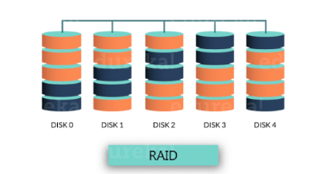
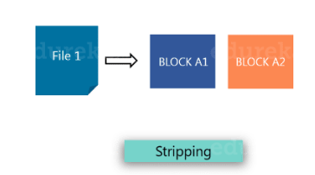
Hadoop2 Vs Hadoop3

Slide 7
Hadoop2 Vs Hadoop3
Generally, in storage systems, Erasure Coding is mostly used in Redundant Array of Inexpensive Disks (RAID).
As you can see in the above image, RAID implements EC through striping, in which the logically sequential data (such as a file) is divided into smaller units (such as bit, byte, or block) and stores consecutive units on different disks.
Then for each stripe of original data cells, a certain number of parity cells are calculated and stored. This process is called encoding. The error on any striping cell can be recovered through decoding calculation based on surviving data cells and parity cells.

Slide 8
Hadoop2 Vs Hadoop3

Slide 9
Hadoop2 Vs Hadoop3

Slide 10
Thanks and do subscribe to my channel

