Slide 1


Hadoop Tutorial
Hadoop HDFS Read and Write Operations

Slide 2
Hadoop Reads/Writes
HDFS follow Write once Read many models.
That means files already stored in HDFS, can not be edited.
But we can append into the existing file data by reopening the file.
In Read-Write operation client first, interact with the NameNode.
NameNode provides privileges and other metadata information so, the client can easily read and write data blocks into/from the respective DataNodes.
Now let’s see in details how client interacts with master and slave nodes in HDFS data read operation.

Slide 3
Hadoop Writes
To Read a file in HDFS, a client needs to interact with master i.e. namenode (master).
Now namenode checks for required privileges, if the client has sufficient privileges then namenode provides the address of the slaves where a file is stored.
Client will interact directly with the respective datanodes to read the data blocks.

Slide 4
Client Node
NameNode
Client JVM
2. Get Block Location
Distributed File System
NameNode
1. Open
HDFS Client
3. Read
FSData Input Stream
6. Close
4. Read
5. Read
DataNode
DataNode
DataNode

Slide 5
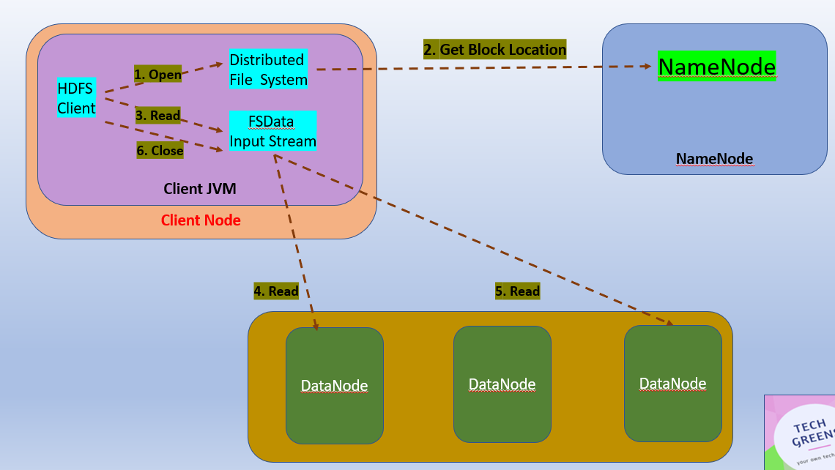
1) Client opens the file to read by calling open() on the FileSystem object, which for HDFS is an instance of DistributedFileSystem.
2) DistributedFileSystem calls the namenode using RPC to determine the locations of the blocks for the first few blocks in the file. For each block, the NN returns the addresses of the DN that have a copy of that block and DNs are sorted according to their proximity to the client.

Slide 6
3) FSDataInputStream is used by client to read data from DN. Client calls read() on the stream. DFSInputStream which has stored the datanode addresses then connects to the closest datanode for the first block in the file.
4) Data is streamed from the datanode back to the client, as a result client can call read() repeatedly on the stream. When the block ends, DFSInputStream will close the connection.

Slide 7
5) If the DFSInputStream encounters an error while communicating with a DN, it will try the next closest one for that block.
No retry on failed nodes.
The DFSInputStream also verifies checksums for the data transferred to it from the datanode, incase of mismatch , it reads from next DN and reports to NN.

Slide 8
In the next part , we will look at Hadoop Write operation in detail.

Slide 9
Thanks and do subscribe to my channel

Slide 10
Hadoop Tutorial : Read and Write Operations
Client Node
NameNode
Client JVM
2. Get Block Location
Distributed File System
NameNode
1. Open
HDFS Client
3. Read
FSData Input Stream
6. Close
4. Read
5. Read
DataNode
DataNode
DataNode

