Slide 1
ORC Internals

Slide 2
What is ORC
ORC: stands for Optimized Row Columnar.
ORC: is columnar oriented storage format.
ORC primarily used in the hive world and gives better performance with hive based data retrievals
because Hive has a vectorized ORC reader.
Single file as the output of each task, which reduces the NameNode's load.
Light-weight indexes stored within the file.

Slide 3
ORC Internals
ORC file contains groups of
Stripes : which is row data.
File Footer: with auxiliary information like:
List of stripes in the file.
Number of rows per stripe.
Each column's data type
Column-level aggregates count, min, max, and sum.
Postscript: holds compression parameters and the size of the compressed footer at the end of the file.
Default Stripe size is 250 MB.
Large Stripe sizes enable large, efficient reads from HDFS.

Slide 4
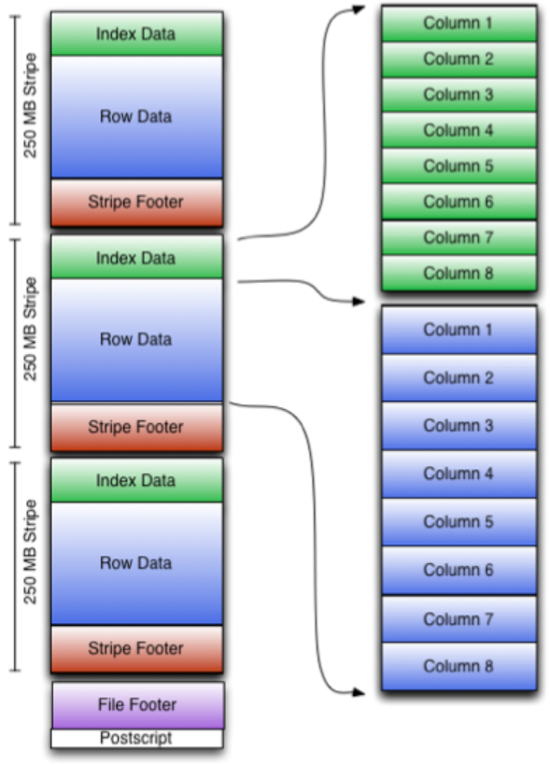
ORC File Structure
Each Stripe Contains three elements :
Index Data
Row Data
Stripe Footer
At the end of the file there are :
File Footer
Postscript

Slide 5
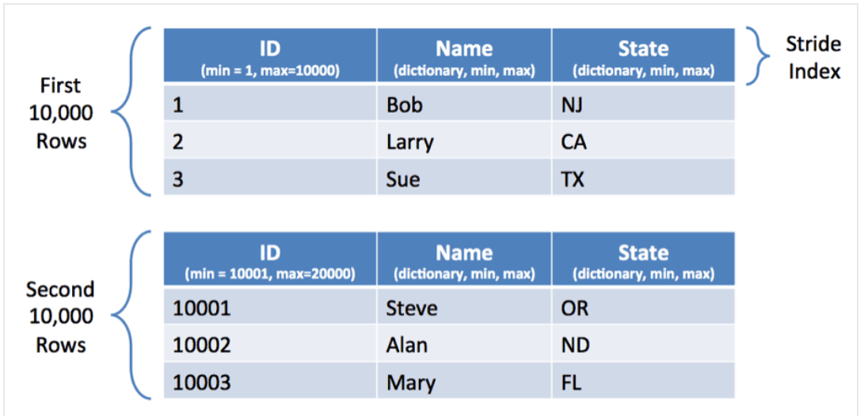
ORC File Details with Data
Index Data Contains:
min and max values for each column.
row positions within each column.
Row Data: is the data for the indexed rows, basically group of rows for the mentioned row positions mentioned in the Index Data
Stripe Footer: contains a directory of stream(Serialized data) location.

Slide 6
Details
Let’s understand all of these elements:
Index Data Contains:
min and max values for each column.
row positions within each column.
Row Data: is the data for the indexed rows, basically group of rows for the mentioned row positions mentioned in the Index Data
Stripe Footer: contains a directory of stream(serialized data) location.

Slide 7
ORC Configurations
Some of the major ORC configuration:
Key | Default | Notes
orc.bloom.filter.columns | "" | comma separated list of column names for which bloom filter should be created
orc.bloom.filter.fpp | 0.05 | false positive probability for bloom filter (must >0.0 and <1.0)
orc.compress | ZLIB | high level compression (one of NONE, ZLIB, SNAPPY)
orc.compress.size | 262,144 | number of bytes in each compression chunk
orc.create.index | true | whether to create row indexes
orc.row.index.stride | 10,000 | number of rows between index entries (must be >= 1000)
orc.stripe.size | 67,108,864 | number of bytes in each stripe

Slide 8
Example
Let’s see an example ,how to use these configurations:
Here the table is created without compression
create table Addresses (
name string,
street string,
city string,
state string,
zip int
) stored as orc tblproperties ("orc.compress"="NONE");

Slide 9
Serialization
Serialization in ORC file format depends on data type
Integer vs String
Integer column serialization:
is done as a stream of integers.
String column serialization :
uses a dictionary to form unique column values.
Dictionary is sorted to speed up predicate filtering
Which improve compression ratios.

Slide 10
Compression
Streams are compressed using a codec, which is specified as a table property for all streams in that table.
To optimize memory use, compression is done incrementally as each block is produced.
Compressed blocks can be jumped/skipped over without first having to be decompressed for scanning. Positions in the stream are represented by a block start location and an offset into the block.
The codec can be Snappy, Zlib, or none.

Slide 11
Thanks and do subscribe to my channel

