Slide 1
Parquet Internals

Slide 2
Parquet Format in Hadoop
Parquet file format is the columnar oriented format in the Hadoop ecosystem.Parquet stores the binary data column wise, which brings following benefits :
Less storage, efficient Compression resulting in Storage optimization, as the same data type is residing adjacent to each other. That helps in compressing the data better hence provide storage optimization.
Increased query performance.
Parquet file format can be used with any Hadoop ecosystem like
Hive
Impala
Pig
Spark

Slide 3
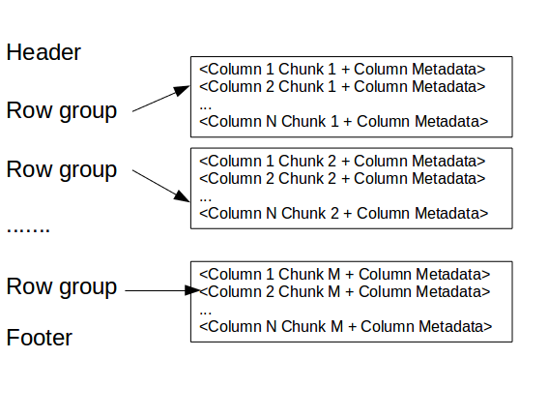
Parquet Internals
Now, Lets take a deep dive and looks at the parquet file internals:
what is the construct of the parquet file ?
A parquet file is consist of following elements
Header
Row groups
Column Chunk
Page
Footer

Slide 4
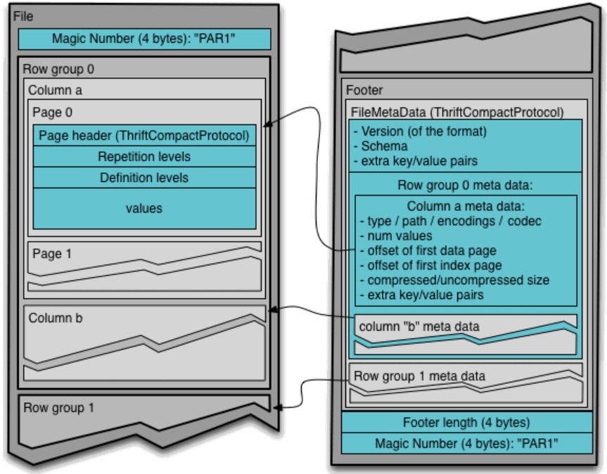
Parquet File Details

Slide 5
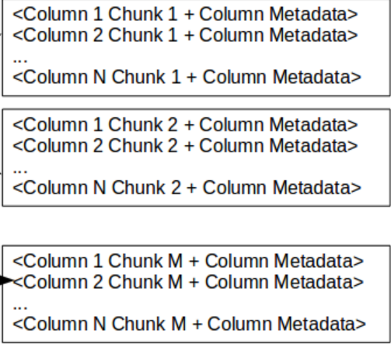
Parquet Internals
Header: just contains a magic number "PAR1" (4-byte) that identifies the file as Parquet format file.
Row group: A logical horizontal partitioning of the data into rows. A row group consists of a column chunk for each column in the dataset.
Row group
Row group
Row group

Slide 6
Parquet Format in Hadoop
Column chunk: A chunk of the data for a particular column. These column chunks live in a particular row group and is guaranteed to be contiguous in the file.
Page: Column chunks are divided up into pages written back to back. The pages share a common header and readers can skip over page they are not interested in.
Footer: holds following
File metadata-
The file metadata contains the locations of all the column metadata start locations.
The file metadata also includes the format version, the schema, any extra key-value pairs.
The file metadata length is 4-byte

Slide 7
Thanks for watching

