Slide 1
Frogs
Prepared by qwaradie@gmail.com

Slide 2
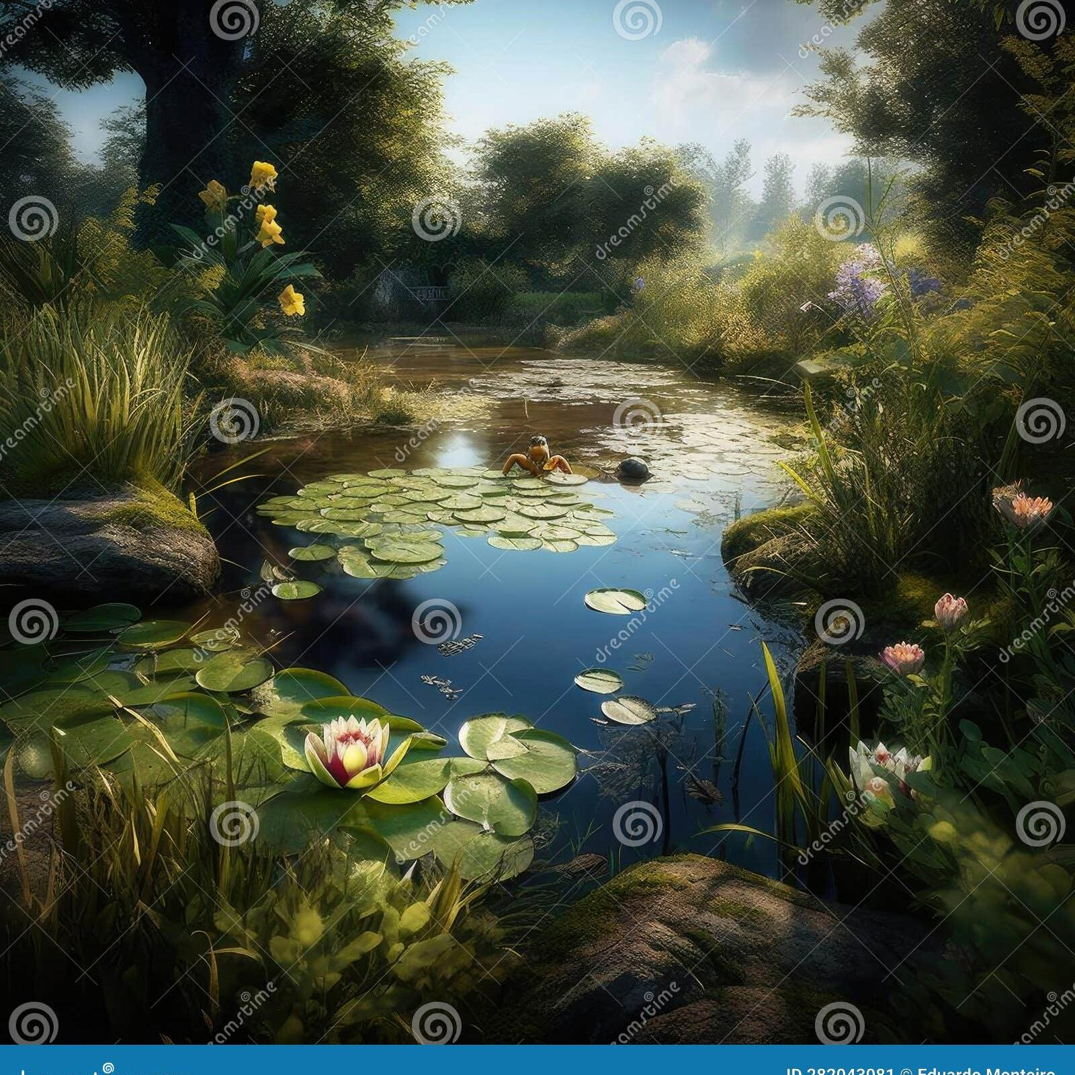

Frogs are essential to ecosystems as indicators of environmental health. They play a vital role in controlling insect populations and are a symbol of transformation and renewal.
Frogs in Nature

Slide 3
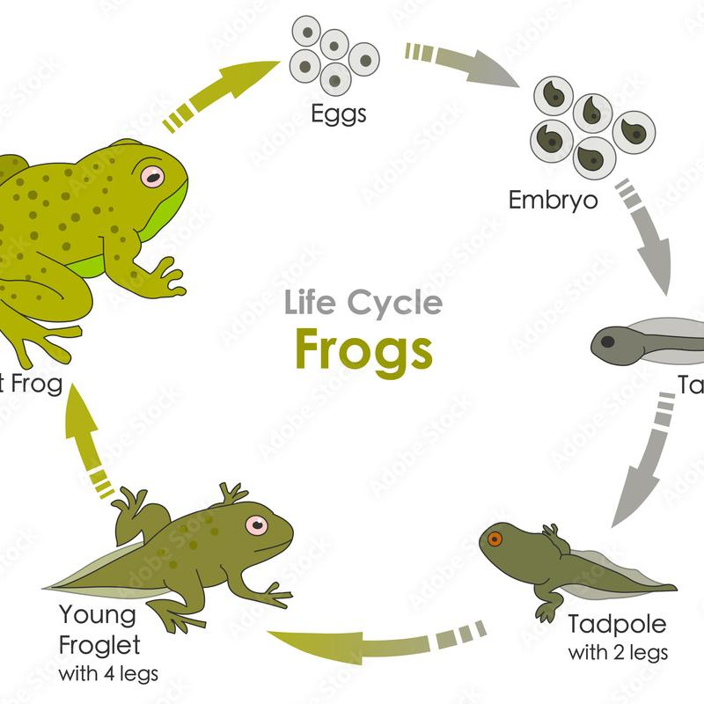
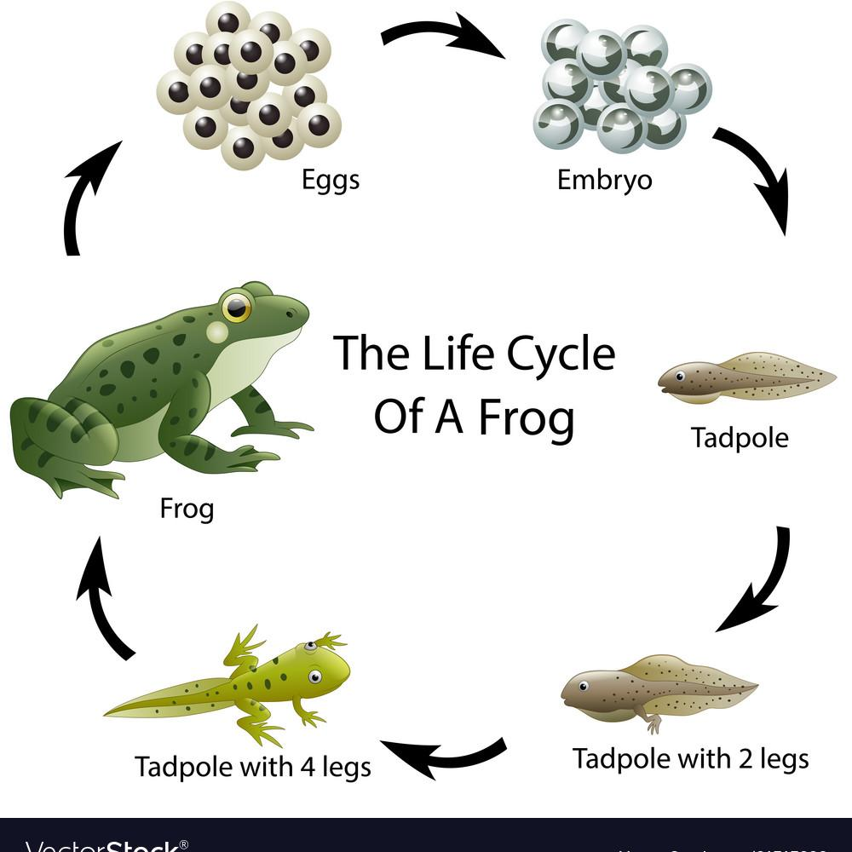
Frog Life Cycle
Frogs undergo metamorphosis, transitioning from aquatic larvae to terrestrial adults. This process symbolizes growth, adaptation, and change in nature.

Slide 4
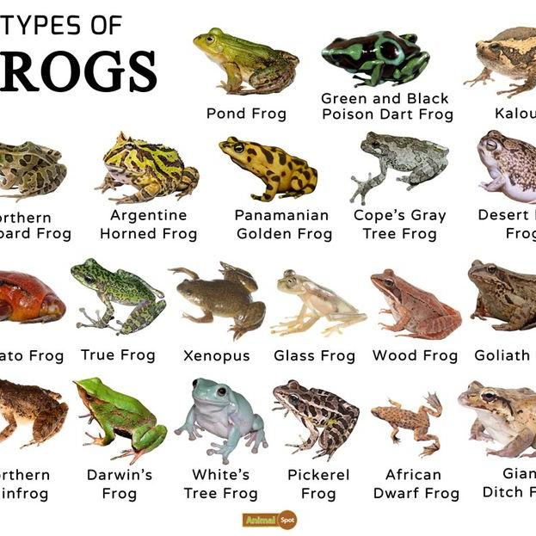
Title
Frogs come in various shapes, sizes, and colors, adapting to diverse habitats worldwide. Their diversity reflects the richness of ecosystems and the importance of biodiversity conservation.

Slide 5
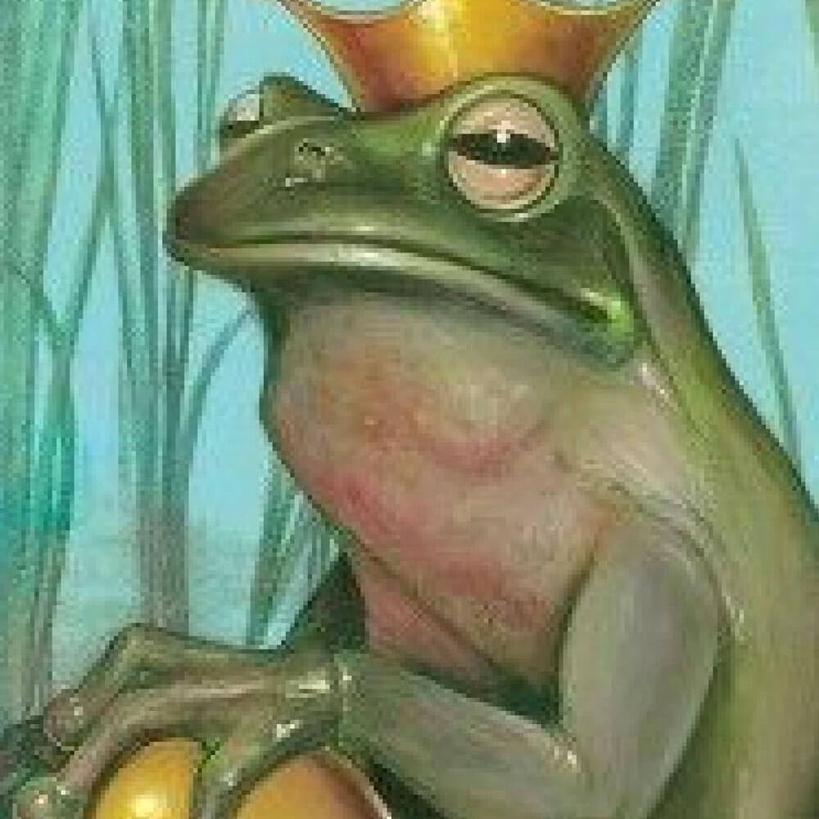
Frogs have been revered and feared in folklore, representing transformation, fertility, and magic. They appear in myths as shape-shifters, messengers of the spirit world, and symbols of luck.
Title

Slide 6
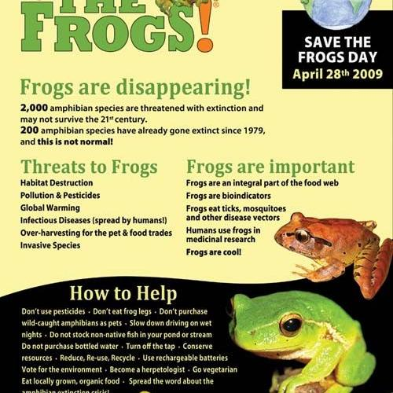
Title
Frogs face threats from habitat loss, pollution, and climate change. Conservation initiatives aim to preserve frog species, safeguard biodiversity, and raise awareness about the importance of these amphibians in ecosystems.

