Slide 1
Frogs
Prepared by qwaradie@gmail.com

Slide 2
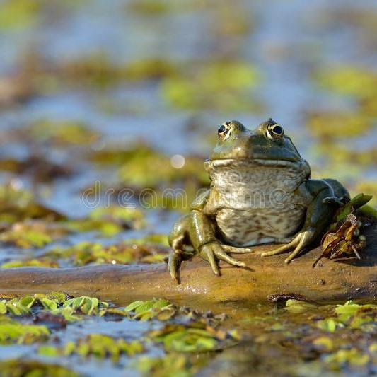
Explore the diverse species of frogs that inhabit rainforests worldwide. Learn about their unique adaptations and ecological importance in these rich ecosystems.
Title

Slide 3
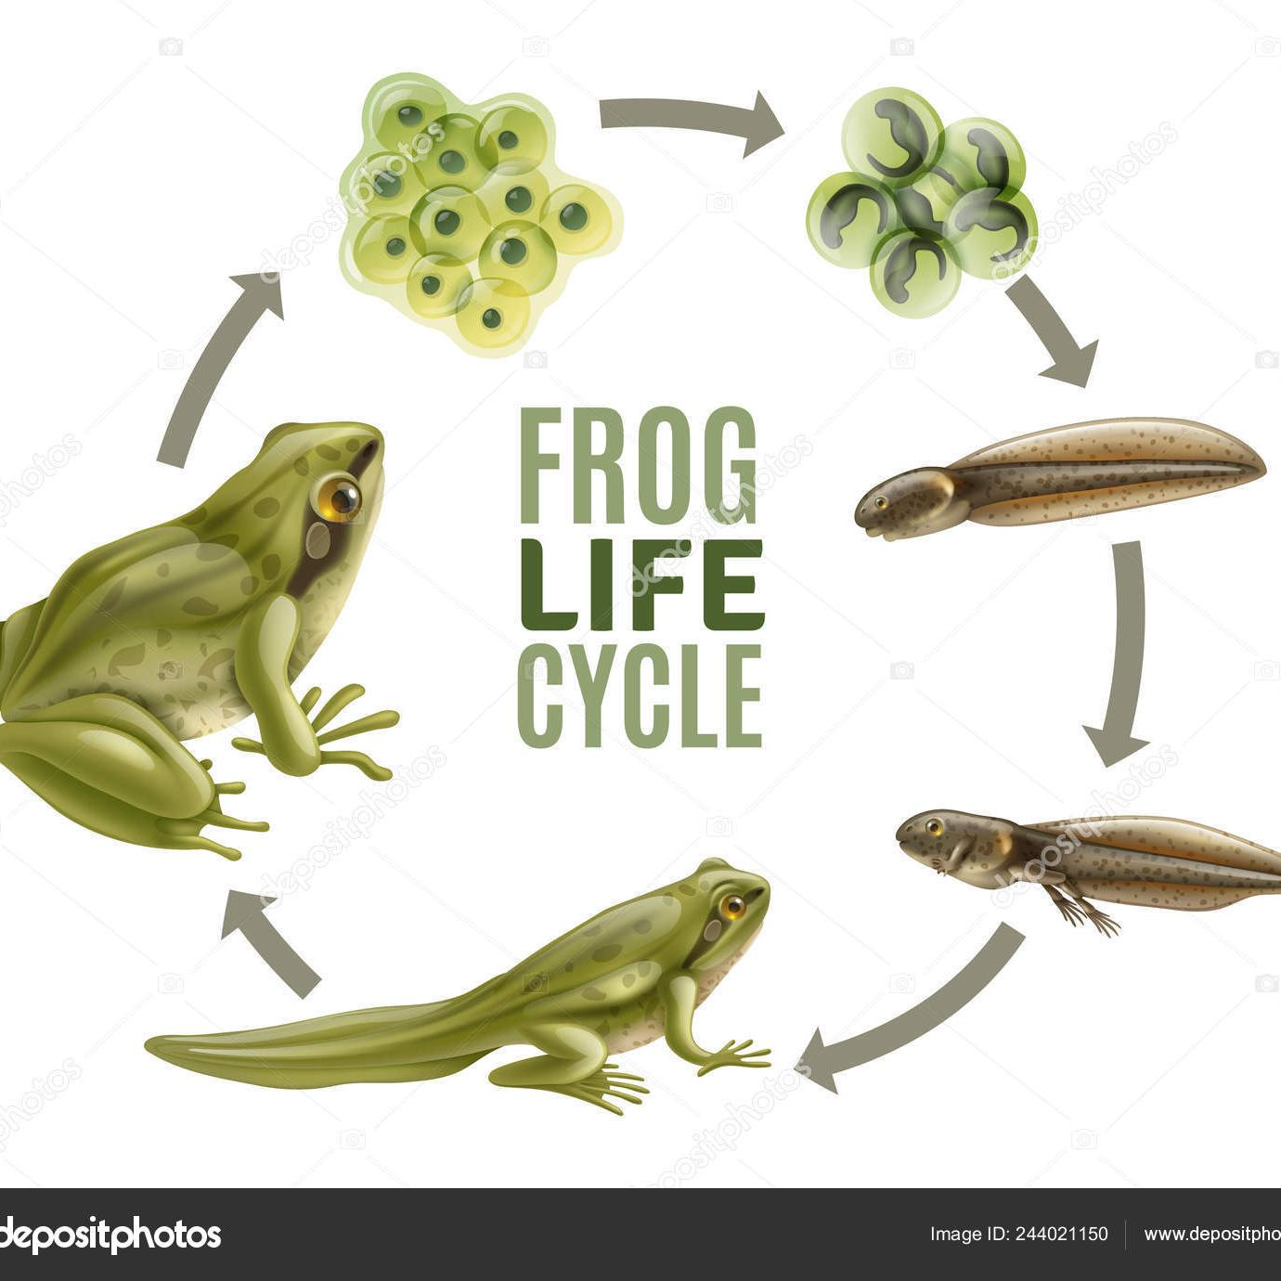
Title
Discover the fascinating metamorphosis process that frogs undergo, from tadpoles to fully developed amphibians. Explore how environmental factors influence their growth and development.

Slide 4
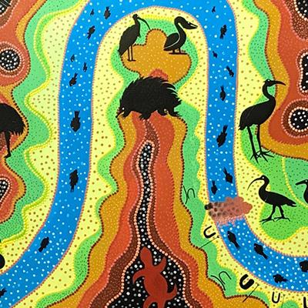
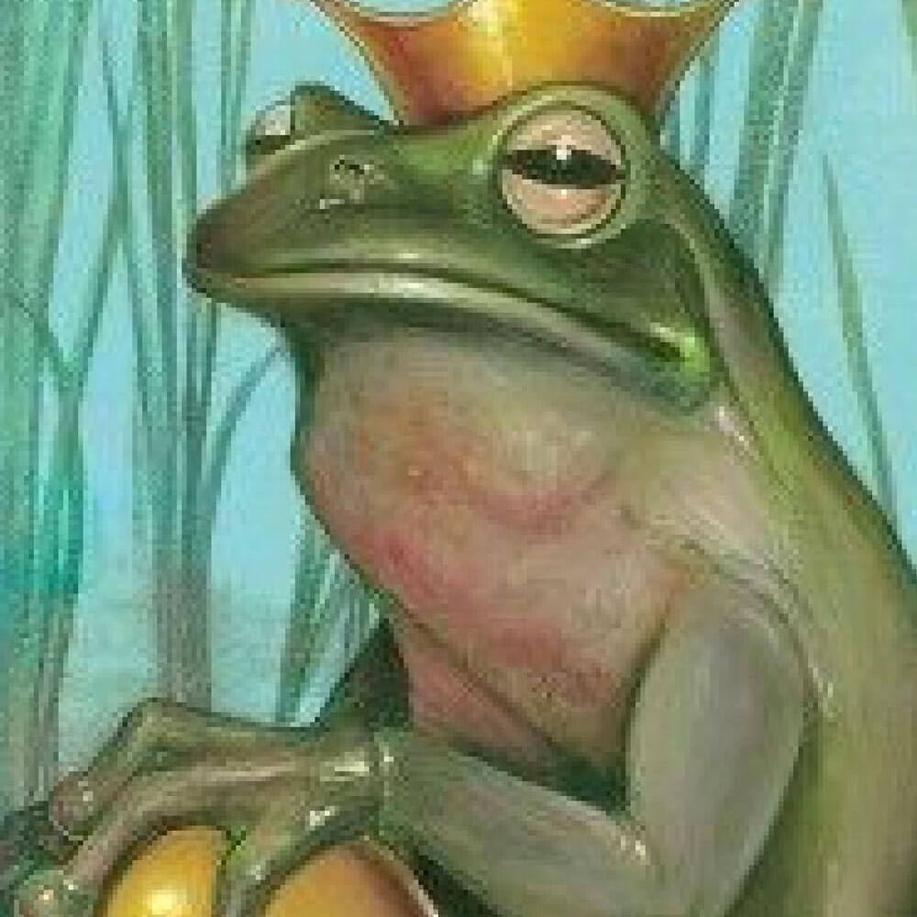
Frog Conservation
Learn about the threats facing frog populations, such as habitat loss and pollution. Explore conservation strategies and initiatives aimed at preserving these vital amphibians for future generations.

Slide 5
Frog Myths and Legends
Delve into the myths and legends surrounding frogs in different cultures around the world. Explore the symbolic significance of frogs in folklore and their representation in ancient tales.

Slide 6
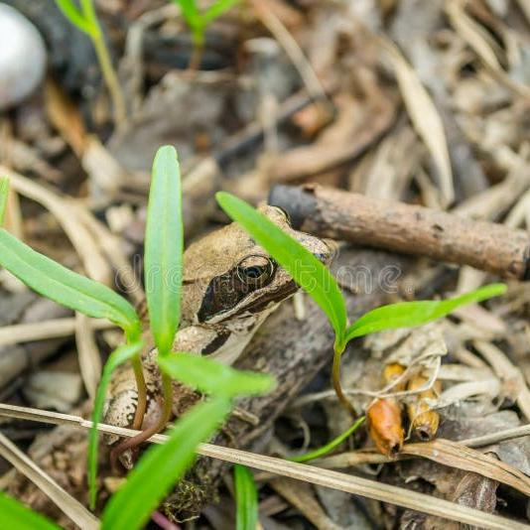
Title
Study the social interactions, communication methods, and hunting techniques of frogs. Explore how these behaviors contribute to their survival and adaptation in diverse habitats.

