Slide 1
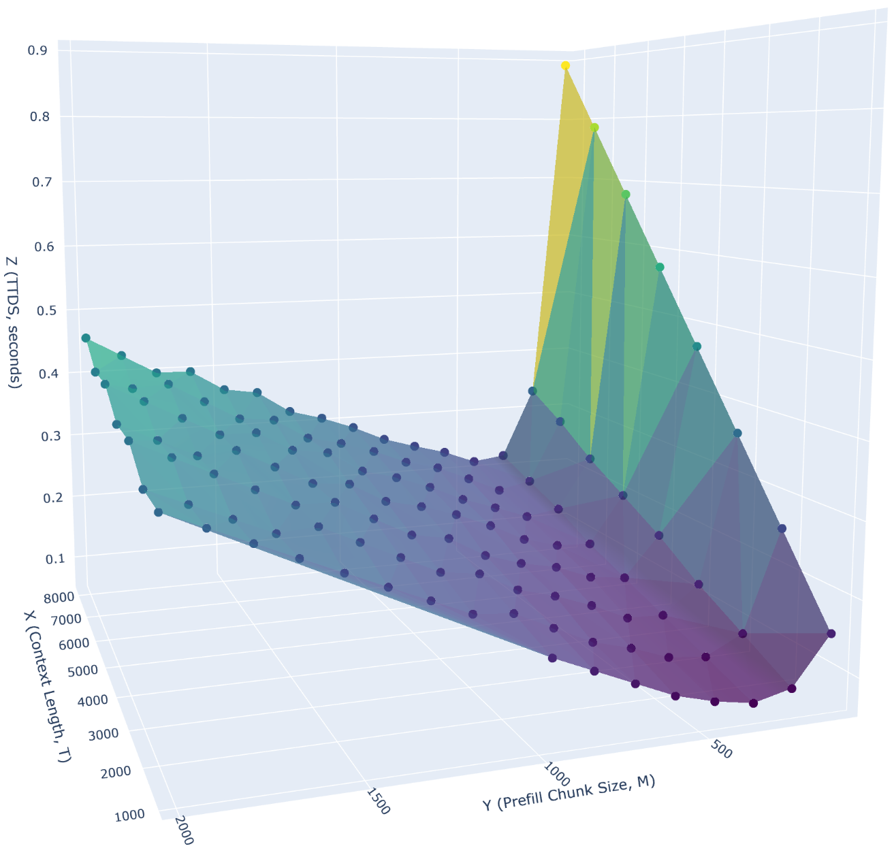
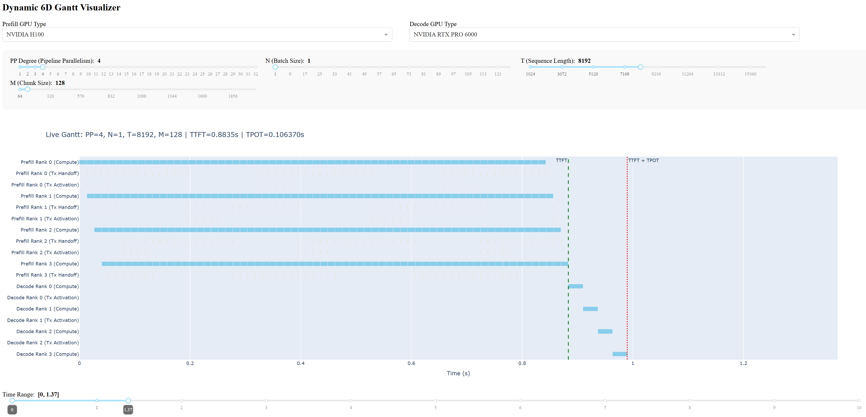
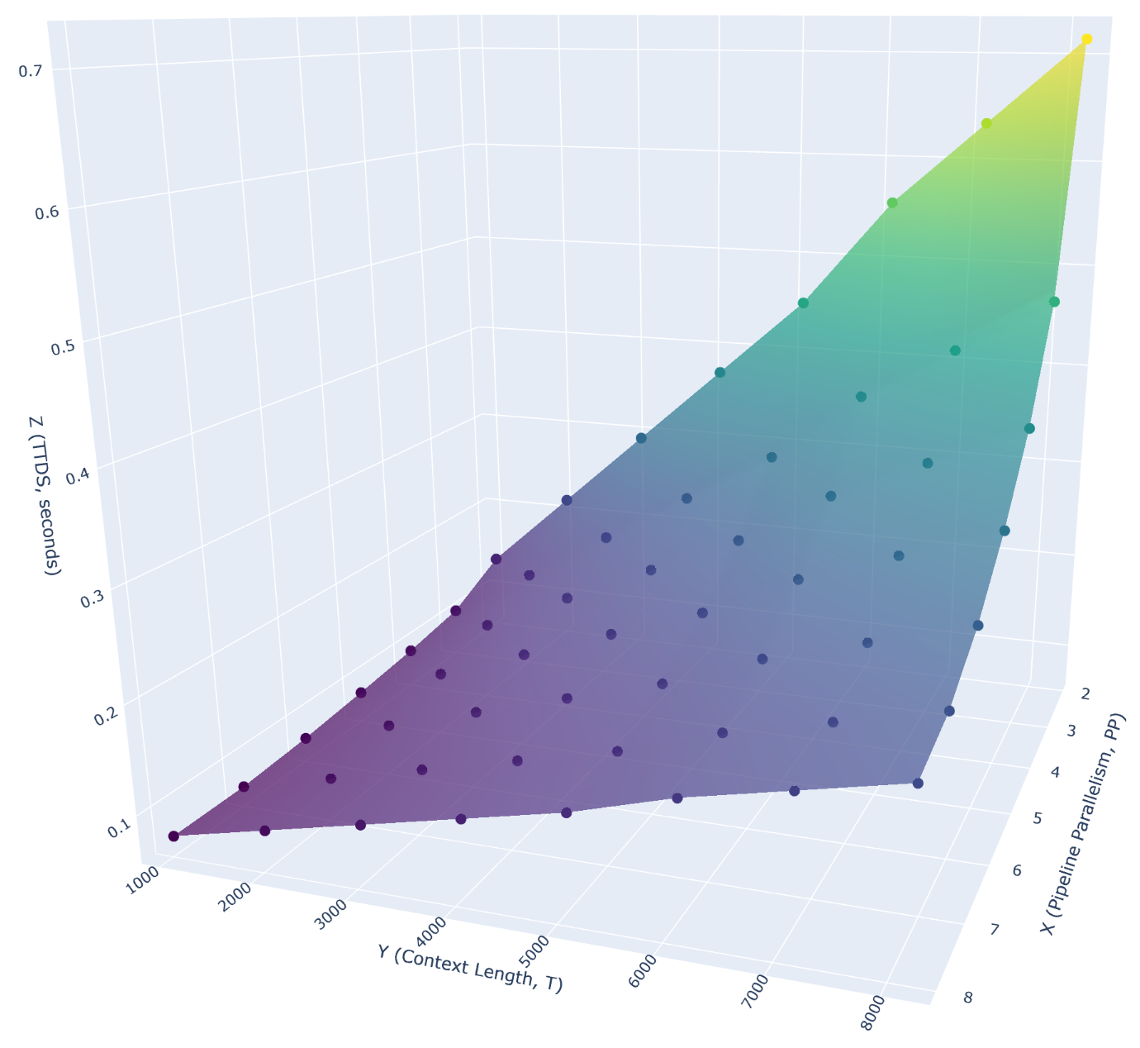
Discrete-Event Simulator (DES)
for Concurrent Communication and Computation in Distributed Systems

Slide 2
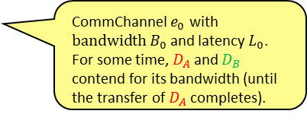
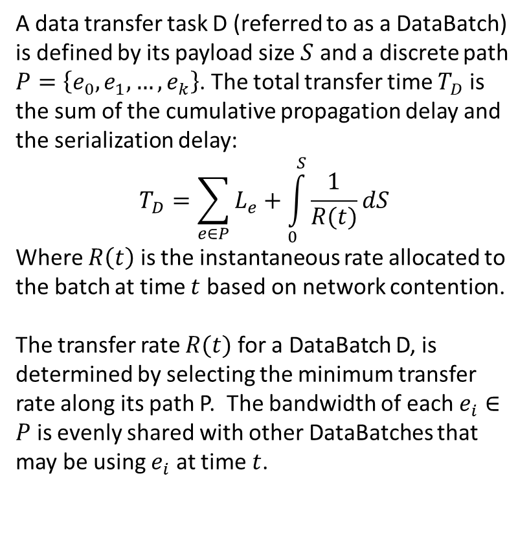



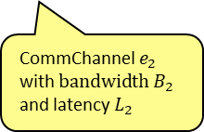

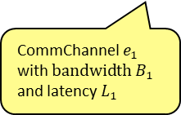



DataBatch Transfer Modeling
$$T_{D_{A}}= ?$$
$$T_{D_{B}}= ?$$
A data transfer task D (referred to as a DataBatch) is defined by its payload size $S$ and a discrete path $P=\left\{e_{0},e_{1},…,e_{k}\right\}$. The total transfer time $T_{D}$ is the sum of the cumulative propagation delay and the serialization delay:
$$T_{D}=\sum_{e∈P}{L_{e}+\int_{0}^{S}{\frac{1}{R(t)}dS}}$$
Where $R\left(t\right)$ is the instantaneous rate allocated to the batch at time $t$ based on network contention.
The transfer rate $R(t)$ for a DataBatch D, is determined by selecting the minimum transfer rate along its path P. The bandwidth of each $e_{i}∈P$ is evenly shared with other DataBatches that may be using $e_{i}$ at time $t$.
$e_{1}$
$e_{2}$
CommChannel $e_{1}$ with $bandwidth B_{1}$ and latency $L_{1}$
CommChannel $e_{2}$ with $bandwidth B_{2}$ and latency $L_{2}$
$e_{0}$
CommChannel $e_{0}$ with $bandwidth B_{0}$ and latency $L_{0}$. For some time, $D_{A}$ and $D_{B}$ contend for its bandwidth (until the transfer of $D_{A}$ completes).
$$D_{B}$$
$$D_{A}$$
DataBatch
DataBatch

Slide 3



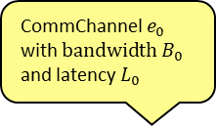
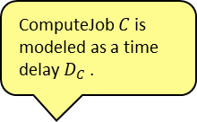
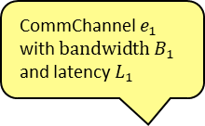


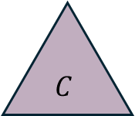
ComputeJob Modeling
ComputeJob $C$ is modeled as a time delay $D_{C}$ .
CommChannel $e_{0}$ with $bandwidth B_{0}$ and latency $L_{0}$
ComputeJob
$$C$$
$$D_{A}$$
$e_{0}$
DataBatch
CommChannel $e_{1}$ with $bandwidth B_{1}$ and latency $L_{1}$
Create
$$D_{B}$$
$e_{1}$
$$T_{D_{B}}= ?$$
DataBatch

Slide 4
UML Class Diagram
add(_compute() or add_batch()
<<interface>>
SimulatedSystem
Simulator. After the first ComputeJob(s) and/or DataBatch(es) have been added to it, call its run() method to run the simulation in discrete time increments.
Completion events
+on_data_transfer_complete(simulator : CommNetworkSimulator, batch : DataBatch) : ComputeJob
+on_compute_complete(simulator : CommNetworkSimulator, compute_job : ComputeJob)
CommNetworkSimulator
Simulator interface with two event handlers
+current_time : float
+run(system : SimulatedSystem, t_delta : float)
+add_compute(compute_job : ComputeJob)
+add_batch(batch : DataBatch)
DisaggregatedPDSystemPP
DataBatch
ComputeJob
+active_batches
+active_compute
+start(simulator : CommNetworkSimulator)
+name : string
+total_size : float
+rem_size : float
+total_latency : float
+latency_remaining : float
+start_time : float
+end_time : float
+name : string
+total_duration : float
+rem_duration : float
+start_time : float
+end_time : float
+completed_batches
+completed_compute
A concrete system that realizes the SimulatedSystem interface. Its methods handle events from the CommNetworkSimulator announcing the (simulated) completion of DataBatch transfers and ComputeJob executions by orchestrating the creation of additional CommJobs and DataBatches and adding them to the CommNetworkSimulator. Its start() method kicks off the first ComputeJob(s) and/or DataBatch(es).
+path
*
CommChannel
+name : string
+bw_gbps : float
+lat_us : float

Slide 5
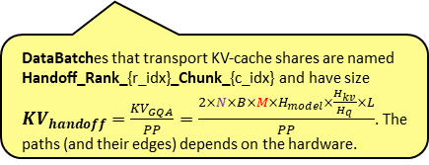
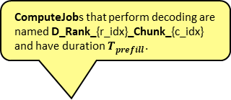

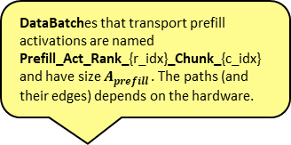

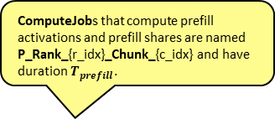
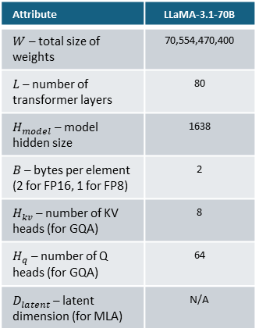
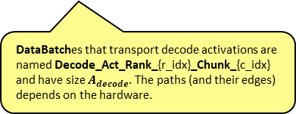
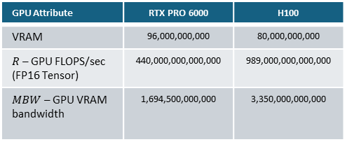
Disaggregated PD with Pipeline Parallelism (logical view)
Prefill
Decode
Different model attention types entail different KV-cache sizes:
GPU Attribute | RTX PRO 6000 | H100
VRAM | 96,000,000,000 | 80,000,000,000
$R$ – GPU FLOPS/sec (FP16 Tensor) | 440,000,000,000,000 | 989,000,000,000,000
$MBW$ – GPU VRAM bandwidth | 1,694,500,000,000 | 3,350,000,000,000
$$KV=\left\{\begin{matrix}{KV}_{GQA}=2×N×B×T×H_{model}×\frac{H_{kv}}{H_{q}}×L & for GQA models \\ {KV}_{MHA}=2×N×B×T×H_{model}×L & for MHA models \\ {KV}_{MLA}=N×T×L×H_{kv}×D_{letent}×2×B & for MLA models\end{matrix}\right.$$
C
KV
C
Attribute | LLaMA-3.1-70B
$W$ – total size of weights | 70,554,470,400
$L$ – number of transformer layers | 80
$H_{model}$ – model hidden size | 1638
$B$ – bytes per element (2 for FP16, 1 for FP8) | 2
$H_{kv}$ – number of KV heads (for GQA) | 8
$H_{q}$ – number of Q heads (for GQA) | 64
$D_{latent}$ – latent dimension (for MLA) | N/A
A
A
Attribute
N – batch size
T – context size
KV
Activations volume (T=1)
C
C
$$A_{decode}=N×B×H_{model}$$
DataBatches that transport prefill activations are named Prefill_Act_Rank_{r_idx}_Chunk_{c_idx} and have size $A_{prefill}$. The paths (and their edges) depends on the hardware.
DataBatches that transport decode activations are named Decode_Act_Rank_{r_idx}_Chunk_{c_idx} and have size $A_{decode}$. The paths (and their edges) depends on the hardware.
A
A
Activations volume
C
KV
$$A_{prefill}=N×B×M×H_{model}$$
C
ComputeJobs that compute prefill activations and prefill shares are named P_Rank_{r_idx}_Chunk_{c_idx} and have duration $T_{prefill}$.
IMPORTANT! If prefill is being done in addition to a previous prefill, then T must be considered in the KV calculation.
A
A
ComputeJobs that perform decoding are named D_Rank_{r_idx}_Chunk_{c_idx} and have duration $T_{prefill}$.
C
KV
C
$$T_{prefill}=max\left(\frac{\left(2×N×M×W\right)+\left(4×N×\left(\frac{L}{PP}\right)×H_{model}×M^{2}\right)}{PP×R_{rank}},\frac{\left(B×W\right)+{KV}_{GQA}}{0.80×PP×{MBW}_{rank}}\right)$$
KV-cache volume
$${KV}_{handoff}=\frac{{KV}_{GQA}}{PP}$$
$$T_{decode}=max⁡\left(\frac{\left(2×N×W\right)+\left(4×N×T×\left(\frac{L}{PP}\right)×H_{model}\right)}{{PP×R}_{rank}},\frac{W×B+{KV}_{GQA}}{{0.80×PP×MBW}_{rank}}\right)$$
Linear
Attention
Compute time
Memory wall
N
DataBatches that transport KV-cache shares are named Handoff_Rank_{r_idx}_Chunk_{c_idx} and have size ${KV}_{handoff}=\frac{{KV}_{GQA}}{PP}=\frac{2×N×B×M×H_{model}×\frac{H_{kv}}{H_{q}}×L}{PP}$. The paths (and their edges) depends on the hardware.
Linear
Attention
Prefill chunking divides T into K chunks of size M.
T
Compute time
Memory wall

Slide 6
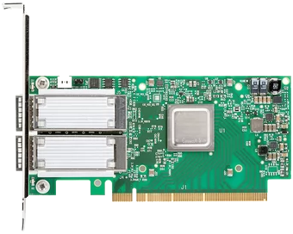
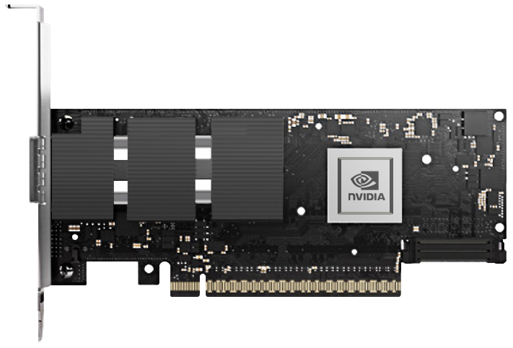



Disaggregated PD with Pipeline Parallelism (physical view)
Server
Server
Decode
Switch
Switch
d_gpu_lanes[3]
PLX
d_eth_lanes[3]
d_eth_cables[3]
Prefill
Switch
Infiniband NDR
d_ib_lanes[3]
p_gpu_lanes[3]
d_ib_cables[3]
RTX PRO
6000
Decode
d_gpu_lanes[2]
PLX
d_eth_lanes[2]
d_eth_cables[2]
Infiniband NDR
d_ib_lanes[2]
p_gpu_lanes[2]
d_ib_cables[2]
RTX PRO
6000
Ethernet
Infiniband NDR
PLX
Infiniband NDR
p_ib_lanes[0]
p_ib_cables[3]
Decode
RTX PRO
6000
d_gpu_lanes[1]
d_eth_lanes[1]
d_eth_cables[1]
PLX
p_gpu_lanes[1]
Infiniband NDR
d_ib_lanes[1]
d_ib_cables[1]
DataBatch that transports the inter-rank prefill activations of size $A_{prefill}$ takes this path
DataBatch that transports the handed off prefill share of size ${KV}_{handoff}$ takes this path
DataBatch that transports the inter-rank decode activations of size $T_{decode}$ takes this path
RTX PRO
6000
Decode
p_gpu_lanes[0]
d_gpu_lanes[0]
PLX
d_eth_lanes[0]
d_eth_cables[0]
Infiniband NDR
d_ib_lanes[0]
d_ib_cables[0]

