Slide 1


Slide 2
Image classification
with fully convolutional networks

Slide 3
ML vs. Classical Programming
Input data
Algorithm
Output data
Input data
Training
Output data
Algorithm (model)
Inference
Output data
Input data

Slide 4
ML modalities
Images
Text
Audio
Video
Tabular data
Environments (Games, VR, Reality)

Slide 5
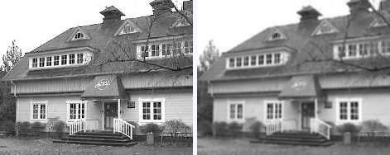
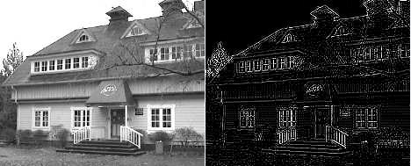
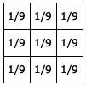

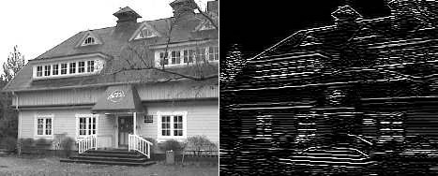

Convolutions
Blur
Edges
Horizontal edges

Slide 6


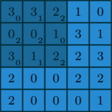


Convolutions
*
=
3*0 + 3*1 + 2*2 + 0*2 + 0*2 + 1*0 + 3*0 + 1*1 + 2*2 = 12
(3, 3, 2, 0, 0, 1, 3, 1, 2) · (0, 1, 2, 2, 2, 0, 0, 1, 2) = 12
Convolution gif animation from: https://github.com/vdumoulin/conv_arithmetic
Notes:
Start with grayscale image
See it as numbers
Introduce the filter
Example application of the filter on one position
Interpretation as dot product, hence, similarity of local features with filter
Resulting matrix
Possible reinterpretation as image
Convolution animation, with padding
Convolution is the workhorse of deep learning, repetition is key.
Segway: Image detection first, then object detection

Slide 7
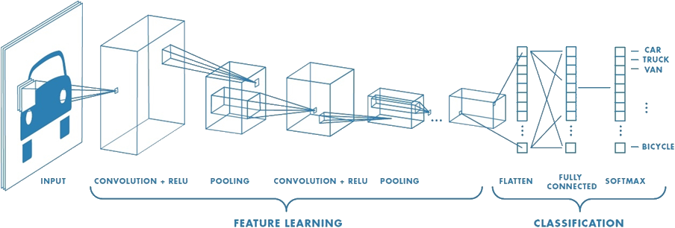
Image classification
Fully connected at the end

Slide 8
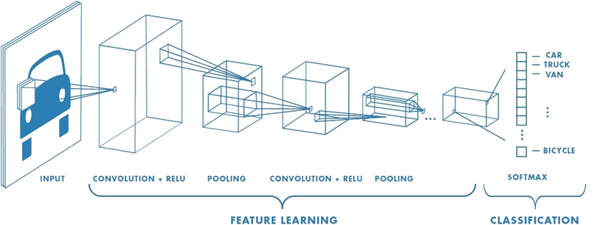
Image classification
Fully convolutional

Slide 9
Training
Training example
features
targets
Model
Prediction
Loss fn
Loss (cost)
Gradients

Slide 10
Inference
Model
features
prediction

Slide 11
Let’s code!
https://github.com/virgil81188/CNN-Workshop

