Slide 1
EXPERIMENTS AND FINDINGS SO FAR
Code models compute
program semantics
they cannot report
A simple account of what is built, used, verbalized, and predictive
Virginia Ceccatelli · University College London
Notes:
[Sources]
- /Users/virginiaceccatelli/Documents/semantic-flow/docs/PAPER_OUTLINE.md
- /Users/virginiaceccatelli/Documents/semantic-flow/docs/RESULTS.md

Slide 2
The question is not whether code models perform well
Do they compute program relations — or exploit surface cues?
Surface cues
Program-semantic state
•
Identifier spelling
≠
•
Which definition a use refers to
•
Which definition reaches a use
•
Token distance
•
Which guard controls a statement
•
Indentation
•
Whether a value is tainted or sanitized
Answer so far: the state is real — but its availability is selective.
Notes:
[Sources]
- /Users/virginiaceccatelli/Documents/semantic-flow/docs/PAPER_OUTLINE.md
- /Users/virginiaceccatelli/Documents/semantic-flow/docs/METHODS.md

Slide 3
Why code lets us ask this cleanly
Controlled testbed
x = source()
if flag:
x = sanitize(x)
sink(x)
•
Synthetic Python with construction-known semantic graphs
•
Exact AST-span → token alignment
•
Frozen DeepSeek-Coder 6.7B main model
•
DeepSeek-Coder 1.3B cross-scale replication
The generator knows the exact binding, def-use, control, and taint graph.
•
Grouped-CV linear probes; shuffled-label selectivity
Key advantage: counterfactual pairs can pin a baseline to exactly 0.500.
Notes:
[Sources]
- /Users/virginiaceccatelli/Documents/semantic-flow/docs/METHODS.md
- /Users/virginiaceccatelli/Documents/semantic-flow/docs/EXPERIMENTS.md

Slide 4
Four separate claims — each with its own falsifier
BUILT
Token-identical label flips
Surface + embedding floor = 0.500
USED
Activation patching
Recovery must move with the causal signal
NOT REPORTED
Same-anchor positive control
A live readout must succeed nearby
NOT ANTICIPATORY
No-model position floor
Prediction must beat sequence position alone
A null is interpretable only when the instrument works at the same place.
Notes:
[Sources]
- /Users/virginiaceccatelli/Documents/semantic-flow/docs/PAPER_OUTLINE.md
- /Users/virginiaceccatelli/Documents/semantic-flow/docs/METHODS.md

Slide 5
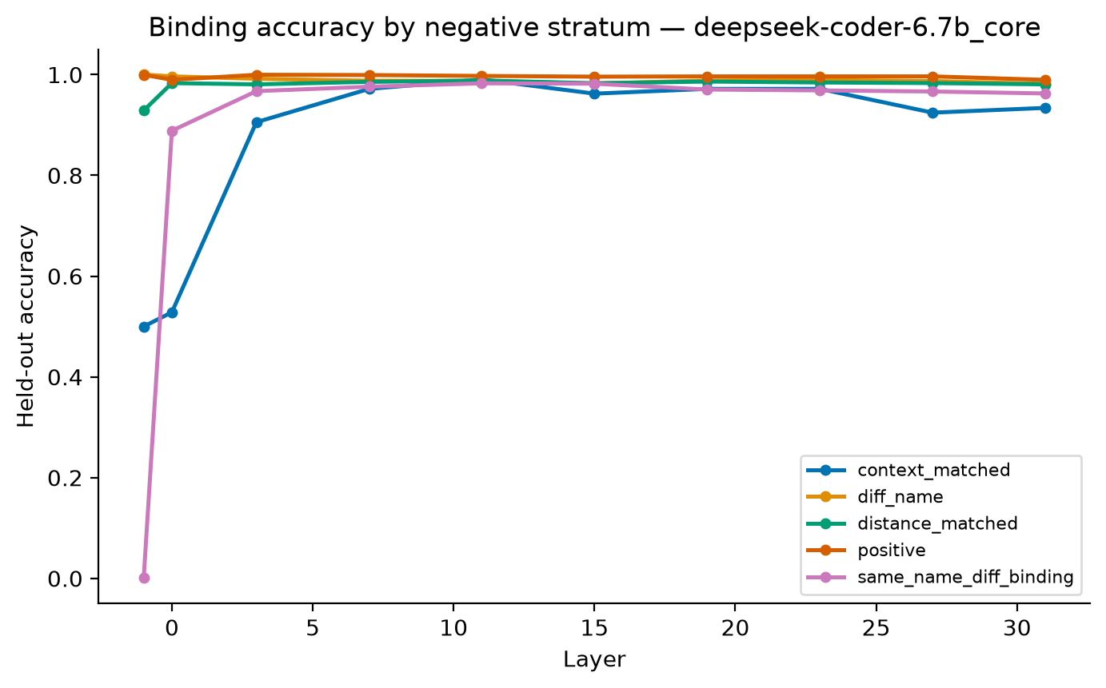
Finding 1 — binding is constructed with depth
0.500
Exact surface and embedding floor
0.984
Peak mid-layer accuracy
Nothing at input → rapid construction → mild late-layer shedding
Notes:
[Sources]
- /Users/virginiaceccatelli/Documents/semantic-flow/results/figures/binding_strata_deepseek-coder-6.7b_core.png
- /Users/virginiaceccatelli/Documents/semantic-flow/results/tables/static_probes_deepseek-coder-6.7b_core.csv

Slide 6
The pattern generalizes — with one important nuance
RELATION
CLEANEST FLOOR
HIDDEN-STATE RESULT
READING
Binding
0.500 exact
0.984 accuracy
Strong semantic evidence
Def–use
Distance-matched
≈0.99 accuracy
Mild distance decay
Control dependence
Surface acc. 0.927
AUC 0.999
Positive, but surface-heavy
Control dependence is encoded, but local syntax already explains much of it.
Notes:
[Sources]
- /Users/virginiaceccatelli/Documents/semantic-flow/results/tables/static_probes_deepseek-coder-6.7b_core.csv
- /Users/virginiaceccatelli/Documents/semantic-flow/docs/RESULTS.md

Slide 7
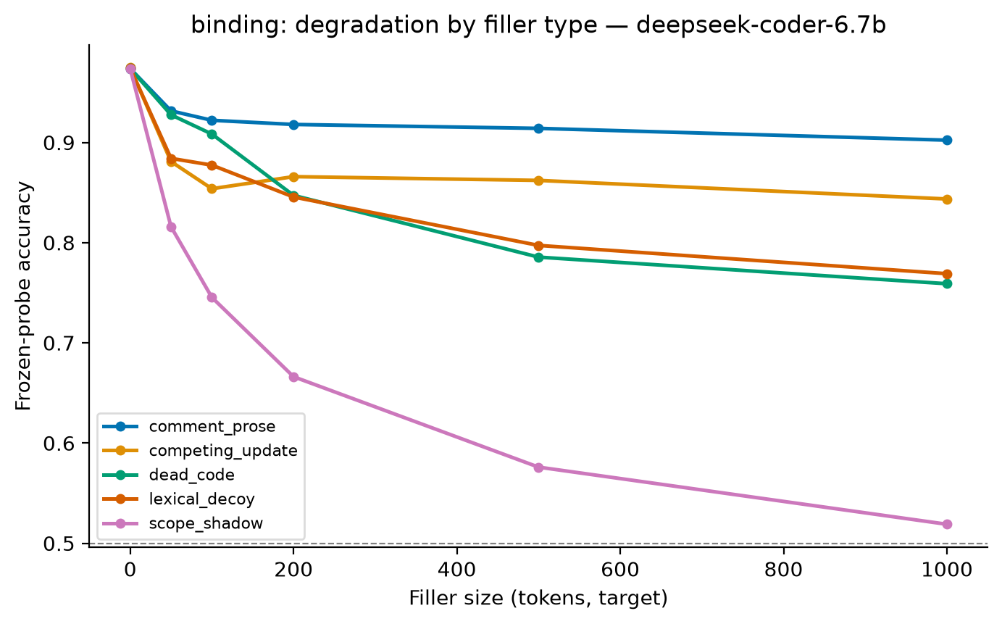
Length is cheap; semantic interference is expensive
0.921
500 inert comment tokens
0.570
500 scope-shadow tokens
At 1,000 tokens, scope shadow reaches chance (0.498). The failure is scope resolution, not context length alone.
Notes:
[Sources]
- /Users/virginiaceccatelli/Documents/semantic-flow/results/figures/context_binding_deepseek-coder-6.7b.png
- /Users/virginiaceccatelli/Documents/semantic-flow/results/tables/context_degradation_deepseek-coder-6.7b.csv

Slide 8
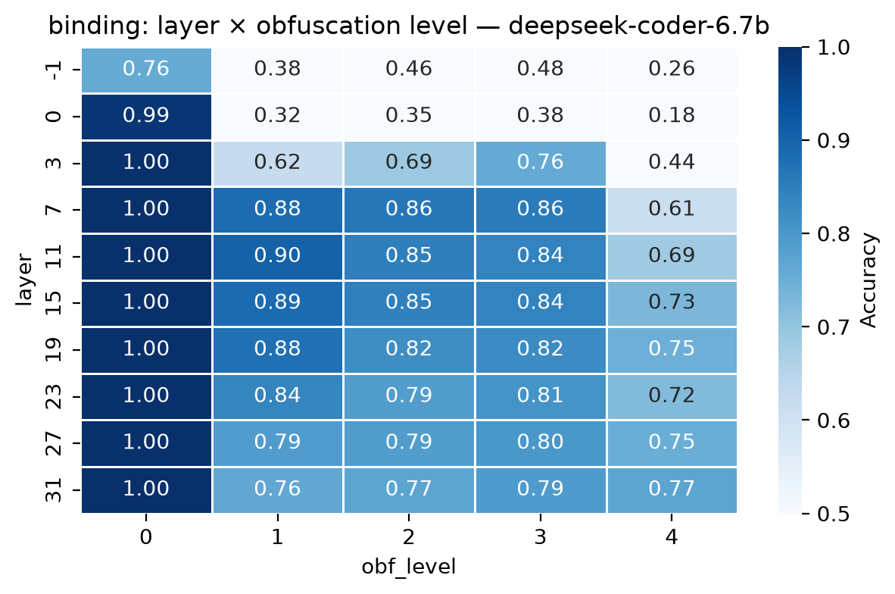
The representation survives renaming, not structural damage
≈0.85–0.90
Mid-layer accuracy after identifier renaming
≈0.75
Best layer after control-flow flattening
Names can change without erasing the relation. Rewriting the program structure is much harder.
Notes:
[Sources]
- /Users/virginiaceccatelli/Documents/semantic-flow/results/figures/obfuscation_binding_deepseek-coder-6.7b.png
- /Users/virginiaceccatelli/Documents/semantic-flow/results/tables/obfuscation_robustness_deepseek-coder-6.7b.csv

Slide 9
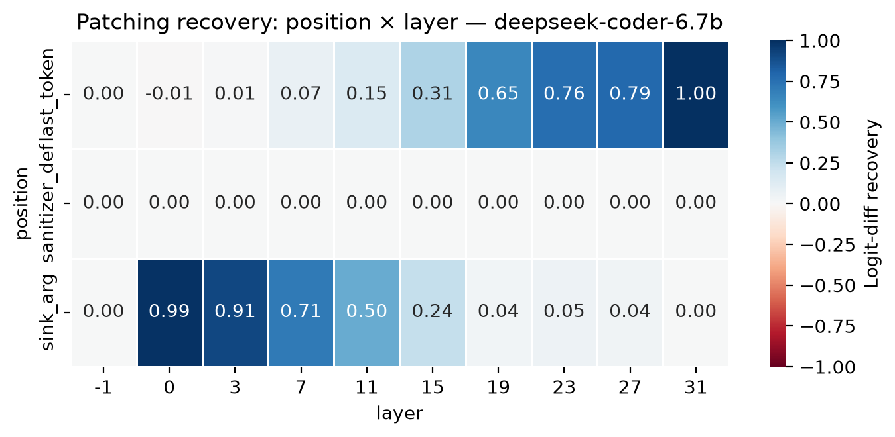
Finding 2 — semantic information is causally routed
EARLY
sink argument
L0 ≈ 0.99
LATE
final position
L31 = 1.00
sanitizer definition
0.000 recovery at every layer
Notes:
[Sources]
- /Users/virginiaceccatelli/Documents/semantic-flow/results/figures/patching_recovery_deepseek-coder-6.7b.png
- /Users/virginiaceccatelli/Documents/semantic-flow/results/tables/causal_patching_deepseek-coder-6.7b.csv

Slide 10
Correct state, wrong answer
Can probe degradation warn us before behavioral failure?
≈99%
19 / 19
−0.010
Per-prefix taint-probe accuracy
Model-wrong examples with correct probe state
Probe excess over analytic null
A readout using no model at all scores +0.113 from position alone.
Conclusion: no anticipatory degradation survives the floor.
1.3B behavior is at chance (balanced accuracy 0.471), so its lead time is undefined.
Notes:
[Sources]
- /Users/virginiaceccatelli/Documents/semantic-flow/results/tables/behavioral_sanity_deepseek-coder-6.7b.csv
- /Users/virginiaceccatelli/Documents/semantic-flow/results/tables/behavioral_leadtime_summary_deepseek-coder-6.7b.csv
- /Users/virginiaceccatelli/Documents/semantic-flow/results/tables/behavioral_sanity_deepseek-coder-1.3b.csv

Slide 11
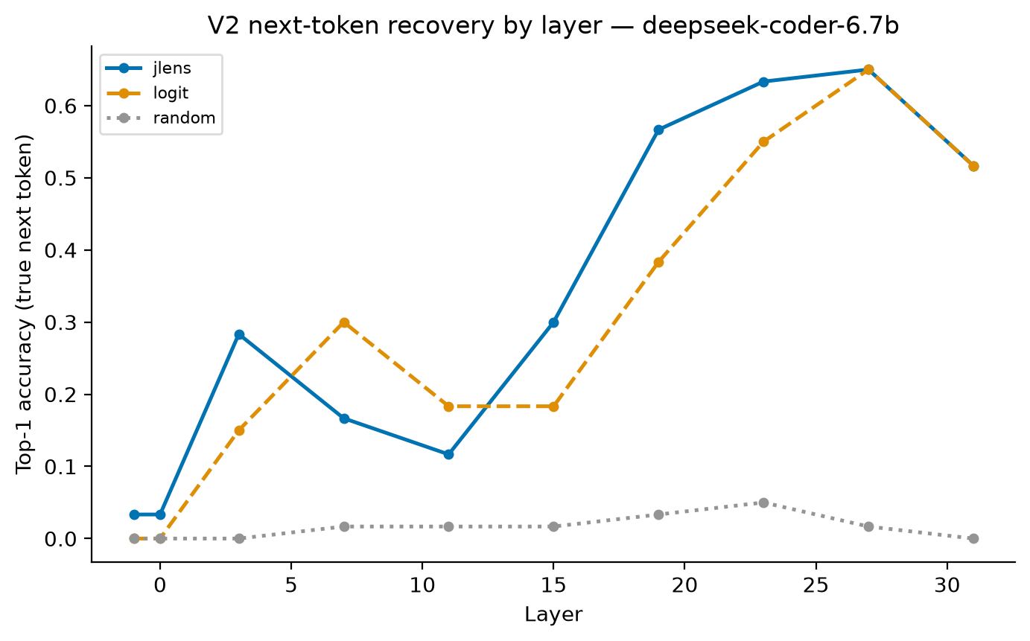
A stronger question: can the model itself read the state out?
The Jacobian lens asks which token the model is locally disposed to produce — not what a trained probe can recover.
1.0000
Final-layer identity cosine
0.650
Next-token top-1 at L27
Random directions: ≤ 0.050
Advantage over logit lens: +0.183
Notes:
[Sources]
- /Users/virginiaceccatelli/Documents/semantic-flow/results/figures/jlens_validation_nexttoken_deepseek-coder-6.7b.png
- /Users/virginiaceccatelli/Documents/semantic-flow/results/tables/jlens_validation_checks_deepseek-coder-6.7b.csv
- /Users/virginiaceccatelli/Documents/semantic-flow/results/tables/jlens_validation_deepseek-coder-6.7b.csv

Slide 12
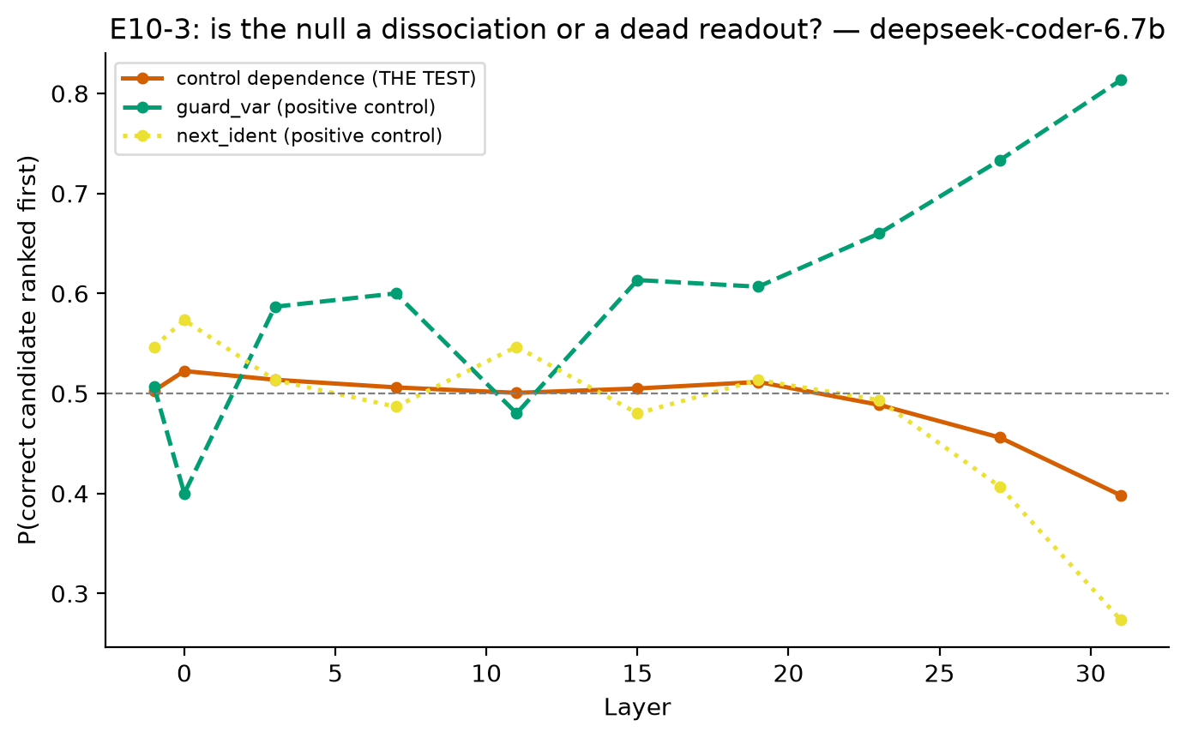
Finding 4 — decodable does not mean reportable
0.813
Guard variable: positive control succeeds
0.500
Control dependence: chance after temporal matching
Yet a trained probe decodes the same relation at AUC 0.999.
The pooled late below-chance tail was a recency confound; matched intervals include chance at every layer.
Notes:
[Sources]
- /Users/virginiaceccatelli/Documents/semantic-flow/results/figures/jlens_controldep_dissociation_deepseek-coder-6.7b.png
- /Users/virginiaceccatelli/Documents/semantic-flow/results/figures/jlens_controldep_temporally_matched_deepseek-coder-6.7b.png
- /Users/virginiaceccatelli/Documents/semantic-flow/results/tables/jlens_controldep_summary_deepseek-coder-6.7b.csv
- /Users/virginiaceccatelli/Documents/semantic-flow/results/tables/static_probes_deepseek-coder-6.7b_core.csv

Slide 13
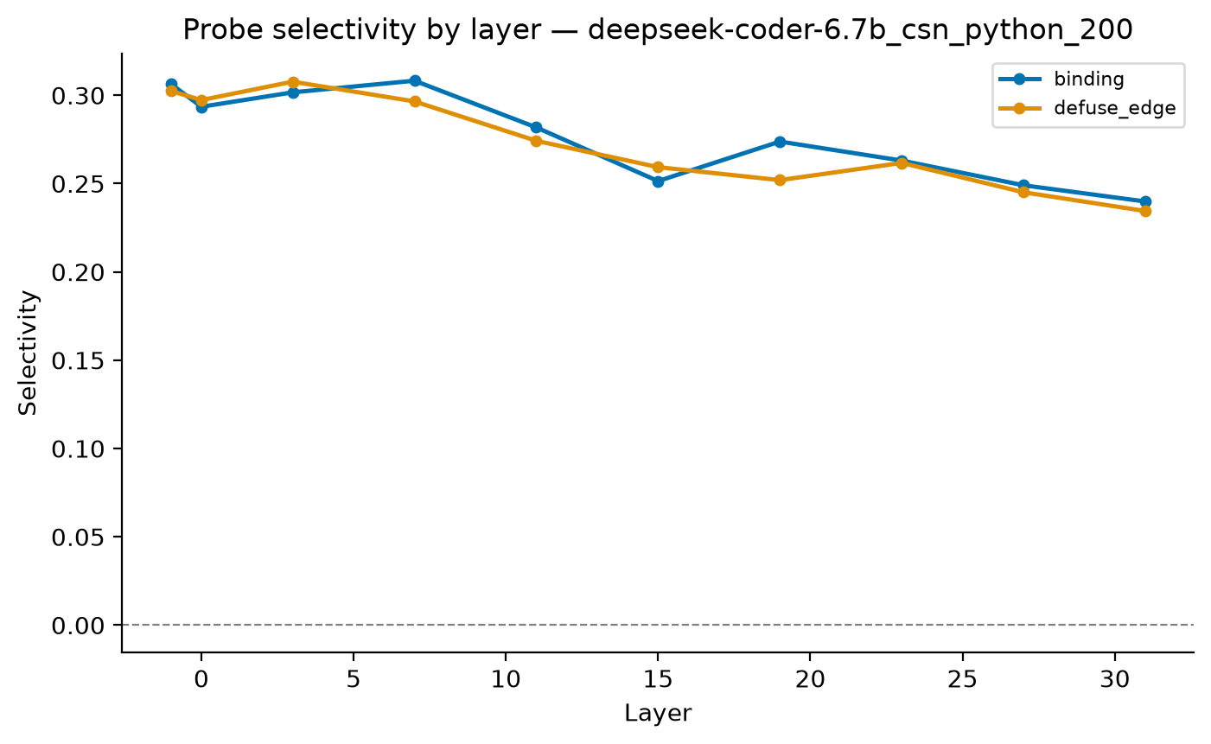
The layer signature transfers to real Python
≈0.90
Accuracy on CodeSearchNet Python
≈0.98
Area under the ROC curve
Useful external check — but real code cannot isolate semantic information from correlated lexical cues.
Notes:
[Sources]
- /Users/virginiaceccatelli/Documents/semantic-flow/results/figures/layers_selectivity_deepseek-coder-6.7b_csn_python_200.png
- /Users/virginiaceccatelli/Documents/semantic-flow/results/tables/static_probes_deepseek-coder-6.7b_csn_python_200.csv

Slide 14
Conclusion — semantic state has four different fates
BUILT
Exact 0.500 floor → 0.984 mid-layer
USED
Causal recovery moves from sink token to output
NOT REPORTED
Probe AUC 0.999; validated J-lens at chance
NOT ANTICIPATORY
State correct on every observed model-wrong prefix
The model can compute a semantic fact without making that fact verbally accessible or using it to anticipate failure.
Notes:
[Sources]
- /Users/virginiaceccatelli/Documents/semantic-flow/docs/PAPER_OUTLINE.md
- /Users/virginiaceccatelli/Documents/semantic-flow/docs/RESULTS.md
- /Users/virginiaceccatelli/Documents/semantic-flow/results/tables

