Slide 1
Probe, R-lens and DAS answer different questions
PROBE
R-LENS
DAS
Is the information present?
Where is an output score attributed?
Does changing the representation change the output?
Train a separate linear classifier on hidden states.
Propagate one model output score backward to earlier tokens.
Interchange one learned semantic coordinate between runs.
Availability
Output-associated attribution
Causal use
A positive result from one method does not imply a positive result from the others.
01
Notes:
[Sources]
- docs/METHODS.md §§0, 3, 6, 8.

Slide 2
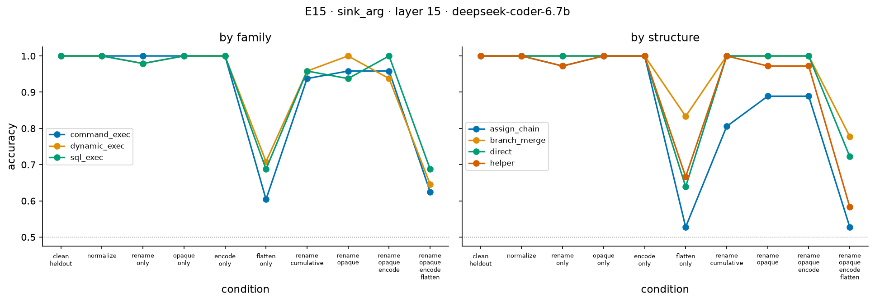
Taint flow is linearly decodable at the sink
Experiment
Train on hidden states at the sink argument: source-derived or trusted? Freeze the probe; test held-out programs.
1.00
Clean
Lexical floors
0.43–0.54
Meaning
The sink state contains information that separates source-derived from trusted flow.
Not shown
Whether the model uses that information to produce an answer.
02
Notes:
Figure is a repository-generated experimental result. Clean held-out hidden-state readout reaches 1.00 at the reported cell; local and whole-program lexical floors are approximately 0.43–0.54 across models.
[Sources]
- results/figures/sinkflow_cells_deepseek-coder-6.7b.png.
- results/tables/sinkflow_clean_deepseek-coder-6.7b.csv.
- docs/RESULTS.md R5.

Slide 3
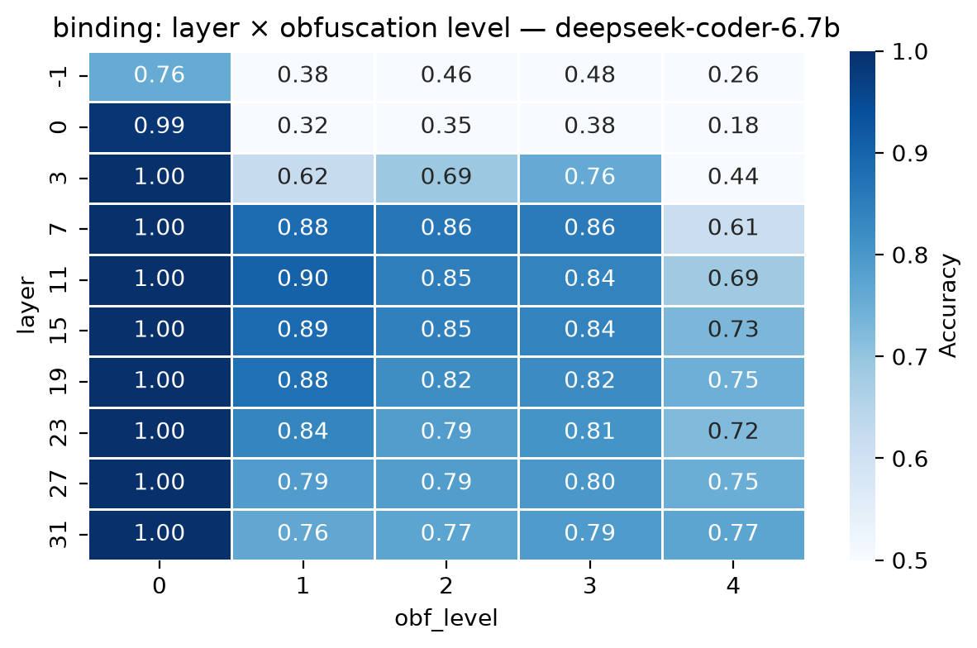
Frozen probes fail most under control-flow flattening
Experiment
Apply clean-trained binding and def–use probes after semantics-preserving rewrites.
DeepSeek 6.7B
Best-layer binding
Rename
0.90
Opaque
0.86
MBA encode
0.86
Flatten
0.77
Across 3 models
Flattening is the lowest-accuracy transformation for both binding and def–use.
03
Notes:
Heatmap columns are cumulative obfuscation levels 0–4; rows are model layers. The side numbers summarize atomic transformations at the best layer.
[Sources]
- results/figures/obfuscation_binding_deepseek-coder-6.7b.png.
- results/tables/obfuscation_robustness_*.csv.
- docs/RESULTS.md R4.

Slide 4
R-lens attributes one answer score across the input
Model output
Backward allocation
Grouped result
score(‘vulnerable’)
Conserving relevance rules propagate the score through each layer.
taint chain
trust chain
sink
other tokens
R-lens starts here
It changes only the backward calculation; the forward answer is unchanged.
Earlier-token shares add back to approximately the original score.
Compare role shares across a matched safe/unsafe pair.
R-lens does not test whether information is decodable, and it does not establish causal necessity.
04
Notes:
The R-lens gate passes on both DeepSeek models: final-layer agreement 1.0000; median conservation error 0.0000 / 0.0001 across validation layers. It is not applicable to StarCoder2 under the implemented rules.
[Sources]
- docs/METHODS.md §§6.4–6.5.
- docs/RESULTS.md R6 and R9.

Slide 5
R-lens finds a small redistribution between identical chains
Matched-pair test
The taint and trust chains use identical tokens; only which chain reaches the sink changes.
Reported cell
DeepSeek 1.3B · L0
DeepSeek 6.7B · L11
Taint chain shifts down
65 / 72
64 / 72
Trust chain shifts up
63 / 72
57 / 72
Median taint shift
−0.014
−0.021
Sign-test p
7.0 × 10⁻¹³
5.8 × 10⁻¹²
Mean permutation p
0.57 (fails)
< 0.001
What it shows
Changing the data-flow relation changes output attribution beyond token identity.
Strength
Weak: 1–2% of the answer score; observational; depth does not replicate across scale.
Open
The attribution does not trace a simple ‘follow the active taint chain’ mechanism.
05
Notes:
Attribution conservation at the reported cells has median |rho−1| around 1e−7 / 2e−7. The direction is counterintuitive rather than a simple active-chain trace, so the claim is redistribution, not faithful reasoning-path recovery.
[Sources]
- results/tables/relevance_summary_deepseek-coder-1.3b.csv.
- results/tables/relevance_summary_deepseek-coder-6.7b.csv.
- docs/RESULTS.md R9.

Slide 6
Yes/no taint question: poor decisions, informative margins
Prompt
“Is the value passed to the sink tainted? Answer yes or no.”
50%
Final choice
Models collapse to one answer token: always ‘no’ or always ‘yes’.
69–92%
Margin ordering
Unsafe programs usually move the yes−no score in the correct direction relative to matched safe programs.
Interpretation
The distinction affects output scores, but the decision threshold is badly calibrated. This is not reliable task performance.
06
Notes:
Clean held-out sink prompt: pair ordering 0.694 / 0.750 / 0.917. At the strongest internal cell, lens sign consistency is approximately 0.889 / 0.847 / 0.944. The logit, J- and R-lenses reach essentially the same conclusion; R-lens is not required for this result.
[Sources]
- results/tables/positive_behaviour_summary_*.csv.
- docs/RESULTS.md R8.

Slide 7
DAS asks whether a semantic coordinate controls the output
Binding experiment
Learn one direction that distinguishes which definition a use refers to; interchange only that coordinate.
Factorial control
The same binding change requires opposite answer-token movements in the two arms.
Account
Train arm ab
Held-out arm ba
Binding representation
positive
positive
Fixed token / answer direction
positive
negative
Required DAS result
positive
positive
Intervention
rank 1 · variable-use site · no dose parameter
Protocol
120 calibration bases · 280 held-out test bases · full-vocabulary argmax
Models
DeepSeek-Coder 6.7B (L8) · StarCoder2 3B (L11)
07
Notes:
The learned subspace is fitted only on arm ab. Successful transfer to ba falsifies a fixed answer-token direction because that account predicts the opposite sign in ba.
[Sources]
- docs/METHODS.md §8.
- docs/RESULTS.md R10.

Slide 8
Rank-1 binding interchange controls the answer
Installed-binding emission · held-out arm ba · 560 rows / 280 bases per model
100%
both models · both arms
Edit magnitude
DAS: 47.9% of hidden-state norm
Mean difference: 71.0% / 71.9%
Controls
6/6 gates · 14/14 machinery checks · 0% non-candidate outputs
Licensed conclusion
Binding information is not only decodable: changing it changes the model's output.
08
Notes:
This is causal evidence for binding, not yet for taint flow. A taint-specific intervention would be needed to establish causal use of the source-to-sink distinction.
[Sources]
- results/binding/deepseek-coder-6.7b/interchange_summary.csv.
- results/binding/starcoder2-3b/interchange_summary.csv.
- docs/RESULTS.md R10.

