Slide 1

Mechanics of Biological Systems [2022-2023]
Models to study the effect of atrial fibrillation on coronary circulation
Virginia Clemente
Mat. INLM01/16855

Slide 2
Summury
Introduction:
brief description of Atrial Fibrillation
Models:
1D – 0D Model of Coronary Circulation
Impaired coronary blood flow at higher Heart Rates during AF: Open – Loop Model
Analysis of AF effects on coronary perfusion across the different myocardial layers: Close - Loop Model
Conclusion and future developments

Slide 3
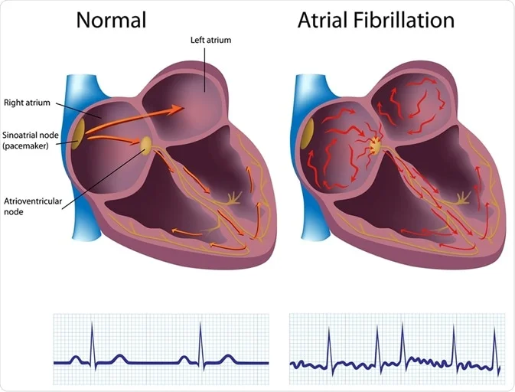
Introduction
The aim of this review has particular focus on the coronary circulation in the presence of ATRIAL FIBRILLATION
Most common arrhythmia
Its prevalence has been steadily increasing over the past decades
causes several disabling symptoms

Slide 4
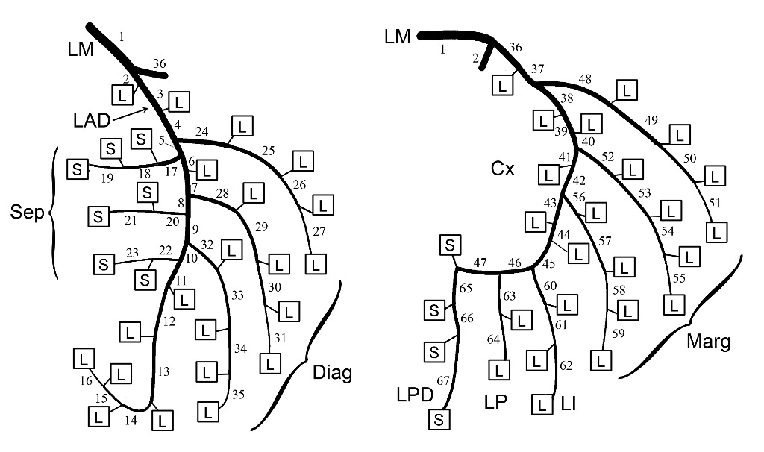




1D – 0D Model of Coronary Circulation
1D Model of Coronary Arteries
Similarity between left dominant anatomies in human and sheeps
1D EQUATIONS:

Slide 5
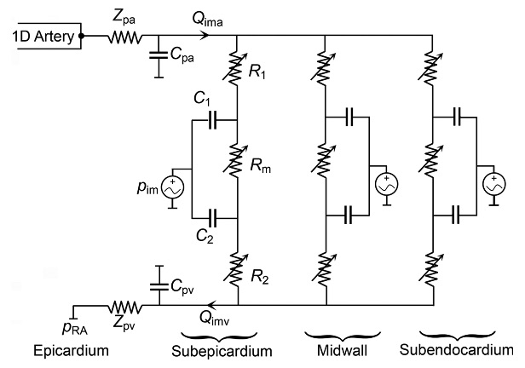



1D – 0D Model of Coronary Circulation
0D Model of intramyocardial microvascular bed
of each 1D coronary artery
$p_{CEP}→cavity induced extracellular pressure$
$p_{SIP}→shortening induced intracellular pressure$

Slide 6
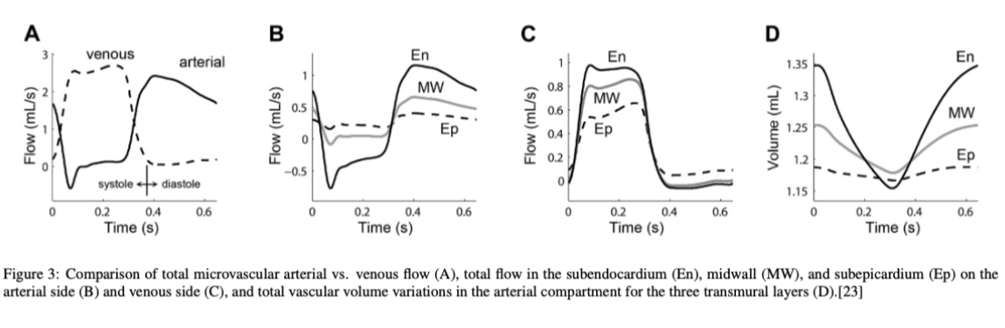
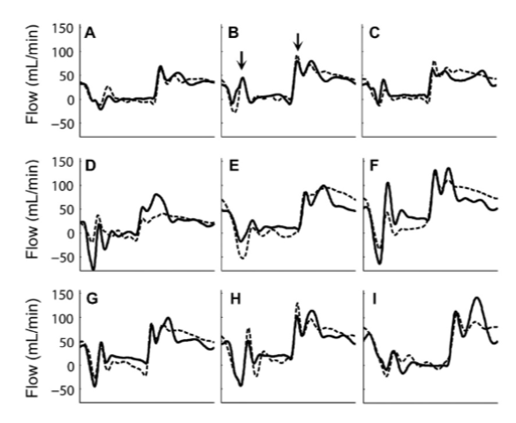
Results
Multiscale model was validated on two levels:
GENERAL VALIDATION, the flow patterns throughout the model closely matched published in vivo data
SUBJECT-SPECIFIC VALIDATION, the agreement between simulated and in vivo flow waveforms in nine adult sheep was generally excellent

Slide 7
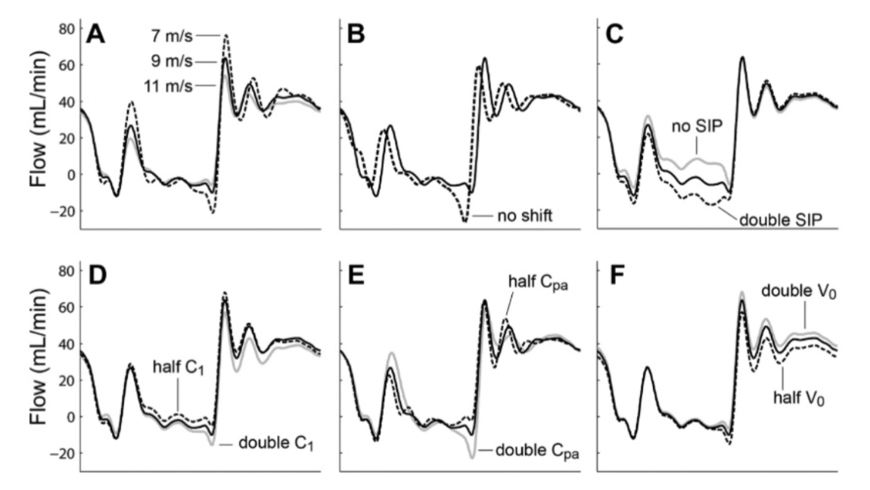

Results
SENSITIVITY ANALYSIS
They included only those global parameters whose values were approximated based on relatively loose constraints.
Analysis suggested that:
wave velocity is an important parameter governing systemic and diastolic flow transients
$p_{SIP}$ provides a substantial contribution to systolic flow.

Slide 8
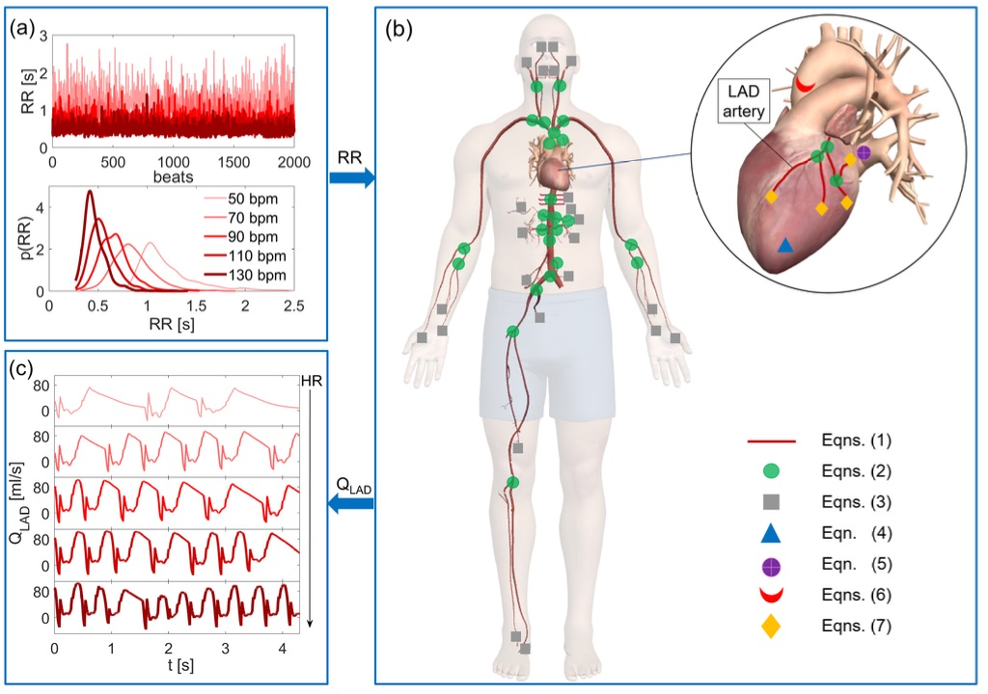



Open Loop Model to study effect of AF on Coronary Circulation
$RR=φ+η→$ cardiac beating period
b) Combination of coronary circulation model with the left heart and arterial tree
c) Hemodynamic parameters are based on the LAD (Left Anterior descending) artery:

Slide 9
Results
Higher HR during AF cause a general alteration of CBF and imbalance of the myocardial oxygen supply-demand ratio
CPP is no longer a good index to approximate the CBF for HR higher than 90 bpm
Waveform and amplitude of the CBF rate are deeply modified by increasing HR

Slide 10
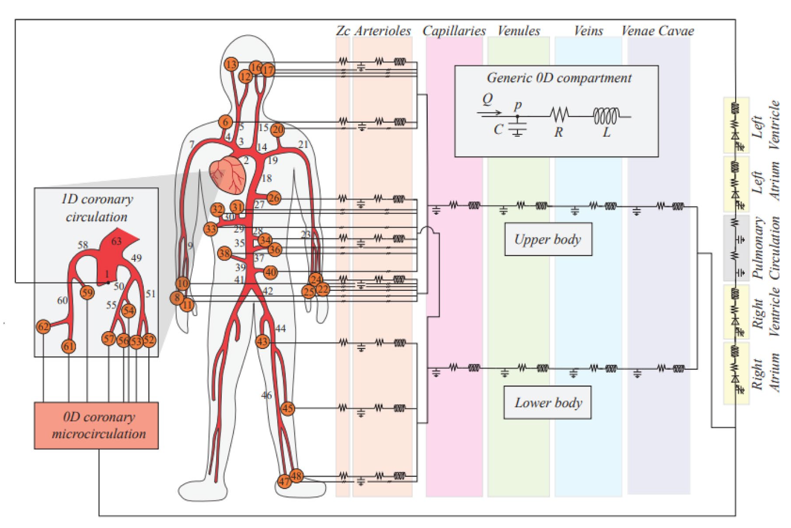
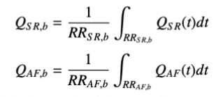
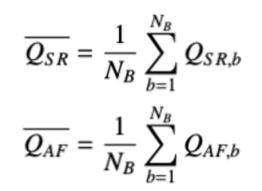
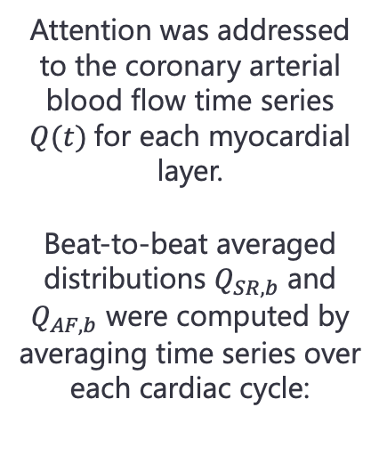
Closed Loop Model
Attention was addressed to the coronary arterial blood flow time series $Q(t)$for each myocardial layer.
Beat-to-beat averaged distributions $Q_{SR,b}$ and $Q_{AF,b}$ were computed by averaging time series over each cardiac cycle:

Slide 11
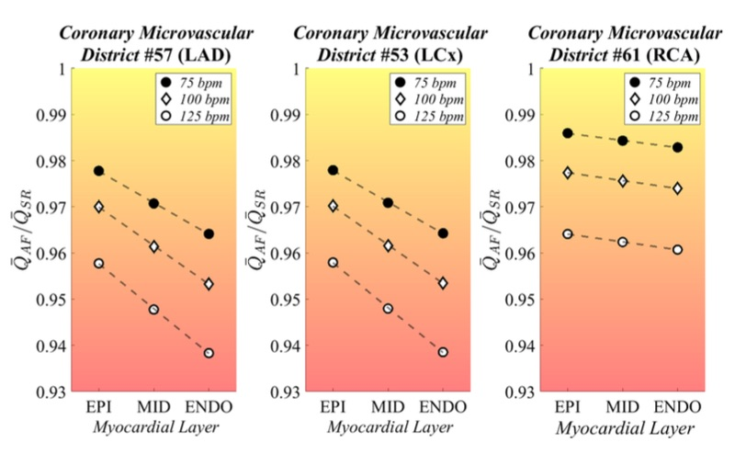
Results
AF caused a direct reduction in microvascular coronary flow, with the most important decrease seen in the subendocardial layers perfused by LAD and LCx

Slide 12
Conclusions and future developments
AF can significantly impact coronary hemodynamics
The main limitations of the Mynard’s model are related to simplifying assumptions.
The limitations of the Scarsoglio model have been surpassed by the Saglietto model.
Computational modeling can provide valuable insights for clinical practice and guide further in vivo investigations.

Slide 13
Thanks for your attention!
Virginia Clemente

Slide 14
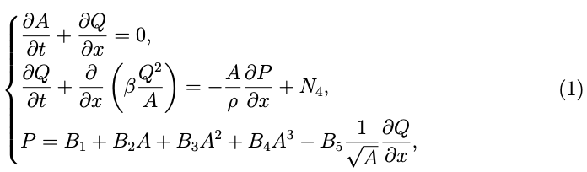

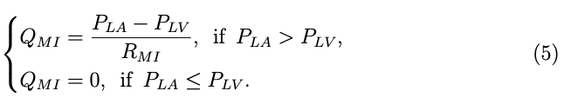
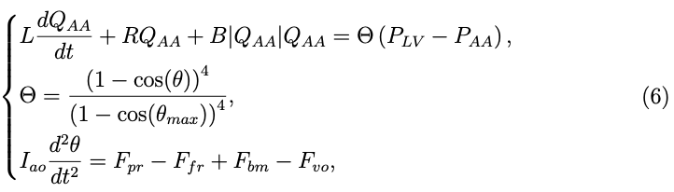
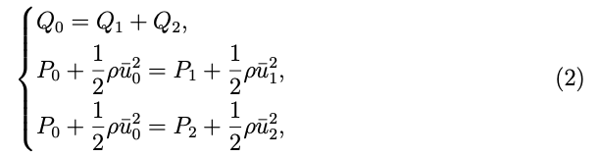
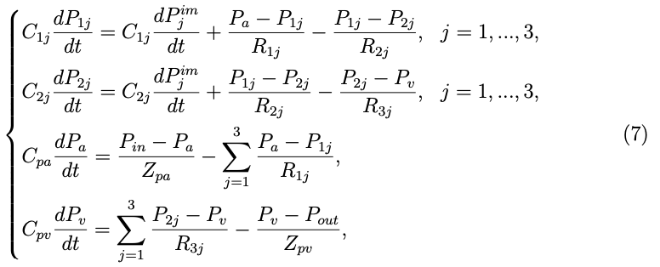

ARTERIAL TREE
LEFT HEART
Constitutive equations relating pressure and area for each 1D artery
Time-varying elastance model
Mitral valve
Conservation of mass and total pressure is set at each arterial junction
Aortic valve
Coronary Distal
Distal Groups of 3 element Windkessel submodel

Slide 15
