Slide 1
Measuring Urban Heat Island Effects in Charlottesville City
Chase Dawson

Slide 2
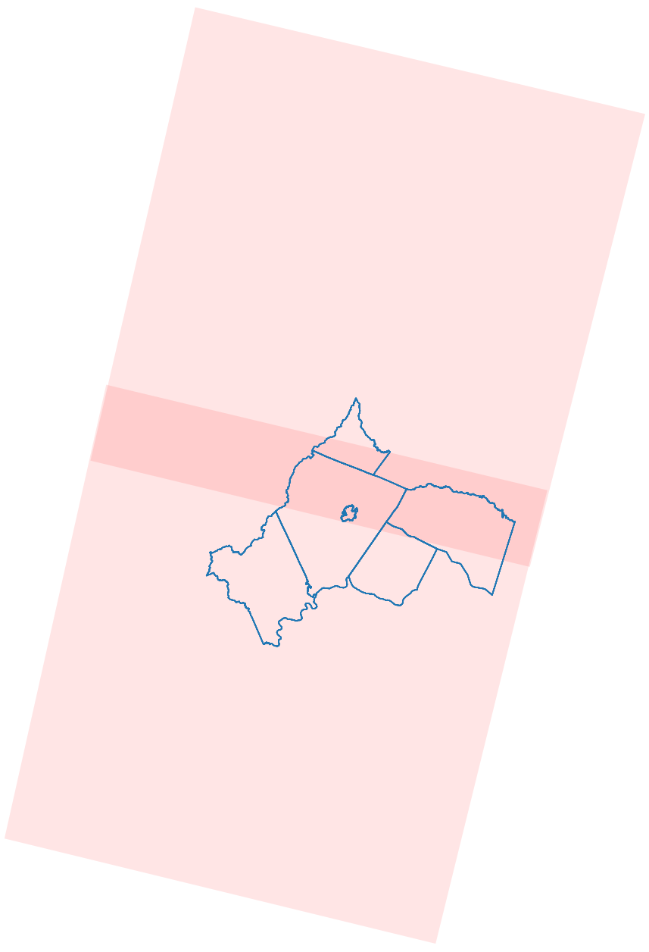
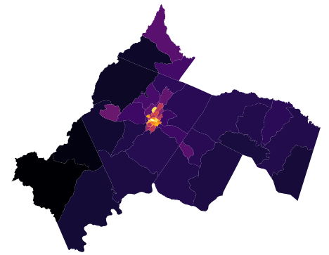

Charlottesville and Surrounding Region Intersected by Two Separate Landsat 8 Images
Warmer Urban Areas, Cooler Rural Areas
°F
Sept. 6th, 2020

Slide 3
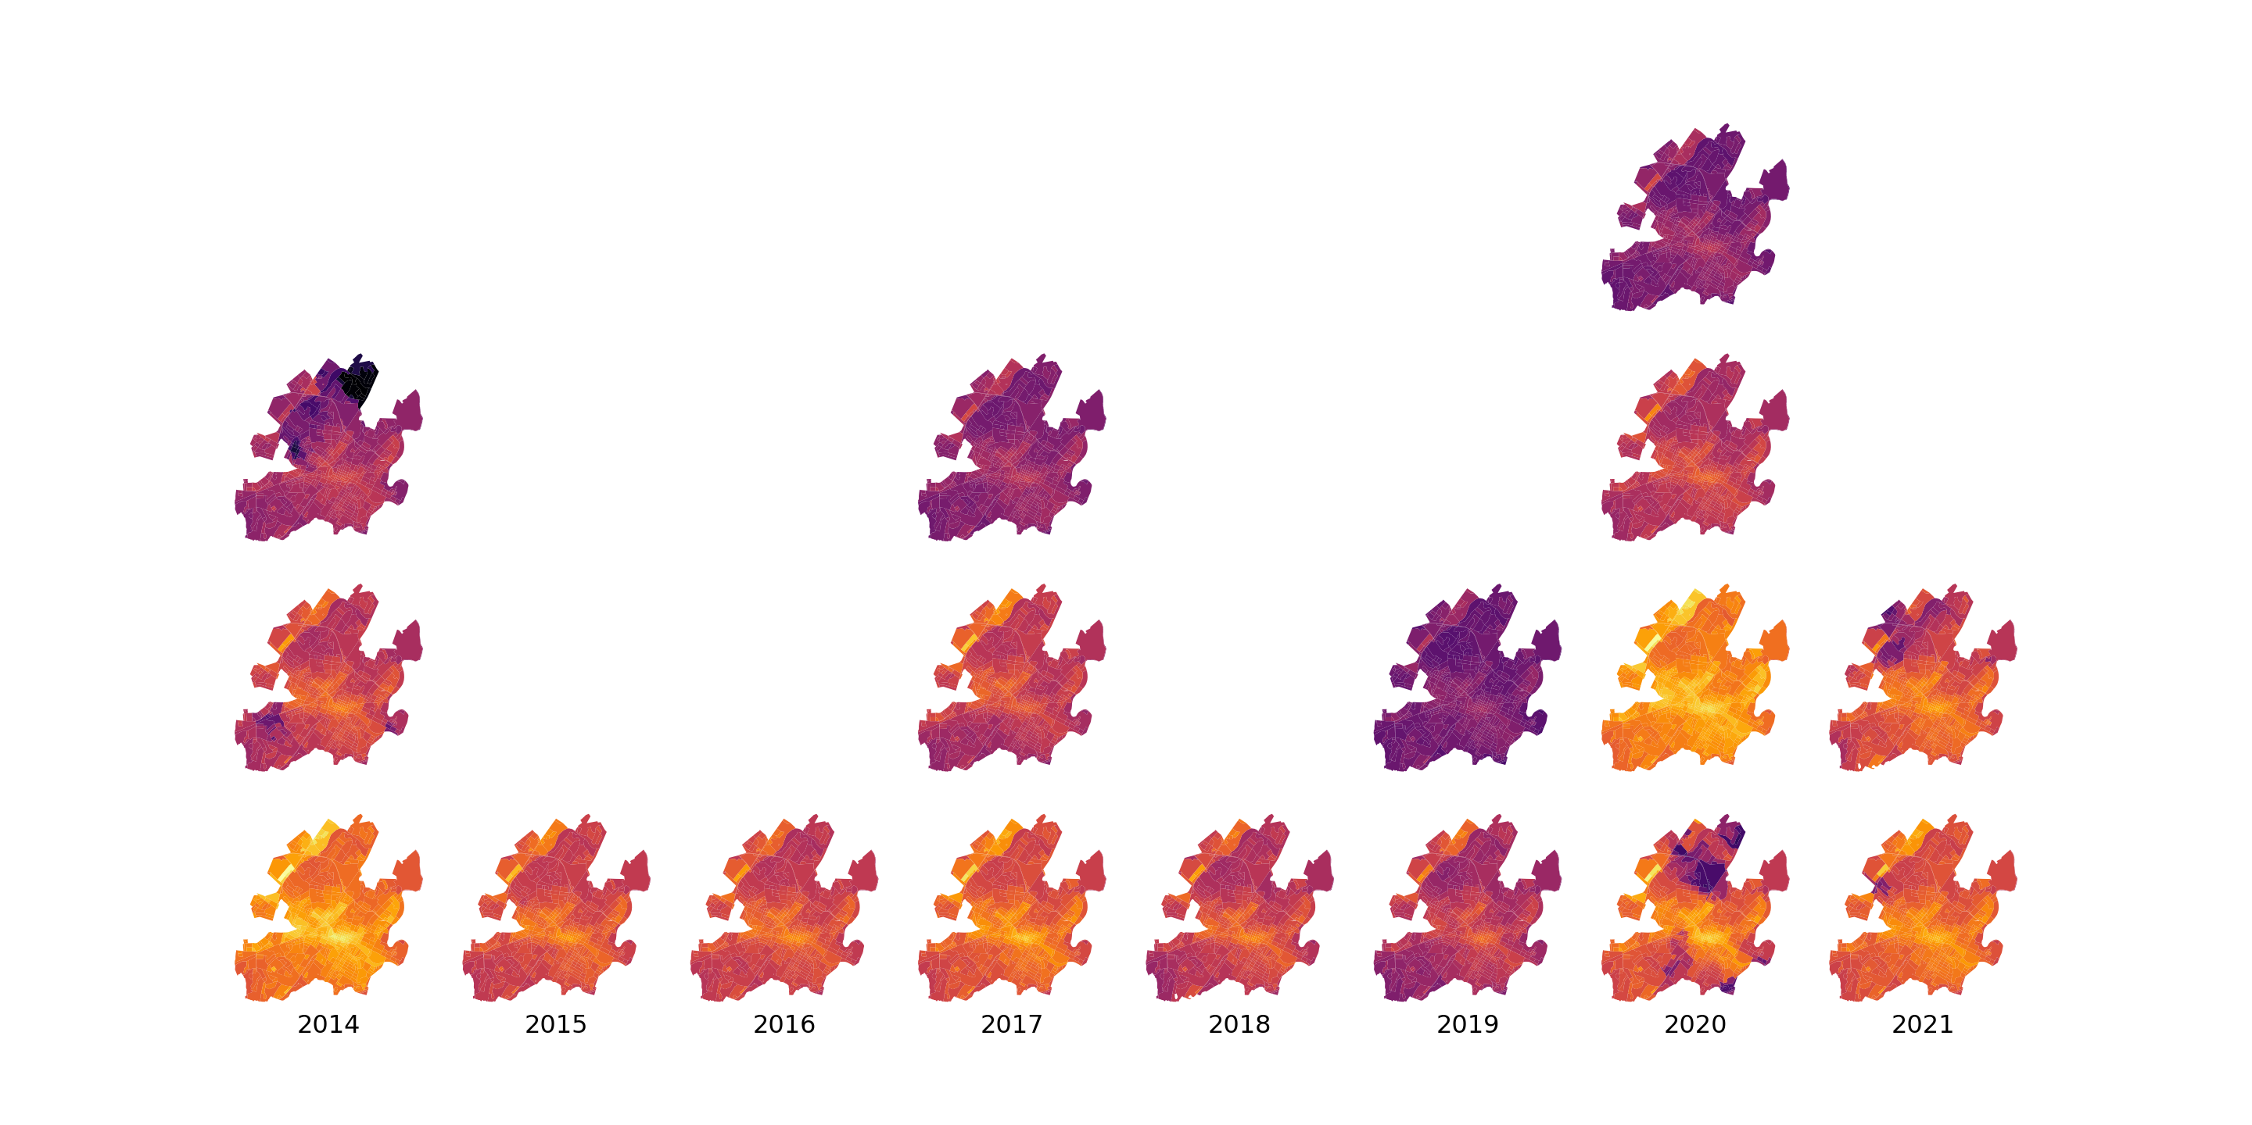

Block-Level Median Surface Temperature in Charlottesville City Over Time
°F

Slide 4
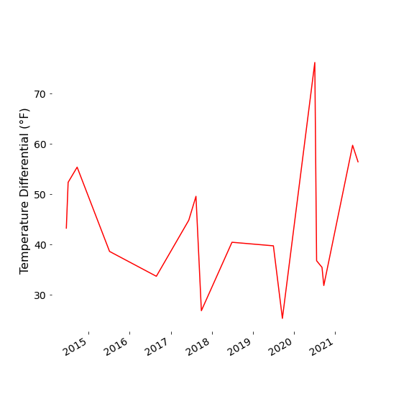
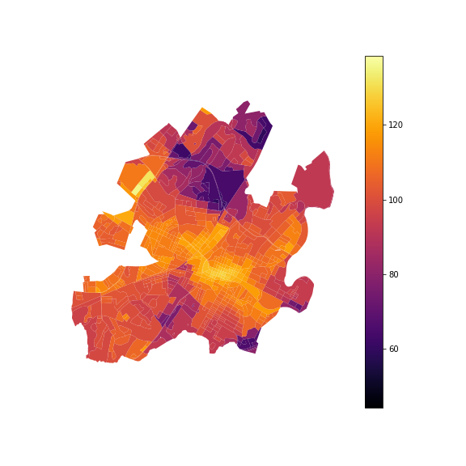
Temperature Differential Between Blocks with Highest Median Temperature and Lowest Median Temperature For Each Scene
July 4th, 2020 at 11:52 am
°F

Slide 5
Next Steps
include Albemarle County “urban ring” in the analysis
compare with other data sources such as tree canopy / green spaces and demographic data
understand the relationship between sun elevation and sun azimuth and surface temperature

