Slide 1

USER BEHAVIOR ANALYSIS
VIRGINIA PUTRI ANNISA

Slide 2
PROBLEM STATEMENT
Lack of granular visibility into how users interact with their cards & transactions.
Credit risk detection is reactive, not proactive.
Current segmentation is too broad, limiting product targeting & risk mitigation.
Absence of real-time fraud monitoring (dark web exposure, identity risks).
Why it matters: Without addressing these, financial institutions risk higher defaults, poor targeting, and potential losses.

Slide 3
Key Pain Points
High-risk dominance
53% of users are in Low Income High Debt → this group drives most defaults.
Low Chip Card Adoption
Only 1.43K chip cards out of 12K total → vulnerability to fraud remains.
Spending Misalignment
Low-income users exhibit disproportionately high spending, increasing credit stress.
Risk is not exclusive
Even High-Income groups show notable risk, suggesting lifestyle-driven debt.
Minimal Gender Gap
Male vs Female income & credit score differences are marginal → gender isn’t a strong segmentation factor.
💡 Implication: Strategies should be income/risk-driven, not gender-driven.

Slide 4
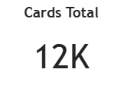
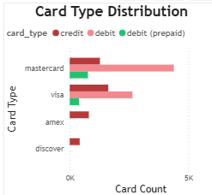
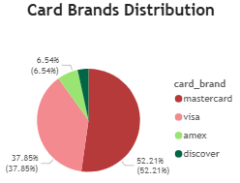
Cards & Transaction Behavior
Mastercard dominates (52%) → negotiation leverage for fees & partnerships.
Credit Cards > Debit Cards → users prefer credit leverage, increasing exposure.
Spending Pattern → low-income group shows the highest total spend → unsustainable.
Chip Card Penetration: 1.43K / 12K (≈12%) → still low adoption.
Dark Web Risk = 0% → current environment safe, but must maintain vigilance.

Slide 5
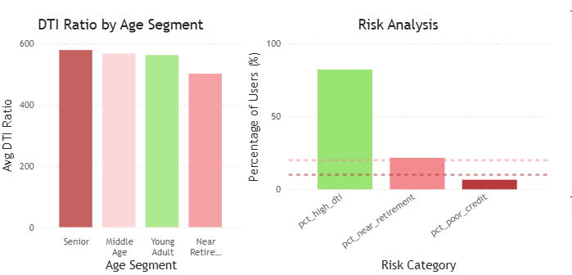
Risk & DTI
DTI ratios high for Low & Medium Income segments → repayment capacity stressed.
High-Risk users exist across all segments, proving risk is not only low-income specific.
Vulnerable Categories:
Poor Credit → already struggling with repayment.
Near Retirement → limited time to recover from financial setbacks.

Slide 6
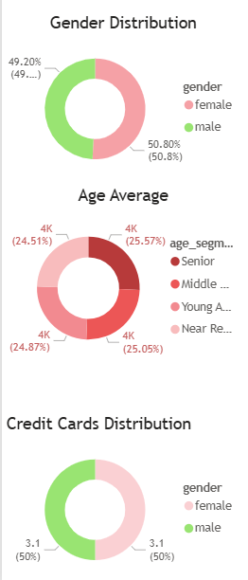
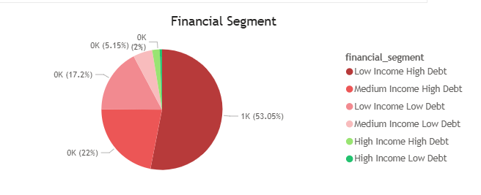
Profiling & Segmentation
Balanced Age Distribution (~25% each: Young, Middle, Senior, Near Retiree).
Largest Segment: Low Income High Debt (53%) → main risk driver.
Gender Split: almost equal (Male 49.2% vs Female 50.8%) → neutral factor.
Credit Card Usage: evenly distributed across genders.

Slide 7
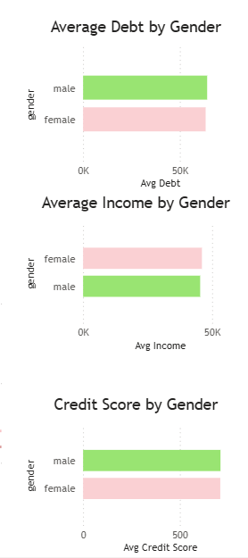
Gender Perspective
Debt: men slightly higher → aligns with marginally higher incomes.
Income: men earn more, but gap is small (gender not significant).
Credit Score: nearly identical → both genders show equal

Slide 8
Recommendations
Risk Management
Tighten credit limits for Low Income High Debt group.
Deploy early-warning scoring for Medium Income.
Product Strategy
Incentivize chip card adoption (discounts, rewards).
Leverage Mastercard dominance for stronger partnerships.
Marketing Strategy
Use gender-neutral campaigns.
Build financial literacy initiatives for low & medium income users.
Next Steps
Add time-series spending analysis to monitor trends.
Integrate geographic segmentation for regional targeting.
Enhance fraud detection integration.

Slide 9


