Slide 1
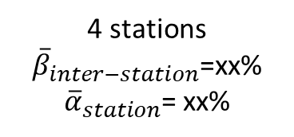

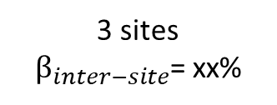
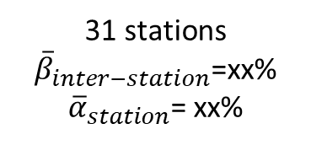


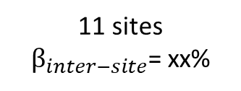

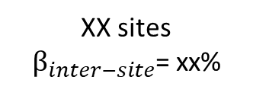
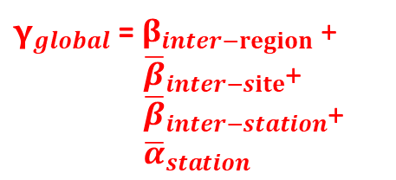
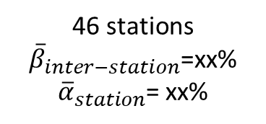
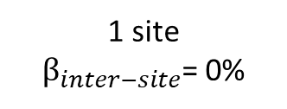
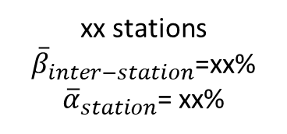

Diversity partitioning of MOTUs
${\text{γ}}_{global}$ = $β_{inter−region}$ +
${\overline{β}}_{inter−site}$+
${\overline{β}}_{inter−station}$+ ${\overline{α}}_{station}$
${\text{γ}}_{global}$ =100%
XX MOTUs
$β_{inter−region}$= xx%
Caribbean
Central Pacific
Western Indian
Central Indo-Pacific
${\overline{β}}_{inter−site}$= xx%
3 sites
${\text{β}}_{inter−site}$= xx%
1 site
${\text{β}}_{inter−site}$= 0%
XX sites
${\text{β}}_{inter−site}$= xx%
11 sites
${\text{β}}_{inter−site}$= xx%
${\overline{β}}_{inter−station}$= xx%
31 stations
${\overline{β}}_{inter−station}$=xx%
${\overline{α}}_{station}$= xx%
4 stations
${\overline{β}}_{inter−station}$=xx%
${\overline{α}}_{station}$= xx%
xx stations
${\overline{β}}_{inter−station}$=xx%
${\overline{α}}_{station}$= xx%
46 stations
${\overline{β}}_{inter−station}$=xx%
${\overline{α}}_{station}$= xx%
${\overline{α}}_{station}$= xx%

