Slide 1
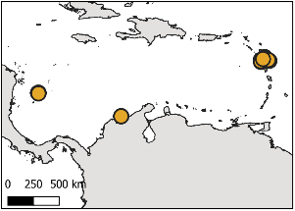
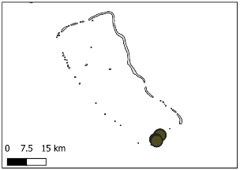
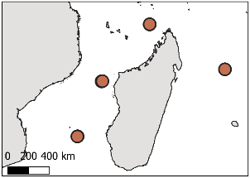
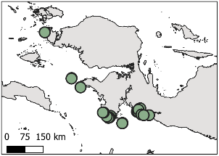
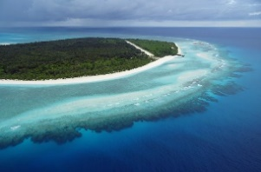
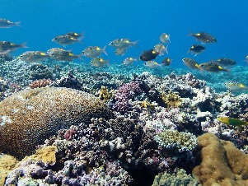




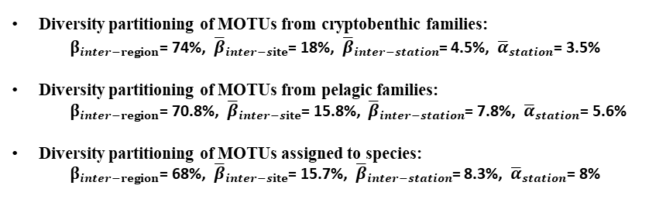









Diversity partitioning of all MOTUs
${\text{γ}}_{global}$ =100%
1713 MOTUs
$β_{inter−region}$= 71.5%
Caribbean
Central Pacific
West Indian
Central Indo-Pacific
${\overline{β}}_{inter−site}$= 17%
3 sites
${\text{β}}_{inter−site}$= 11%
1 site
${\text{β}}_{inter−site}$= 0%
4 sites
${\text{β}}_{inter−site}$= 11%
11 sites
${\text{β}}_{inter−site}$= 46%
${\overline{β}}_{inter−station}$= 6.5%
31 stations
${\overline{β}}_{inter−station}$= 6.3%
${\overline{α}}_{station}$= 4.1%
4 stations
${\overline{β}}_{inter−station}$= 4.3%
${\overline{α}}_{station}$= 4.3%
16 stations
${\overline{β}}_{inter−station}$= 5%
${\overline{α}}_{station}$= 5%
46 stations
${\overline{β}}_{inter−station}$= 10.6%
${\overline{α}}_{station}$= 7.3%
${\overline{α}}_{station}$= 5%
Diversity partitioning of MOTUs from cryptobenthic families:
$β_{inter−region}$= 74%, ${\overline{β}}_{inter−site}$= 18%, ${\overline{β}}_{inter−station}$= 4.5%, ${\overline{α}}_{station}$= 3.5%
Diversity partitioning of MOTUs from pelagic families:
$β_{inter−region}$= 70.8%, ${\overline{β}}_{inter−site}$= 15.8%, ${\overline{β}}_{inter−station}$= 7.8%, ${\overline{α}}_{station}$= 5.6%
Diversity partitioning of MOTUs assigned to species:
$β_{inter−region}$= 68%, ${\overline{β}}_{inter−site}$= 15.7%, ${\overline{β}}_{inter−station}$= 8.3%, ${\overline{α}}_{station}$= 8%

