Slide 1
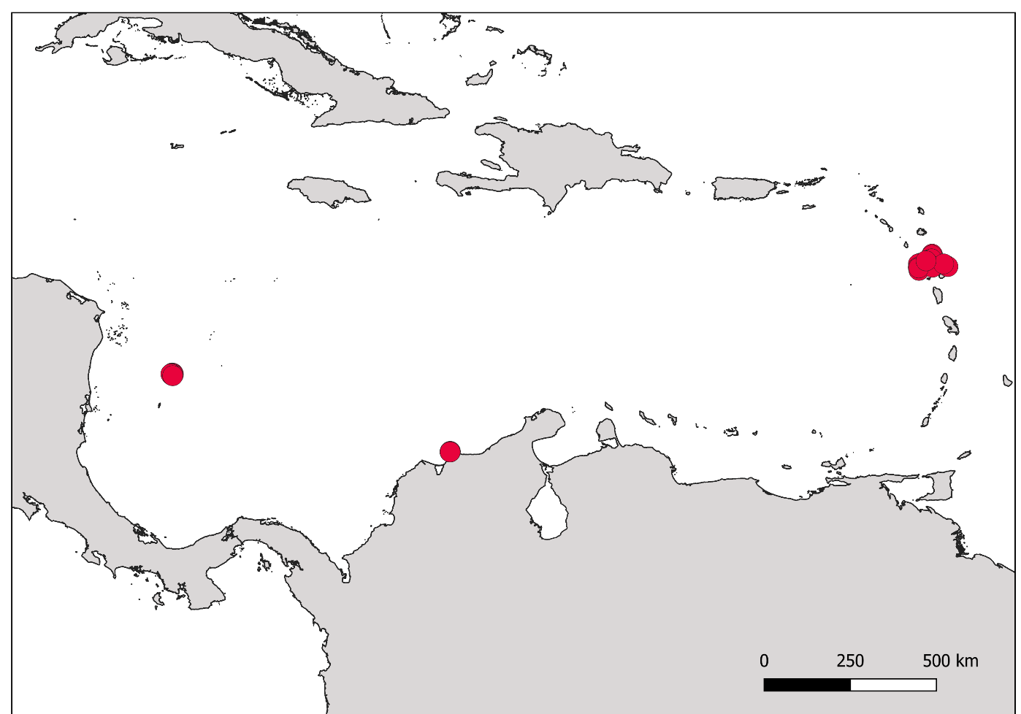
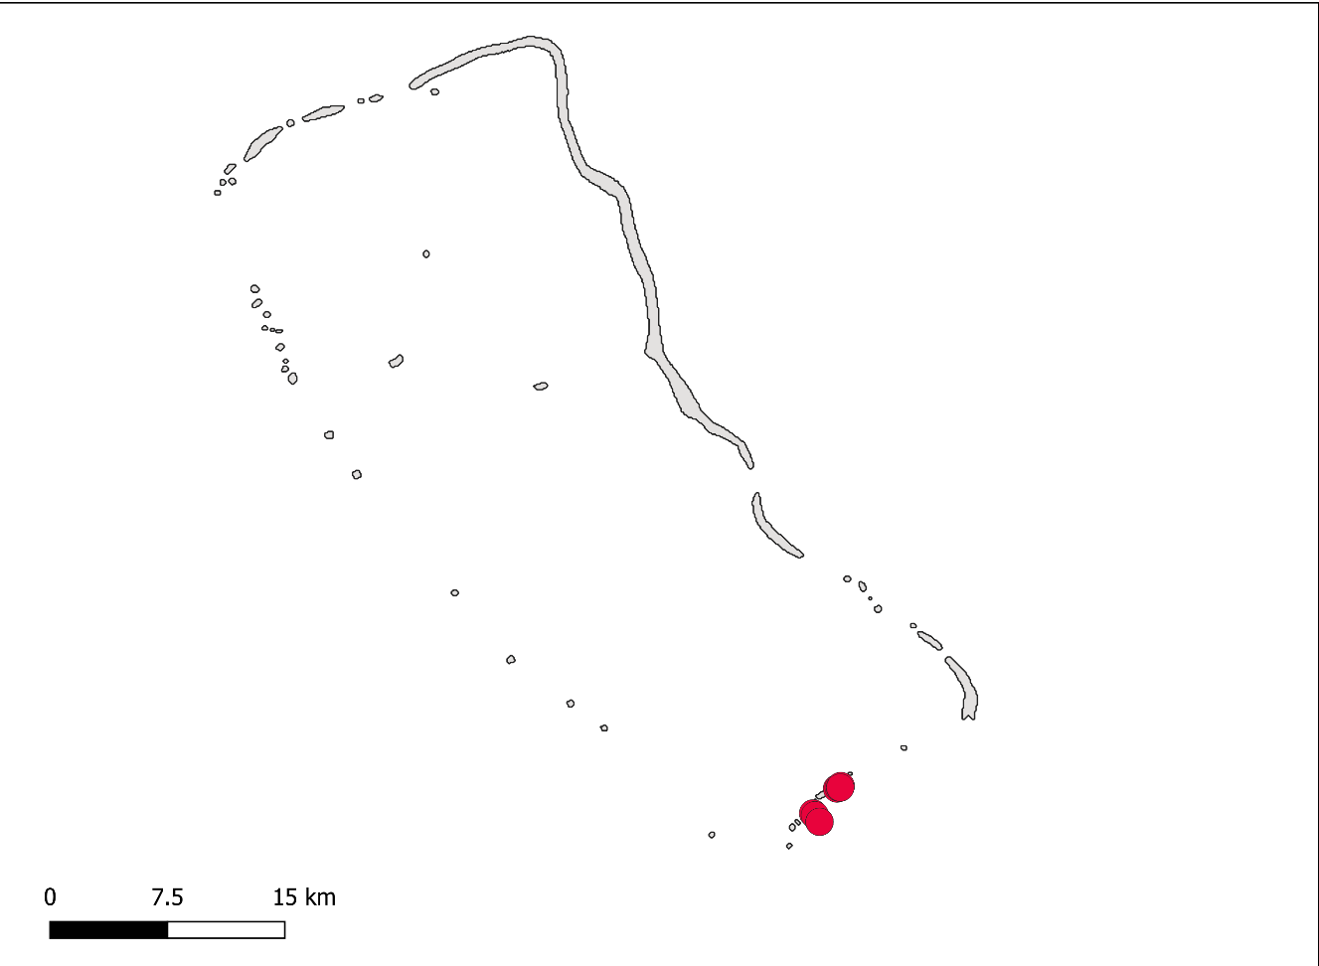
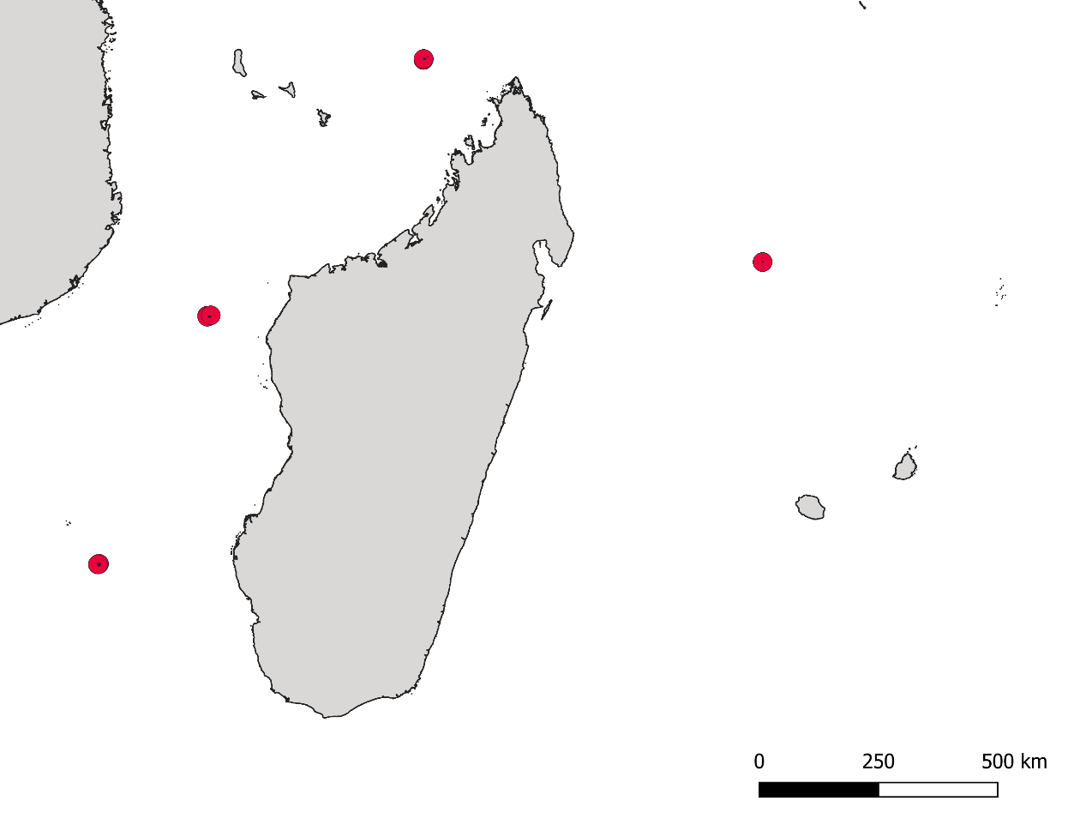
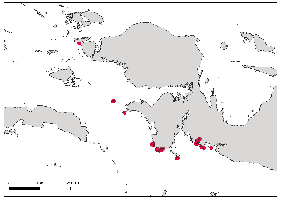
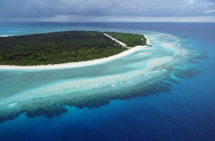
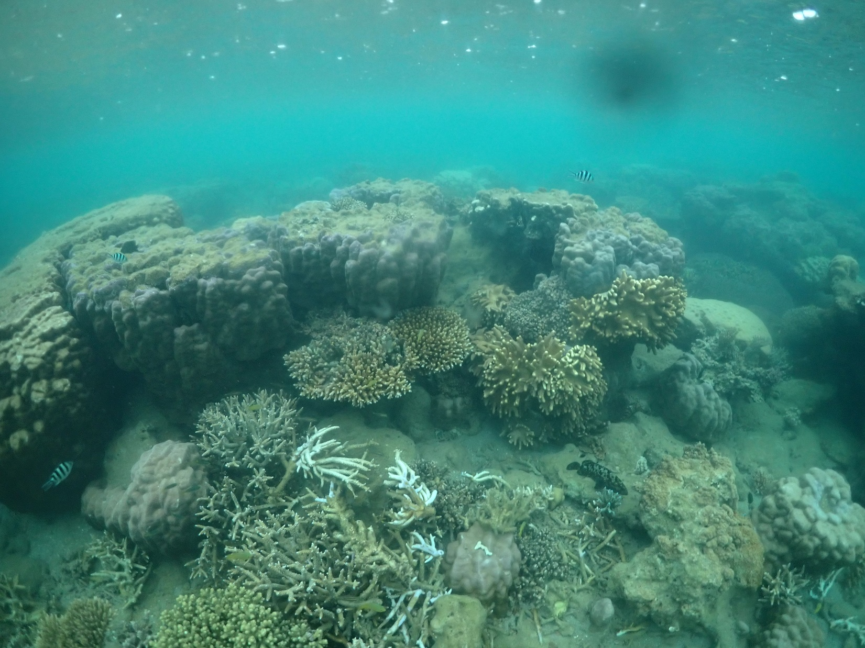




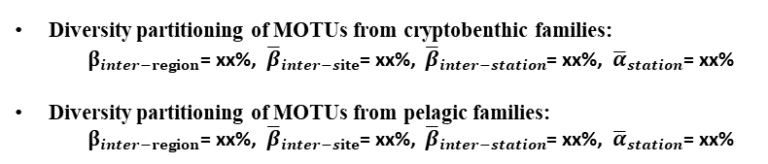









Diversity partitioning of all MOTUs
${\text{γ}}_{global}$ =100%
XX MOTUs
$β_{inter−region}$= xx%
Caribbean
Central Pacific
Western Indian
Central Indo-Pacific
${\overline{β}}_{inter−site}$= xx%
3 sites
${\text{β}}_{inter−site}$= xx%
1 site
${\text{β}}_{inter−site}$= 0%
XX sites
${\text{β}}_{inter−site}$= xx%
11 sites
${\text{β}}_{inter−site}$= xx%
${\overline{β}}_{inter−station}$= xx%
31 stations
${\overline{β}}_{inter−station}$=xx%
${\overline{α}}_{station}$= xx%
4 stations
${\overline{β}}_{inter−station}$=xx%
${\overline{α}}_{station}$= xx%
xx stations
${\overline{β}}_{inter−station}$=xx%
${\overline{α}}_{station}$= xx%
46 stations
${\overline{β}}_{inter−station}$=xx%
${\overline{α}}_{station}$= xx%
${\overline{α}}_{station}$= xx%
Diversity partitioning of MOTUs from cryptobenthic families:
$β_{inter−region}$= xx%, ${\overline{β}}_{inter−site}$= xx%, ${\overline{β}}_{inter−station}$= xx%, ${\overline{α}}_{station}$= xx%
Diversity partitioning of MOTUs from pelagic families:
$β_{inter−region}$= xx%, ${\overline{β}}_{inter−site}$= xx%, ${\overline{β}}_{inter−station}$= xx%, ${\overline{α}}_{station}$= xx%

