Slide 1
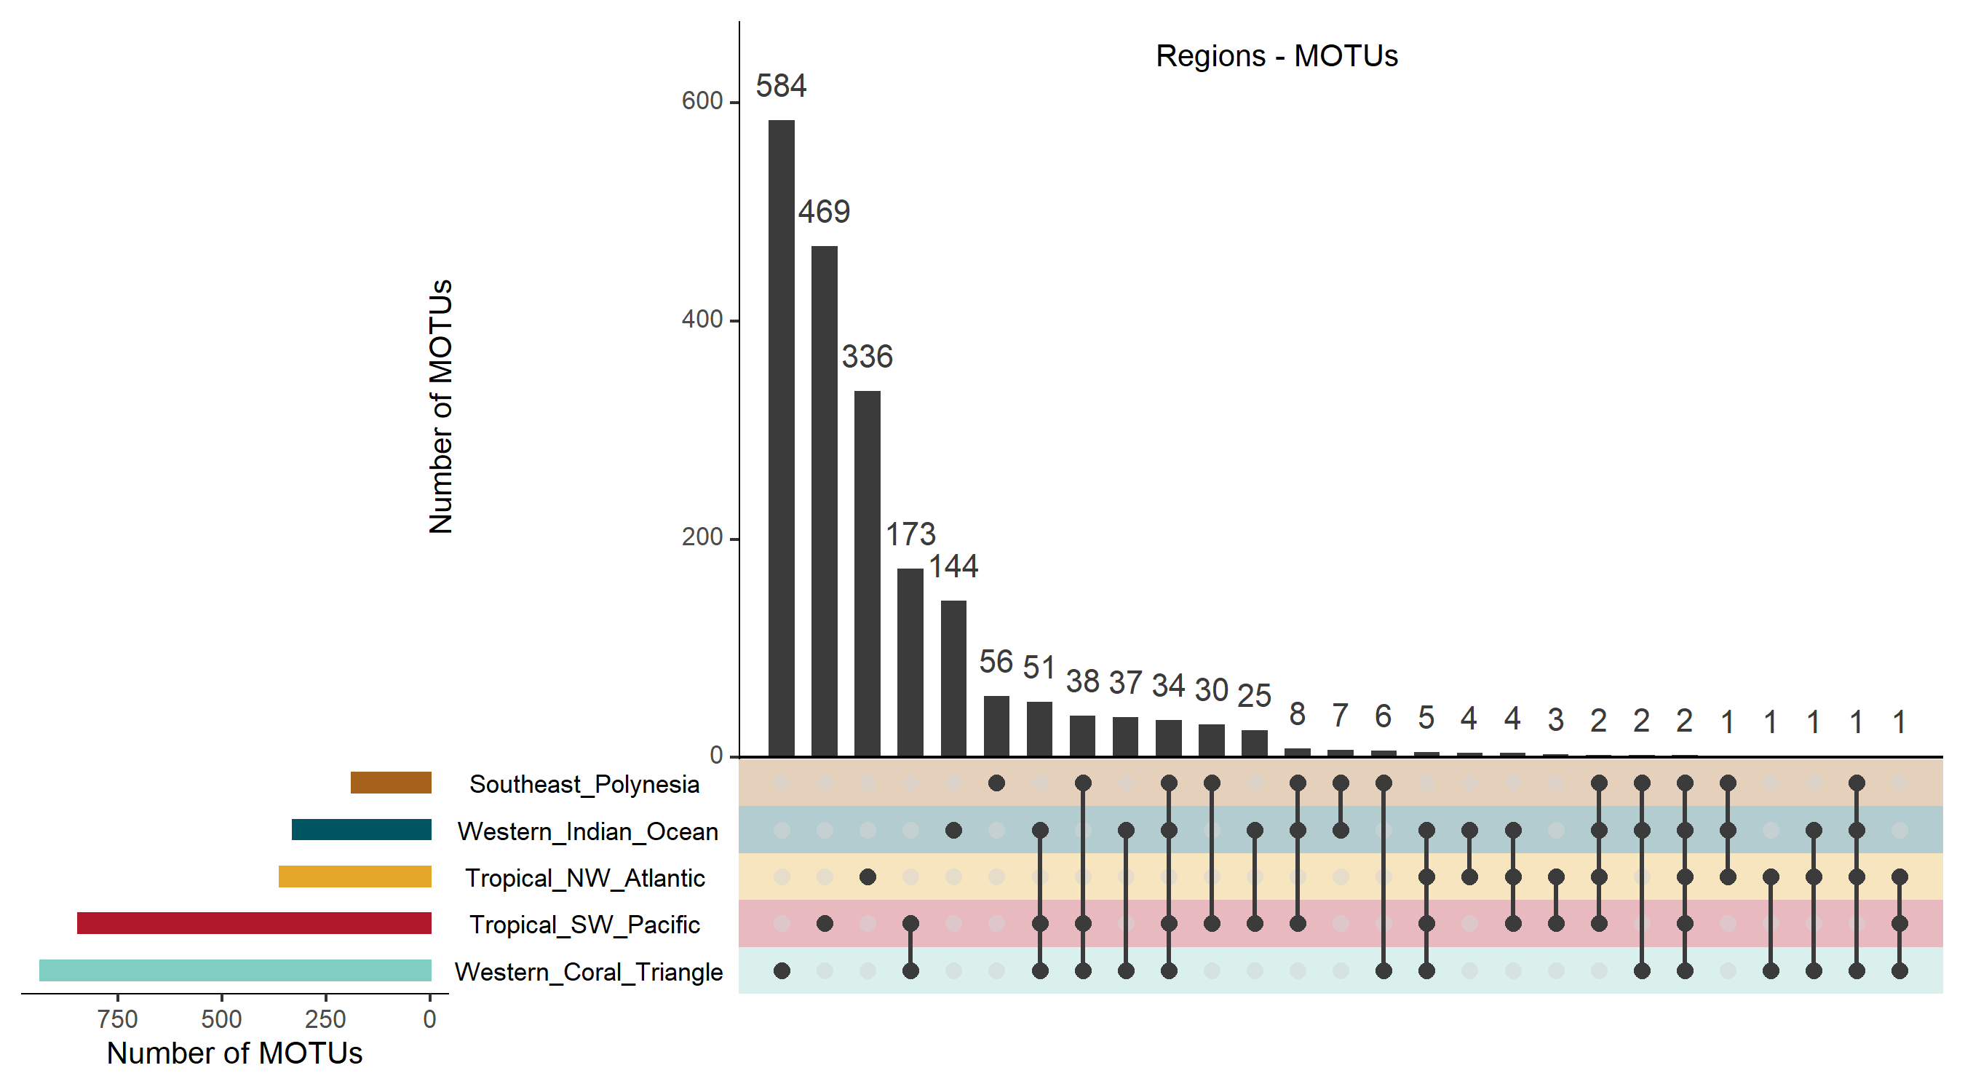
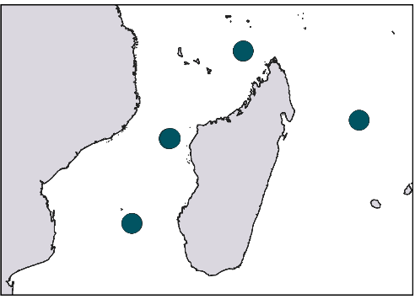

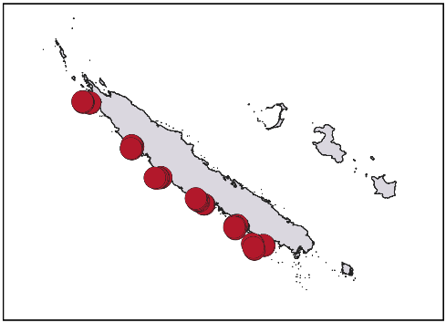


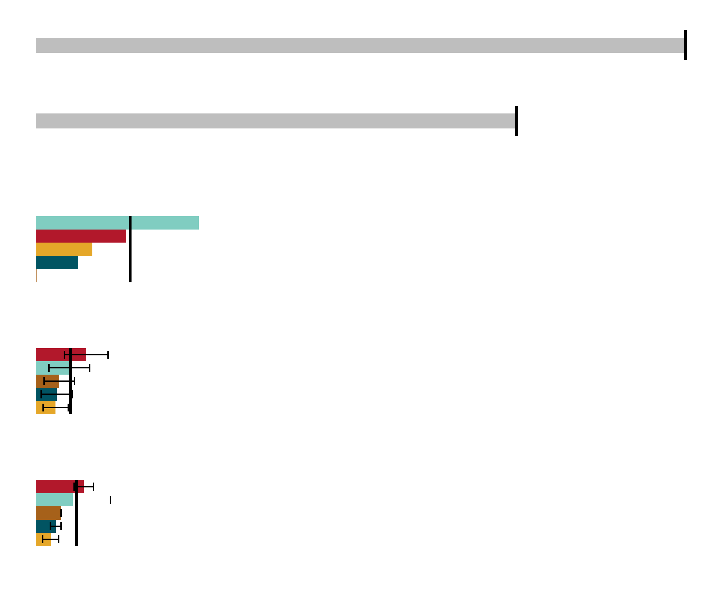


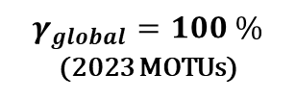






a
b
Western Indian Ocean
Western Coral Triangle
Tropical SW Pacific
Southeast Polynesia
Tropical NW Atlantic
4 sites
16 stations
9 sites
32 stations
6 sites
18 stations
1 site
4 stations
6 sites
30 stations
γ
$γ_{global}=100 \%$ (2023 MOTUs)
0
$$β_{r}$$
100 %
0
$$β_{inter−region}=73,7 \%$$
$${\overline{β}}_{s}$$
$${\overline{β}}_{inter−site}=14.8 \%$$
0
$${\overline{β}}_{st}$$
$${\overline{β}}_{inter−station}=5.9 \%$$
0
$$\overline{α}$$
$${\overline{α}}_{station}=5.7 \%$$
0

Slide 2
