Slide 1
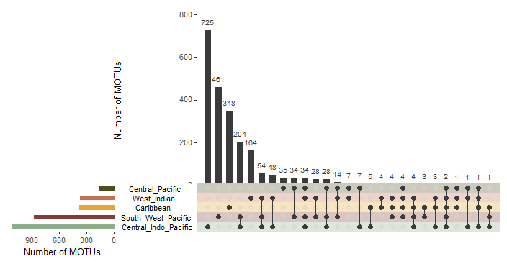
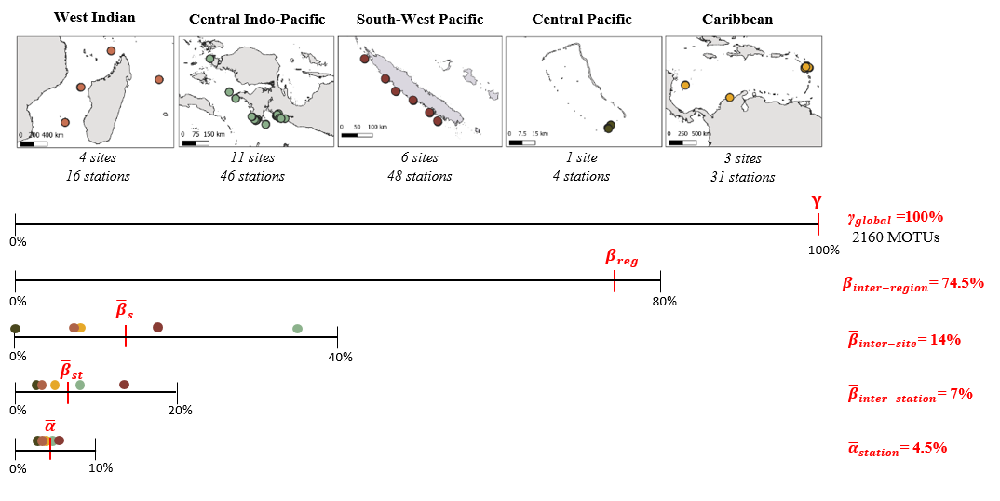
a
b

Slide 2
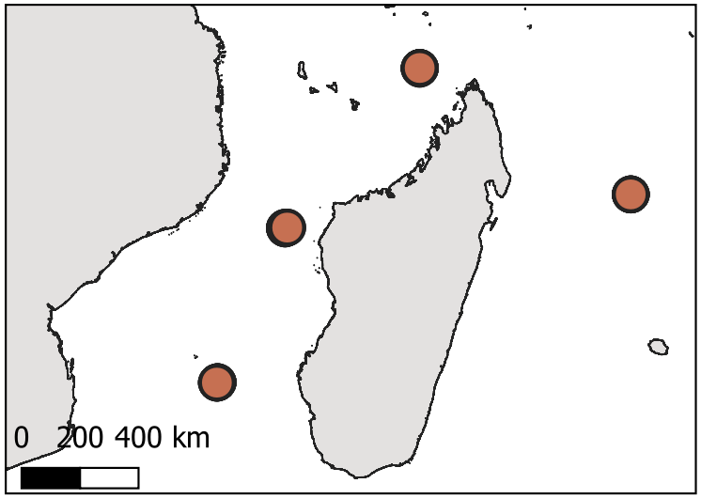
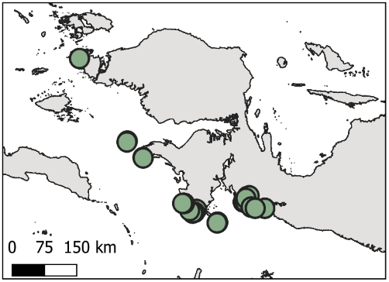
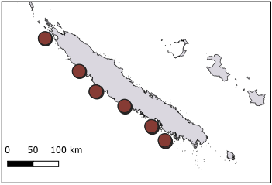
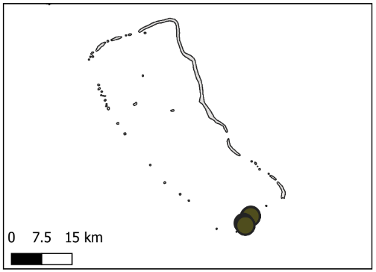
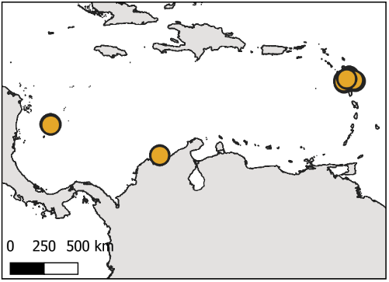
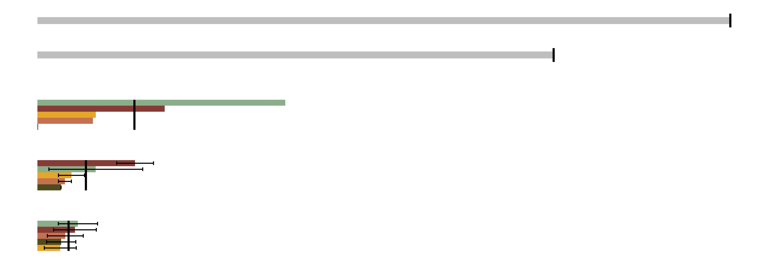









a
b
West Indian
Central Indo-Pacific
South-West Pacific
Central Pacific
Caribbean
4 sites
16 stations
11 sites
46 stations
6 sites
48 stations
1 site
4 stations
3 sites
31 stations
γ
0
$$β_{r}$$
100 %
$γ_{global}=100 \%$ (2160 MOTUs)
0
$${\overline{β}}_{s}$$
$$β_{inter−region}=74.5 \%$$
0
$${\overline{β}}_{st}$$
$${\overline{β}}_{inter−site}=14 \%$$
$${\overline{β}}_{inter−station}=7 \%$$
0
$$\overline{α}$$
$${\overline{α}}_{station}=4.5 \%$$
0

