Slide 1
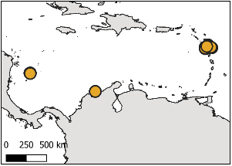
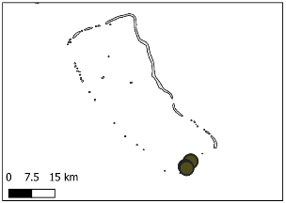
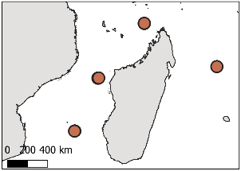
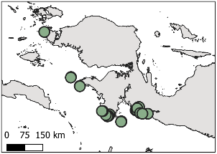
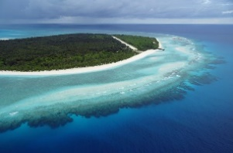
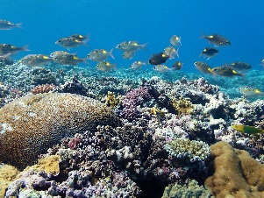


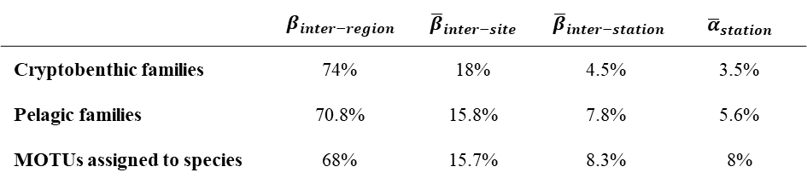











Diversity partitioning of all MOTUs
${\text{γ}}_{global}$ =100%
1713 MOTUs
$β_{inter−region}$= 71.5%
Caribbean
Central Pacific
West Indian
Central IndoPacific
${\overline{β}}_{inter−site}$= 17%
3 sites
${\text{β}}_{inter−site}$= 11%
1 site
${\text{β}}_{inter−site}$= 0%
4 sites
${\text{β}}_{inter−site}$= 11%
11 sites
${\text{β}}_{inter−site}$= 46%
${\overline{β}}_{inter−station}$= 6.5%
31 stations
${\overline{β}}_{inter−station}$= 6.3%
${\overline{α}}_{station}$= 4.1%
4 stations
${\overline{β}}_{inter−station}$= 4.3%
${\overline{α}}_{station}$= 4.3%
16 stations
${\overline{β}}_{inter−station}$= 5%
${\overline{α}}_{station}$= 5%
46 stations
${\overline{β}}_{inter−station}$= 10.6%
${\overline{α}}_{station}$= 7.3%
${\overline{α}}_{station}$= 5%
 | $$β_{inter−region}$$ | $${\overline{β}}_{inter−site}$$ | $${\overline{β}}_{inter−station}$$ | $${\overline{α}}_{station}$$
Cryptobenthic families | 74% | 18% | 4.5% | 3.5%
Pelagic families | 70.8% | 15.8% | 7.8% | 5.6%
MOTUs assigned to species | 68% | 15.7% | 8.3% | 8%

