Slide 1
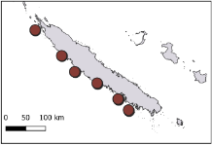
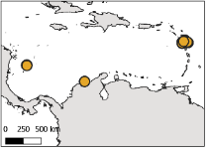
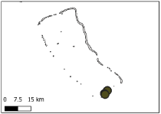
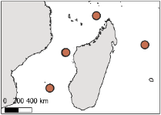
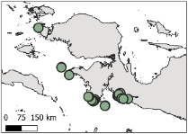
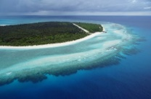
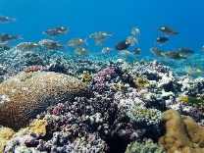



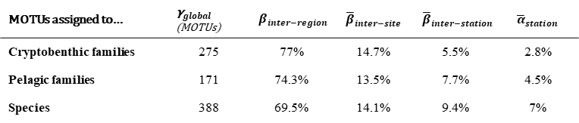












${\text{γ}}_{global}$ =100%
2160 MOTUs
a - Diversity partitioning of all MOTUs
$β_{inter−region}$= 74.5%
South West Pacific
Caribbean
Central Pacific
West Indian
Central Indo Pacific
${\overline{β}}_{inter−site}$= 14%
6 sites
${\text{β}}_{inter−site}$= 18.3%
3 sites
${\text{β}}_{inter−site}$= 8.6%
1 site
${\text{β}}_{inter−site}$= 0%
4 sites
${\text{β}}_{inter−site}$= 8.2%
11 sites
${\text{β}}_{inter−site}$= 35.6%
${\overline{β}}_{inter−station}$= 7%
48 stations
${\overline{β}}_{inter−station}$= 14%
${\overline{α}}_{station}$= 5.4%
31 stations
${\overline{β}}_{inter−station}$= 5%
${\overline{α}}_{station}$= 4.2%
4 stations
${\overline{β}}_{inter−station}$= 3.4%
${\overline{α}}_{station}$= 3.4%
16 stations
${\overline{β}}_{inter−station}$= 4%
${\overline{α}}_{station}$= 4%
46 stations
${\overline{β}}_{inter−station}$= 8.4%
${\overline{α}}_{station}$= 5%
${\overline{α}}_{station}$= 4.5%
b
MOTUs assigned to… | ${\text{γ}}_{global}$ (MOTUs) | $$β_{inter−region}$$ | $${\overline{β}}_{inter−site}$$ | $${\overline{β}}_{inter−station}$$ | $${\overline{α}}_{station}$$
Cryptobenthic families | 275 | 77% | 14.7% | 5.5% | 2.8%
Pelagic families | 171 | 74.3% | 13.5% | 7.7% | 4.5%
Species | 388 | 69.5% | 14.1% | 9.4% | 7%
c
 | $${\text{γ}}_{global}$$ | $$β_{inter−region}$$ | $${\overline{β}}_{inter−site}$$ | $${\overline{β}}_{inter−transect}$$ | $${\overline{α}}_{transect}$$
RLS species | 1786 | 88.4% | 8.5% | 1% | 2.8%

Slide 2
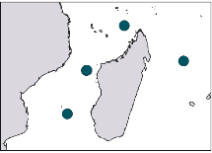
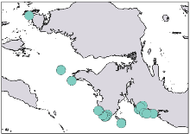
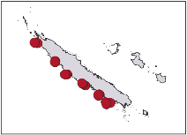
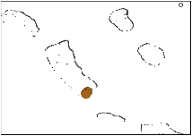
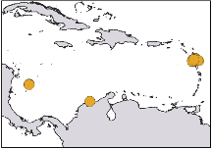















${\text{γ}}_{global}$ =100%
2023 MOTUs
$β_{inter−region}$= 73.7%
Western Indian Ocean
Western Coral Triangle
Tropical SW Pacific
Southeast Polynesia
Tropical NW Atlantic
${\overline{β}}_{inter−site}$= 14,8%
4 sites
${\text{β}}_{inter−site}$= 8.3%
9 sites
${\text{β}}_{inter−site}$= 29.5%
6 sites
${\text{β}}_{inter−site}$= 20.6%
1 site
${\text{β}}_{inter−site}$= 0%
6 sites
${\text{β}}_{inter−site}$= 11.3%
${\overline{β}}_{inter−station}$= 5,9%
16 stations
${\overline{β}}_{inter−station}$= 3.8%
${\overline{α}}_{station}$= 4.1%
32 stations
${\overline{β}}_{inter−station}$= 5.6%
${\overline{α}}_{station}$= 5.8%
18 stations
${\overline{β}}_{inter−station}$= 10,5%
${\overline{α}}_{station}$= 10.6%
4 stations
${\overline{β}}_{inter−station}$= 4.7%
${\overline{α}}_{station}$= 4.4%
30 stations
${\overline{β}}_{inter−station}$= 2,6%
${\overline{α}}_{station}$= 3.1%
${\overline{α}}_{station}$= 5.7%

Slide 3









West Indian
Central Indo-Pacific
South-West Pacific
Central Pacific
Caribbean
4 sites
16 stations
11 sites
46 stations
6 sites
48 stations
1 site
4 stations
3 sites
31 stations
γ
${\text{γ}}_{global}$ =100%
2160 MOTUs
0%
$$β_{reg}$$
100%
$β_{inter−region}$= 74.5%
0%
$${\overline{β}}_{s}$$
80%
${\overline{β}}_{inter−site}$= 14%
0%
$${\overline{β}}_{st}$$
40%
${\overline{β}}_{inter−station}$= 7%
0%
$$\overline{α}$$
20%
${\overline{α}}_{station}$= 4.5%
0%
10%

