Slide 1

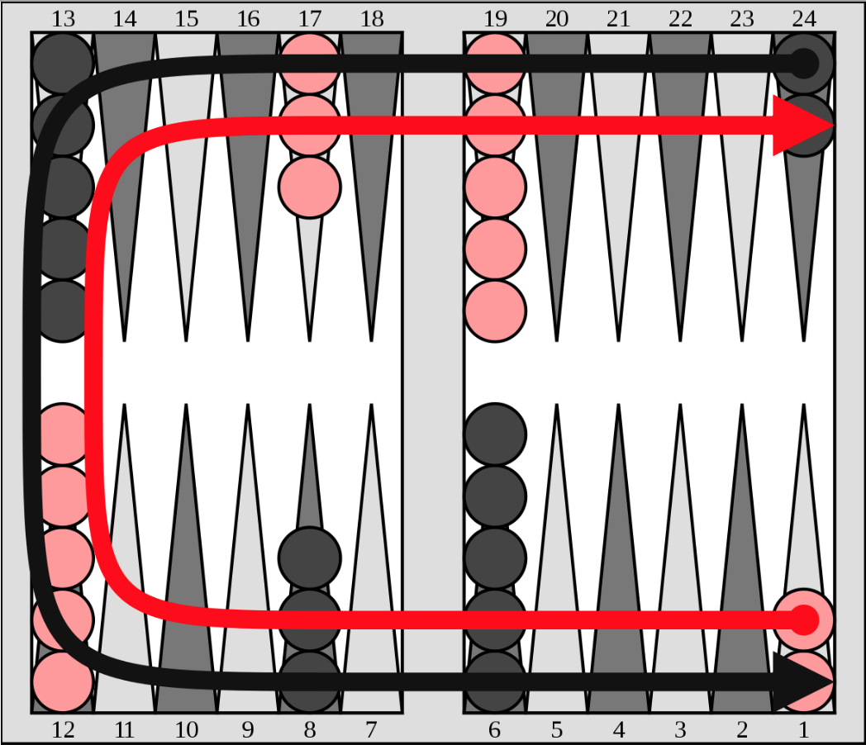
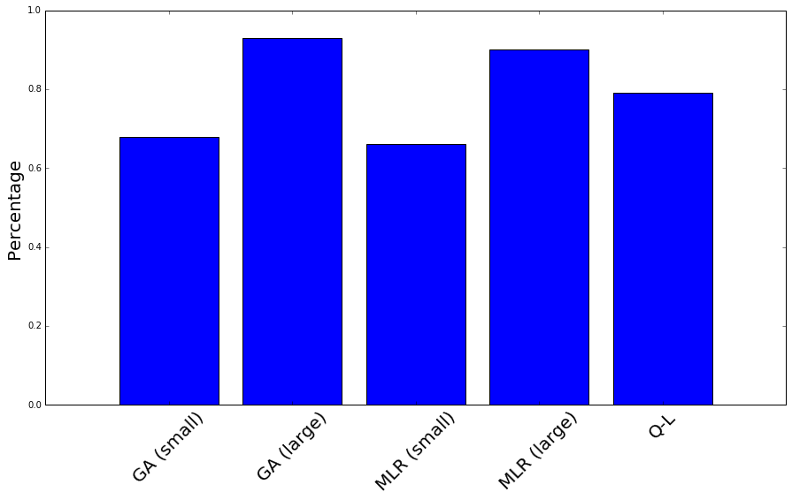
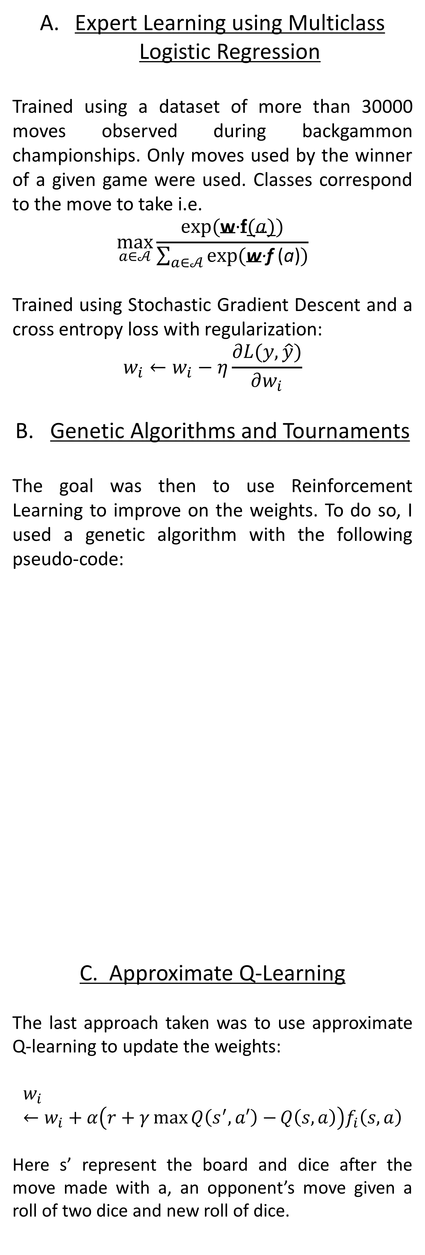
Building A Backgammon AI
Virgile Audi
vaudi@g.harvard.edu
CS182 - Fall 2016
Introduction
Backgammon is an easy game to play, but not easy to play well.
Can an AI learn to play it well?
Backgammon is one of the oldest board games known to men. It is a 2 player zero-sum game, where playing pieces are moved according to the roll of 2 dice, and a player wins by removing all of his/her pieces from the board before his/her opponent. Players can stop their opponent’s progression by capturing left alone pawns.
The goal of this project was inspired by the approach taken to create the AlphaGo AI i.e. train an AI by using both expert learning topped with Reinforcement Learning.
Models and Algorithm
Results
Expert Learning using Multiclass Logistic Regression
Trained using a dataset of more than 30000 moves observed during backgammon championships. Only moves used by the winner of a given game were used. Classes correspond to the move to take i.e.
$$\max_{a∈𝒜}{\frac{exp(\text{w}\text{·}\text{f}(a))}{\sum_{a∈𝒜}{exp⁡(\text{w}\text{·}\text{f} \text{(}\text{a}\text{)})}}}$$
Trained using Stochastic Gradient Descent and a cross entropy loss with regularization:
$$w_{i}←w_{i}−η\frac{∂L(y,\hat{y})}{∂w_{i}}$$
Genetic Algorithms and Tournaments
The goal was then to use Reinforcement Learning to improve on the weights. To do so, I used a genetic algorithm with the following pseudo-code:
C. Approximate Q-Learning
The last approach taken was to use approximate Q-learning to update the weights:
$$w_{i}←w_{i}+α\left(r+γ\max{Q\left(s^{′},a′\right)−}Q\left(s,a\right)\right)f_{i}\left(s,a\right)$$
Here s’ represent the board and dice after the move made with a, an opponent’s move given a roll of two dice and new roll of dice.
In order to asses the results, two methods were used:
Evaluating the accuracy of predictions on held-out test data of ”pro” moves
Playing tournaments opposing AI’s at different levels of training and/or between different methods of training: logistic vs genetic for instance
Mastering the game of Go with deep neural networks and tree search, Deep- Mind in Nature January 2016
Temporal Difference Learning and TD-Gammon, Gerald Tesauro, 1995
Why Did TD-Gammon Work, J. B. Pollack and A. D. Blair, 1996
Self-Play and Using an Expert to Learn to Play Backgammon with Temporal Difference Learning, Marco A. Wiering 2010
Figure 1. Board and Rule of Backgammon
Figure 2. Accuracy on held-out test data
Problem Formulation
Step 0: Initialize the weights using the results of the logistic regression
While it < max_it:
Generate a contestant by perturbing slightly each weight: ŵ_i = w_i + U(-.5,.5)
Play a tournament i.e. first to 15 points
If current champion wins:
Continue
Else:
Update the weights:
w_i = (1-a)w_i + aŵ_i
where a depends on the amplitude of the win
 | GA (L) | MLR (S) | MLR (L) | Q-L
GA(S) | (8-15) | (15-5) | (15-6) | (16-1)
GA(L) |  | (15-0) | (16-0) | (15-0)
MLR (S) |  |  | (1-15) | (8-15)
MLR (L) |  |  |  | (15-2)
For the scope of this project, we will use the framework of Markov Decision Process:
States s∈𝑆 : All possible distributions of pawns combined with a roll of two dice
Set of actions a∈𝒜 given by the possible moves of pawns given the board and dice
The objective is to choose the optimal move at each step. We can evaluate the number of boards in backgammon to 18,528,584,051,601,162,496, which would make evaluating a value for every state completely infeasible. We therefore resorted to approximations by representing the board as a feature vector such as:
Number of left alone pawns in each quadrant
Number of enemy pawns imprisoned in each quadrant
Number of safe pawns
To chose the optimal move is therefore equivalent to finding weights for each feature so that the best move leads to board with highest score sc = w·f
Table 3. First-to-15 Results
(S=Small features and L=Large features)
Bibliography

