Slide 1
gensim
https://radimrehurek.com/gensim/tutorial.html

Slide 2
Introduction
Installation
Concepts
From Strings to Vectors
Topics and Transformations
Similarity Queries

Slide 3
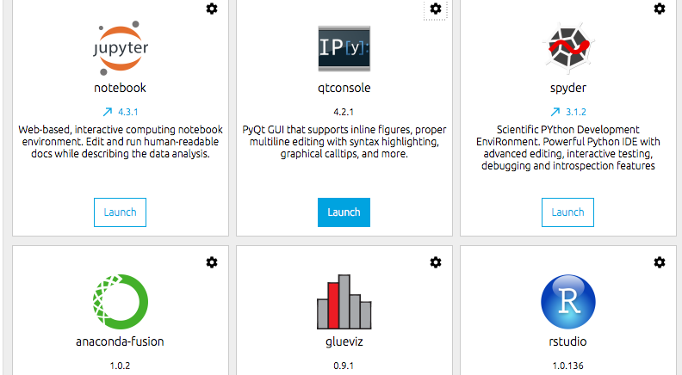
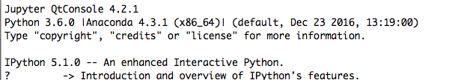
Installation (1)

Slide 4
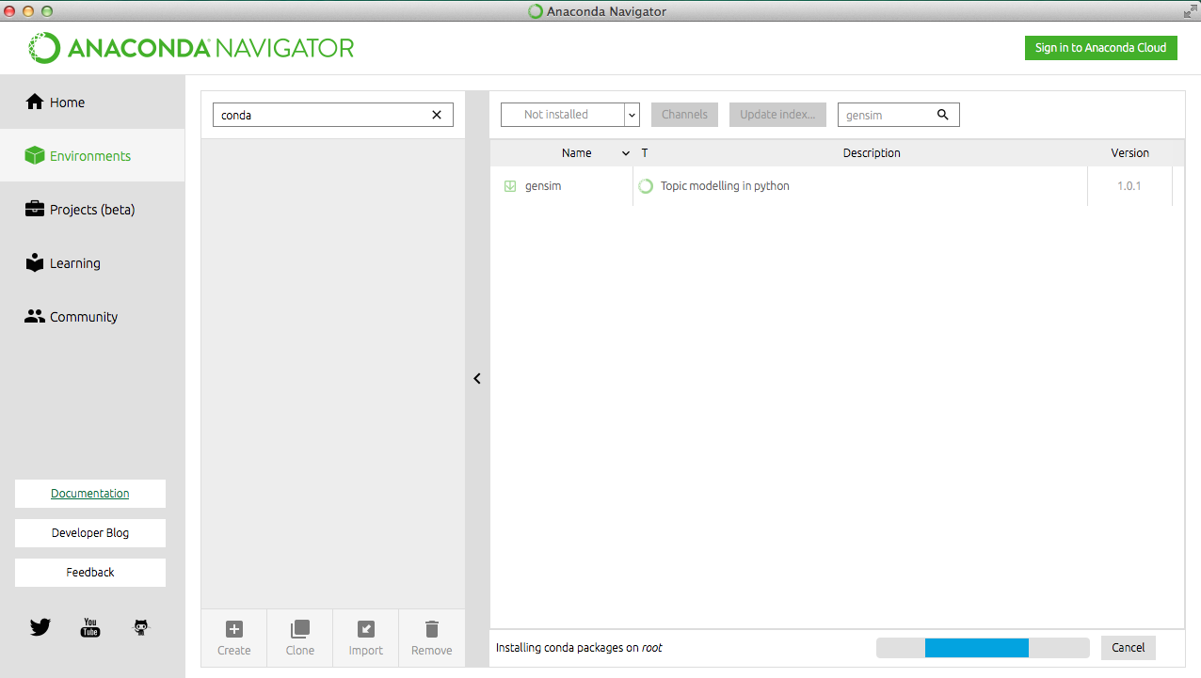
Installation (2)
conda install -c anaconda gensim=1.0.1

Slide 5
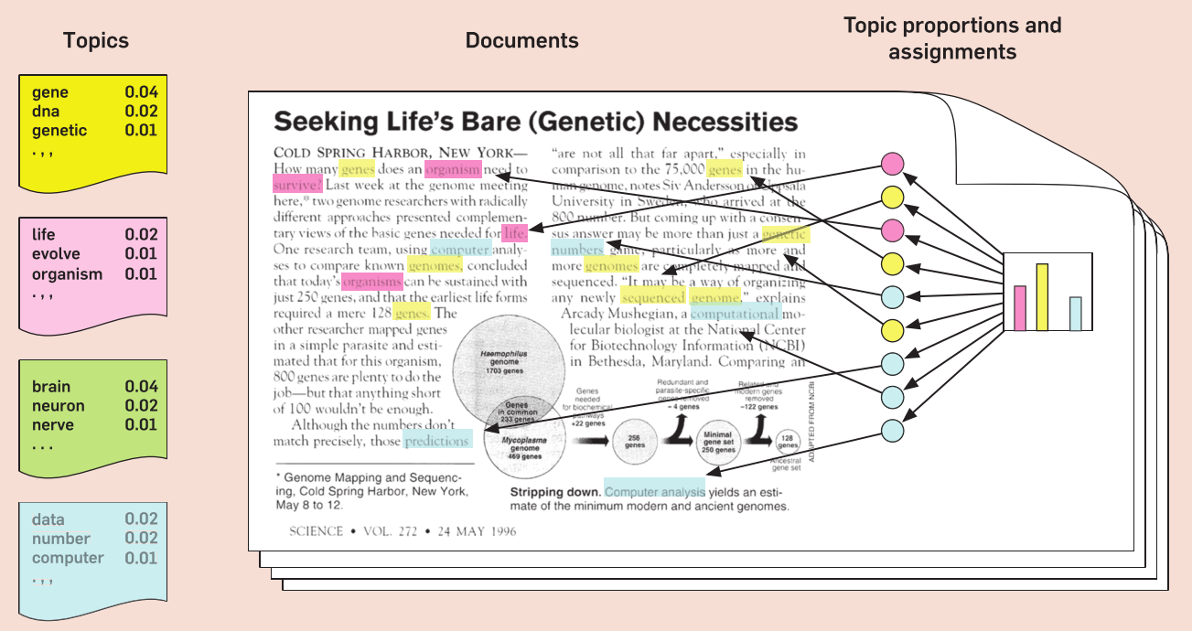
Concepts
Topic modelling:
Attempts to uncover the underlying semantic structure of text in order to identify recurring patterns.
These patterns are called topics. They may or may not correspond to our intuitive notion of a topic.

Slide 6
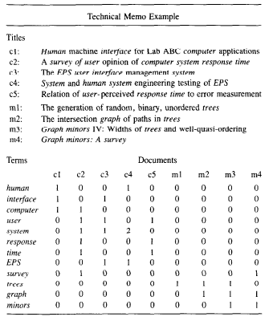
Concepts
Latent semantic analysis:
analyzing relationships between a set of documents and the terms they contain by producing a set of concepts related to the documents and terms.

Slide 7
From Strings to Vectors (1)
Documents represented as strings
To convert documents to vectors, we’ll use a document representation called bag-of-words: “How many times does the word system appear in the document? Once.”
The mapping between the questions and ids is called a dictionary.

Slide 8
From Strings to Vectors (2)
from gensim import corpora
documents = ["Human machine interface for lab abc computer applications",…
dictionary = corpora.Dictionary(texts)
corpora.Dictionary: collecting word counts and relevant statistics.

Slide 9

From Strings to Vectors (3)
To actually convert tokenized documents to vectors:
The function doc2bow() simply counts the number of occurrences of each distinct word, converts the word to its integer word id and returns the result as a sparse vector.

Slide 10
From Strings to Vectors (4)
Formats for serializing a Vector Space corpus (sequence of vectors) to disk.
One Document at a Time
Corpus Formats:
Market Matrix format.
>>> corpus = corpora.MmCorpus('/tmp/corpus.mm')
>>> print(list(corpus)) # calling list() will convert any sequence to a plain Python list [[(1, 0.5)], []]

Slide 11
From Strings to Vectors (5)
Joachim’s SVMlight format,
Blei’s LDA-C format
GibbsLDA++ format.
NumPy
SciPy

Slide 12
Topics and Transformations (1)
Transform documents from one vector representation into another.
To bring out hidden structure in the corpus
To make the document representation more compact
tfidf = models.TfidfModel(corpus)

Slide 13
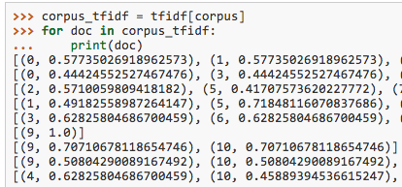
Topics and Transformations (2)
Transforming vectors to Tfidf
Tfidf as a read-only object that can be used to convert any vector from bag-of-words (integer counts) to TfIdf (real-valued weights):

Slide 14
Topics and Transformations (2)
Transforming Tfidf to Latent Semantic Indexing into a latent 2-D space.
# initialize an LSI transformation
lsi = models.LsiModel(corpus_tfidf, id2word=dictionary, num_topics=2)
corpus_lsi = lsi[corpus_tfidf]
# create a double wrapper over the original
corpus: bow->tfidf->fold-in-lsi

Slide 15
Topics and Transformations (3)
It appears that according to LSI, “trees”, “graph” and “minors” are all related words (and contribute the most to the direction of the first topic), while the second topic practically concerns itself with all the other words

Slide 16
Transformation
Random Projections, RP aim to reduce vector space dimensionality
Latent Dirichlet Allocation, LDA is yet another transformation from bag-of-words counts into a topic space of lower dimensionality
Hierarchical Dirichlet Process, HDP is a non-parametric bayesian method

Slide 17
Similarity interface (1)
To determine similarity between pairs of documents, or the similarity between a specific document and a set of other documents.
>>> from gensim import corpora, models, similarities
>>> dictionary = corpora.Dictionary.load('/tmp/deerwester.dict')
>>> corpus = corpora.MmCorpus('/tmp/deerwester.mm') # first tutorial
>>> print(corpus)
MmCorpus(9 documents, 12 features, 28 non-zero entries)

Slide 18
Similarity interface (2)
Cosine measure
Suppose a user typed in the query “Human computer interaction”.
doc = "Human computer interaction”
vec_bow = dictionary.doc2bow(doc.lower().split())
vec_lsi = lsi[vec_bow] # convert the query to LSI space
print(vec_lsi)
[(0, -0.461821), (1, 0.070028)]

Slide 19
LDA
Latent Dirichlet Allocation
Dirichlet distributions: SI N palomas ocupan r nidos, y n > r, entonces hay al menos un nido con dos o mas palomas
In the context of text modeling, the topic probabilities provide an explicit representation of a document.

Slide 20
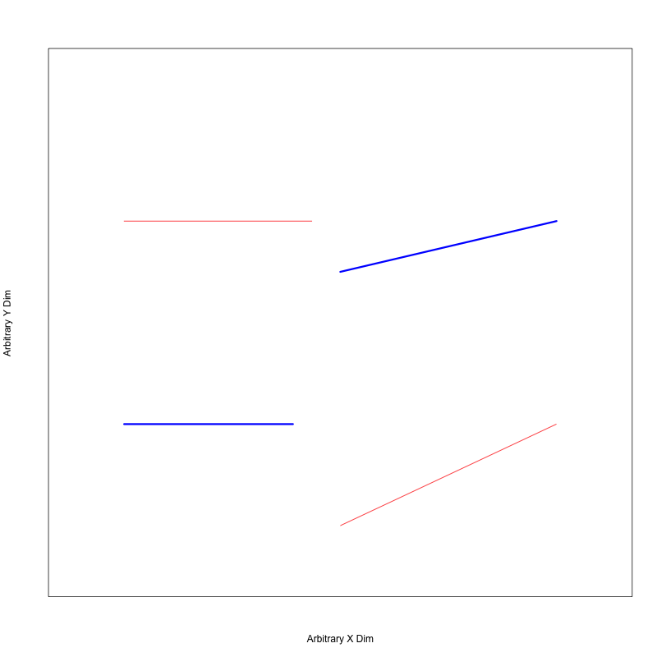
LDA: How would you cluster?

Slide 21
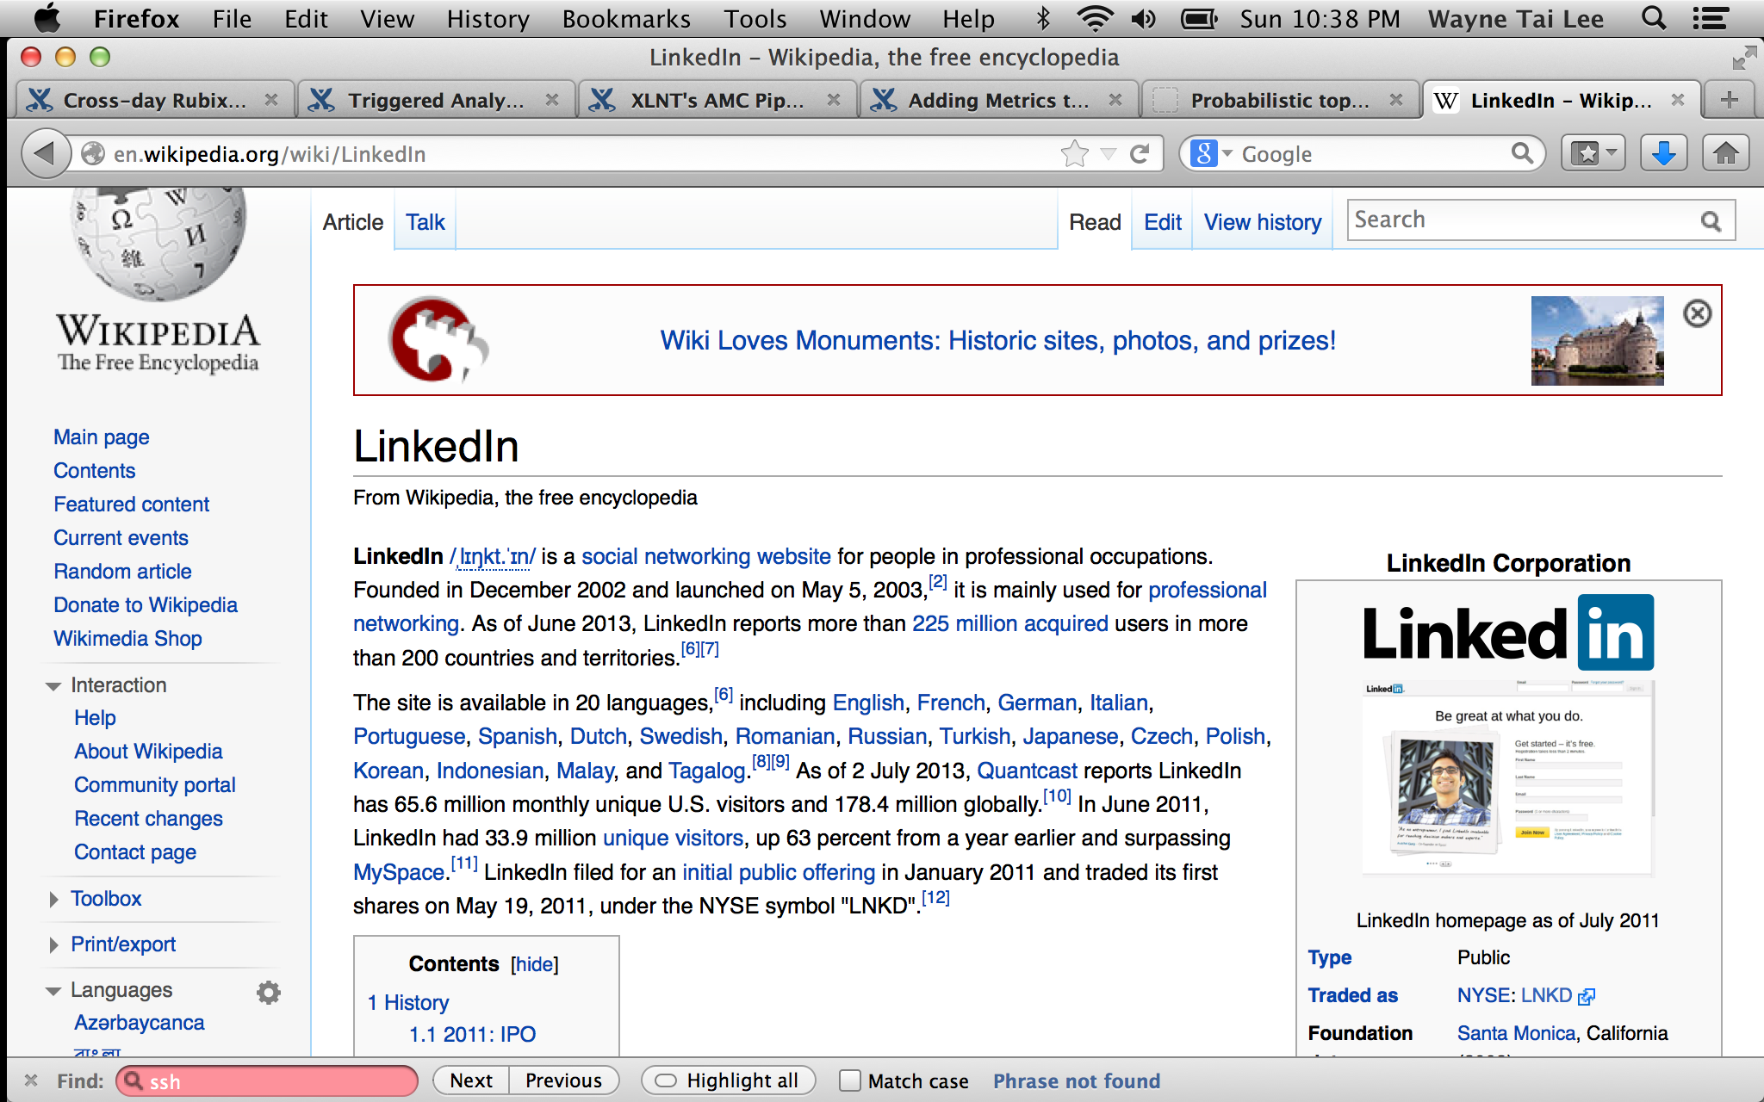
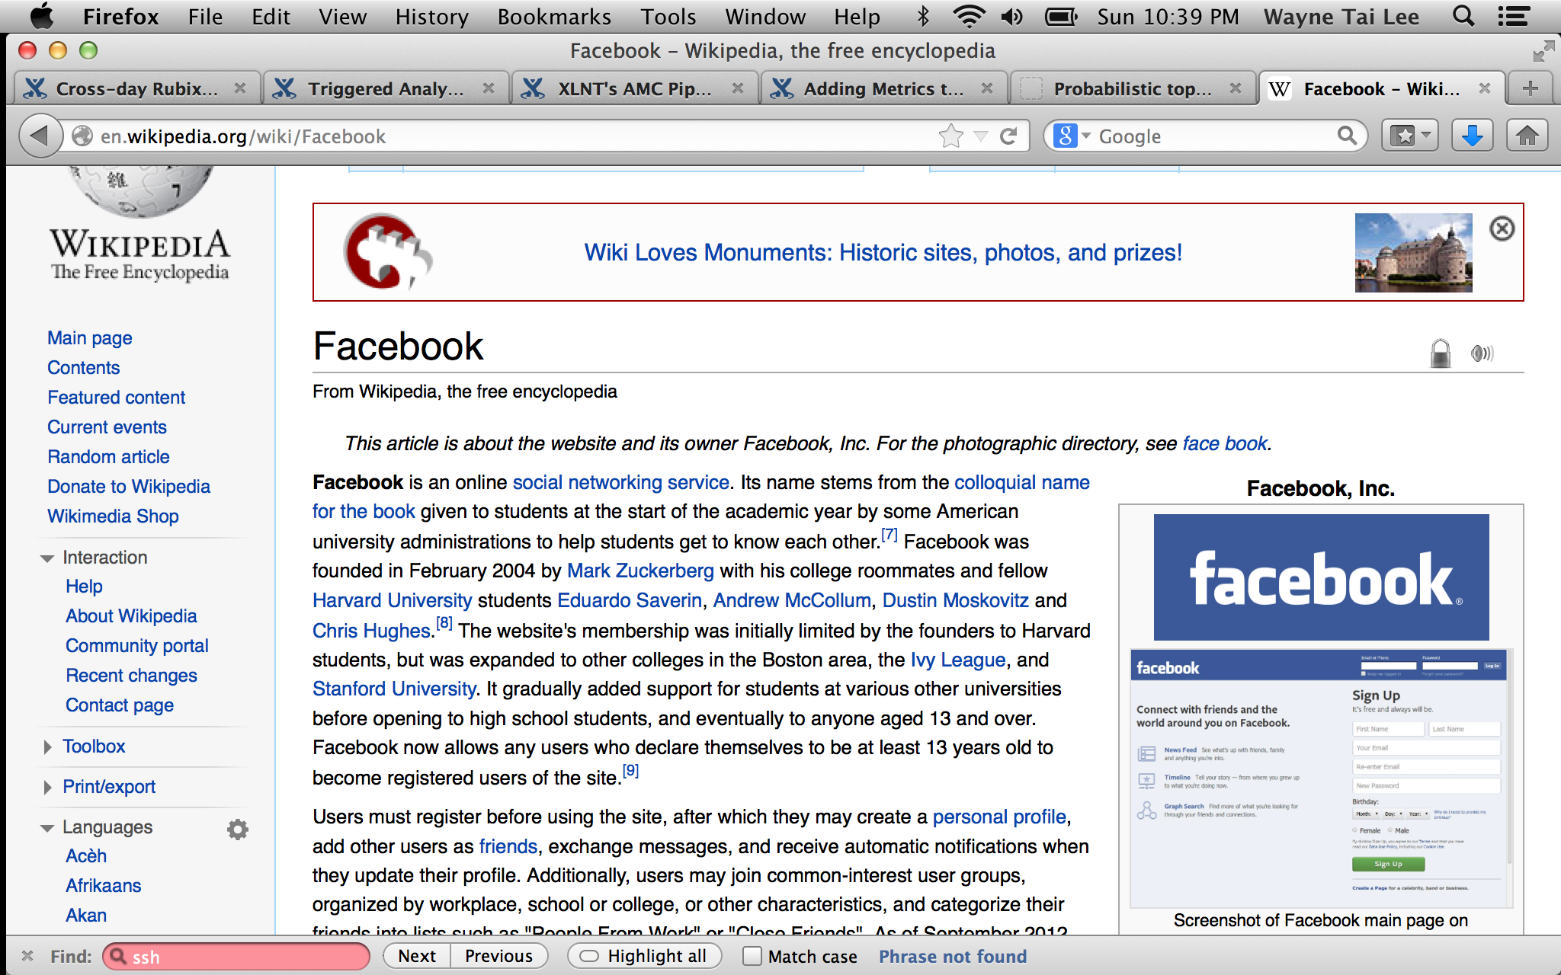
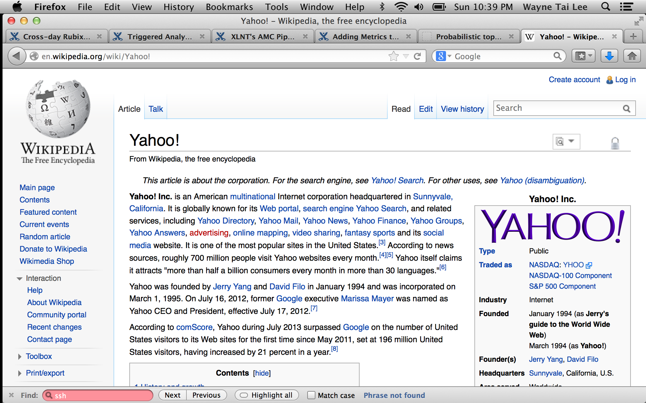
Now try these ones!

Slide 22
LDA
Latent Dirichlet allocation (LDA), the basic idea
Probabilities as beliefs,
Bayesian Statistics
where each topic is characterized by a distribution over words.
Reference 1: David M. Blei, Andrew Y. Ng, Michael I. Jordan. Latent Dirichlet Allocation. Journal of Machine Learning Research 3 (2003) 993-1022
Reference 2:https://es.slideshare.net/WayneLee9/lda-oct3-2013
Notes:
The topic probability of the word v according to topic
The topic proportions of each document d: ”
The topic assignment of each word

Slide 23
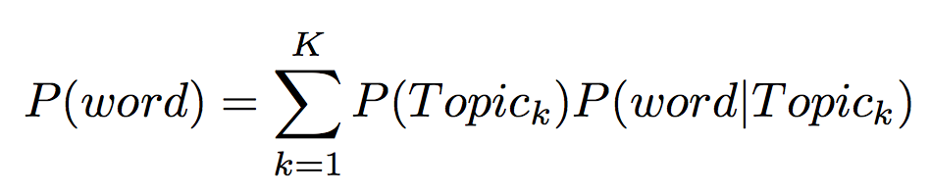
LDA
Each word comes from different topics (bag of words: ignore order)

Slide 24


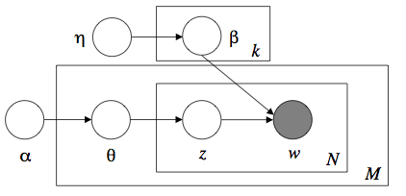


LDA
= document composition)
= key words
w=documents
M= # documents
N= # words
Z=cluster for the word (topic)
, control the weights for the multinomial (generalization binomial).

Slide 25
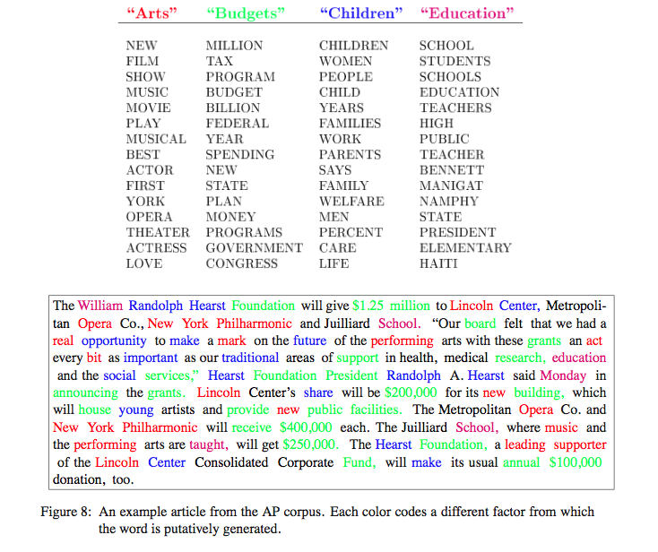
What is the distribution of words defined by a topic?

Slide 26
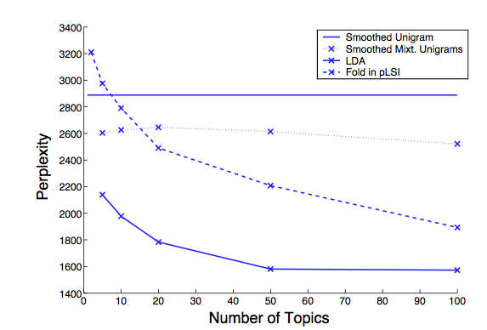
Perplexity
It is a measurement of how well a probability distribution or probability model predicts a sample.
A low perplexity indicates the probability distribution is good at predicting the sample.

Slide 27
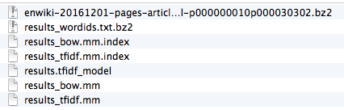
Gensim LDA
Preparing the corpus:
python -m gensim.scripts.make_wikicorpus ~/gensim/results/enwiki-latest-pages-articles.xml.bz2 ~/gensim/results/wiki_en

Slide 28
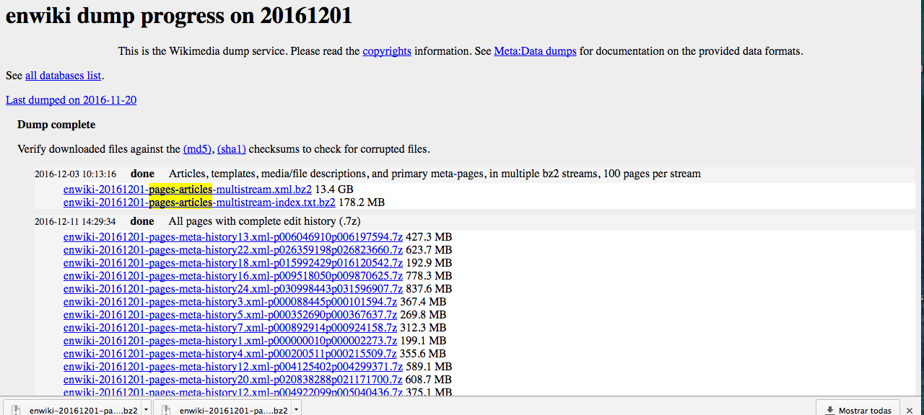
https://dumps.wikimedia.org/enwiki/

Slide 29
Gensim lda
load id->word mapping (the dictionary)
one of the results of step 2 above: …wordids.txt
load corpus iterator: … tfidf.mm
extract 100 LDA topics, using 1 pass and updating once every 1 chunk (10,000 documents)

