Slide 1
classly.
Smart Classroom Management
A connected workspace for rooms, timetables and bookings
Team Members
Akshith · 25200300122
Charishma · 2520030140
Pranavi · 2520030026

Slide 2
Introduction
Classrooms are a campus's most shared resource, yet many institutions still manage them with paper registers and spreadsheets.
48
Classrooms managed
Classly is a web-based smart classroom management system that brings rooms, faculty, subjects, timetables and bookings into one dashboard, with an AI assistant for quick answers.
32
Classes scheduled today
6
Departments covered
Classly · Smart Classroom Management 2 / 12

Slide 3
Abstract
Smart Classroom Management is a web application that digitises how a campus organises its learning spaces.
It provides role-based sign-in, a live dashboard of room availability, a faculty and subject directory, a weekly timetable, a room booking workflow with clash detection and approval, analytics reports and an AI assistant that suggests suitable rooms.
The current version is a front-end prototype built with HTML, CSS and JavaScript using sample data; a backend and database are planned next.
Classly · Smart Classroom Management 3 / 12

Slide 4
Problem Statement
1
Manual scheduling
2
Poor visibility
Paper registers and spreadsheets cause errors and double-bookings.
Staff cannot see which rooms are free right now.
3
Underused spaces
4
Slow approvals
No data on utilisation, so some rooms sit idle while others overflow.
Booking requests travel by phone or email and get lost.
Classly · Smart Classroom Management 4 / 12

Slide 5
Objectives
1
Centralise rooms, faculty, subjects and timetables in one system
2
Show real-time classroom availability and status
3
Let users request room bookings and avoid time clashes
4
Give admins one place to approve or review requests
5
Provide analytics to improve room utilisation
6
Offer an AI assistant for quick room suggestions
Classly · Smart Classroom Management 5 / 12

Slide 6
Key Features
Smart room booking
Live availability
Timetable planning
Request, clash-check and approve
Available, occupied, maintenance
Weekly calendar of classes
Faculty & subjects
Reports & analytics
AI assistant
Searchable directories
Utilisation charts, CSV export
Suggests rooms and flags conflicts
Classly · Smart Classroom Management 6 / 12

Slide 7
System Architecture
Users
Administrator · Faculty · Student
▼
Presentation layer (Web UI)
Login · Dashboard · Classrooms · Timetable · Bookings · Reports
▼
Room module
Booking logic
Timetable
AI assistant
Now: sample data in JavaScript · Next: REST API and database
Classly · Smart Classroom Management 7 / 12

Slide 8
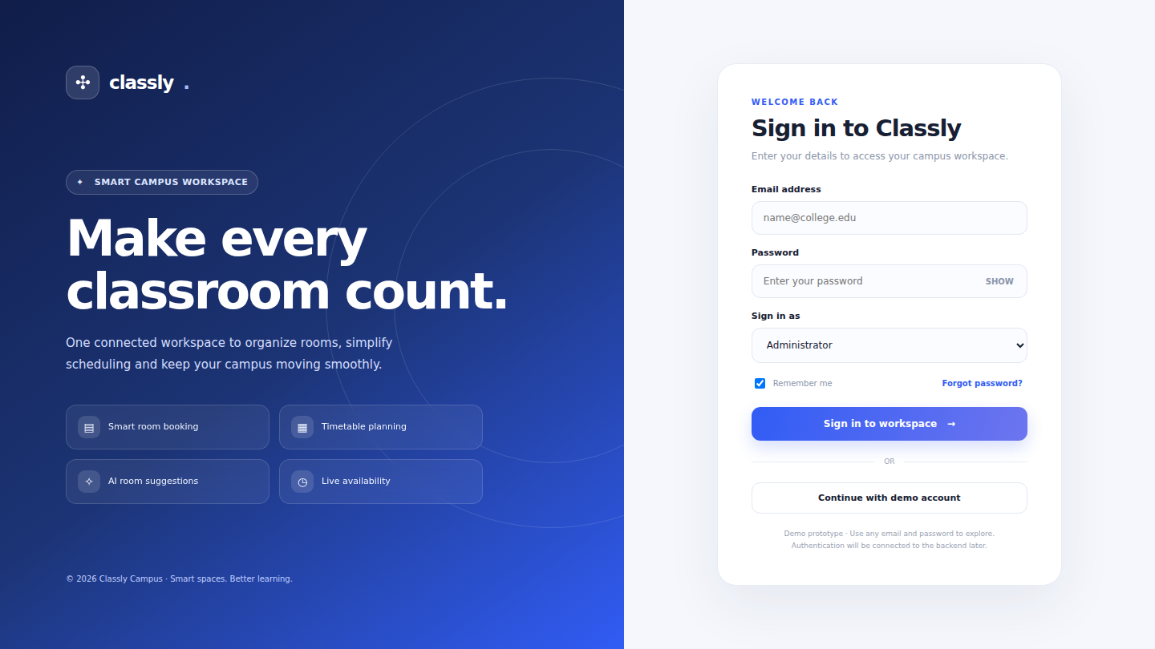
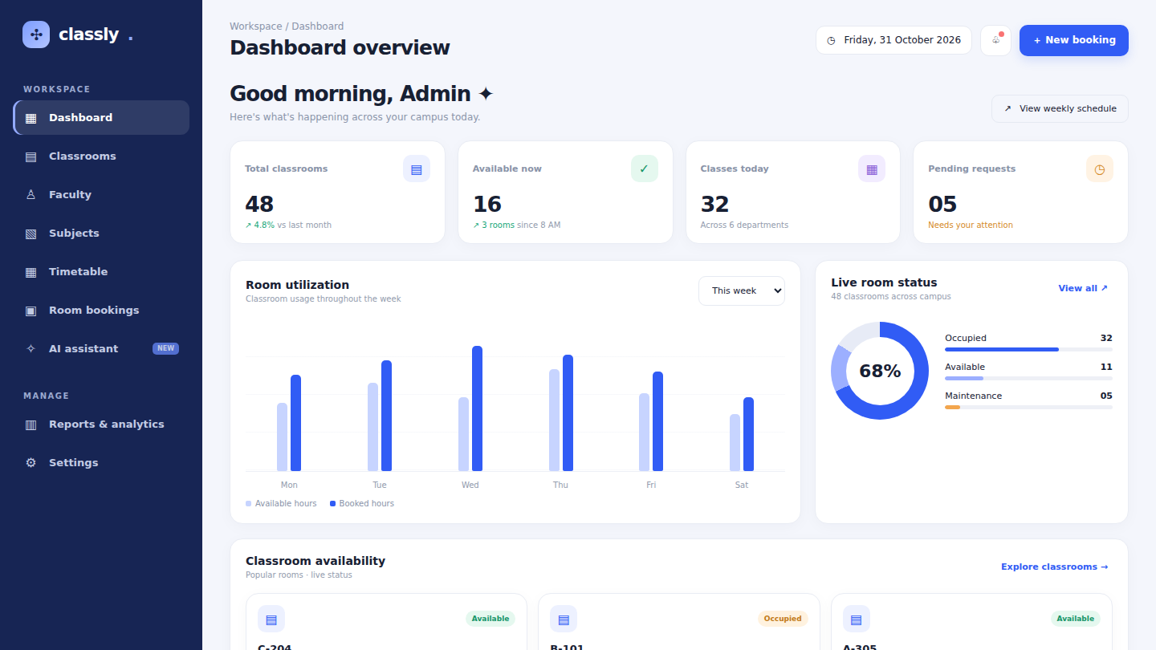
Screenshots: Login and Dashboard
Login screen
Dashboard
Sign in as Administrator, Faculty or Student.
Stats, weekly utilisation and live room status.
Classly · Smart Classroom Management 8 / 12

Slide 9
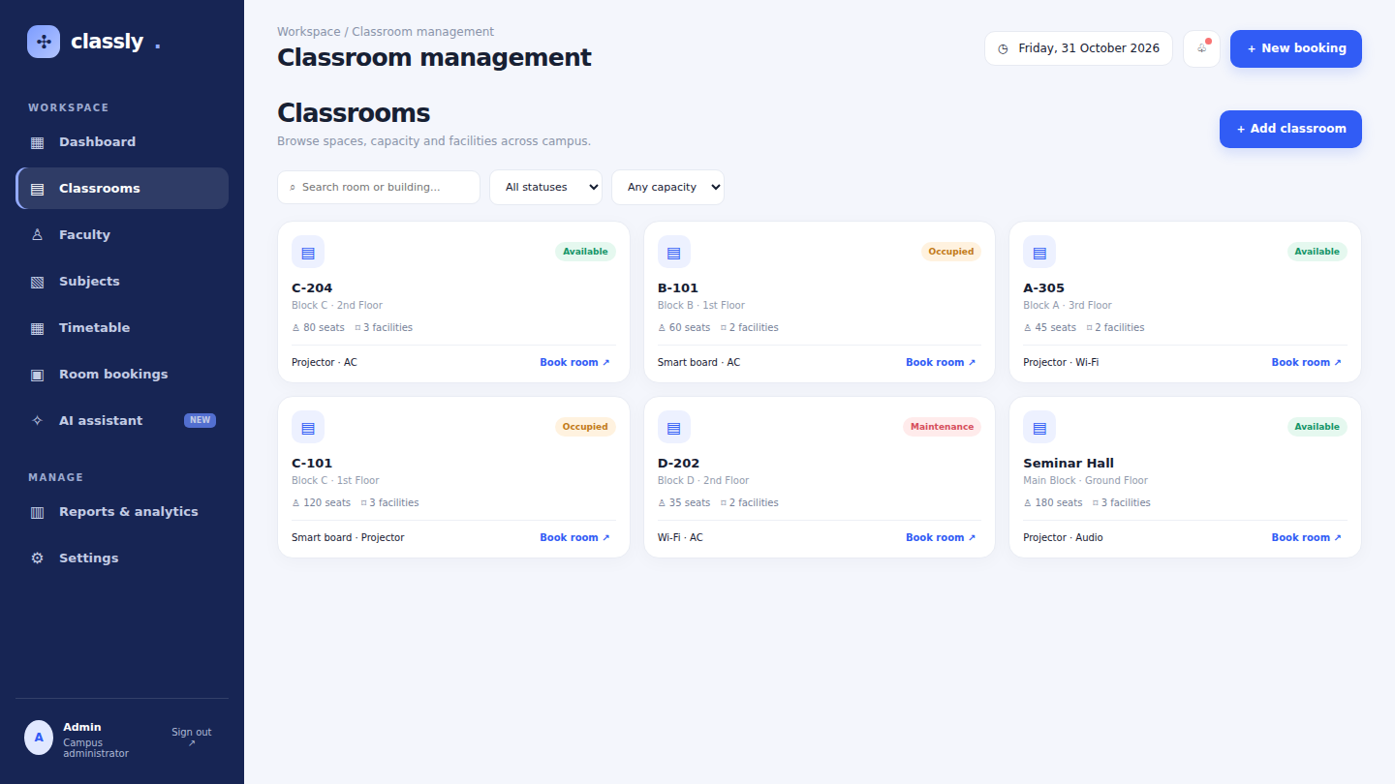
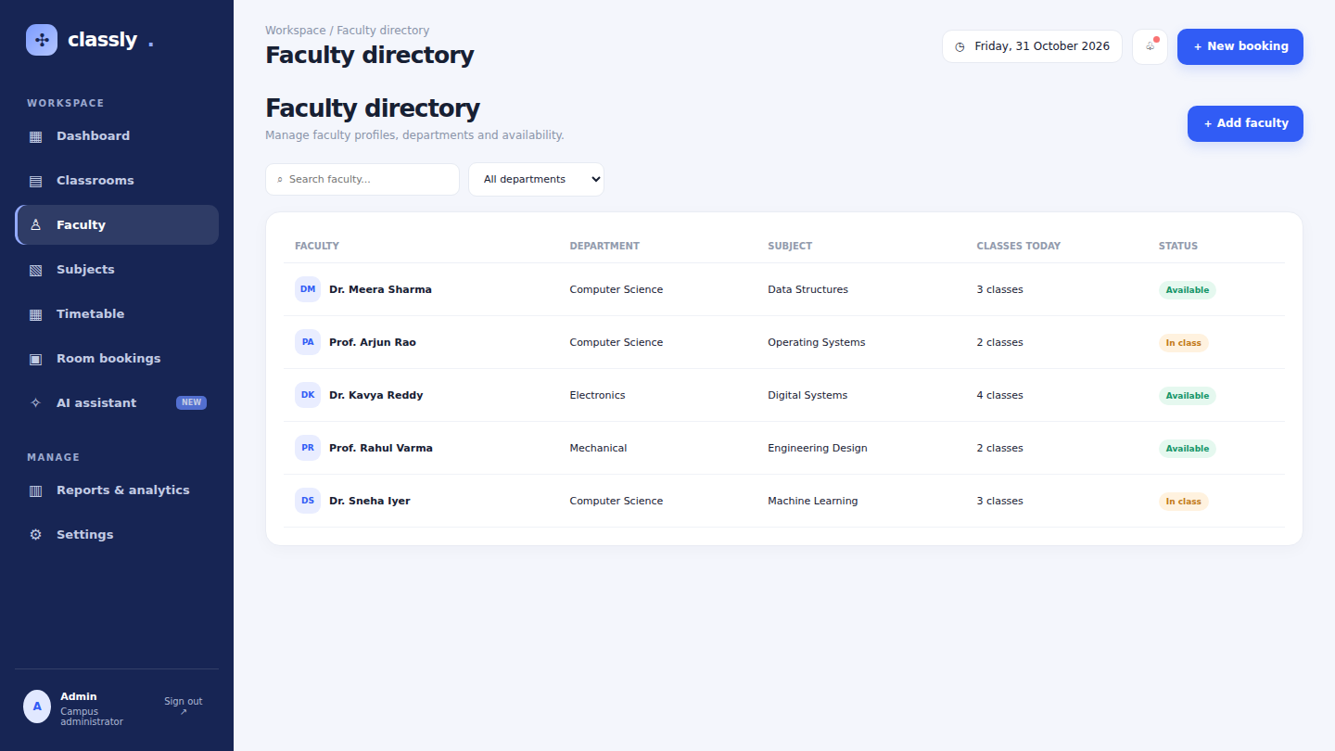
Screenshots: Classrooms and Faculty
Classrooms
Faculty directory
Search and filter rooms by status and capacity.
Searchable list with department and availability.
Classly · Smart Classroom Management 9 / 12

Slide 10
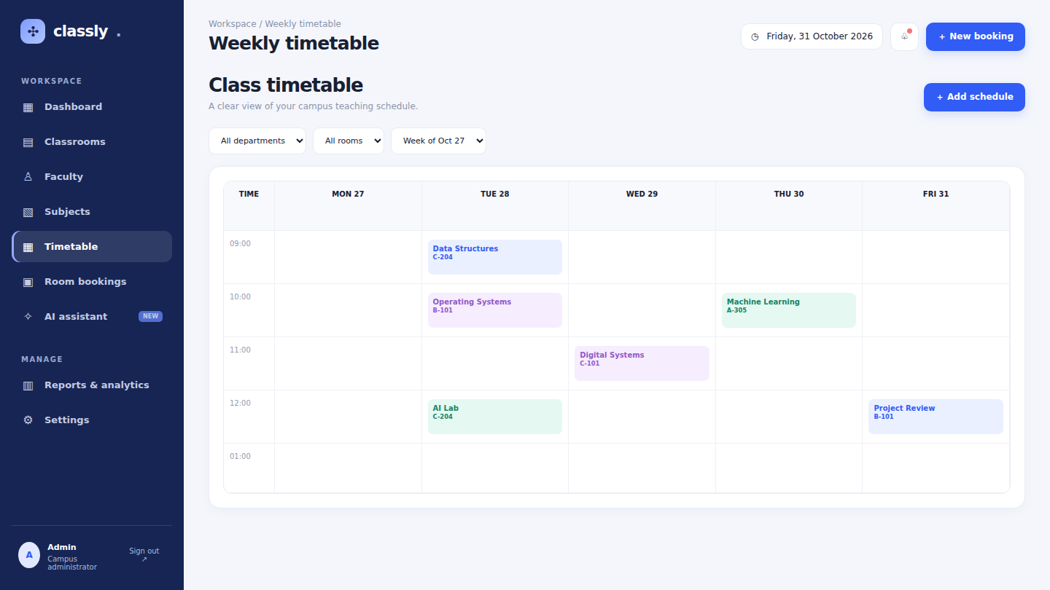
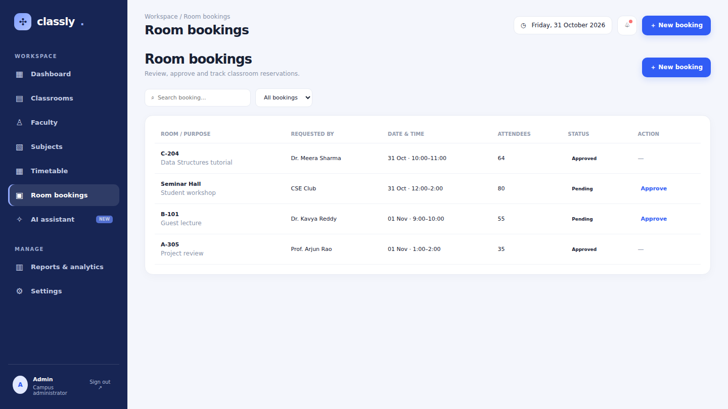
Screenshots: Timetable and Bookings
Weekly timetable
Room bookings
Calendar view of classes by room.
Requests with pending and approved status.
Classly · Smart Classroom Management 10 / 12

Slide 11
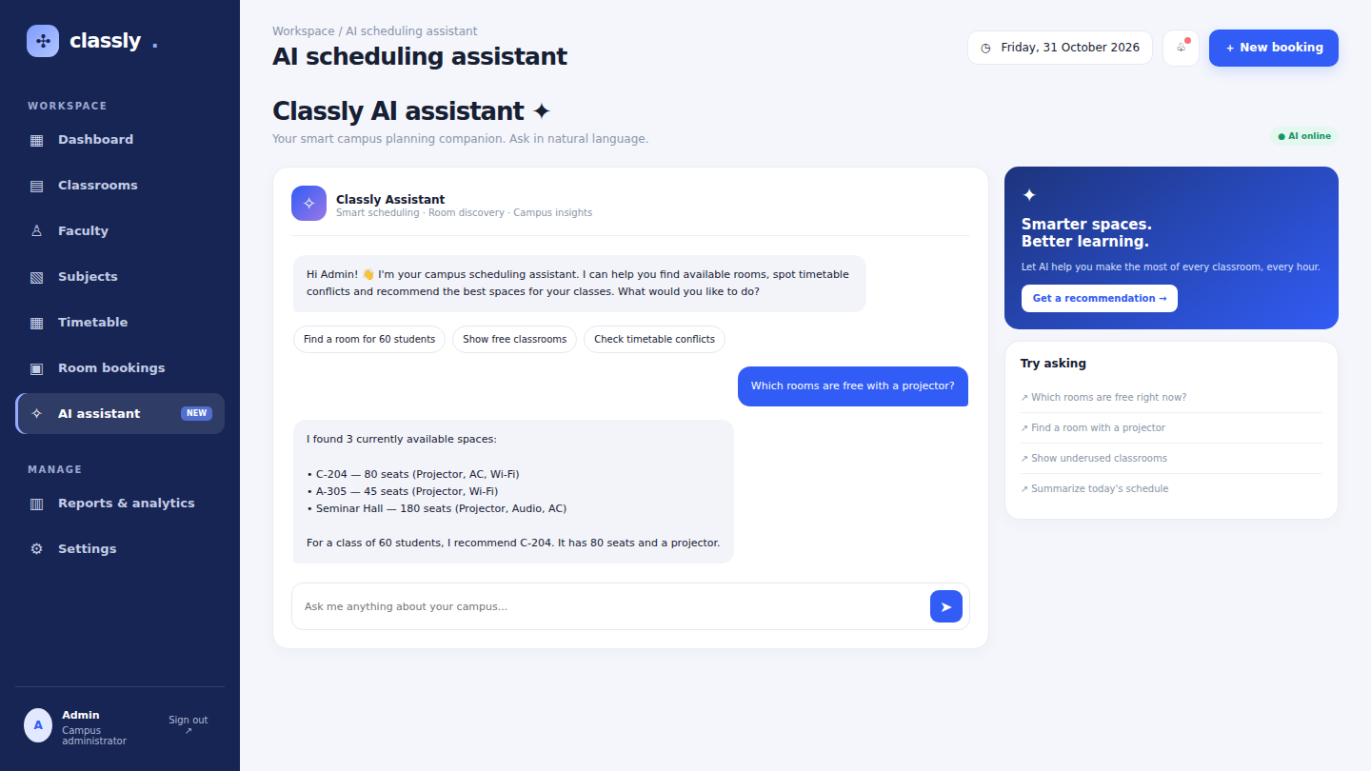
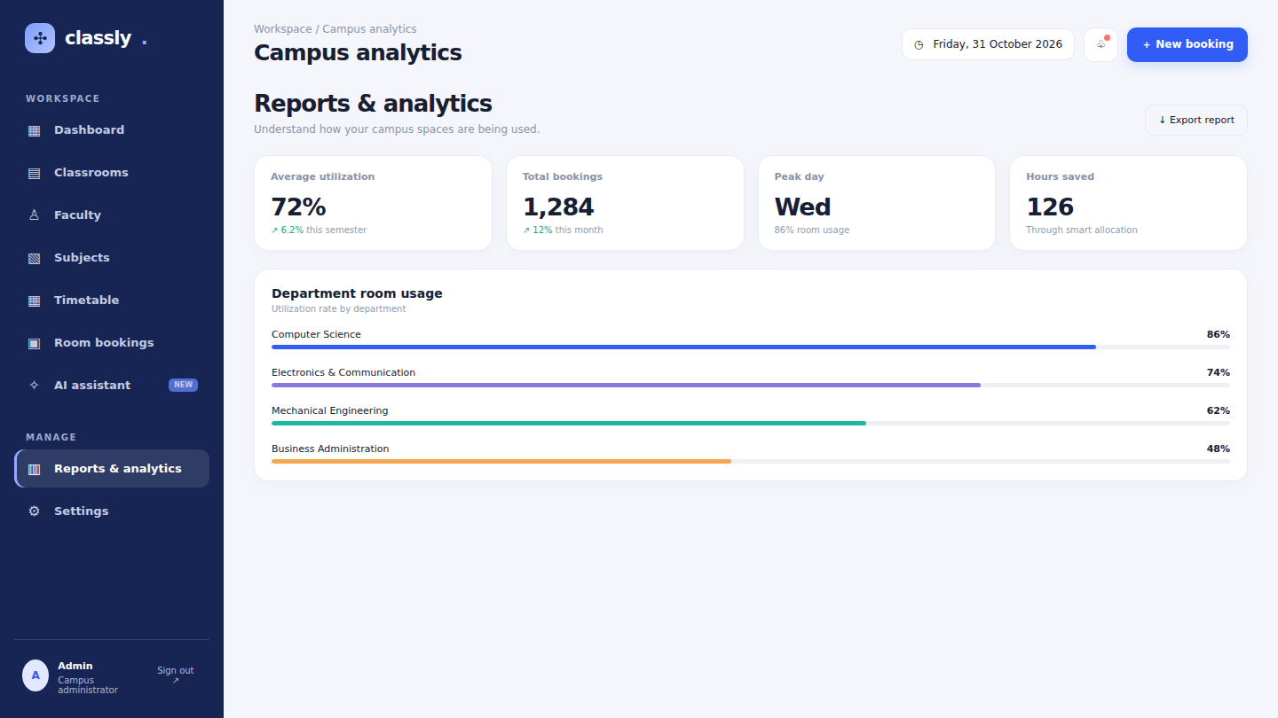
Screenshots: AI Assistant and Reports
AI assistant
Reports & analytics
Answers room availability questions.
Campus metrics with CSV export.
Classly · Smart Classroom Management 11 / 12

Slide 12
Conclusion & Future Scope
Classly turns classroom management into a simple, visual, digital workflow.
Next: backend and database, real authentication, notifications and timetable auto-generation.
Thank you
Akshith (25200300122) · Charishma (2520030140) · Pranavi (2520030026)

