Slide 1
Sports & Entertainment: Match Outcome
Prediction Using Logistic Regression
and Random Forest
Batch 2
TEAM
UNDER THE GUIDANCE OF
Jakka Bhanu
Roll No: 2520030006 | Section 8
Shaik Asif
Assistant Professor, CSE
V. Charishma
Roll No: 2520030140 | Section 8

Slide 2
Problem Statement
Binary
Predict whether a given team wins or loses an IPL match — framed as a supervised binary classification problem, using pre-match and historical performance features.
Classification task: Win (1) vs Loss (0)
2 Models
Target variable
Match result (win / loss) for a specified team, from the winner column.
Logistic Regression vs. Random Forest
Input features
5 Metrics
Recent team form, head-to-head record, venue/home advantage, toss outcome.
Accuracy · Precision · Recall · F1 · Confusion Matrix
Why it matters
Traditional predictions rely on intuition; ML can uncover interacting patterns invisible to simple stats.
Domain value: fans, broadcasters, team management & sports analytics platforms.
Project goal
Compare an interpretable baseline (Logistic Regression) against an ensemble model (Random Forest) — accuracy vs. interpretability.
2

Slide 3
Dataset Identification
IPL Complete Dataset (2008–2024)
Source: Kaggle, authored by Prateek Bhardwaj — covers every IPL season from inception through 2024.
1,095 × 20
260,920 × 17
2008–2024
matches.csv — match-level records
deliveries.csv — ball-by-ball data
17 seasons of IPL cricket
File | Description | Key Columns
matches.csv | Match-level summary for every IPL match | season, city, venue, team1/2, toss_winner, toss_decision, winner, result_margin
deliveries.csv | Ball-by-ball record for every delivery bowled | match_id, inning, batting_team, bowling_team, over, ball, batter, bowler, total_runs, is_wicket
Why this dataset: full IPL history gives sufficient volume/variety; combining match-level + ball-by-ball data enables rich engineered features (recent form, head-to-head, venue trends); clear target variable for binary classification.
3

Slide 4
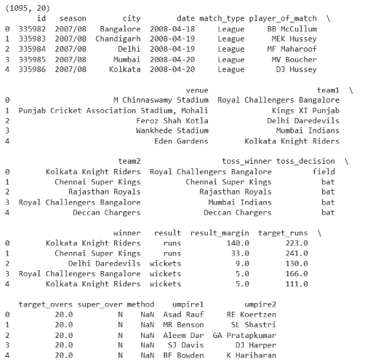
Dataset Snapshot
matches.csv — df.shape / df.head()
4

Slide 5
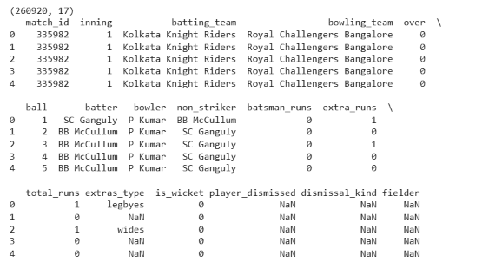
Dataset Snapshot
deliveries.csv — df.shape / df.head()
4

Slide 6
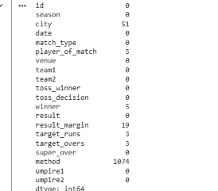
Data Cleaning & Preparation
Missing values — matches.isnull().sum()
Key cleaning steps
method (1074 missing)
Most matches aren't decided by DLS — expected and safe to ignore/flag.
result_margin (19), target_runs (3), target_overs (3)
Small counts — tie/no-result matches; handled separately.
city (51), player_of_match (5), winner (5)
Minor gaps; rows reviewed and either filled from venue or dropped.
Franchise renaming
Delhi Daredevils → Delhi Capitals, Deccan Chargers → Sunrisers Hyderabad, Kings XI Punjab → Punjab Kings — standardized with .replace() across team1, team2, winner.
5

Slide 7
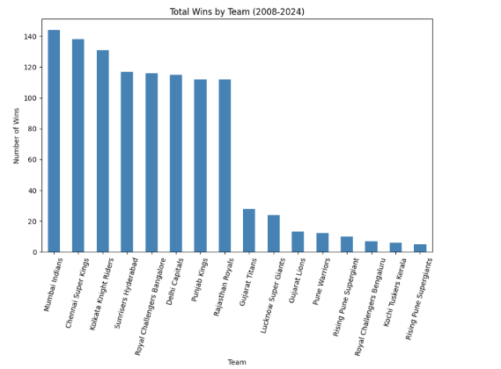
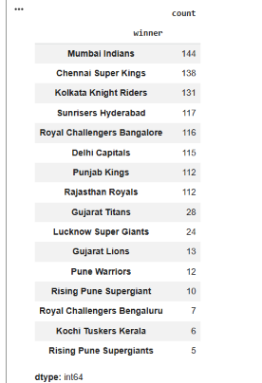
EDA — Team Performance
winner.value_counts()
Takeaway: Mumbai Indians lead with 144 wins, followed by Chennai Super Kings (138) and Kolkata Knight Riders (131). Newer/relocated franchises (Gujarat Titans, Lucknow Super Giants) show far fewer wins — a clear class imbalance to account for in modeling.
6

Slide 8
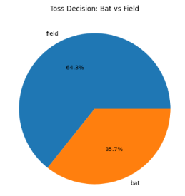
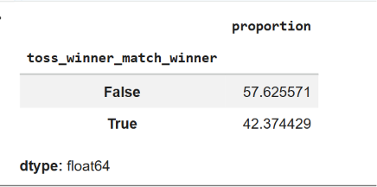
03 · EXPLORATORY ANALYSIS
EDA — Toss Analysis
Toss decision split
Does the toss winner also win the match?
64.3%
42.4%
Choose to field first after winning toss
Toss winner also wins the match
Takeaway: Winning the toss does NOT strongly predict the match outcome — only 42.4% of toss winners go on to win. Toss should be included as a weak feature, not a dominant predictor.
7

Slide 9
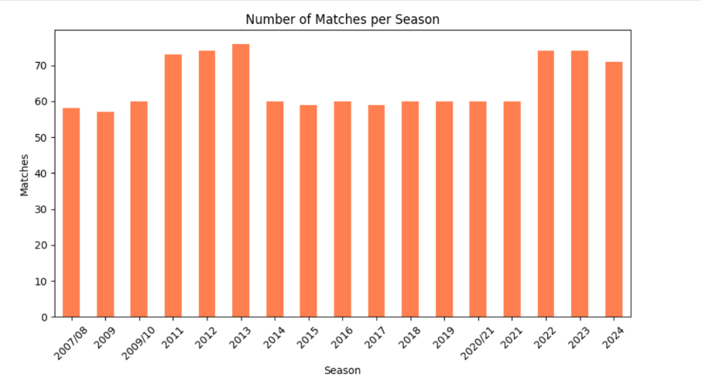
EDA — Matches per Season
Takeaway: Match counts are steady (~55–75/season), with a dip in 2020/21 (COVID-affected season) and a rise from 2022 onward following the league's expansion to 10 teams.
8

Slide 10
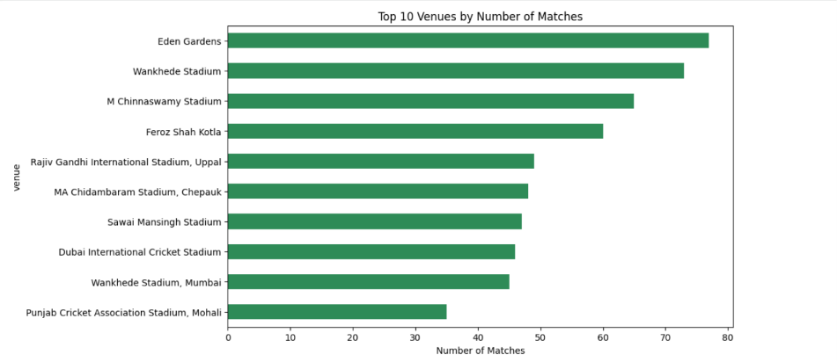
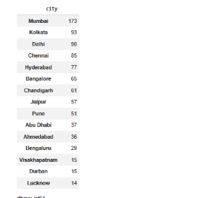
EDA — Venues & Host Cities
Top 10 venues by match count
Top host cities
Takeaway: Eden Gardens, Wankhede, and M. Chinnaswamy host the most matches; top cities (Mumbai, Kolkata, Delhi, Chennai) align with top venues — useful for engineering a home/away advantage feature.
9

Slide 11
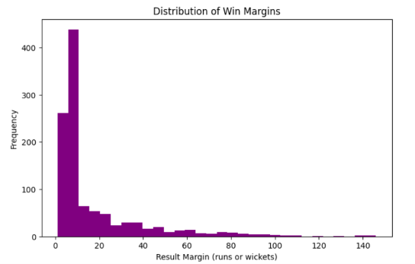
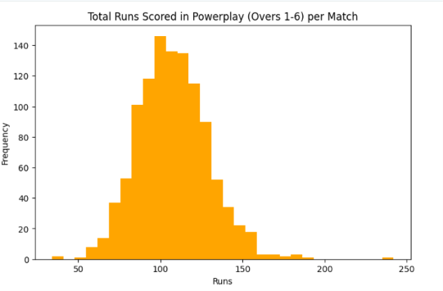
EDA — Win Margins & Powerplay Runs
Distribution of win margins
Powerplay (overs 1–6) runs per match
Takeaway: Win margins are heavily right-skewed — most IPL matches are close (0–20 runs/wickets), few blowouts. Powerplay runs are roughly normally distributed around 100–110, a strong candidate engineered feature.
10

Slide 12
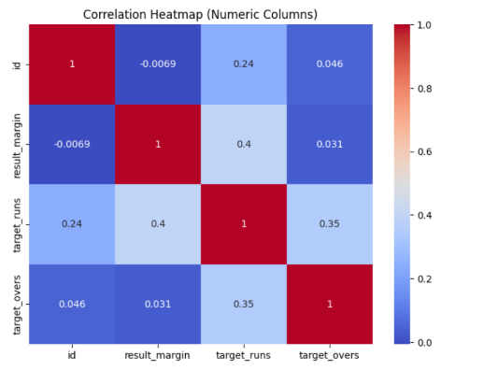
EDA — Correlation Heatmap
What it shows
Raw numeric columns (id, result_margin, target_runs, target_overs) show weak correlations with each other.
target_runs ↔ result_margin: 0.40 — mild positive relationship.
No raw column is strongly predictive on its own.
Implication:
Predictive power will come mainly from engineered features (recent form, head-to-head, venue trends) rather than raw columns — motivating the feature engineering step before modeling.
11

Slide 13
Methodology (Planned)
1
2
3
4
5
Preprocessing
Feature Engineering
Train/Test Split
Model Training
Evaluation
Clean nulls, standardize team names, encode categoricals
→
Recent form, head-to-head, venue advantage, toss impact
→
Chronological split to avoid data leakage across seasons
→
Logistic Regression (baseline) + Random Forest (ensemble)
→
Accuracy, precision, recall, F1, confusion matrix
Why compare two models:
Logistic Regression offers interpretability — clear insight into which factors drive outcomes. Random Forest captures non-linear feature interactions and typically achieves higher accuracy. Comparing both surfaces the trade-off between explainability and predictive power for this domain.
12

Slide 14
THANK YOU

