Slide 1
English-Korean Translator
Joo Kyung Kim

Slide 2
Objectives
Create a Neural Machine Translator that can translate English phrases to Korean.
What’s being used today:
Google Translate, Naver’s Papago
Hello!
안녕!

Slide 3
Korean vs English
톰은 한국어 공부해.
Tom Korean studies.

Slide 4
Summary Statistics
98,161 English-Korean sentence pairs
English vocabulary size: 12,251 unique words
Korean vocabulary size: 58,663 unique words
Hello!
안녕!

Slide 5
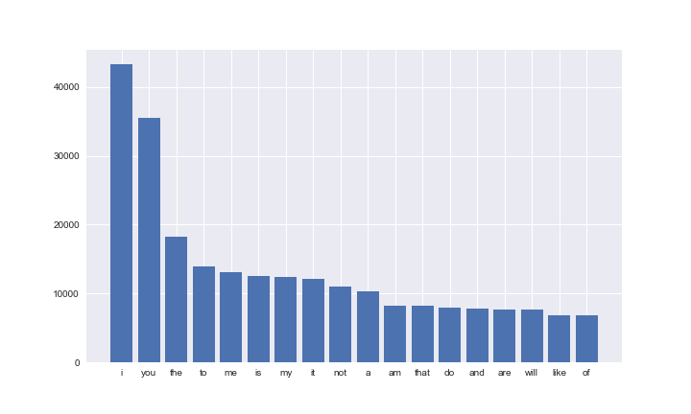
Summary Statistics

Slide 6
Processing each sentence
Hello everyone, how’re you guys doing?
<start> hello everyone how are you guys doing <end>
[ 1, 648, 192, 68, 17, 4, 428, 250, 2, 0, 0, 0, 0,…]

Slide 7
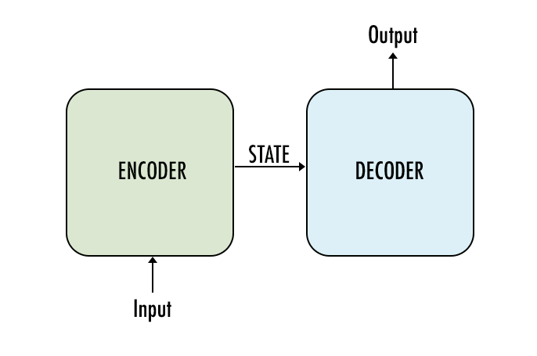
The Model

Slide 8
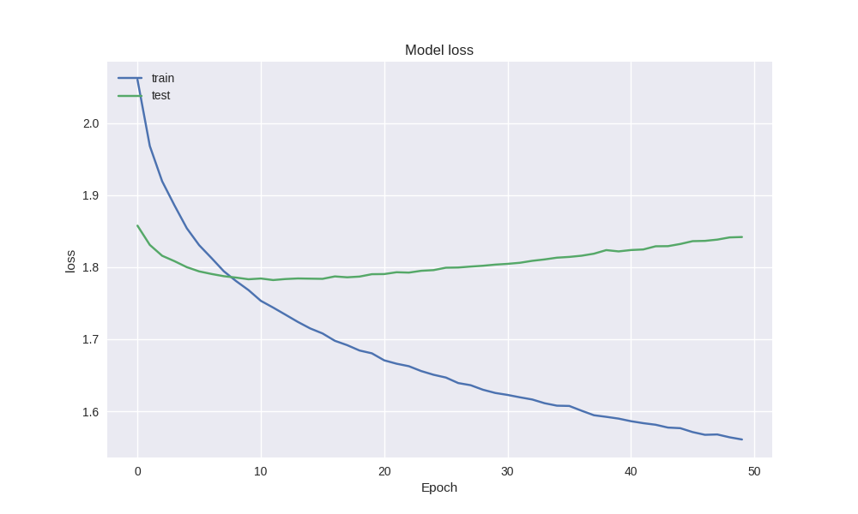
Results
Model Loss
Loss
Epoch

Slide 9
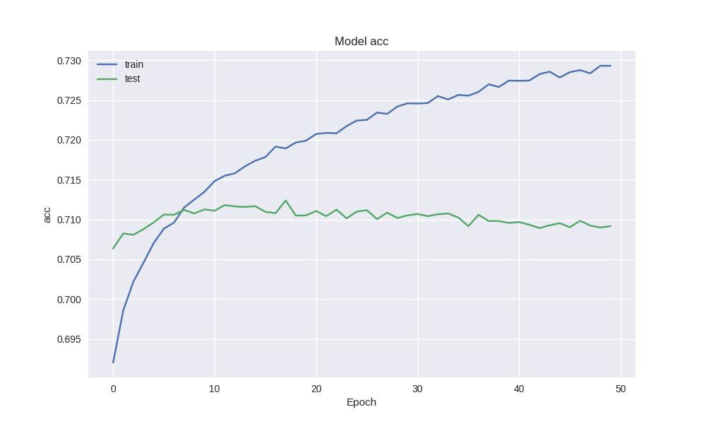
Results
Model Accuracy
Accuracy
Epoch

Slide 10
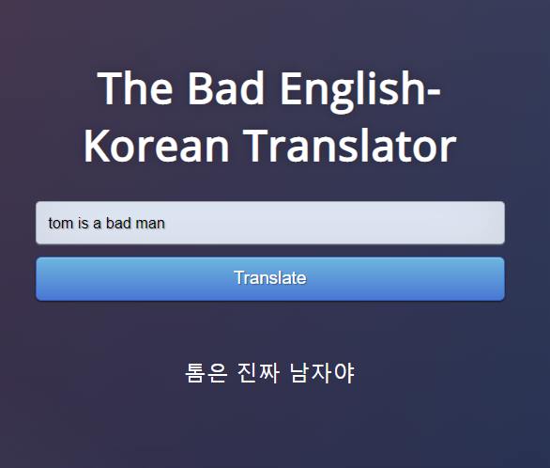
Results
Tom is a bad man.
톰은 진짜 남자야
(Tom is a real man)

Slide 11
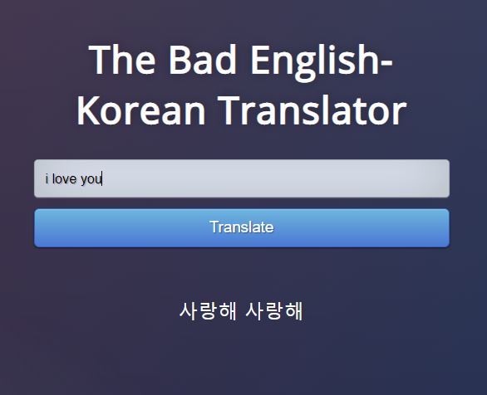
Results
I love you.
사랑해 사랑해
(I love you I love you)

Slide 12
Looking Forward
More data
Experiment with different models
Deeper Neural Network
Hyperparameter tuning
Hello!
안녕!

Slide 13

Joo Kyung Kim
https://www.linkedin.com/in/jookimjkk/
https://github.com/virsagothethird/Korean-English-translator

